Slide 1
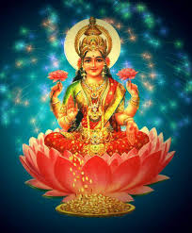
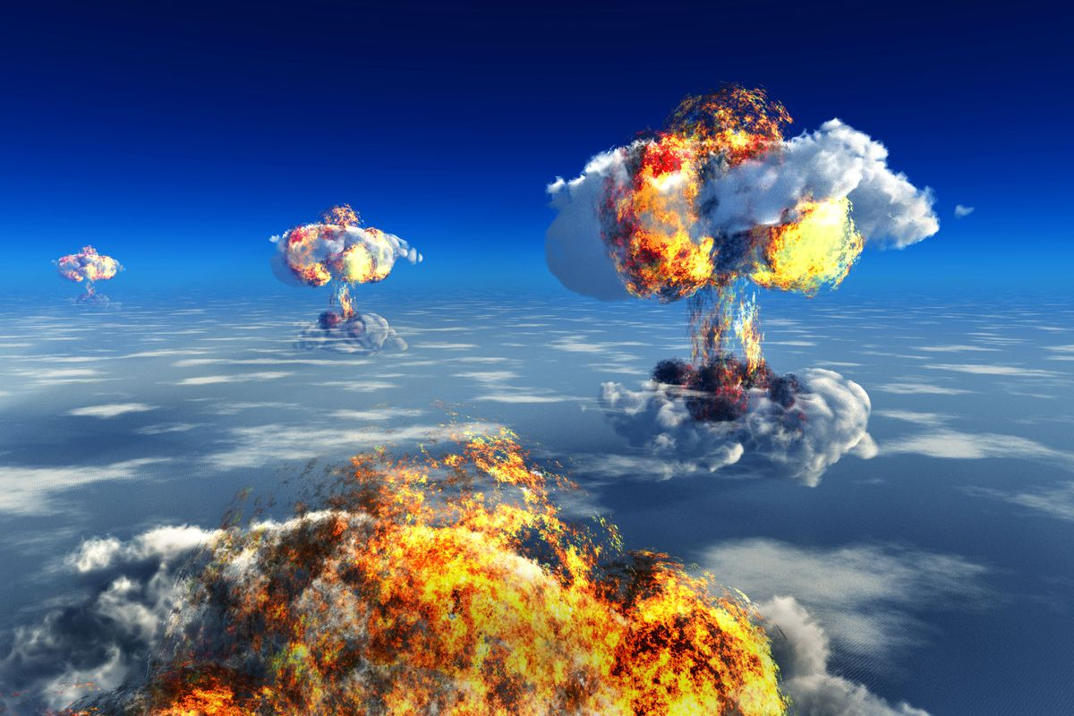
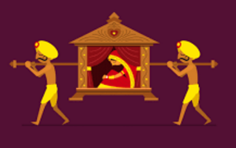
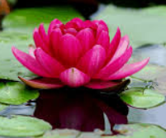
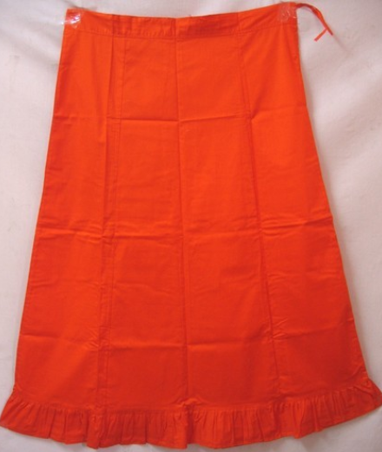
Puzzle #1
5/7
5/11
3/6
1/5
7/9

Slide 2
#1 (5/7) lakshmi | (5/11) nuclear war | (3/6) dolika | (1/5) lotus | (7/9) petticoat

