Slide 1

Skeleton Puzzle Maker
Siva R Jasthi
ICS499 Software Engineering and Capstone Project
Information and Computer Sciences
Metropolitan State University

Slide 2
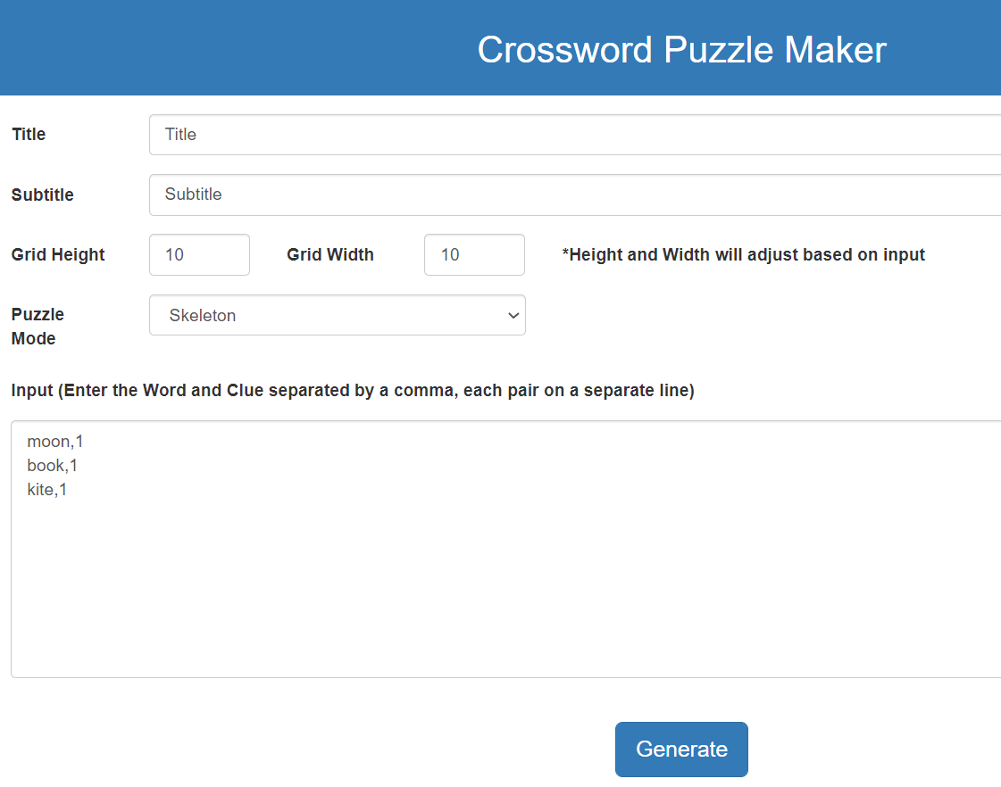
Crossword Maker (Current)
We will be using the current crossword maker as the basis to build a new application called “Skeleton Puzzle Maker”

Slide 3
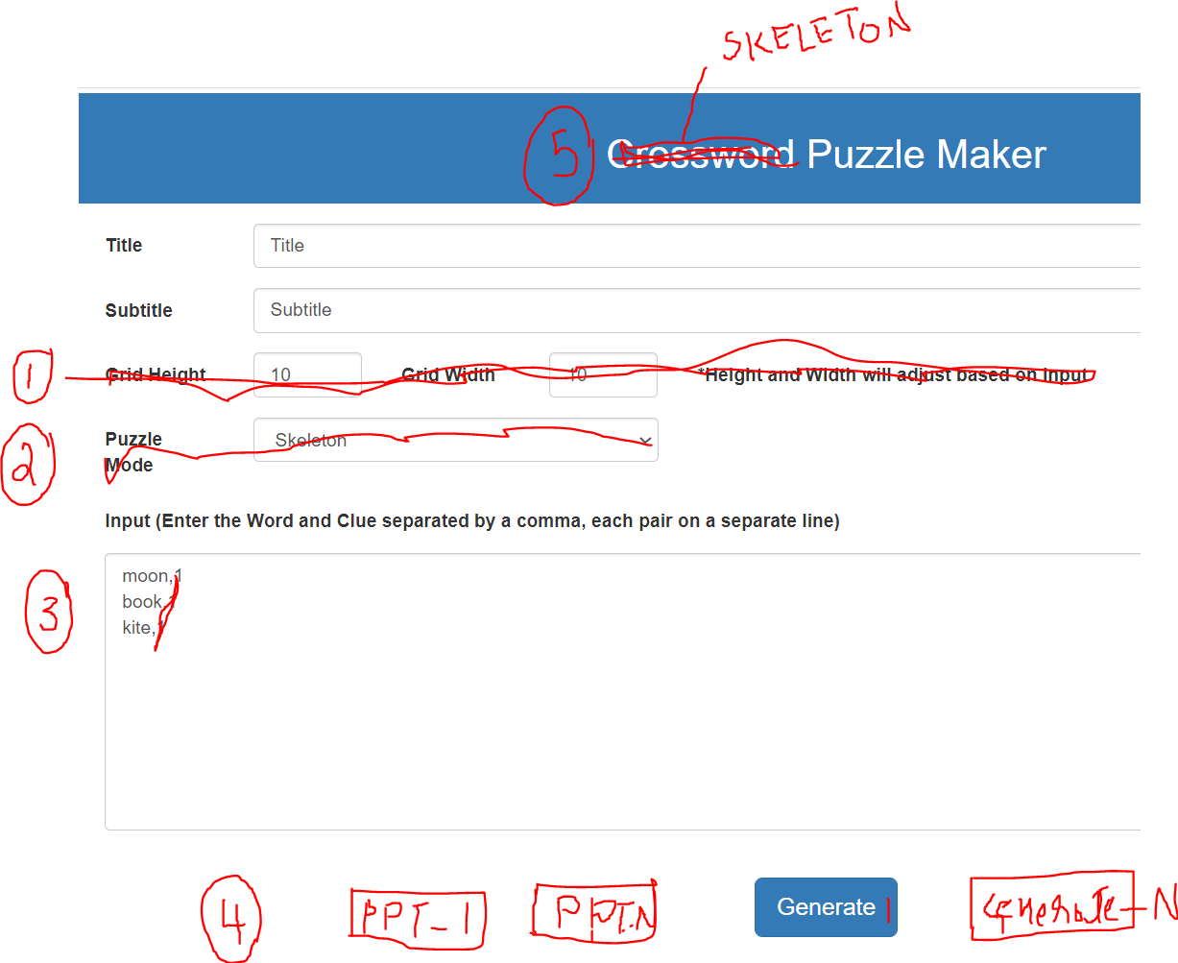
Skeleton Maker

Slide 4
Skeleton Maker Enhancements
1. Remove the grid size.
We will limit the grid only to 3 words.
2. Remove the Puzzle Type
We will limit the type only to “Skeleton”
3. Skeleton Maker doesn’t need the clues. Just words are good enough
4. Skeleton Maker will have these buttons “PPT-1”, “PPT-N”, “Generate-1”, “Generate-2”
5. Change the name of the app to “Skeleton Puzzle Maker”

Slide 5
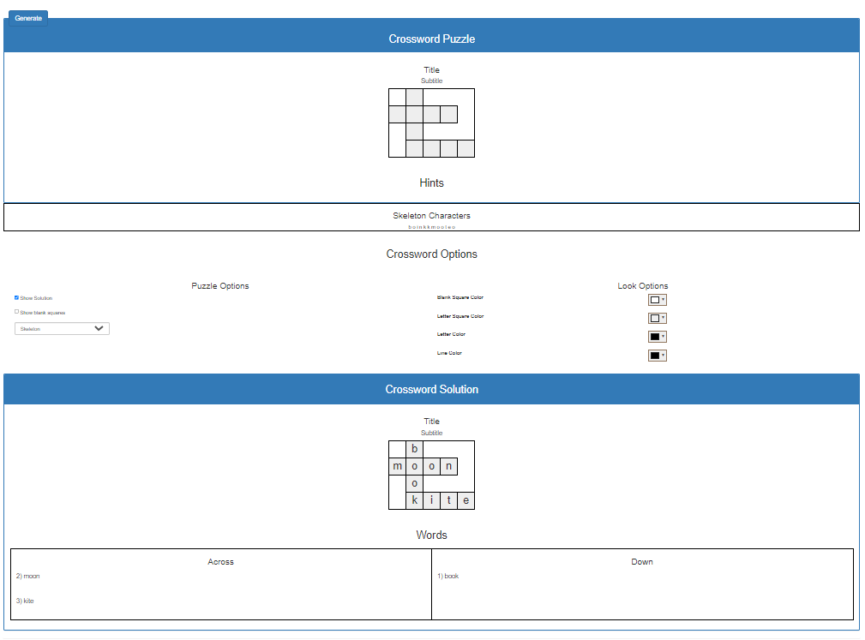
Buttons in “Skeleton Puzzle Maker”
Generate-1
Generate -1:
Is existing functionality.
Just one puzzle will be created from the list of the words given.
3 words are randomly selected from the input list.

Slide 6
Buttons in “Skeleton Puzzle Maker”
Generate-N
Generate -N: Is an enhancement.
N number of puzzles are created.
Each puzzle contains 3 random words.
Once a word is used in Puzzle 1, that should NOT be used in Puzzle 2.
If a word is used in puzzle 2, that should NOT be used in Puzzle 3 and so on.
It is possible that you may have some words that may NOT be fit in any skeleton. Those orphan words should be shown at the end of the page.

Slide 7
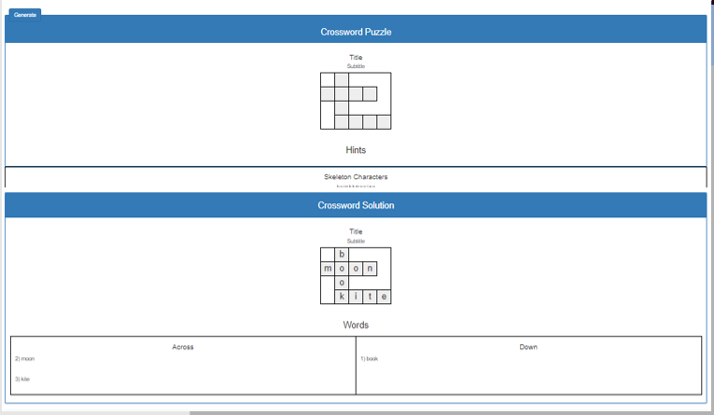
Buttons in “Skeleton Puzzle Maker”
Generate-N
Generate-N generates N number of puzzles in one go.
Color and line selection is needed only at the top of the page. That should be applicable to all the puzzles on that page.
Each puzzle section will contain the following sections.
Puzzle, Logical Character list, Solution, Word list
At the end of the page, the app lists all the words that can be fit in any puzzle.

Slide 8
Buttons in “Skeleton Puzzle Maker”
PPT-1
PPT -1: is an enhancement
Clicking this button will generate a Power Point (skeleton_1_timestamp.pptx) with just one random puzzle (consisting of 3 words)
This power point will have just two slides.
One is the Puzzle slide.
One is the Solution slide.

Slide 9
Buttons in “Skeleton Puzzle Maker”
PPT-N
PPT -N: is an enhancement
Clicking this button will generate a Power Point (skeleton_N_timestamp.pptx)
This power point will have many slides.
Slide Count = 2 * number of puzzles that can be generated from the input word list.
All the puzzle slides are shown at the beginning. Then all the solution slides are shown at the end.

Slide 10
Design Constraints
[1] This should work for both ENGLISH and TELUGU words. If you use the web services provided to you, then your app will work for both ENGLISH and TELUGU.
[2] The only web service you need to use is:
https://indic-wp.thisisjava.com/api/getLogicalChars.php?string=metro&language=English
{"response_code":200,"message":"Logical Chars Calculated","string":"metro","language":"English","data":["m","e","t","r","o"]}
If you are doing anything inside your code to split the string into logical characters, then it wouldn’t work for Telugu.

Slide 11
Evaluation Criteria
No | Item | Points | Status
1 | Index.php shows the front end | 10
2 | Generate-1 works as before | 10
3 | Generate-2 is implemented; Puzzles, Solutions and orphan words are shown | 25
4 | PPT-1 is implemented. PPT name embeds the time stamp. | 25
5 | PPT-2 is implemented. PPT name embeds the time stamp. | 40
6 | PHP Web Services are used in the implementation | 10
7 | The app is working for Telugu (Generate-1, Generate-2, PPT-1, PPT-2) | 20
8 | Project is implemented in iterations and 8 pull requests are submitted to “skeleton” GitHub repo | 10
 | Total | 150

Slide 12
Execution logistics
[1] You should complete the project by 29th October.
[2] You can decide what goes into each iteration.
[3] You need to give at least two demos of the final project.
(1st demo) 24th Septmeber
(2nd demo) 29th October
Of course, you can give more demos to get my feedback if that helps you. You can request a meeting as needed.

Slide 13
Questions?

