Slide 1



A GRAPHICAL PASSWORD AUTHENTICATION IN STORAGE SYSTEM
FASHION GENERAL
-PRESENTED BY
JAYALAKSHMI S
2019202018 MCA-R
GUIDE : MR.H.RIASUDHEEN

Slide 2


PROBLEM STATEMENT
Computer security depends largely on passwords to authenticate human users from attackers. The most common computer authentication method is to use alphanumerical usernames and passwords. However, this method has been shown to have significant drawbacks.
For example, users tend to pick passwords that can be easily guessed. On the other hand, if a password is hard to guess, then it is often hard to remember.

Slide 3
PROPOSED SYSTEM
In graphical authentication there are various techniques to secure your password. Here I’m using a grid based approach to authenticate by using image as a reference.At the time of registration, user will upload his/her image then user’s selected image will appear on the page with transparent grid layer on it. So user will select certain grids to set his/her password as shown in the figure below.

Slide 4
ADDITONAL COMPLEXITY
Applying Elliptic curve cryptographic apporach to store the user data in a encrypted form.
Sending notification to register mobile number for every 3 unsuccessfull attempts,So the authorized user can be alerted.
Applying SHA3 Algorithm in grid value, so that the instead of grid values, the hash value is stored in a password field.

Slide 5
COMPARSION THE KEY SIZE BETWEEN RSA AND ECC
RSA | ECC
1024 | 160
2048 | 224
3072 | 256
7680 | 384
15360 | 521

Slide 6
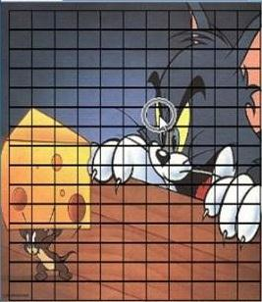
Once the user selected his Point-Of-Interest region in a picture.
The system automatically calculates the selected axis with the adjacent axis and store it in a password field of a hosting system.
At the time of login the image will loaded automatically.Now the user needs to point the same Point-Of-Interest region which he/she selected at a time of registration.
If the user forgets his password,the system will provide the reset password facility.
After the successfull login the user can load his files into the system.

Slide 7
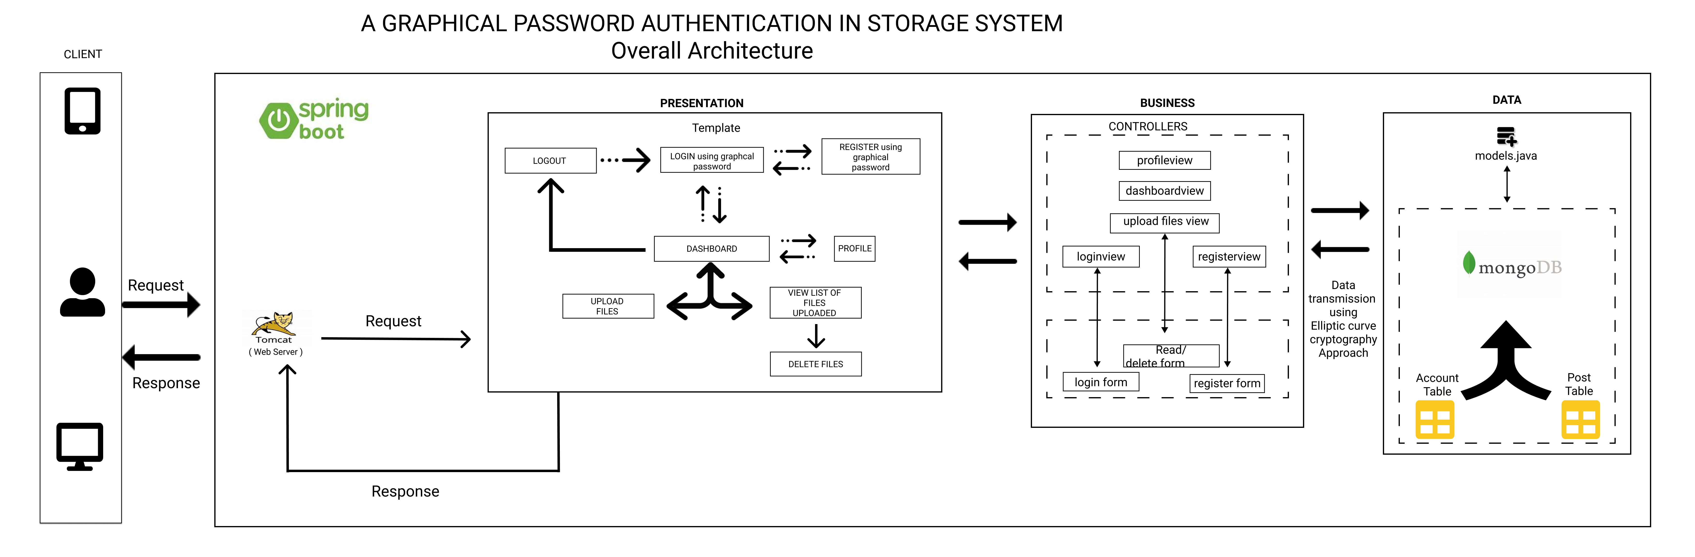

Slide 8
FLOWCHART

Slide 9
TOOLS
IDE: VSCode
Language: JAVA
Framework: Spring-boot
Database: MongoDB
TEXT HERE

Slide 10
REFERENCES
A. Almulhem, "A graphical password authentication system," 2011 World Congress on Internet Security (WorldCIS-2011), 2011, pp. 223-225, doi: 10.1109/WorldCIS17046.2011.5749855.
Tenreiro de Magalhaes, S. & Santos, Henrique & Santos, L.D. & Revett, Kenneth. (2009). Keystroke Dynamics and Graphical Authentication Systems.
http://www.iosrjen.org/Papers/Conf.ICIATE-2018/Volume-6/12-58-60.pdf
https://www.irjet.net/archives/V4/i11/IRJET-V4I11330.pdf
Khodadadi, Touraj & Alizadeh, Mojtaba & Gholizadeh, Somayyeh & Zamani, Mazdak & Darvishi, Mahdi. (2015). Security Analysis Method of Recognition-Based Graphical Password. Jurnal Teknologi. 72. 57-62. 10.11113/jt.v72.3941.

