Slide 1
SAN LIBRARY

Slide 2
Selection process
Group formation
Brainstorm
Brief discussion
selection

Slide 3
Start Off
1
Final picture
Features necessity
Methods specification
implementation

Slide 4
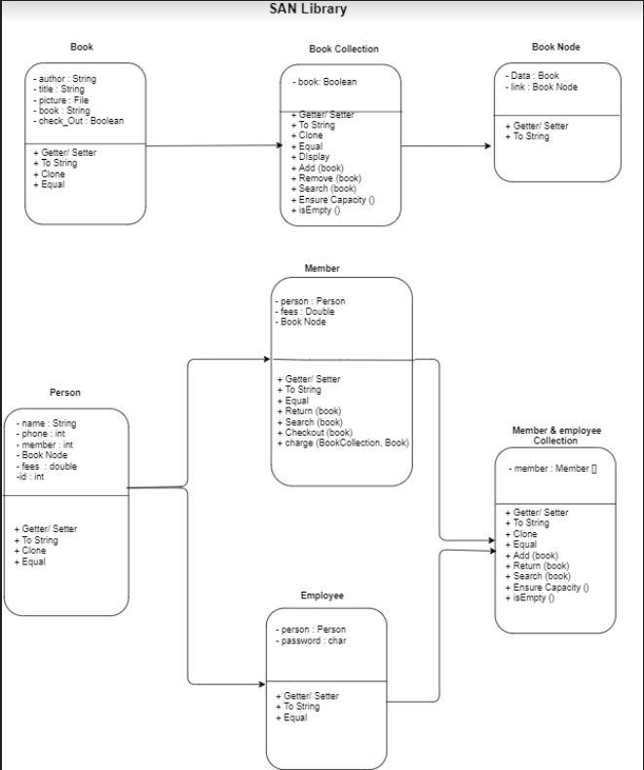
UML Diagram

Slide 5
Data Structures
Linked List
Books checked out by a Member
Array Bag
Queue
Library Book Collection
Waitlist for Books that are Checked Out

Slide 6
Searching & Sorting Methods
Merge Sort
Binary search

Slide 7

Package Person
Uses Inheritance for the creation of member and employee as a person
Contain 9 classes with person’s information
Uses Linked List to store books in a specific member account
Creates both members and employees

Slide 8

Package Books
Uses Array Bag to store the book collection of the library
Contain two classes with information each book

Slide 9


Package GUI
Creates the sign-up page, Library main page, and others
Contain five classes that all together facilitate the use of the library

Slide 10


Demo

Slide 11
Tools & Resources
Eclipse
GitHub
Icon Achier
Slides Carnival
Online Tutorials

Slide 12
Credits
SlidesCarnival
People
Books
SAN
Library
Queue
ArrayBag
Linked List

Slide 13
THANKS!
Any questions?

