Slide 1

Where to invest?
Exploratory Data Analysis on two players in the cab industry: a presentation to the executives of XYZ

Slide 2
Overview
The two cab services under study are Pink Cab and Yellow Cab
The data all pertain to these companies and their customers, and were recorded over a three-year period.
We conducted exploratory data analysis to find basic relationships between the variables as well as to suggest areas for further investigation
All analysis was done using R
The questions that we will be investigating are as follows:
How is cab use distributed among different areas (cities and regions)?
How is cab use distributed between the competitors?
What times of year (seasons) saw less or more cab use?
How are different levels of cab use associated (if at all) with different demographics (namely age and gender)?
Which company earned greater profits over the three years and how profitable was it?

Slide 3
Data validation
The data set contains 24 variables and 355 032 observations
8 variables were treated as numeric and the remainder were character/categorical type
The 80 706 observations with missing values all occurred in the same pattern and were treated as cancelled trips
The corresponding customers were not excluded from the analysis
Outliers in terms of price charged and cost were not removed since these variables were roughly proportional to each other
Corresponding distances of the trips did not include any outliers, so these observations were assumed

Slide 4
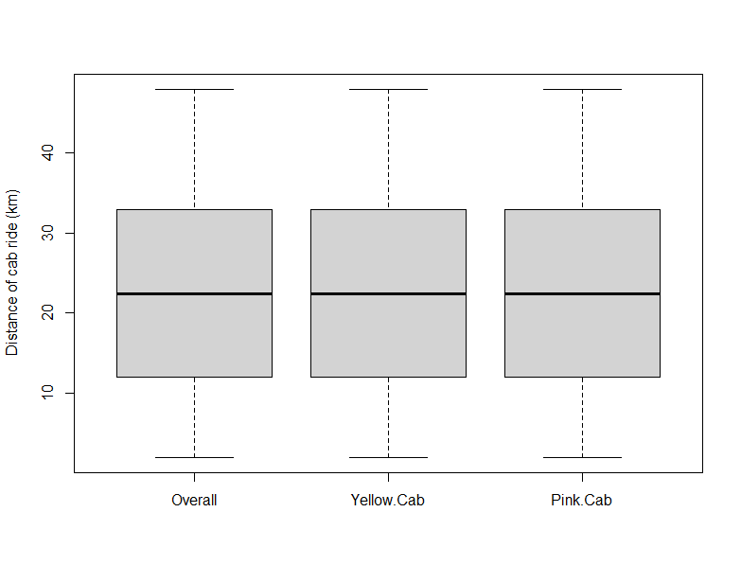
The distribution of trip distances between the two companies was identical.
This leads us to instead investigate the relative frequency of usage according to other features such as age, gender, and location.

Slide 5
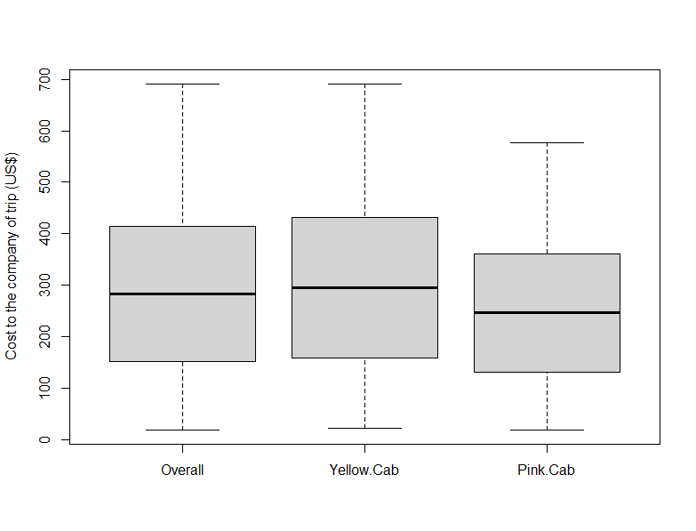
Yellow Cab had a higher median
expenditure than Pink Cab over
the two-year period

Slide 6
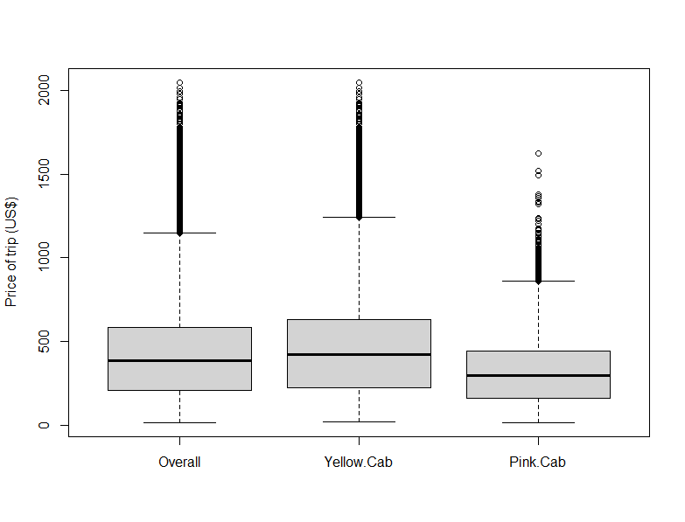
Yellow Cab also charged a higher
median price than Pink Cab

Slide 7
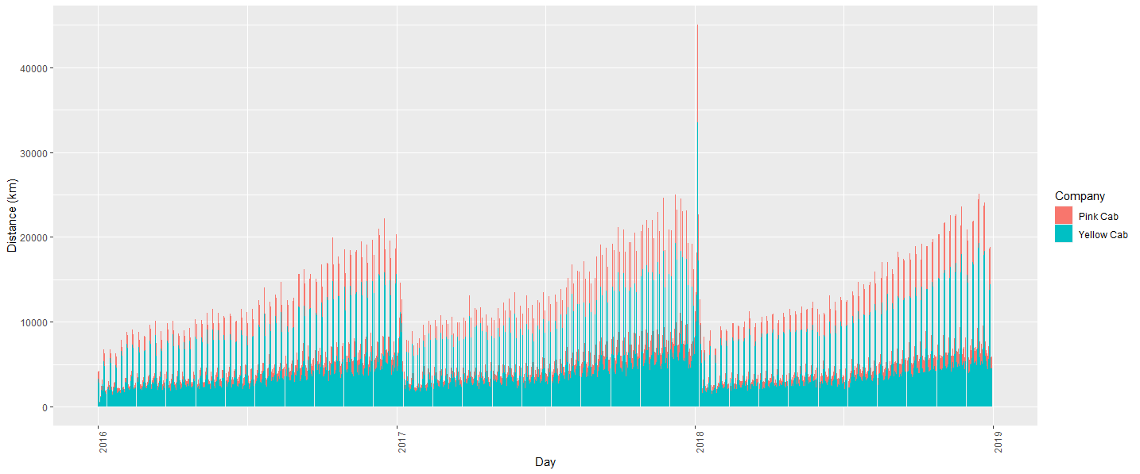
Looking at the distance travelled by cabs of both companies on a daily basis, we can see a strong periodicity, especially if we ignore the day with a high distance near the beginning of 2018

Slide 8
Autumn and summer were the busiest seasons
for the two cab services.
From the previous chart we can see that yellow
cabs travelled the greatest distance in all
seasons.

Slide 9
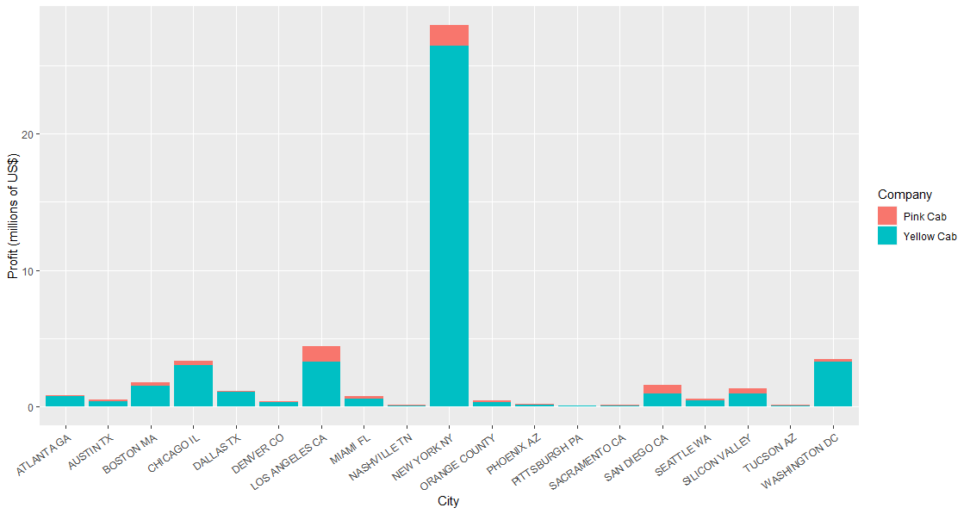
For both cabs, the Big
Apple was the most
lucrative market, but only by a slim margin for Pink Cab.

Slide 10
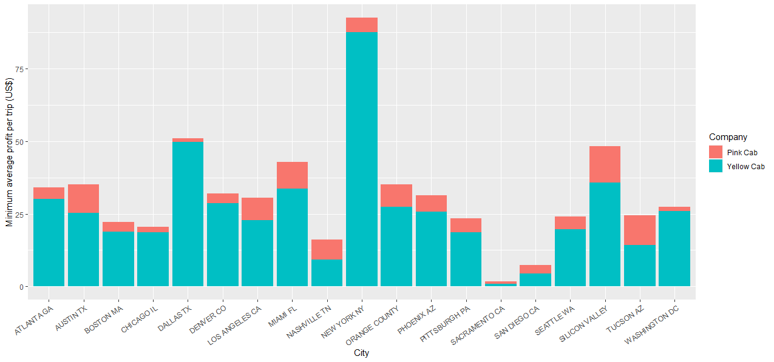
After dividing gross profit
by the number of cab
riders in each city, NYC is
still the most profitable for Yellow Cab, but Silicon Valley, Tucson and Austin might be better focus areas for Pink Cab.
This chart suggests where
growth should be emphasised for maximum returns.

Slide 11
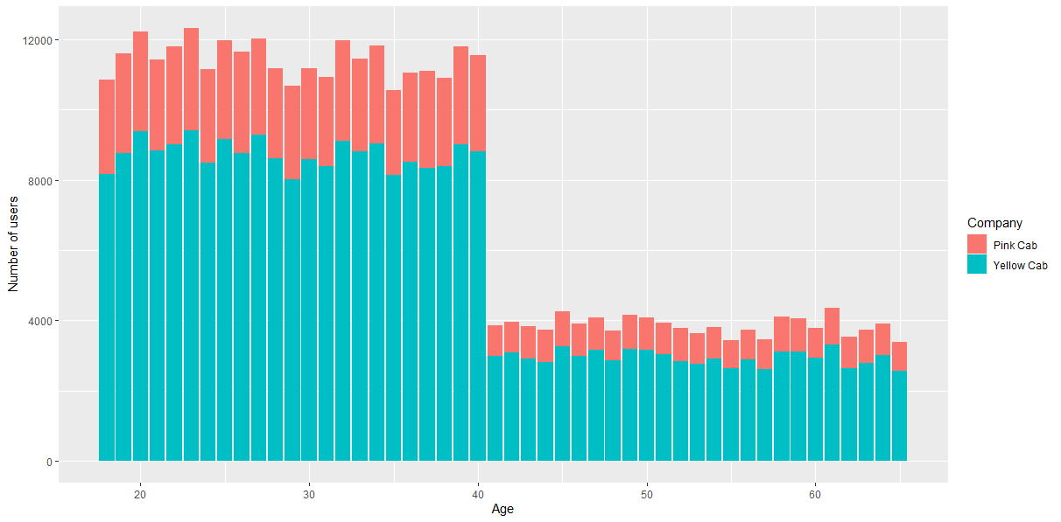
For both companies, there are half as many cab users in the over-40 age group as in
the younger age group.

