Slide 1
Saira Javed Barlas C12809080 DT228/3
SAP
1st Sept. 2016
1st Feb. 2016 to 9th Sept. 2016

Slide 2


Introduction
SAP
Design Studio
Development
Feature work
Future

Slide 3



About the Company

Slide 4


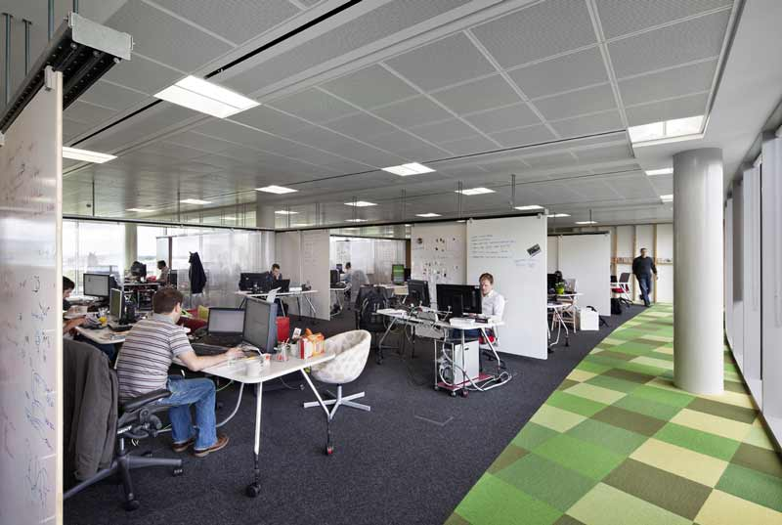
A Typical Day

Slide 5
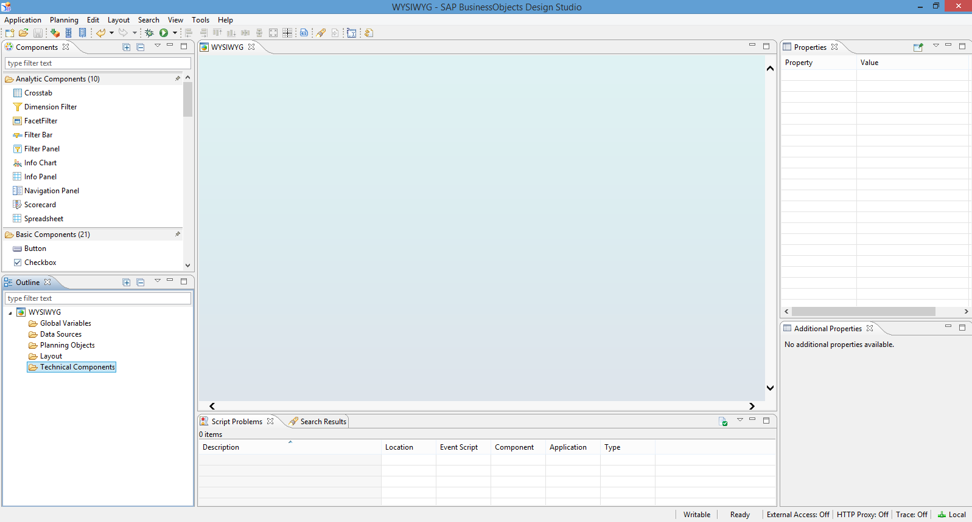


Work Experience

Slide 6




Reflection

Slide 7

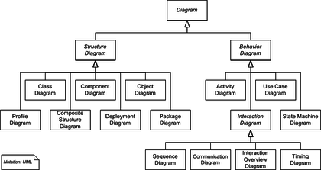

DIT & Your Company

Slide 8
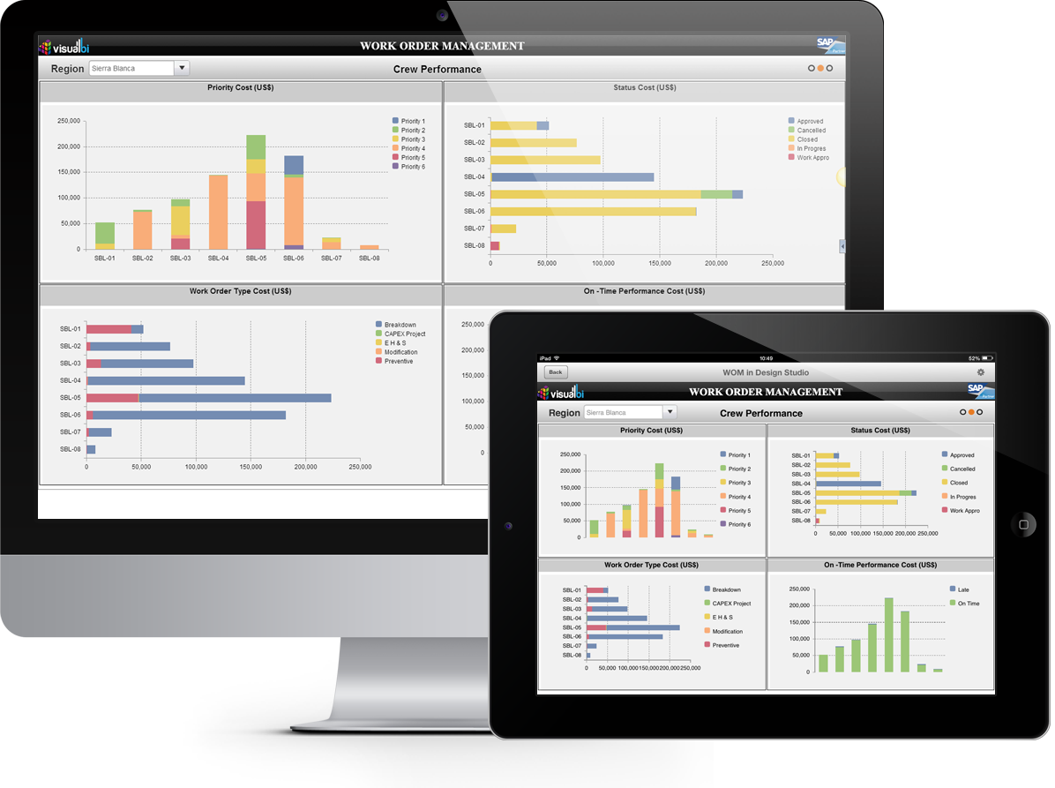


My contribution

Slide 9

Conclusions/Recommendations

