Slide 1

Group project
By Stephen McGuinness

Slide 2
What are the project guidelines?
Do not attempt anything complicated.
Marks are awarded for organization and presentation.
Set up to 4 objectives (one per team member), covering stages of processing or data analysis.
1200 – 2500 words

Slide 3

How do we ensure we keep on track?

Slide 4
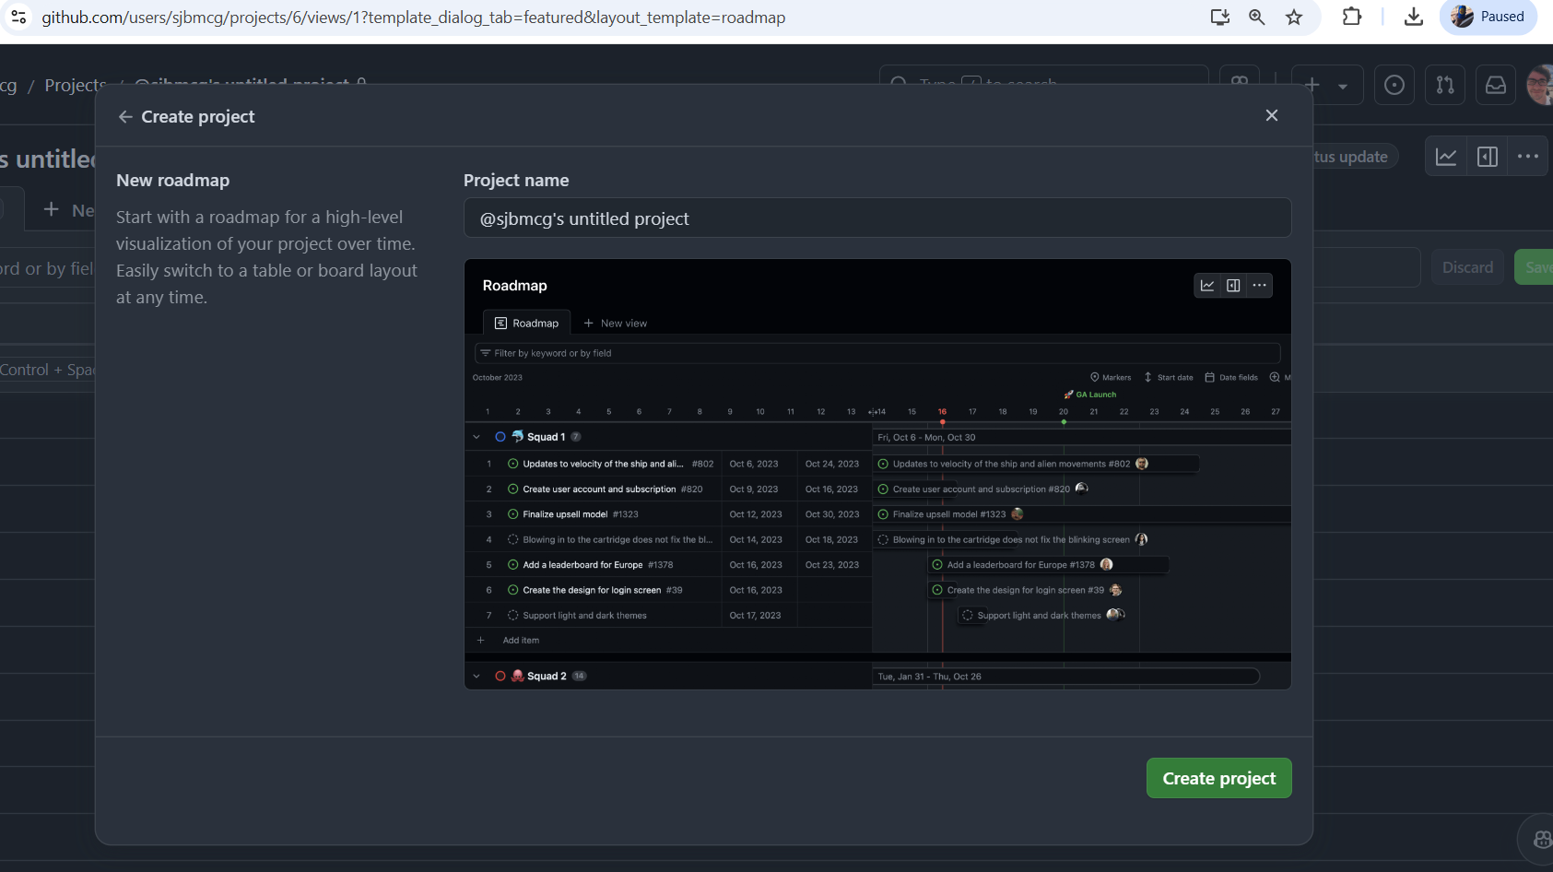

Slide 5
Example of dataset
https://www.kaggle.com/datasets/osmi/mental-health-in-tech-survey

Slide 6
Project Goals and Objectives
Understand factors relating to mental health in tech professionals and to identify patterns or correlations.
Key objectives:-
  Data Cleaning - Correct typos, standardize formats.
  Exploratory Data Analysis (EDA) – Identify trends and summarize data.
  Data Pipeline – Build core analysis.
  Visualizations – Present insights.
Notes:
Predicting whether someone in the dataset is likely to seek mental health based on variables, age, work interference, company size etc.

Slide 7
Roles and responsibilities
Data Collection and Cleaning
Visualization and reporting
Data Modeling
Exploratory Data Analysis

Slide 8
Data exploratory questions examples
Are there significant gender differences in mental health treatment behavior?
Does having a family history of mental health increase treatment likelihood?
Why do we need this information?
Aids in feature selection for model focus.

Slide 9
Why feature selection matters
Fewer, relevant features = a stronger, more accurate model.

