Slide 1
Structuring Your Game's Code
Shandy Brown
sjbrown@geeky.net
http://ezide.com/games/writing-games.html

Slide 2
Assumptions
Python
  GIL, interpreted
  Dynamic, interactive, cross-platform, rich library, Pygame, Pyglet
Personal Computer target platform

Slide 3
Rapid Development
Solo / small team
Finish, finish, finish!

Slide 4
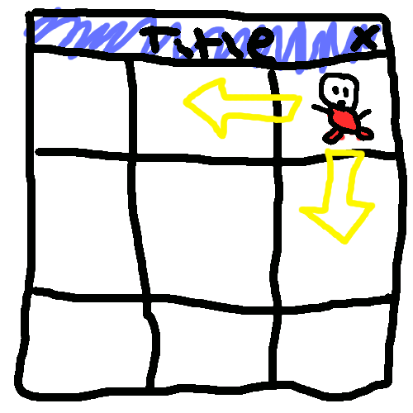
Sketch it out!
Understand the ”nouns”
Refer back to it
Preliminary debugging
  Will it work?
  Will it be fun?

Slide 5
Model-View-Controller
Multiple views are common in games
  Log files, radars, huds, zoom levels, special effects
Your code will get big, keep the Model clean
More easily add networking
Collaboration with artists may necessitate quickly adapting to artwork changes

Slide 6
Model-View-Controller Cons
Sometimes there is instrinsic coupling
  ”button” is part of the Controller, but to determine if a mouse click happened inside the button, you must examine the View.

Slide 7
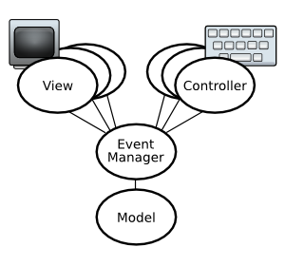
Mediator
Recieve, prioritize, dispatch events
Modes change (pause, menu)
Easily add/remove Views or Controllers
Game programming is event-based anyhow

Slide 8
Chimp Line-by-line
#stolen from the ChimpLineByLine example at pygame.org
main():
...
while True:
#Handle Input Events
for event in pygame.event.get():
if event.type == QUIT:
return
elif event.type == MOUSEBUTTONDOWN:
fist.punch()
elif event.type == MOUSEBUTTONUP:
fist.unpunch()
#Draw Everything
allsprites.update()
screen.blit(background, (0, 0))
allsprites.draw(screen)
pygame.display.flip()

Slide 9
Re-organized Chimp
class KeyboardController:
...
def on_Tick(self, event):
#Handle Input Events
…
class CPUSpinnerController:
...
def Run(self):
while self.keepGoing:
events.post(”Tick”)
def on_Quit(self, event):
self.keepGoing = False
…
class PygameView:
...
def on_Tick(self, event):
#Draw Everything
...
import events
main():
...
keybd = KeyboardController()
spinner = CPUSpinnerController()
pygameView = PygameView()
events.registerListener(keybd)
events.registerListener(spinner)
events.registerListener(pygameView)
spinner.Run()

Slide 10
Adding a new event is easy
events.post(”Foo”, arg1, arg2)
def on_Foo(self, event):
  event has an attribute ”args” = (arg1, arg2)
or
events.post(”Foo”, arg1, arg2)
def on_Foo(self, arg1, arg2):

Slide 11
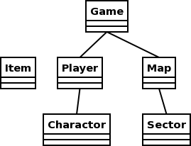
Model objects
Won't fit for every game, but many can be modeled this way
Difference between Player and Charactor
”Inventory” is an possible addition

Slide 12
Settlers of Catan
Player
  color, cards, houses, roads
Map
  tiles, corners, edges, robber
Sector::Tile
  pip, terrain

Slide 13
Starcraft
Player
  color, permissions
Charactor::Zergling
  health, attacks, orders
Sector
  terrain, altitude

Slide 14
Sectors / Locations
Sectors are discrete, logical ”areas”
  Few enough to reasonably put in a list
  Cannot be ”in-between” sectors, though the View animations can give that impression
Locations are ”points”
  pixels or finer precision

Slide 15
Pac Man
Player
  lives, score
Charactor::PacMan
  direction, location
Charactor::Ghost
  attacking/fleeing, speed, direction, location
Item::Pellet
  isPowerPellet

Slide 16
Thanks!

