Slide 1



01 | 26
National sports and activity infrastructure for Thailand
A product of Education AI Group Co., Ltd.
September 2026
Notes:
Good morning, and thank you for the time. What I’m going to show you today is not an app, and it’s not a booking website. It’s infrastructure — national infrastructure for sport and activity in Thailand. My name is Justin Cohen. I’m the Chief Executive of Education AI Group, and MySportia is what we build. I’ll show you why it exists, what’s already running today, and what we’re building next.

Slide 2



Education AI Group
02 | 26
ACT I — WHY THIS EXISTS
The opportunity
Notes:
Everything we’ve built follows from one problem. So let me start there — with two numbers.

Slide 3
03 | 26
ACT I · THE OPPORTUNITY
The problem
75%
of Thai adults are highly sedentary, sitting more than seven hours a day
3 in 4
stop playing sport entirely after leaving education
The reason is not lack of interest. It is lack of access.
Notes:
Over seventy-five percent of Thai adults are highly sedentary. Sitting more than seven hours a day. And three out of four people stop playing sport — entirely — after they leave education. (Pause.) Three in four. And here’s the part that matters: it is not because people stop wanting to play. Nobody falls out of love with football at twenty-two. They stop because access breaks down. And access is a problem you can actually fix.

Slide 4
04 | 26
ACT I · THE OPPORTUNITY
Where it started
Sport is everywhere in education. Then it stops.
It once took over two hours of phone calls to organise a single game of paintball — a venue with no online booking, a group to coordinate, and no way to see whether anything was available.
A flight, a hotel or a car can be booked in ninety seconds.
One game of paintball
2 hours
A flight, a hotel, a car
90 seconds
Sport is one of the last major consumer categories with no unified way in.
Notes:
That slide is my own afternoon. It once took me over two hours on the phone to organise one game of paintball. One game. A venue with no online booking, friends to coordinate, no way to see what was available. And I can book a flight in ninety seconds. A hotel in ninety seconds. Sport is one of the last major categories of modern life with no unified way in. That gap is why three in four people stop playing — and it’s the exact moment this idea started.

Slide 5
05 | 26
ACT I · THE OPPORTUNITY
Why access is hard
Fragmented
No one to play with
Venues run on phone calls, LINE chats, paper schedules and spreadsheets. Over 60% have no online booking system at all. There is no central place to discover or book anything.
Having someone at your level to play against is the single biggest predictor of whether a person keeps participating.
Minority sports are invisible
No visibility for the state
Climbing, diving, Muay Thai, archery, community leagues — happening across the country, with no way for the people who would play them to find them.
A largely cash sector means no participation data, no sector picture, and tax revenue that goes uncollected.
Notes:
So why is it so hard? Four reasons, and they compound. The sector is fragmented — phone calls, LINE chats, paper diaries. Over sixty percent of venues have no online booking at all. People have no one to play with — and having someone at your level is one of the strongest predictors there is of whether you keep going. Not motivation. A person. The smaller sports are invisible — I’ll show you that in a second. And because so much runs on cash, the state can’t see it — no data, no sector picture, and tax that never gets collected.

Slide 6

06 | 26
ACT I · THE OPPORTUNITY
Every sport — including the ones nobody builds for
Every sport. Every activity. One infrastructure.
Once the connective layer exists, the marginal cost of carrying one more sport is close to zero. The small sports get the same infrastructure as the big ones.
Notes:
Look at this for a moment. Climbing. Diving. Archery. Muay Thai. Every one of these is happening somewhere in Thailand right now — and almost none of it can be found by the people who would play it. These sports are not unpopular. They are invisible. And here’s what infrastructure changes: once the connective layer exists, adding one more sport costs almost nothing. For the first time, the small sports get the same infrastructure as the big ones — no one builds dedicated software for the archery community, and the infrastructure carries them anyway, at no extra cost.

Slide 7

07 | 26
ACT I · THE OPPORTUNITY
What MySportia is
National infrastructure connecting people to the places where they can play — raising participation in sport and activity, including amateur and minority sports, by automating the business side so venues can concentrate on delivering the service.
Notes:
So here is what MySportia is, in one sentence. (Read it from the slide, slowly. Do not paraphrase it.) That’s the whole company. Everything else I show you today is just this sentence, built.

Slide 8
08 | 26
ACT I · THE OPPORTUNITY
The architecture — two sides, one system
VENUE SIDE — THE ENGINE
CONSUMER SIDE — THE STOREFRONT
Online booking and schedules · payments as a master merchant with Stripe and Omise (PromptPay, Thai QR, cards) · automatic invoices, receipts and VAT · customer database and marketing · memberships and packages · automated reminders · resource and staff management
Find any sport by location, date or type · instant booking and payment · peer matchmaking by skill level · create a game, league or tournament · rankings, leaderboards and results · your bookings, passes and memberships in one account, under your control · vetted activities, in Thai and English
One system
Venue transactions generate the availability, schedules and results the consumer side draws from
The full planned scope — two sides, one system.
Notes:
It has two sides, and they’re one system. The venue side is the engine. It runs the business — bookings, schedules, payments through PromptPay and Thai QR and cards, automatic invoices and VAT, memberships, customer records, staff. Everything a venue owner currently does by hand at eleven o’clock at night. The consumer side is the storefront. Find any sport, book it and pay in a few taps, find someone at your level. And the person gets control — their bookings, their passes, their memberships, in one account in their pocket. In Thai and in English. One system. The engine makes the storefront possible — and that’s the next part of the story.

Slide 9
Education AI Group
09 | 26
ACT II — WHAT EXISTS, AND WHAT COMES NEXT
The build
Notes:
So how do you actually build this? The honest answer is: in the wrong order — deliberately. Let me explain.

Slide 10
10 | 26
ACT II · THE BUILD
The order this had to be built in
The obvious thing to build first was the consumer marketplace. It could not be built.
Hotels first got booking systems. Only then did a booking marketplace become possible.
The venues were the bottleneck. Notebooks, spreadsheets, phone calls, LINE messages. No real-time availability, no digital payments, no central system.
You cannot build a marketplace on top of businesses that are not bookable.
So the order was inverted, deliberately.
First fix the venues. Then build the thing people actually use.
Notes:
We know the marketplace couldn’t be built first — because that’s where we started. We tried. It could not be built. The venues were the bottleneck. Notebooks. Spreadsheets. LINE messages. You cannot build a marketplace on top of businesses that are not bookable. There is nothing to connect to. There’s a precedent, and it’s a good one. Hotels went through exactly this: they got reservation systems first — and only once hotels were bookable could a marketplace like Booking.com exist. So we inverted the order, deliberately. First fix the venues. Then build the thing people actually use. We spent our first year on the unglamorous half — and it’s the only reason the rest of this presentation is possible.

Slide 11
11 | 26
ACT II · THE BUILD
The three phases
PHASE 1
BUILT
PHASE 2
BOOKING LAYER BUILT
PHASE 3
THIS PROJECT
Fix the venues
The marketplace
The lifestyle layer
One system that runs the business: bookings, schedules, payments, invoices and VAT, memberships, customers, staff and resources. Make every venue instantly bookable.
Aggregate the digitised venues. One place to find any sport by location, date or type, with real-time availability and instant booking, in Thai and English.
Profiles and skill ratings, opponent and partner matching, leagues, tournaments and national rankings, activity feed and community, native mobile applications.
Discovery
→
Booking
→
Participation
→
Community
→
Progression
Phases 1 and 2 cover discovery and booking. Phase 3 is participation, community and progression — the half that determines whether a person is still playing in a year.
Notes:
That gives you the three phases — and tells you exactly where we are. Phase one: fix the venues. One system that runs the whole business. Built. Phase two: the marketplace. One place to find and book any sport, in Thai and English. Built. Phase three: the lifestyle layer. Profiles and skill ratings. Matching you to an opponent at your level. Leagues, tournaments, national rankings. Community. Native mobile apps. That is this project. Discovery. Booking. Participation. Community. Progression. The first two get someone to one session. The last three decide whether they’re still playing in a year — they’re what turns the three-in-four around.

Slide 12
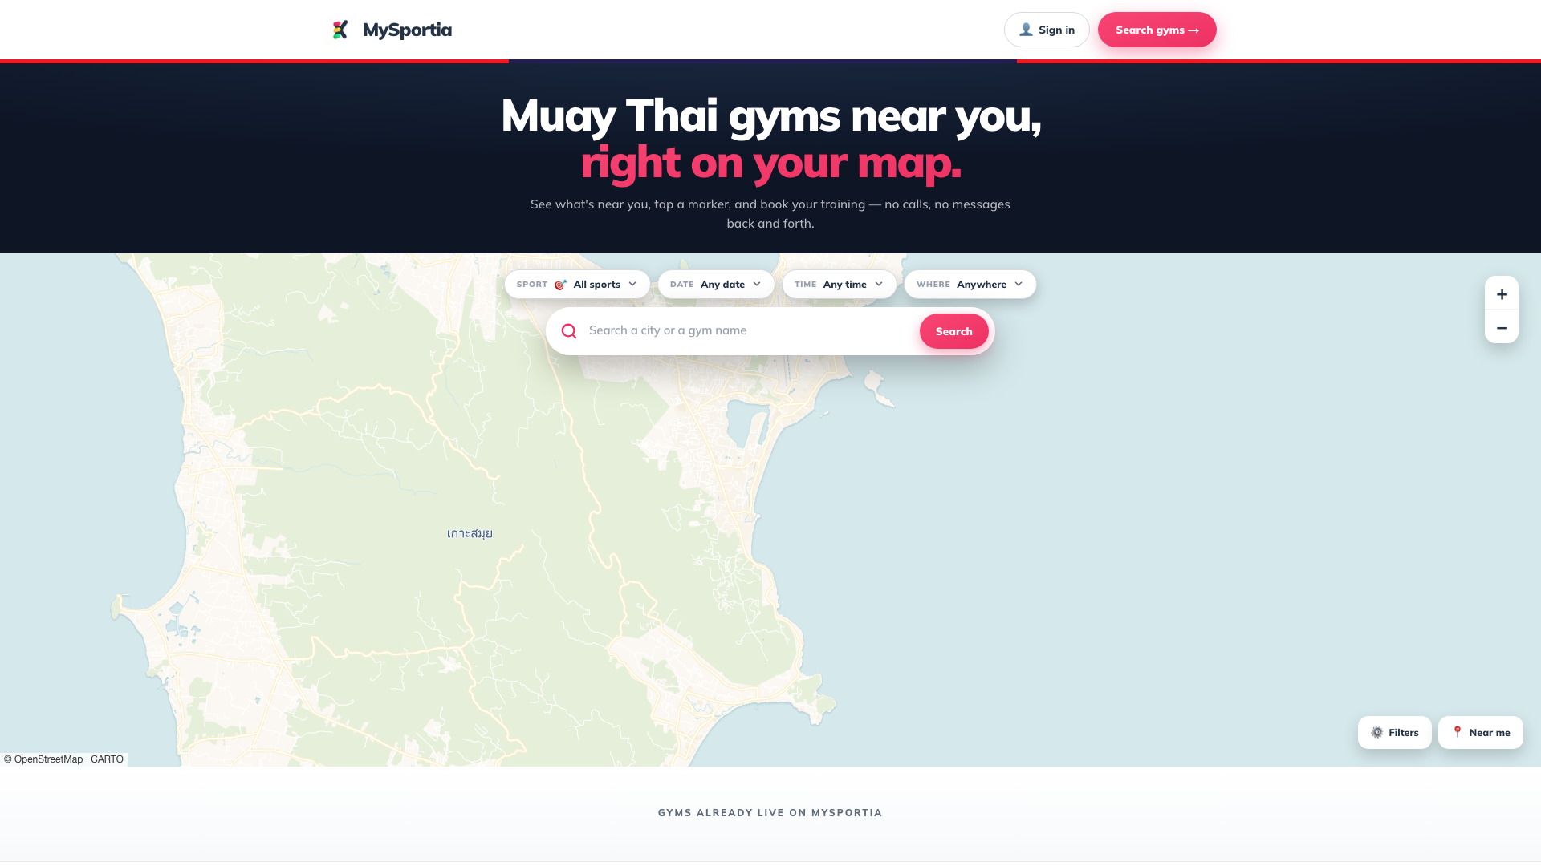
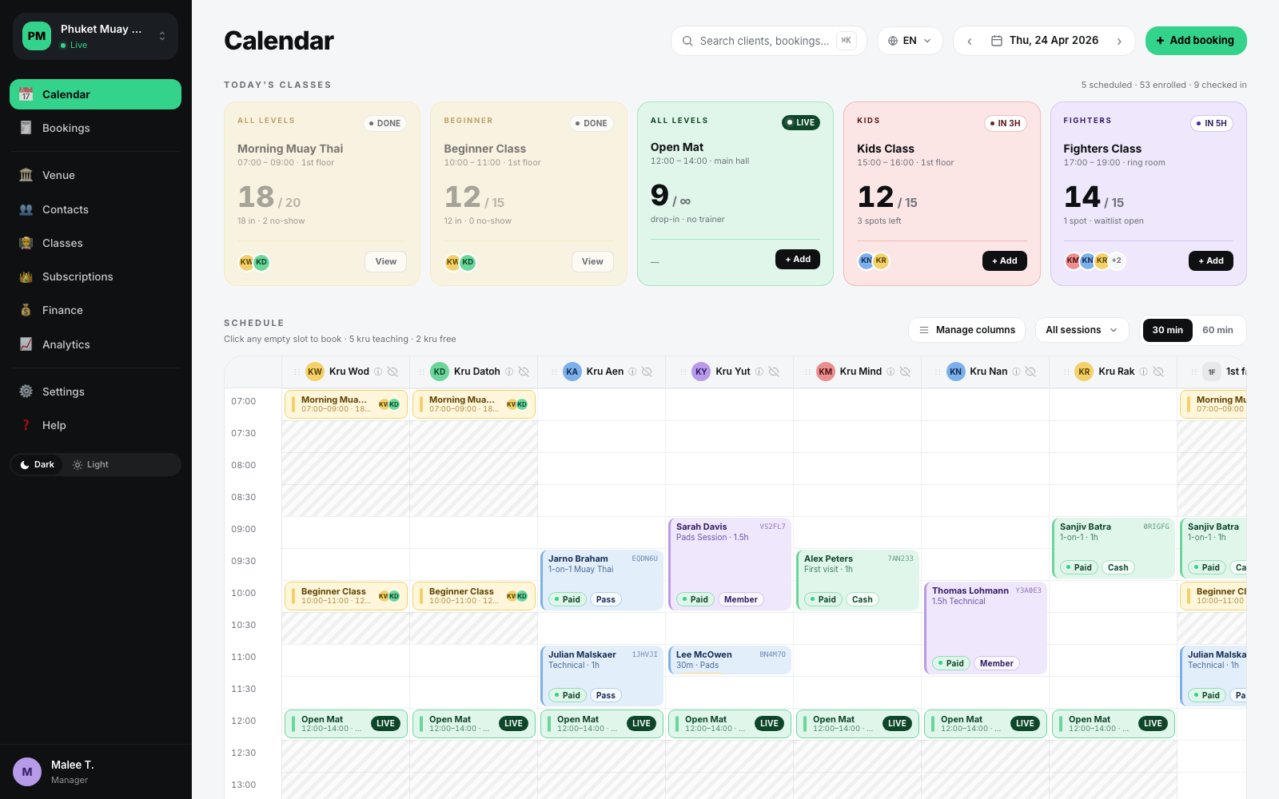
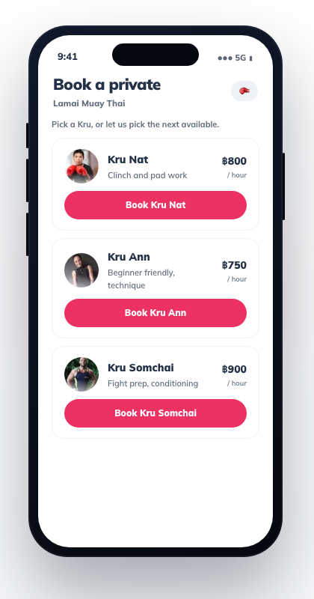
Education AI Group
12 | 26
ACT II · THE BUILD
Built and running — live today
Marketplace listing and booking — live at mysportia.com
Venue management back office — bookings, scheduling, customer records, staff and reporting
Booking on a phone
Live at 32 pilot venues in Thailand
Master merchant with Stripe and Omise — PromptPay, Thai QR, cards. Phase 1 and the booking layer of Phase 2: approximately 15% of the planned system.
Notes:
Now — everything on this slide is live. This is not a concept and these are not mockups. This is the marketplace, live at mysportia.com — real venues on a real map. This is the booking flow on a phone — pick a trainer, pick a time, pay. And this is the back office a venue manager sees every morning. It’s running today at thirty-two pilot venues in Thailand, taking real bookings and real payments, right now. And underneath it sits real payment infrastructure: we operate as a master merchant with Stripe and with Omise — a new venue is taking digital payments in hours, not weeks. Measured against the full product we’ve planned, this is roughly fifteen percent of it. The venues are fixed. The plumbing works.

Slide 13
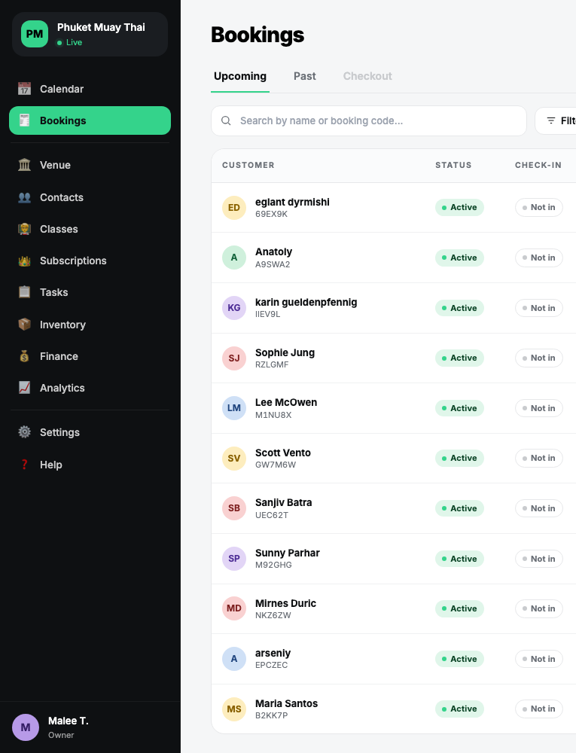
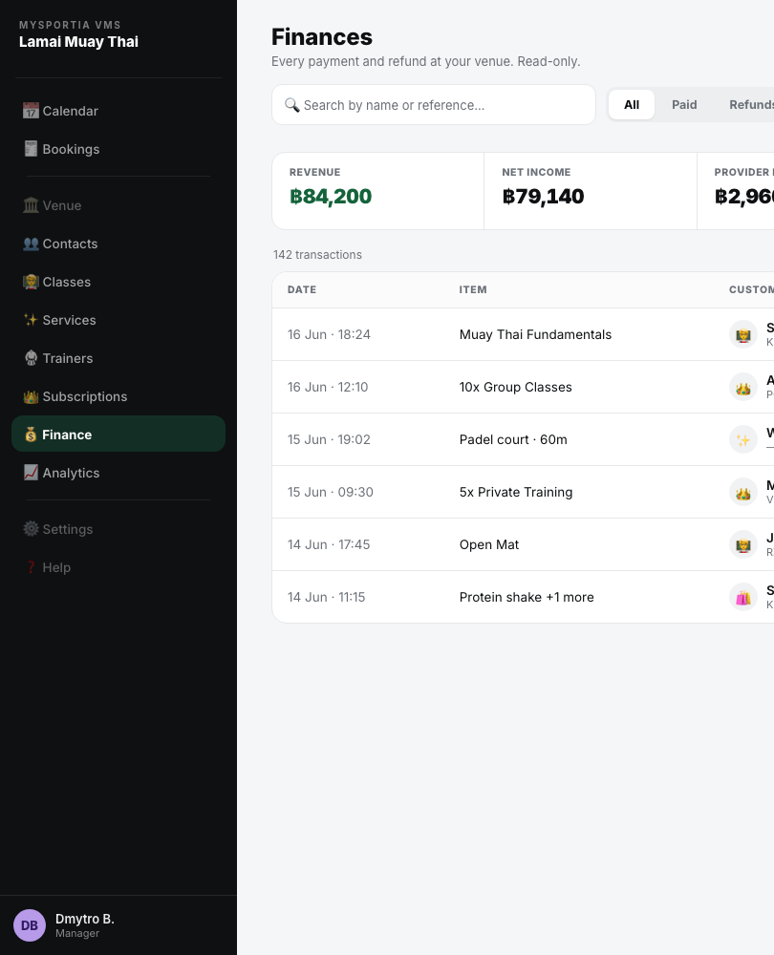
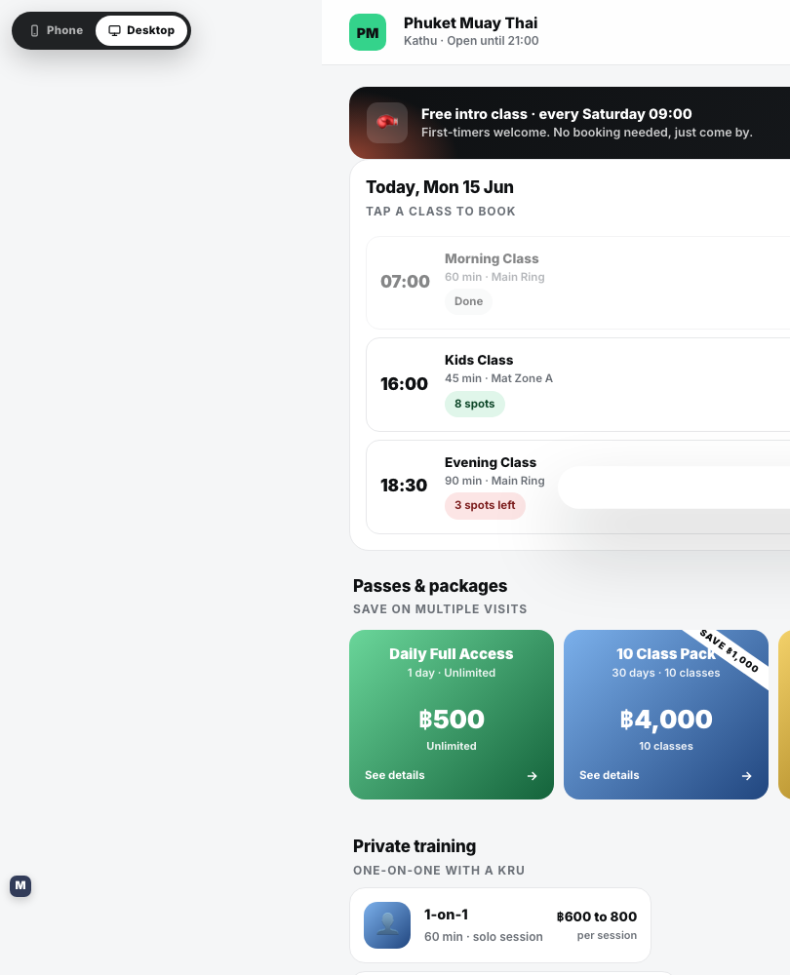
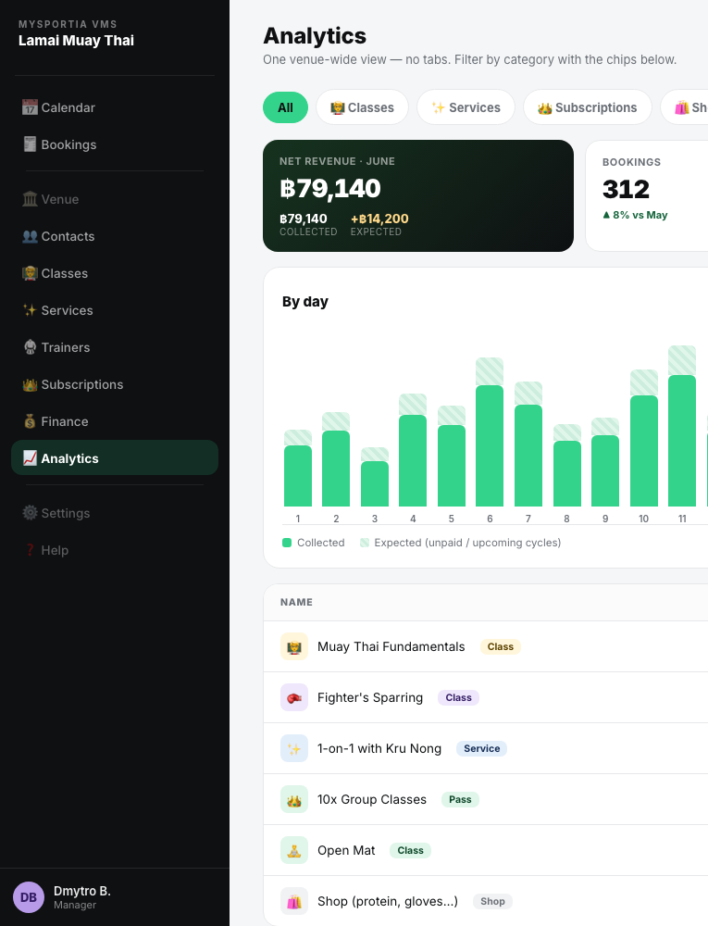
13 | 26
ACT II · THE BUILD
What a venue gets
Zero admin
Their own brand
More revenue
Bookings, payments, reminders, invoices and VAT run themselves. Staff coach instead of doing paperwork.
The venue's own storefront and booking pages. The venue owns its customer relationships — the platform stays in the background.
The numbers to grow
The marketplace brings customers a venue could never reach on its own, and empty slots start to fill.
Which classes fill, who comes back, what earns. Decisions made on data instead of guesswork.
Notes:
So what does a venue actually get? Four things. More revenue — the marketplace brings customers they could never reach, and empty slots start to fill. Zero admin — bookings, payments, reminders, invoices, VAT — it runs itself. Staff coach instead of doing paperwork. Their own brand — their storefront, their customer relationships. We stay in the background. And the numbers to grow — which classes fill, who comes back, what earns. That's why venues join. And it's why they stay.

Slide 14
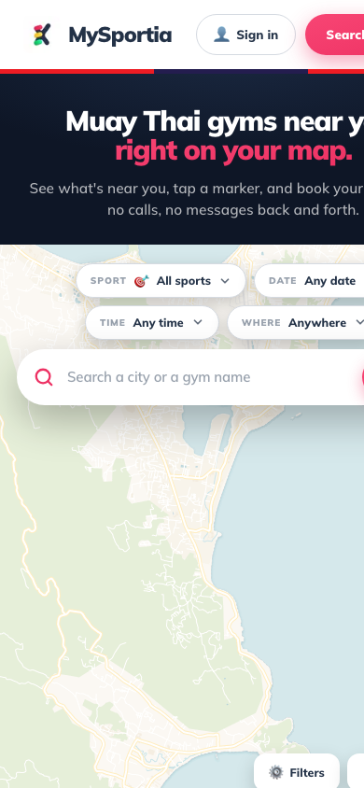
Education AI Group
14 | 26
ACT II · THE BUILD
What a player gets
Everything in one place
Any sport, any venue, live availability — in Thai and English.
Booked and paid in seconds
PromptPay, Thai QR or card. Confirmed instantly.
Control
Bookings, passes and memberships in one account, in their pocket — not on a paper card behind a counter.
Someone to play with — built under this project
Matched to an opponent at their level, with leagues and rankings to play for.
Notes:
And the player? Everything in one place — any sport, any venue, live availability. Booked and paid in seconds — PromptPay, Thai QR, a card. Control — bookings, passes, memberships in one account in their pocket. And with this project: someone to play with — matched to their level, with leagues and rankings to play for. That's what turns one booking into a habit.

Slide 15
15 | 26
ACT II · THE BUILD
To be developed — approximately 85%
1
Player feed and consumer experience
5
Venue hardware integration
A personalised activity feed through which players discover venues, sessions and events near them, with social profiles and activity history.
Device firmware, the hardware integration layer and the platform services that operate venue access gates, point-of-sale terminals, self-service kiosks and QR-based entry and validation.
2
Opponent matching
6
Native mobile applications
Matching players to opponents and partners by sport, skill level, location and availability, so that a player without a group can still book and play.
Separate native applications for players and for venue operators, on iOS and Android.
3
Leagues, tournaments and rankings
7
AI-assisted venue onboarding
Creation and running of leagues and tournaments across venues, with fixtures, results, standings and a national ranking system by sport.
Automated extraction and structuring of a venue's services, schedule and pricing so that a venue can be brought onto the platform in hours rather than weeks.
4
Automated tax reporting to the Revenue Department
8
Multi-tenant backend for national scale
Automated preparation and submission of venue tax reporting directly from transaction records, bringing venues into the digital tax system without manual filing.
The platform architecture required to operate across thousands of venues nationally, with tenant isolation, regional data handling and operational monitoring.
None of these functions exists in the system today. All will be built in Thailand, by the company's Thai engineering team, over twelve months.
Notes:
This is what we build next. Eight functions — and none of them exists in the system today. A player feed, so people discover what’s near them. Opponent matching — sport, skill level, location, availability — so a person without a group can still play. Leagues, tournaments and national rankings, so there’s something to play for. Automated tax reporting — the venue’s returns prepared from its own transaction records and submitted through the Revenue Department’s digital channels, so a venue enters the tax system without doing the paperwork. Venue hardware — gates, kiosks, point of sale, QR entry. Native mobile apps for players and venue operators. AI-assisted onboarding, so a venue joins in hours, not weeks. And the backend for national scale — thousands of venues, not thirty-two. All of it built in Thailand, by our Thai engineering team, in twelve months.

Slide 16
16 | 26
ACT II · THE BUILD
The 15 / 85 split
85%
15%
Built and running
This project
Venue back office · marketplace booking · payments
Eight new functions · twelve months · in Thailand
The first half is the plumbing. The second half is the product.
Completeness measured against full planned product scope.
Notes:
One picture, so the proportions are clear. The fifteen percent is what we’ve shown you — built, running, taking payments. The eighty-five percent is this project. The first half is the plumbing. The second half is the product.

Slide 17
17 | 26
ACT II · THE BUILD
Why the two halves are one system
Every venue that joins brings its existing members with it. They become users of the marketplace on day one — with no consumer advertising at all.
A venue joins
→
Its members become marketplace users on day one
A venue joins
→
This is why the consumer side reaches national scale without national marketing spend — and why the two halves are one system rather than two products.
→
No consumer advertising
A venue joins
Notes:
One more thing about how this grows, because it’s the part people miss. Every venue that joins brings its members with it. The gym signs on Monday — and by Tuesday its whole membership is on the marketplace. And we spent nothing on consumer advertising to make that happen. Zero. That’s why the consumer side reaches national scale without national marketing spend. The supply side carries its own demand in with it.

Slide 18


18 | 26
ACT II · THE BUILD
One infrastructure. Many industries.
Nothing in the venue engine is sport-specific. Bookings, schedules, payments as a master merchant, memberships, customer records, automatic accounting and tax reporting — every service business in Thailand needs the same machine.
MySportia
Sports and activity venues
LIVE — 32 PILOT VENUES
Kizzem
Venue and service booking, any industry
BUILT
PetFlow HQ
Pet-care businesses
BUILT
Further verticals follow the same model.
This application funds the sports platform. The infrastructure it completes is the model for every vertical that follows — built once, in Thailand.
Notes:
One more thing about the infrastructure, because it's worth seeing where this goes. Nothing in the venue engine is sport-specific. Bookings, schedules, master-merchant payments, memberships, automatic accounting, tax reporting — every service business in Thailand needs the same machine. MySportia is the live proof, in sport. And within the group, the same model is already built for other industries — Kizzem for venue and service booking generally, PetFlow HQ for pet care. More follow. This application funds the sports platform. But the infrastructure it completes is a model Thailand keeps — built once, here.

Slide 19
19 | 26
ACT II · THE BUILD
Technology
AWAITING INPUT — CHIEF TECHNOLOGY OFFICER
Languages
Frontend framework
Backend framework
Database
Hosting and infrastructure
AWAITING INPUT
AWAITING INPUT
AWAITING INPUT
AWAITING INPUT
AWAITING INPUT
CI/CD
Monitoring
Mobile (iOS / Android)
Device firmware and hardware integration toolchain
AI and automation tooling
AWAITING INPUT
AWAITING INPUT
AWAITING INPUT
AWAITING INPUT
AWAITING INPUT
Notes:
I won’t take you deep into the technology today — the full stack is documented for anyone who wants it, and our Chief Technology Officer will happily go as deep as you like. What matters in this room is simpler: it’s a modern cloud platform, it already runs in production, it already handles real payments — and everything new gets built in Thailand, in Bangkok, by the Thai team we’re hiring.

Slide 20
20 | 26
ACT II · THE BUILD
The twelve-month development plan
Q1 FROM APPROVAL
Q2
Q3
Q4
8 · Multi-tenant backend for national scale
1 · Player feed and consumer experience
7 · AI-assisted venue onboarding
5 · Venue hardware integration
6 · Native mobile applications
4 · Automated tax reporting to the Revenue Department
2 · Opponent matching
3 · Leagues, tournaments and rankings
Built in Thailand, at the Bangkok development office, by the company's Thai engineering team.
Quarters counted from approval. Numbers refer to the eight functions on slide 15.
Notes:
The build runs twelve months, in four quarters. Foundations first — the backend for scale and the core consumer experience. Then hardware integration and the mobile applications through the middle of the year. Leagues, rankings and the community layer complete it. One team, one office in Bangkok, one deadline. At the end of it: a system ready to operate at national scale.

Slide 21
21 | 26
ACT II · THE BUILD
Customers and revenue
CUSTOMERS
LICENCE BAND
THB / MONTH
Sports and activity venues in Thailand — Muay Thai gyms, fitness centres, padel and tennis courts, swimming pools and multi-sport facilities. On the consumer side, players who discover and book those venues through the marketplace.
Starter
1,000
Growth
2,000
Professional
REVENUE
5,000
A tiered monthly software licence fee, invoiced to the venue. The fee is fixed within each band according to venue size, and is set independently of the venue's own revenue.
Enterprise
from 10,000
The company also earns payment processing income from venues using its integrated payments. That income is ordinary non-promoted income, is fully disclosed, and is taxed normally.
Notes:
Who pays, and how. It’s deliberately simple. Our customers are sports and activity venues in Thailand — Muay Thai gyms, fitness centres, padel and tennis courts, pools. And on the other side, the players who book them. Venues pay a tiered monthly software licence — a fixed fee by venue size, from a thousand baht a month for the smallest to ten thousand and up for the largest. Fixed means fixed: it does not move with the venue’s own revenue. A venue always knows exactly what the software costs. There’s also payment processing income when venues use our integrated payments — ordinary income, fully disclosed, taxed normally. But the licence is the business.

Slide 22
Education AI Group
22 | 26
ACT III — WHO WE ARE, AND WHAT THE COUNTRY GETS
Thailand's return
Notes:
Last act. Who’s building this — and what Thailand gets back.

Slide 23
23 | 26
ACT III · THAILAND'S RETURN
The Thailand dividend
When a venue runs on MySportia, its whole revenue runs through one system.
→
→
→
1
2
3
4
Connected revenue
Automatic accounting
Direct filing
A growing, visible tax base
Every booking and every payment is recorded as it happens.
Accounts are produced automatically — invoices, receipts and VAT, without a bookkeeper.
Under this project, that extends to filing itself: automated tax reporting to the Revenue Department, prepared from the venue's own transaction records and submitted through the Department's digital channels.
Today, most of this sector runs on cash. Revenue goes unrecorded, and tax goes uncollected. A connected venue is a visible venue — and the platform gives it the tools to grow: new customers from the marketplace, automated operations, more revenue to declare.
A bigger, cleaner tax base — at no cost to the state.
Notes:
Let me spell out what this means for Thailand, because it's bigger than sport. When a venue runs on MySportia, its whole revenue runs through one system. Every booking, every payment, recorded as it happens. Accounts produced automatically — invoices, receipts, VAT — without a bookkeeper. And under this project, filing itself: returns prepared from the venue's own records, submitted through the Revenue Department's digital channels. Today most of this sector is cash. Revenue goes unrecorded, tax goes uncollected. A connected venue is a visible venue — and we don't just make them visible, we make them bigger: new customers from the marketplace, automated operations, more revenue to declare. A bigger, cleaner tax base — at no cost to the state.

Slide 24
24 | 26
ACT III · THAILAND'S RETURN
The team
Education AI Group has no employees today. Every role on this slide is new employment created after approval.
JC
Justin Cohen
DB
Dmytro Bodlev
TO BE RECRUITED AFTER APPROVAL — ROLES, NO NAMES
Chief Executive Officer, authorised director
Chief Technology Officer
Chief Operating Officer
venue operations, customer support, service delivery, venue hardware deployment
MSc Advanced Management, Leeds University. Founding and leading technology, product and consumer businesses since 2006, including hardware product development from design through manufacture.
Platform architecture and delivery. Will build and lead the Thai engineering team in Bangkok.
Project Manager
delivery planning and coordination across engineering, design and testing
Head of Sales
national venue acquisition and the Thai agent network
THAI ENGINEERING TEAM
Project management, systems analysis, development, design, testing. Based at the Bangkok development office.
4
8
12
Year 1
Year 2
Year 3
Notes:
Education AI Group has no employees today — and that’s deliberate. Every role you see here is a job we create after approval. This project doesn’t shift existing jobs around; it creates new ones. I lead the company. My background is twenty years of building technology, product and consumer businesses — including taking hardware from design through manufacture. Dmytro Bodlev is our Chief Technology Officer. He architected the platform you saw running — and after approval, he builds and leads the Thai engineering team in Bangkok. Around us: a Chief Operating Officer, a Project Manager, and a Head of Sales — and the Thai engineering team itself: four engineers in year one, eight in year two, twelve in year three. All new hires. All in Bangkok.

Slide 25
25 | 26
ACT III · THAILAND'S RETURN
Investment, employment and what Thailand gets
5.65M THB
Higher participation in sport and physical activity, against a measured 75% sedentary rate
total project investment
2,080,000
Amateur and minority sports made visible — once the connective layer exists, the marginal cost of carrying one more sport is close to zero
Thai IT salaries in year one, against BOI's 1,500,000 minimum
12months
Venues brought into the digital tax system, through automated reporting to the Revenue Department, at no cost to the state
to completion
2sites
Sports tourism, supporting the government's own Amazing Thailand Grand Tourism and Sports Year campaigns and the National Physical Activity Strategy 2018–2030
Ko Samui head office · Bangkok development branch, 100 sqm
Skilled Thai technology employment, and the training that goes with it
Participation data the state has never had — which sports are growing, where, and among whom
Notes:
The commitment: five point six five million baht of investment. Thai IT salaries of just over two million baht in year one — the requirement is one and a half; the exact figure is on the slide. Twelve months to completion. Two sites — Ko Samui and Bangkok. And the return — because this is the reason the project deserves promotion: Participation goes up, against that seventy-five percent sedentary rate. The small sports become visible. Venues come into the digital tax system. It supports the government’s own sports tourism campaigns. It creates skilled Thai technology employment. And it produces something Thailand has never had: real participation data.

Slide 26
Education AI Group
26 | 26
Get Thailand playing.
Education AI Group Co., Ltd.
Registration 0845568020186 · Bo Phut, Ko Samui, Surat Thani
info@educationai.group
Notes:
Three in four people stop playing. Not because they want to — because nothing connects them to the places where they could. We’ve spent a year building the half nobody sees. Now we build the half everyone will use. (Pause.) Get Thailand playing. Thank you. I’m happy to take questions — and if you’d like, the live system is a phone away.

