Slide 1

Basic Details of the Team and Problem Statement
Ministry/Organization Name/Student Innovation: AICTE, MIC-Student Innovation
PS Code:SIH1486
Problem Statement Title: Student Innovation
Team Name: Travel buddy
Team Leader Name:U.M.sreekanth
Institute Code (AISHE):SJCET
Institute Name:St.john college of Enginnering and Technology
Theme Name:Travel and Tourism

Slide 2
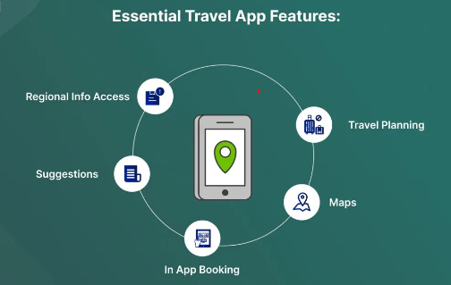
Idea/Approach Details
Describe your idea/Solution/Prototype here:
"Travel involves the act of spending time away from home in pursuit of recreation, relaxation, and pleasure while making use of commercial service provisions."
"Our idea is to facilitate travel to various destinations by providing comprehensive services, including accommodation, food, emergency healthcare contacts, and route maps for our customers."
"We are creating a platform where travelers and tourists can access all these necessities at their convenience."
"This platform prioritizes both health and security features."
Describe your Technology stack here:
mobile technology
Augmented reality
IoT
Virtual assistance
Big data and block chain
5G

Slide 3
Idea/Approach Details
Describe your Use Cases here
Describe your Dependencies / Show stopper here
Personalized Travel Planning
Digital Travel Assistants
Contactless Travel Experience
Language Translation Apps
Crisis and Emergency Alerts
Local Food and Culinary Experiences
Sustainable Travel Booking
Virtual Reality (VR) Travel Experiences
Geographical Diversity
Cultural Richness
Historical Significance
Economic Impact

Slide 4
Team Member Details
Team Leader Name: Type Your Name Here
Branch (Btech/Mtech/PhD etc): Stream (ECE, CSE etc): Year (I,II,III,IV):
Team Member 1 Name: Type Your Name Here
Branch (Btech/Mtech/PhD etc): Stream (ECE, CSE etc): Year (I,II,III,IV):
Team Member 2 Name: Type Your Name Here
Branch (Btech/Mtech/PhD etc): Stream (ECE, CSE etc): Year (I,II,III,IV):
Team Member 3 Name: Type Your Name Here
Branch (Btech/Mtech/PhD etc): Stream (ECE, CSE etc): Year (I,II,III,IV):
Team Member 4 Name: Type Your Name Here
Branch (Btech/Mtech/PhD etc): Stream (ECE, CSE etc): Year (I,II,III,IV):
Team Member 5 Name: Type Your Name Here
Branch (Btech/Mtech/PhD etc): Stream (ECE, CSE etc): Year (I,II,III,IV):
Team Mentor 1 Name: Type Your Name Here
Category (Academic/Industry): Expertise (AI/ML/Blockchain etc): Domain Experience (in years):
Team Mentor 2 Name: Type Your Name Here
Category (Academic/Industry): Expertise (AI/ML/Blockchain etc): Domain Experience (in years):

Slide 5
Important Pointers
Please ensure below pointers are met while
Kindly keep the maximum slides limit to 4 pages
All the topics should be utilized for description of your idea
Try to avoid paragraphs and post your idea in points
Keep your explanation precisely and easy to understand
Idea should be unique and novel. If it has a business potential more weightage will be given.
Apart from this PPT abstract of your idea will be asked separately while submitting
You need to save the file in PDF and upload the same on portal. No PPT, Word Doc or any other format will be supported
You can delete this slide (Important Pointers) when you upload the details of your idea on SIH portal.

