Slide 1
Optiver - Trading at the Close
CS6140 Fall NEU Seattle
Final Project Team B
Yishuang, Chen
Shiang Jin, Chin
Kaijun, Gao

Slide 2
Overview of the presentation
Introduction
Exploratory Data Analysis
Models' selection and Baseline Results
Experiments
Preprocessing
Features Engineering
Hyperparameter Tuning
Summary

Slide 3
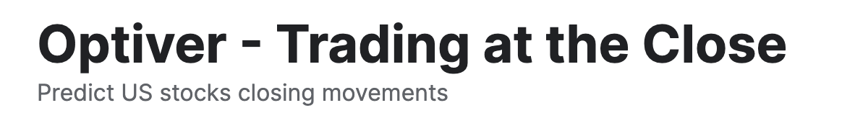
Introduction
Background
Stock exchanges are fast-paced, high-stakes environments where every second counts. In the last ten minutes of the Nasdaq trading session, market makers like Optiver combine traditional order book data with auction book data. This merging of information from both sources is essential to provide the best prices to all market participants.
Task
Develop a model capable of predicting the closing price movements for hundreds of Nasdaq listed stocks using data from the order book and the closing auction of the stock.

Slide 4
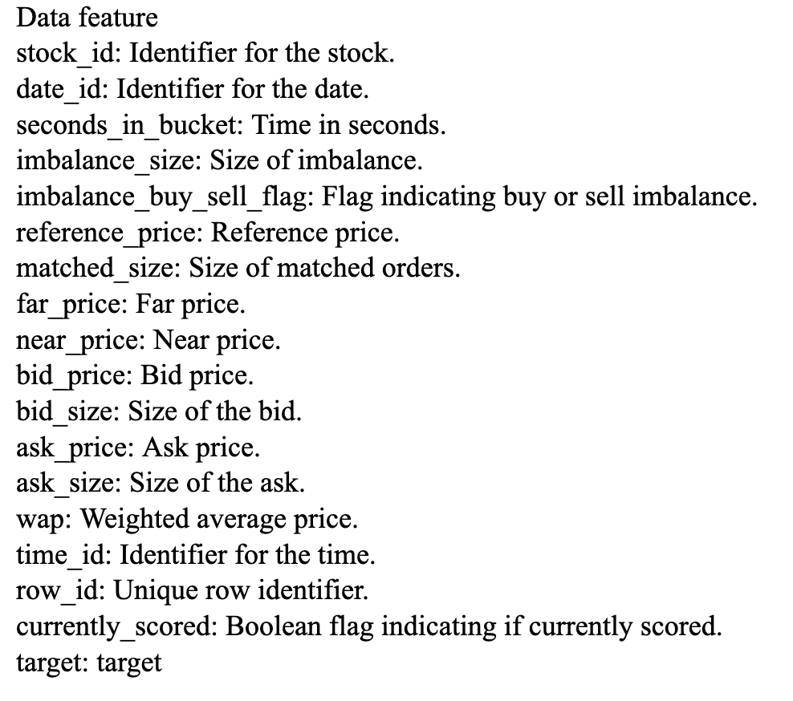
Overview of the Dataset

Slide 5
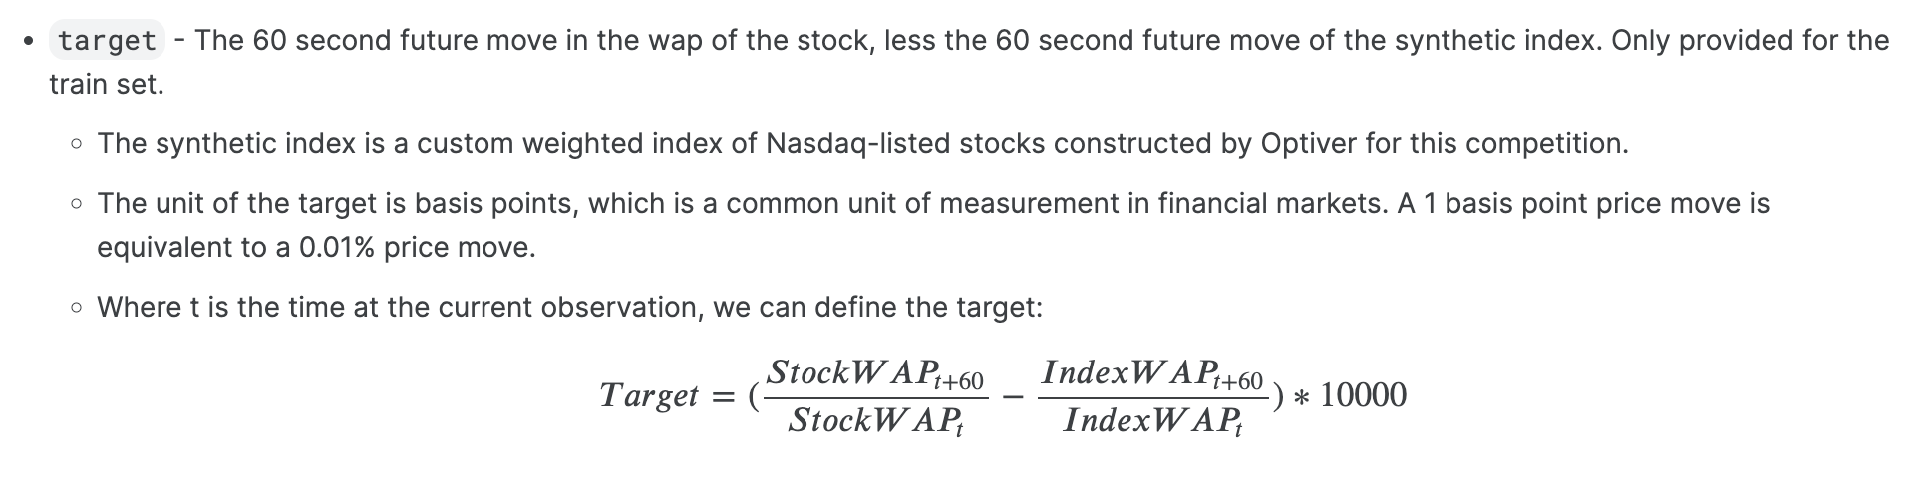
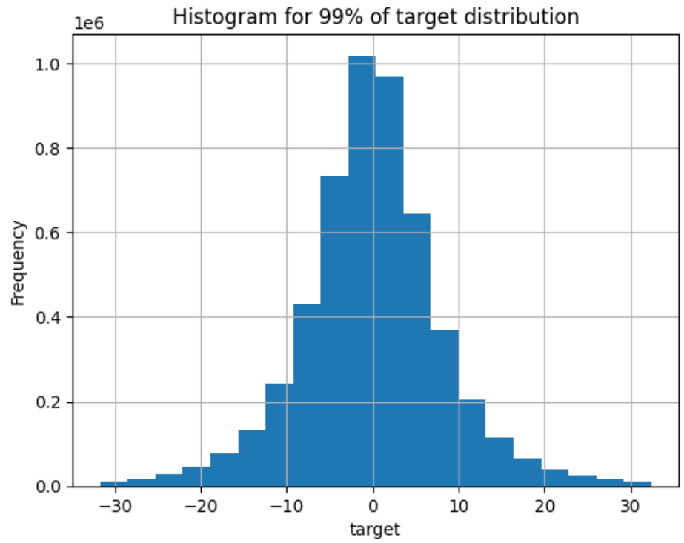
Overview of the Dataset

Slide 6

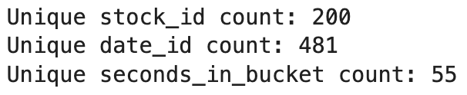
Overview of the Dataset

Slide 7
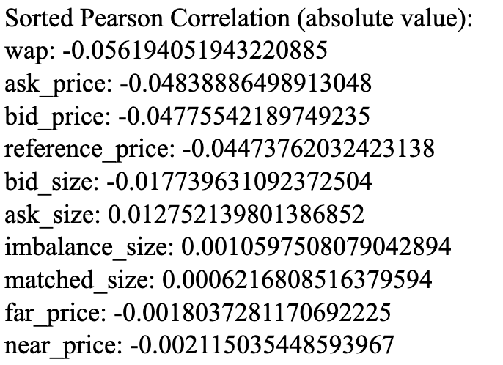
Correlation Analysis
Weak correlation with the target

Slide 8
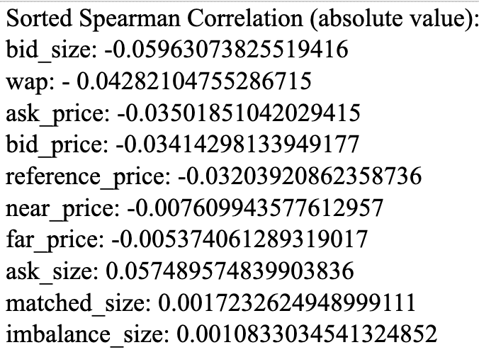
Correlation Analysis
Weak correlation with the target

Slide 9
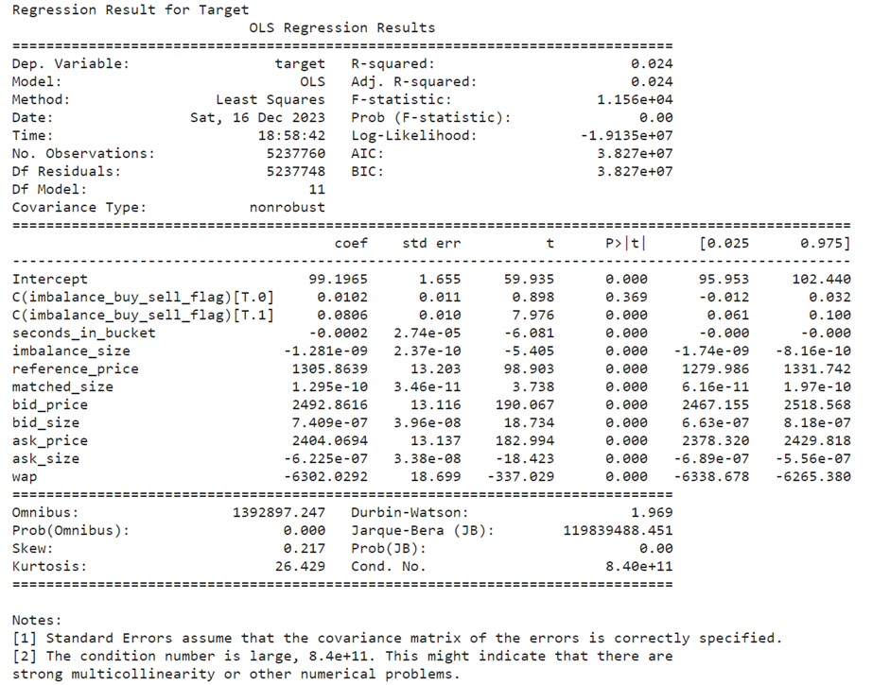
Correlation Analysis
R-squared is very low, only 2.4% variance is explained by the variables

Slide 10
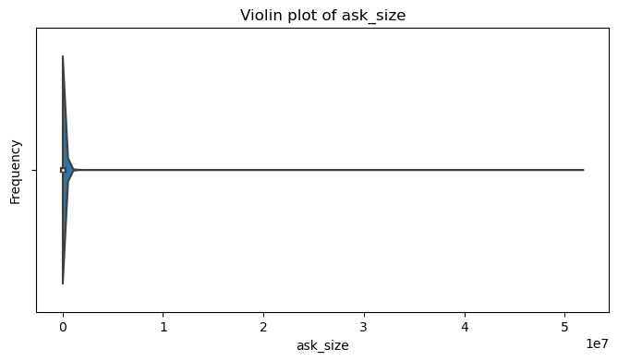
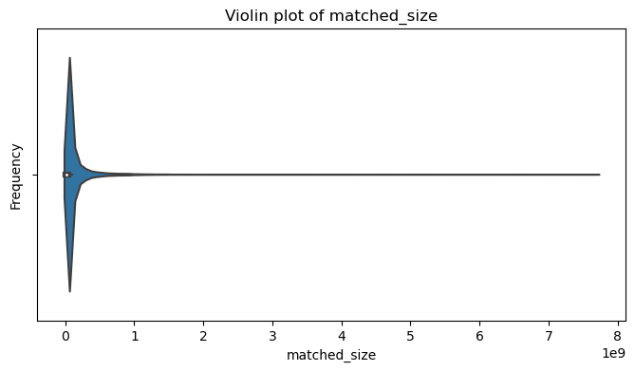
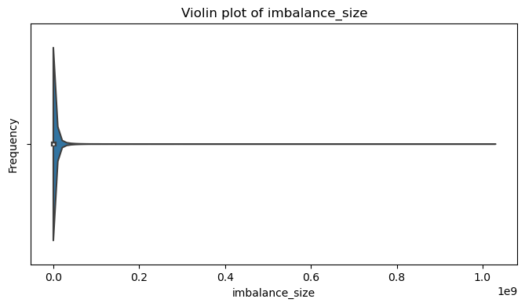
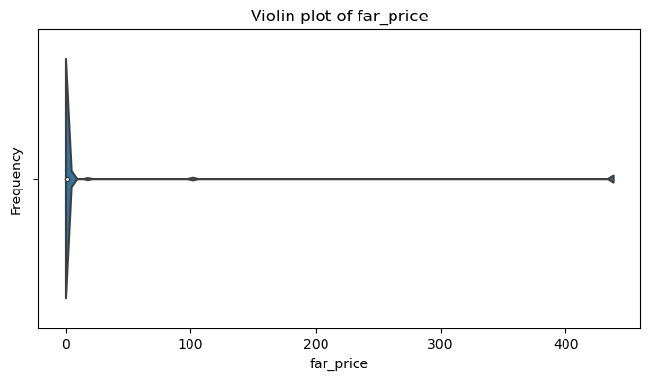
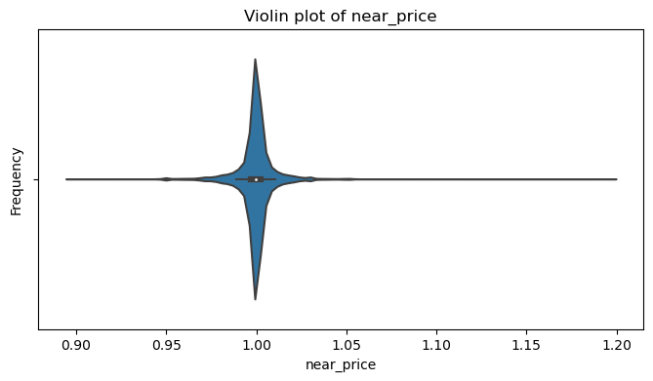
Distributions of data
Violin plot for all numeric attributes

Slide 11
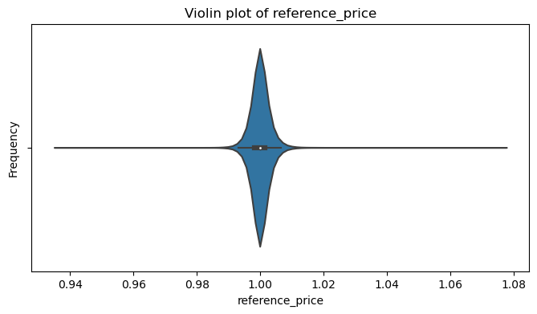
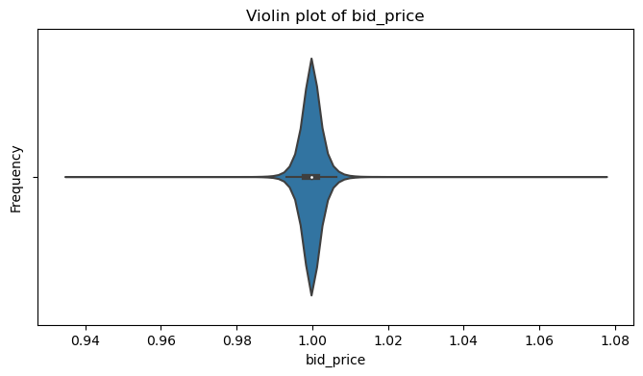
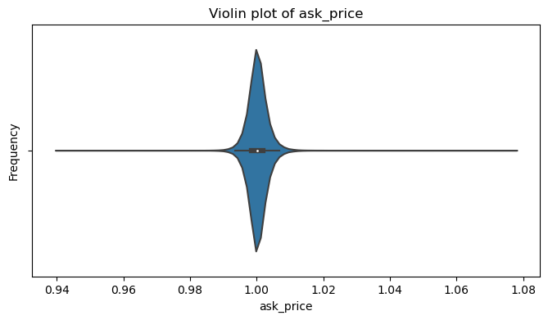
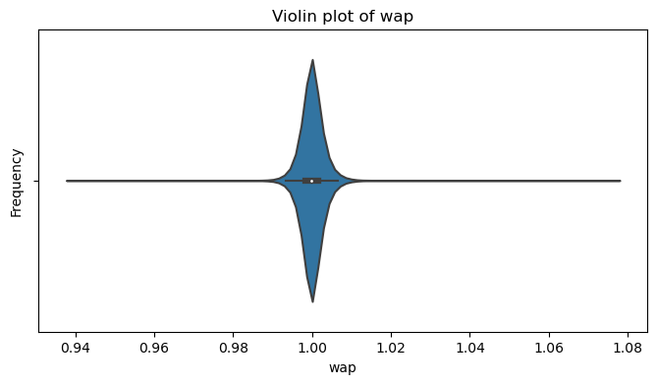
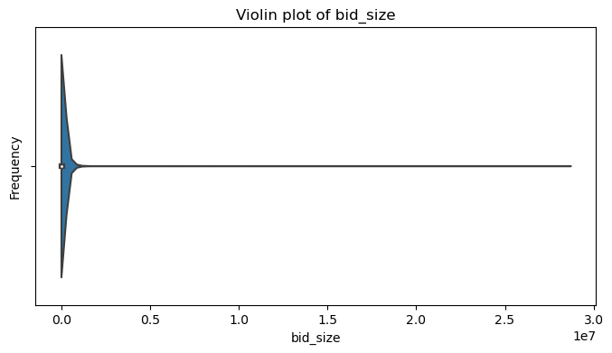
Distributions of data
Violin plot for all numeric attributes

Slide 12
Model selection
Mean absolute error of models based on validation
（Split: Training: 0.8, Testing:0.2）
Linear regression:6.315
XGBoost: 6.26461
LightGBM: 6.30160

Slide 13
Introduction to XGBoost and LightGBM in Stock Price Prediction
XGBoost: An optimized distributed gradient boosting library.
LightGBM: A fast, distributed, high-performance gradient boosting framework.
Both tools are known for efficiency, accuracy, and handling large-scale data.
Application: Predicting closing prices of Nasdaq stocks using extensive data.

Slide 14
Cross-validation and Initial runs
TimeSeriesSplit (TSS) and K-Fold used for XGBoost and LightGBM models.
The mean absolute error (MAE) was used to evaluate the model's performance, and the results for each fold were recorded.
TSS Results: Showed variance in performance, indicating sensitivity to market behavior changes.
K-Fold Results: More consistent performance, highlighting different handling of temporal dependencies.
Test Title | Training Score |  | Validation Score
 | Average | Best Validate | Average | Best
LightGBM with k-fold | 6.29844 | 6.42056 | 6.32005 | 5.23449
LightGBM with tss | 6.13952 | 6.33684 | 6.44559 | 5.87780
XGBoost with k-fold | 6.23408 | 6.35195 | 6.2999 | 5.21481
XGBoost with tss | 6.04233 | 6.27734 | 6.61353 | 5.89368

Slide 15
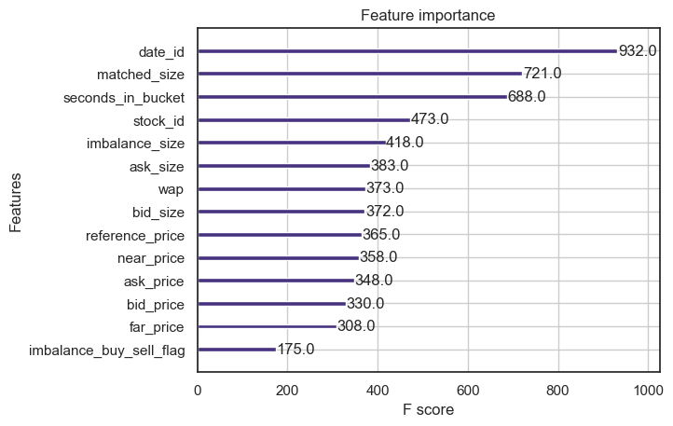
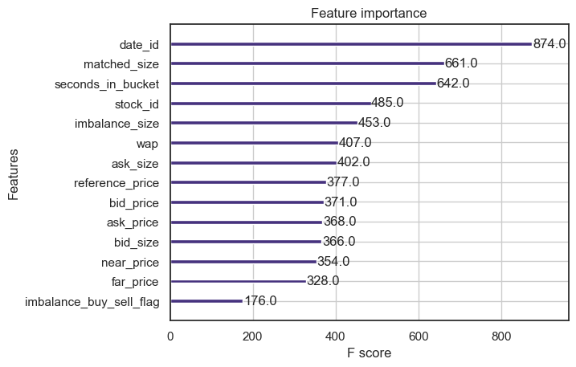
Feature importance

Slide 16
Model Performance with StandardScaler
Second XGBoost run utilized StandardScaler for feature scaling.
StandardScaler standardizes features by removing mean, scaling to unit variance.
Training followed TimeSeries Split cross-validation with 10 folds.
Positive Impact: StandardScaler improved validation scores, indicating better model generalization (only for XGBoost).
For LightGBM no significant improvement.
Score Variability: Reduced standard deviation in validation scores, signifying more consistent performance.
Test Title | Training Score |  | Validation Score
 | Average | Best Validate | Average | Best
LightGBM with k-fold | 6.29844 | 6.42056 | 6.32005 | 5.23449
Scaled XGBoost with k-fold | 6.23368 | 6.35322 | 6.29938 | 5.22012

Slide 17
Principal Component Analysis(PCA)
PCA for dimensionality reduction: Transforms data into a smaller set of uncorrelated variables.
Three principal components captured 95% of data variance.
Post-PCA, the XGBoost model was trained using K-Fold cross-validation with 10 splits.
Validation Scores: Ranged from approximately 4.82 to 6.19 across folds.
Lower standard deviation in validation scores, indicating improved consistency.
Best Fold Performance: Fold 0 with a validation score of around 4.82.
Results hard to repeat due to various factor
Test Title | Training Score |  | Validation Score
 | Average | Best Validate | Average | Best
XGBoost with imputed mean | 5.21884 | 5.22979 | 5.60285 | 4.82914
LGBM drop na | 5.59804 | 5.69312 | 5.63493 | 4.77072
LGBM pca applied after split (fill 0) | 6.29813 | 6.42039 | 6.31076 | 5.23347

Slide 18
Feature Engineering
Overview of Features experimented
Removing features of less important
Adding First and Second Derivatives
Adding Imbalance Factors
Separate Models for the dependent variables

Slide 19
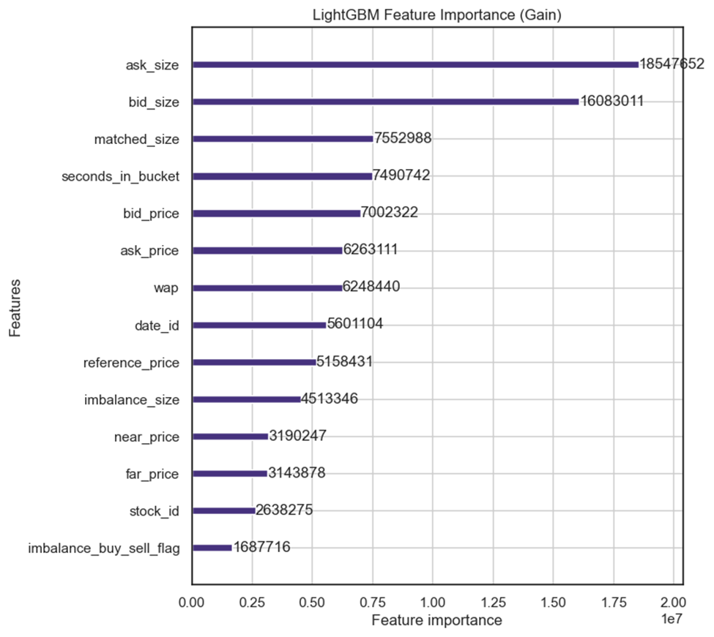
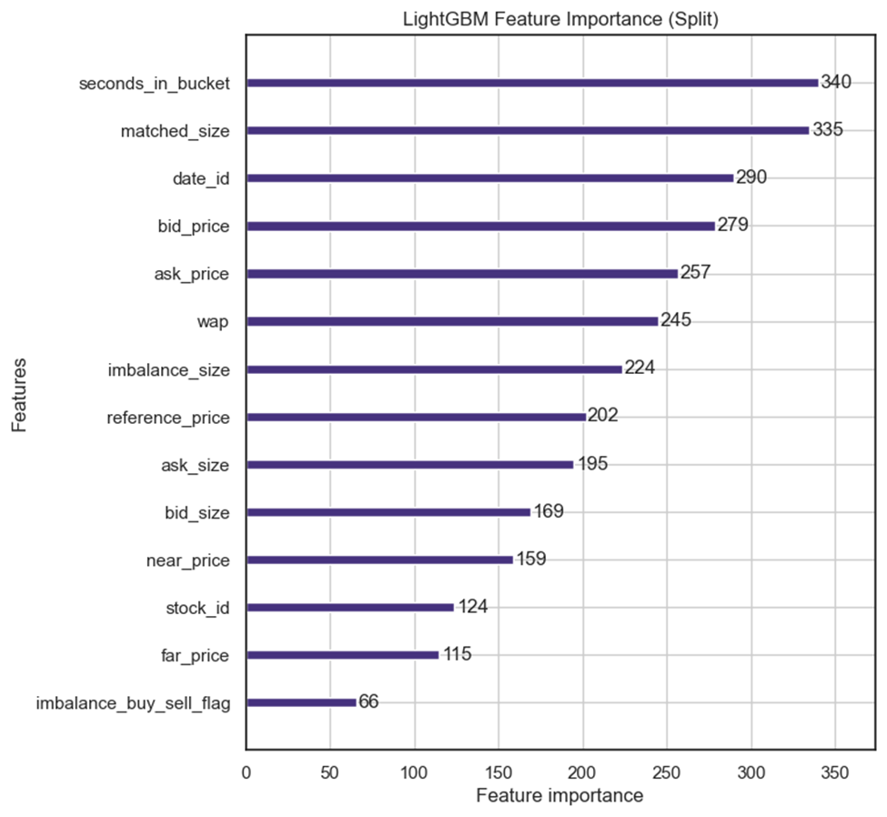
Feature Engineering
Removing features of less important

Slide 20
Result
Test Title | Training Score |  | Validation Score |  | Test Score (Submission)
 | Average | Best Validate | Average | Best
Initial Run with kfold | 6.29844 | 6.42056 | 6.32005 | 5.23449 | 5.4249
4 features removed | 6.30591 | 6.42768 | 6.32560 | 5.23688 | 5.4245
With derivatives on Reference price
With derivatives on all trend features
With all imbalance features
With only two imbalance features
With derivatives on reference price & all imbalance features
2 model
2 model with imbalance features

Slide 21
Feature Engineering
Adding First and Second Derivatives
First Derivatives - change of value in last 10 seconds
Second Derivatives - change in change of value
Two feature sets
On reference price only
On reference price + ask_size, bid_size, matched_size, bid_price, ask_price, wap, imbalance_size

Slide 22
Results
Test Title | Training Score |  | Validation Score |  | Test Score (Submission)
 | Average | Best Validate | Average | Best
Initial Run with kfold | 6.29844 | 6.42056 | 6.32005 | 5.23449 | 5.4249
4 features removed | 6.30591 | 6.42768 | 6.32560 | 5.23688 | 5.4245
With derivatives on Reference price | 6.29823 | 6.41934 | 6.31806 | 5.23228 | N/A
With derivatives on all trend features | 6.29823 | 6.41934 | 6.31804 | 5.23228 | N/A
With all imbalance features
With only two imbalance features
With derivatives on reference price & all imbalance features
2 model
2 model with imbalance features

Slide 23
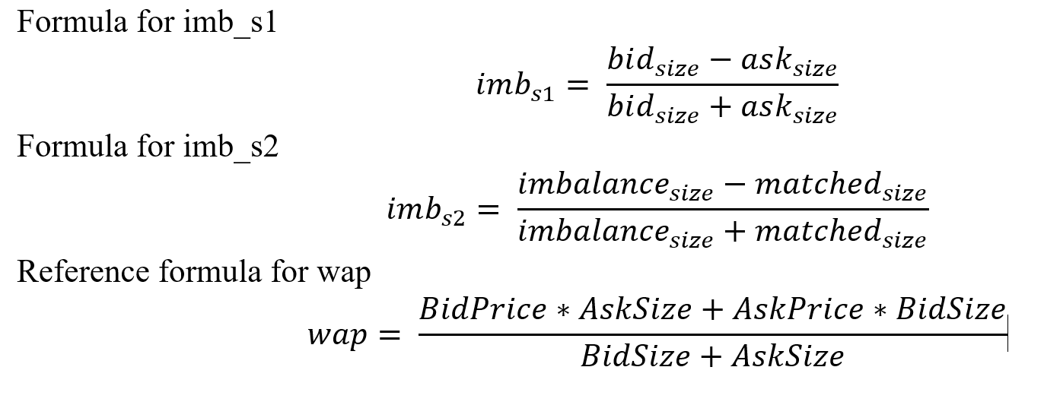
Feature Engineering
Adding Imbalance Factors

Slide 24
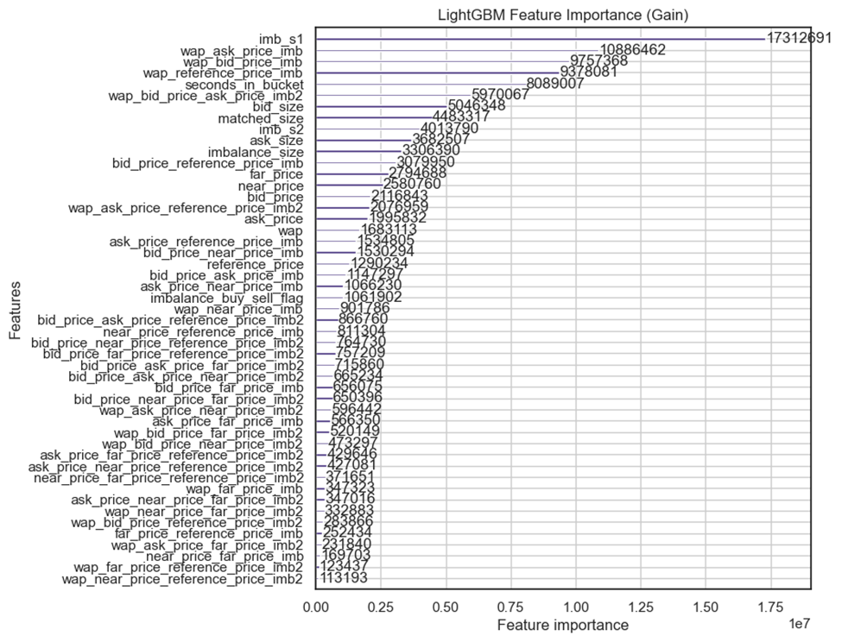
Feature Engineering

Slide 25
Summary
Test Title | Training Score |  | Validation Score |  | Test Score (Submission)
 | Average | Best Validate | Average | Best
Initial Run with kfold | 6.29844 | 6.42056 | 6.32005 | 5.23449 | 5.4249
4 features removed | 6.30591 | 6.42768 | 6.32560 | 5.23688 | 5.4245
With derivatives on Reference price | 6.29823 | 6.41934 | 6.31806 | 5.23228 | N/A
With derivatives on all trend features | 6.29823 | 6.41934 | 6.31804 | 5.23228 | N/A
With all imbalance features | 6.26616 | 6.38593 | 6.28535 | 5.1937 | 5.39
With only two imbalance features | 6.29743 | 6.41905 | 6.31597 | 5.22403 | N/A
With derivatives on reference price & all imbalance features | 6.26397 | 6.38409 | 6.28376 | 5.19254 | N/A
2 model
2 model with imbalance features

Slide 26
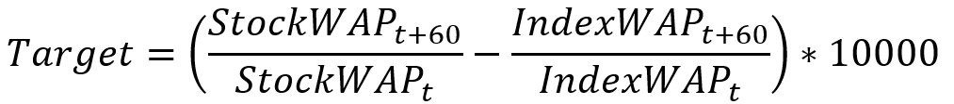
Feature Engineering
Separate Models for the dependent variable
Known
Unknown
What if we use two models to predict the unknowns separately?

Slide 27
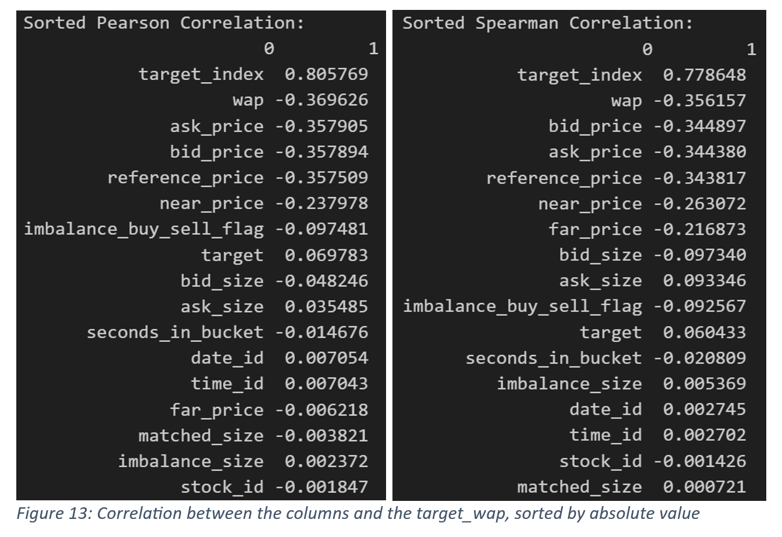
Feature Engineering

Slide 28
Summary
Test Title | Training Score |  | Validation Score |  | Test Score (Submission)
 | Average | Best Validate | Average | Best
Initial Run with kfold | 6.29844 | 6.42056 | 6.32005 | 5.23449 | 5.4249
4 features removed | 6.30591 | 6.42768 | 6.32560 | 5.23688 | 5.4245
With derivatives on Reference price | 6.29823 | 6.41934 | 6.31806 | 5.23228 | N/A
With derivatives on all trend features | 6.29823 | 6.41934 | 6.31804 | 5.23228 | N/A
With all imbalance features | 6.26616 | 6.38593 | 6.28535 | 5.1937 | 5.39
With only two imbalance features | 6.29743 | 6.41905 | 6.31597 | 5.22403 | N/A
With derivatives on reference price & all imbalance features | 6.26397 | 6.38409 | 6.28376 | 5.19254 | N/A
2 model | 6.42320 | 6.54786 | 6.47963 | 5.28060 | 5.4613
2 model with imbalance features | 6.39075 | 6.51506 | 6.43437 | 5.26175 | 5.4391

Slide 29
Hyperparameter Tuning (Light GBM)
Candidates
n_estimators, learning_rate, num_leaves, max_depth, min_data_in_leaf, max_bin, max_gain_to_split, subsample
Correlations of tuning effects
Higher accuracy scores -> longer training time required -> higher risk of overfitting
More generalized model -> lower training time required -> lower training accuracy scores
Use optuna library to automate the process

Slide 30
Summary
Test Title | Training Score |  | Validation Score |  | Test Score (Submission)
 | Average | Best Validate | Average | Best
Baseline (with imbalance factors) | 6.26616 | 6.38593 | 6.28535 | 5.1937 | 5.39
First Tuning | 6.19929 | 6.31821 | 6.27048 | 5.1798 | 5.3823
Second Tuning | 6.22611 | 6.34055 | 6.27049 | 5.1807 | 5.3906
Third Tuning | 6.23874 | 6.35838 | 6.27021 | 5.1807 | 5.3785

Slide 31
Hyperparameter Tuning (XGBoost)
Candidates for Tuning: n_estimators, learning_rate, max_depth, min_child_weight, gamma, subsample, colsample_bytree, reg_alpha, reg_lambda.
Correlations of Tuning Effects:
Increased training accuracy often leads to longer training times and a higher risk of overfitting.
A more generalized model usually requires less training time but may have lower training accuracy.
Automating the Process: Utilizing libraries Optuna for systematic and efficient hyperparameter optimization.

Slide 32
Summary
Test Title | Training Score |  | Test Score (Submission)
 | Average | Best Validate
Baseline | 6.23408 | 6.35195 | N/A
First Tuning | 6.31042 | 6.30532 | 5.4142
Second Tuning | 6.31143 | 6.30353 | 5.4539
Third Tuning | 6.31497 | 6.30682 | 5.4262

Slide 33
Summary & Conclusion
Effect of preprocessing :
StandardScaler() -> mixed results
PCA() -> mixed results
kfold vs tss -> kfold is better
Effect of feature engineering
Remove feature -> negative
First & Sec derivative -> positive but not significant
Imbalance features -> positive
two models -> negative

Slide 34
Summary & Conclusion
Effect of hyperparameter tuning
generally positive
best model -> lightGBM
Test score -> 5.3782
Compared to the target distribution
Still room for improvement

Slide 35
Q & A and Thank you

