Slide 1




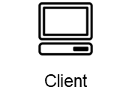



Amazon Elastic Compute Cloud (Amazon EC2)
Send Get Queries
Consumers & Redis server instance
Tomcat Webapp Servlet(s)
GetServlet
SwipeServlet
Get Requests
Get Responses
Post Requests
T3 instance
Pub Post
Messages
T3 instance
Consume
Messages
Post Responses
T3 instance
Elastic IP address
Elastic IP address

