Slide 1
Installations
Python + TensorFlow +
Other Packages + Jupyter Notebook
Sungjoon Choi
(sungjoon.choi@cpslab.snu.ac.kr)

Slide 2
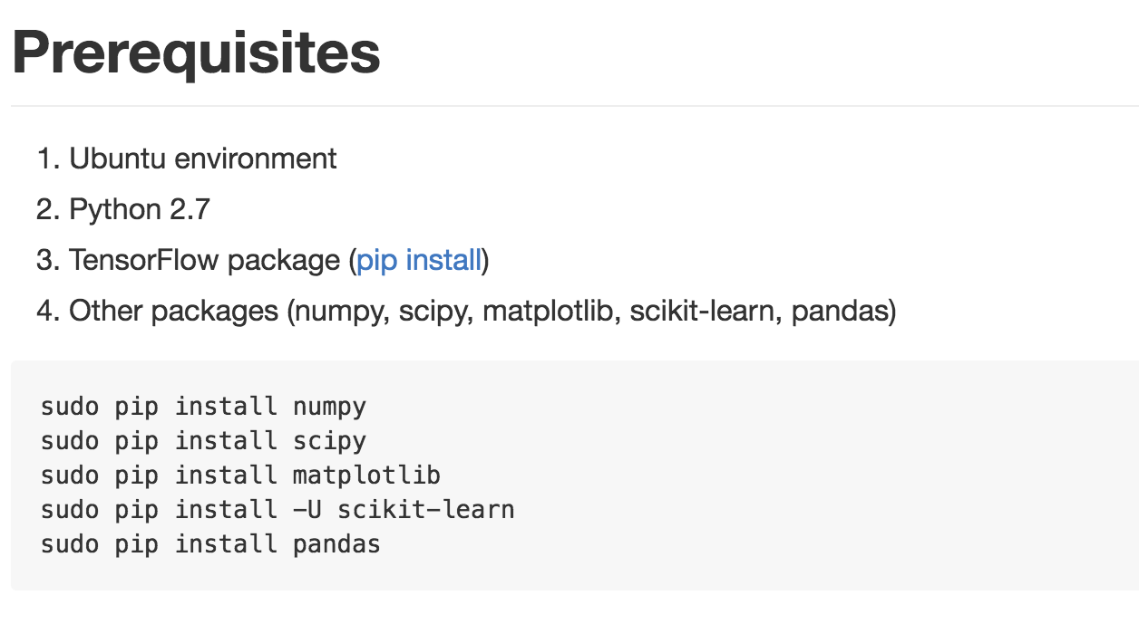
GitHub
https://github.com/sjchoi86/dl-workshop

Slide 3
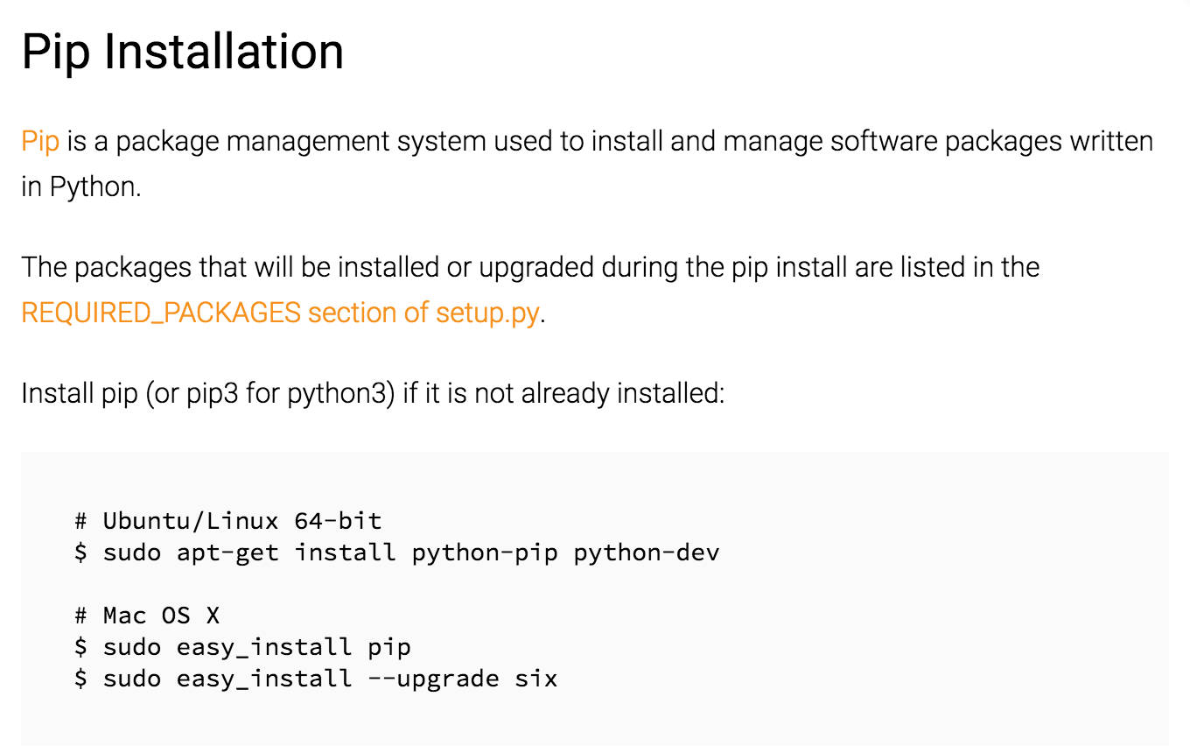

Slide 4
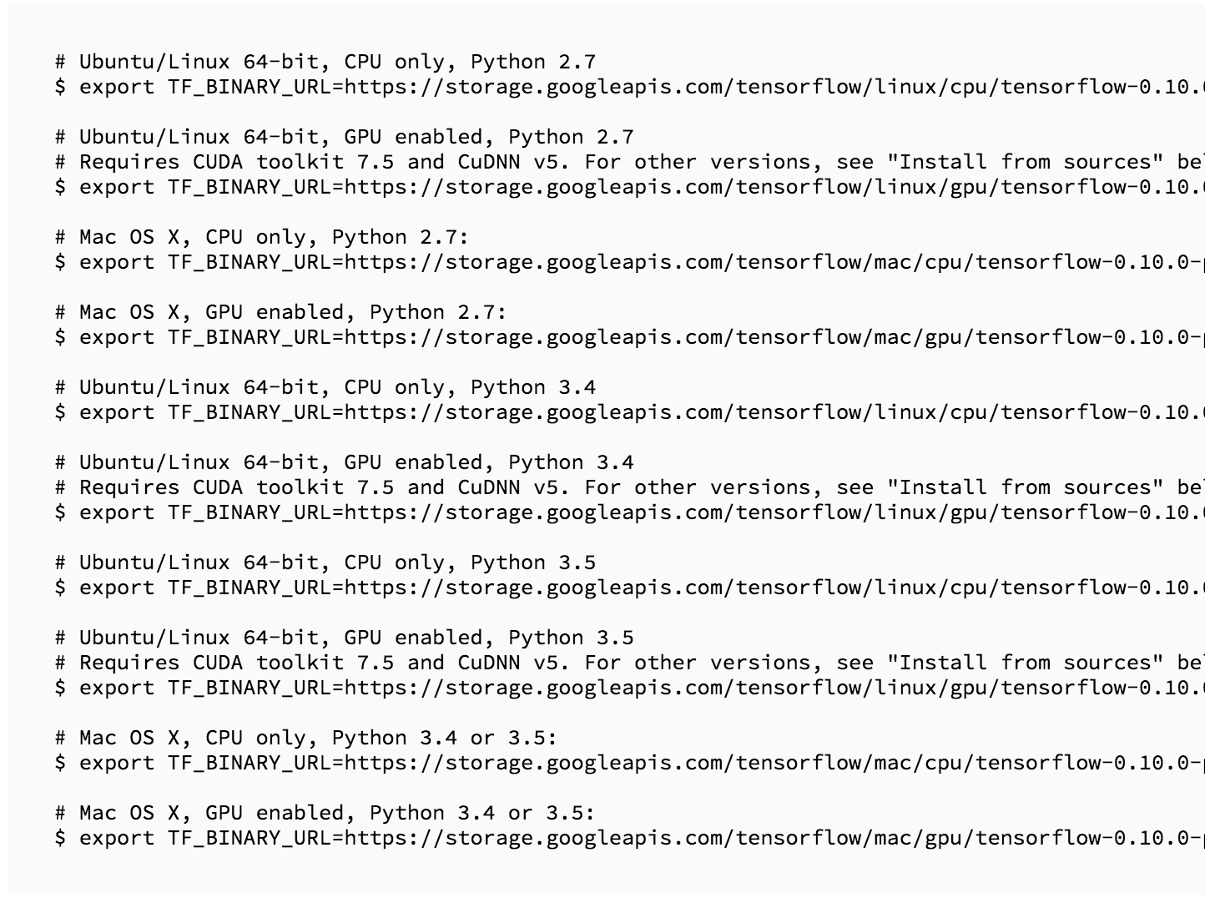

Slide 5
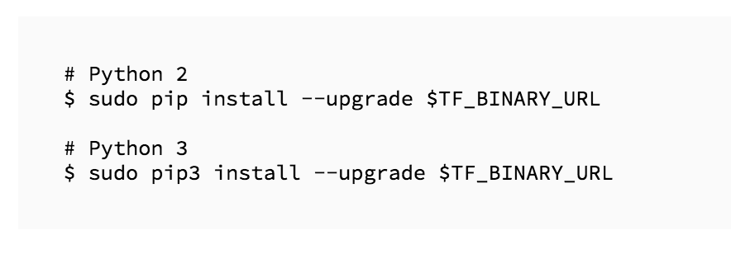
Finally

Slide 6
Back to GitHub
https://github.com/sjchoi86/dl-workshop

Slide 7
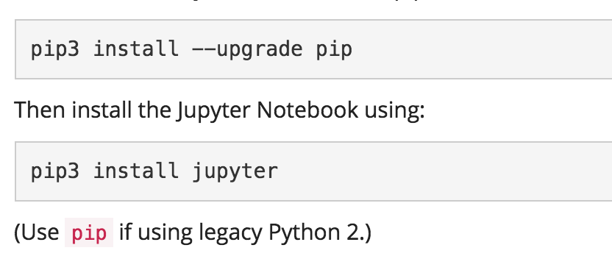
Install Jupyter Notebook

