Slide 1



Financial AI with Sentiment Analysis
CityU-EE Gifted Education Fund Programme: AIoT Coding, Engineering and Entrepreneurial Skills Education for Gifted Students
Team Members (Project 5)
10 CHOE Jungrhin
13 Emma MUI
29 Manun CHAUHAAN

Slide 2
Introduction
Implementation of behavioural and social economics through linguistic multimodal diffusion AI model.

Slide 3
Background & Motivation
Background:
Multimodality models are AI models that can combine data in two modes
(eg. image and text)
Diffusion models are AI models that can recreate data similar to its own training data
DSGE is a macroeconomic analytical tool which explains historical data
TextWorld is a text-based game developed by Microsoft
Motivation:
Economics needs to consider the basis for all social connections, which is language
Instead of just the theories, which rely on a lot of assumptions
Problems we would like to solve:
Many economic predictions these days do not factor in human behavior, and rely solely on historical quantitative data
Vision, Goals & Objectives:
Make an AI model that can predict consumer reactions based on news or events
Agents do not have to depend on economic theory

Slide 4
Are there existing solutions?
AI Economist model: a 2-level deep Reinforcement Learning framework
Uses a simulation called Gather-Trade Build
Has multiple economic agents trading between each other, a planner (government) and taxation
Reinforcement learning learns the behavior of each agent
Easier problems use curriculum learning
Randomness added with entropy regularlisation

Slide 5
What is your solution?
Current solutions do not account for human behaviour - only the numbers
Sentiment analysis to find the specific language that trigger emotive, or more noticeable responses in humans
Use the outcomes here to make a model that can predict any consumer behaviour
TextWorld game for simulation, additional economic data with DSGE
On top of multimodal and diffusion models

Slide 6
Technology
Sentiment analysis:
Captures language in financial Tweets
Gain insight into human behaviour
t5 transformer model on Google Cloud
sentence_transformers library’s all-MiniLM-L6-v2 model
conducts sentence embeddings
K- means clustering
allows to predict if words signify a positive or negative change in markets

Slide 7
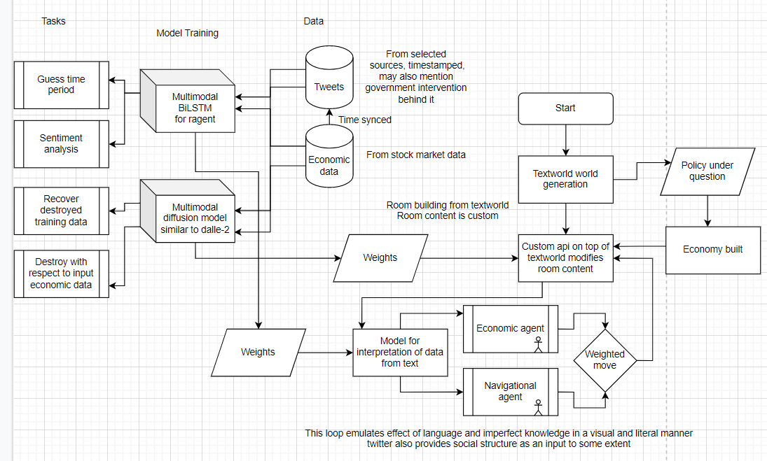

Wider project roadmap
Only sentiment analysis can be done in the time given to us

Slide 8
Future work
Multimodality: conjunction of economics and natural language
Diffusion model: works with learning to find original training data from noisy version
Multimodality is given auxiliary information of labeling economic state at time of tweet. Downstream tasks: Tweet economic data matching, Tweet recovering with retention of targeted noise (economic data insertion).
TextWorld game simulation to predict outcome of any economic event

Slide 9
Thanks!
Any questions?
Contact details:
Rhin: choejn1@kgv.hk
Emma: emmamui2026@cdnis.edu.hk
Manun: chauhm1@kgv.hk
Project repository on GitHub: https://github.com/sjdnsjd919/FinancialAI-SentimentAnalysis

