Slide 1





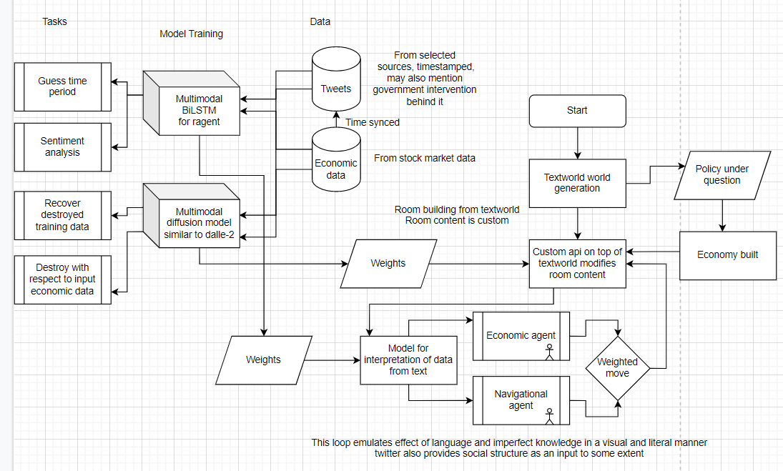
AIoT Coding, Engineering and Entrepreneurial Skills Education for Gifted Students
Financial AI with Sentiment Analysis
Students: 10 Choe Jungrhin, 13 Emma Mui, 29 Manun Chauhaan Project ID: P5
Abstract
Results/Application
Using AI to capture the linguistics behind what affects consumers’ behaviour and choices, to better predict consumer response to economic events.
Unfortunately, we were denied access to the Twitter Developer Platform
Could not implement Twitter API in our project
Alternative was to use an API built on Twitter API called StockerBot
Not necessary to use this as datasets created with StockerBot were available on Kaggle - including stock market data
Managed to finish up to stage 2.1 of the project:
Successfully aligned timestamps of Tweets to the stock market price data on the same day
Not prepared in time for the demo
Words in Tweets around the time of a fall in stock price were captured, as well as when the stock price increases
Done via K-means clustering, and can mostly predict the nature of a string of text eg. “Price of NFLX rises”
Objective/Background/Motivation
Our economy is a big part of our society
Economics relies on a lot of assumptions, but doesn’t reflect the real world as consumers do not always act rationally
Wanted to capture the linguistics which affect consumer behavior to better understand this situation
AI and Natural Language Processing can potentially be used to deal with this
GitHub link
Youtube link
Methodology
Multi-part project:
Find datasets for economic data (stock market) and people’s reactions using Kaggle and/or Twitter API
Sentiment analysis on what words can trigger consumer reactions to economic events
Use Twitter and stock market data passed through t5 transformer model
Implement a diffusion model with multimodality using MMF framework
Use the model as a basis to make a TextWorld (word-based game) simulation that can simulate and predict economies under different situations
Discussion/Conclusion
From our results, we can see that our project has been successful in the parts we have been able to complete
Most importantly, we have learnt that finding the right dataset(s) is the most important stage of any AI project
We can further develop this project by bringing it to stages 2.2 and 3 listed in our methodology
Could try to explore other, more efficient ways to achieve what we have done
Look into ways to apply the model other than through simulating and predicting in TextWorld

