Slide 1

Economic modelling using DSGE and TextWorld
CityU-EE Gifted Education Fund Programme: AIoT Coding, Engineering and Entrepreneurial Skills Education for Gifted Students
Slogan or tagline for your project
Team Members (Project ID)
10 CHOE Jungrhin | 29 Manun CHAUHAAN

Slide 2
Introduction
About your project idea
Implementation of behavioural and social economics through linguistic multimodal diffusion ai model.

Slide 3
Background & Motivation
Background:
DSGE is a macroeconomic analytical tool which explains historical data
TextWorld is a text-based game developed by Microsoft
Motivation:
Modelling the human world through Economics needs to consider the basis for all social connections, which is language
Problems we would like to solve:
Many economic predictions these days do not factor in human behavior, and rely solely on historical quantitative data
Vision, Goals & Objectives:
We would like to
Other Important Facts

Slide 4
What is the target market?
4000
3000
2000
1000
0
You may use charts or graphs to illustrate the result from market research

Slide 5
What is the target market?
Governments, corporations and banks
Enterprise level rather than consumers

Slide 6
What is the target market?
You may add a table to compare data
 | A | B | C
Yellow | 10 | 20 | 7
Blue | 30 | 15 | 10
Orange | 5 | 24 | 16

Slide 7
Are there existing solutions?
AI Economist model: a 2-level deep Reinforcement Learning framework
Uses a simulation called Gather-Trade Build
Has multiple economic agents trading between each other, a planner (government) and taxation
Reinforcement learning learns the behavior of each agent
Easier problems use curriculum learning
Randomness added with entropy regularlisation

Slide 8
What is your solution?
Current solution does not account for human behaviour
Agents are assumed to be rational which was strongly disproven in the 2008 economics Nobel prize
Novel technology we created accounts for modern human behaviour.
Uses Twitter and TextWorld to make agents convey information in human language`

Slide 9
Technology
Multimodality in the form of conjunction of economics and natural language
Uses inputs of Tweets in times of economic events to gain insight into human behaviour, implement to textworld to mimic imperfect information.
Diffusion model works with learning to find original training data from noisy version, Multimodality is given auxiliary information of labeling economic state at time of tweet. Downstream tasks: tweet economic data matching, tweet recovering with retention of targeted noise (economic data insertion).

Slide 10
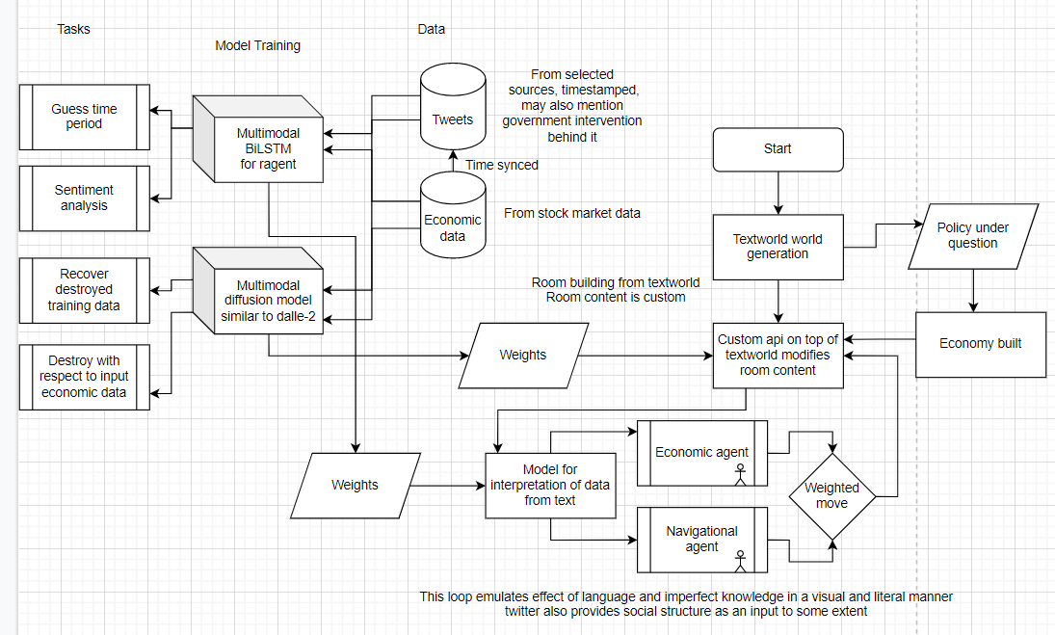

What is your solution?
How does it work?
Elaborate the concepts, technologies applied, etc.

Slide 11
Future work
Future plan to further develop the product
Plan to deploy and market the product

Slide 12
Thanks!
Any questions?
Contact details:
Rhin: choejn1@kgv.hk, rhinchoe0106@gmail.com
Manun: chauhm1@kgv.hk,
Project repository on GitHub: https://github.com/sjdnsjd919/TextBasedDSGE

