Slide 1
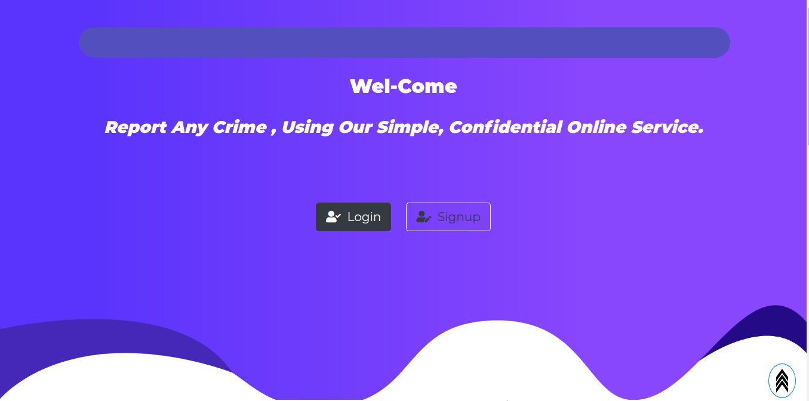
Web Based Crime Report & Analysis System
Presented By :
Deepak Sapkota
&
Arun Shrestha

Slide 2

Web Based Crime Report & Analysis System
Abstract
Introduction
This project’s main idea is to implement an online web application for maintaining the common people complaints for police department.
Keywords: crime,register,complaints, awareness, punishments, reporting
The “Web Based Crime Report and Analysis System” In PHP is a simple mini project for reporting complaints of any crimes. The project contains Admin,Sub-Admin and the User’s Section separately.
Landing Page
User Section
Sub-Admin Section
Admin Section
CRAS
Project Objectives
SOFTWARE DEVELOPMENT
The project entitled as “Crime Report and Analysis System” is a web based application it will be very useful for police department as well as common peoples.
The framework we will be using for developing this project is Incremental model. This model combines linear sequential model with the iterative prototype model.

Slide 3
OUTLINE
Landing Page
User Section
Sub-Admin Section
Admin Section

Slide 4
Registration process / Login Process
User Registration
User
Login
REGISTRATION
Database
LOG-IN
Database
Sub-Admin
Check Wheather user
Registered or Not ?
Response for User
Registration Request
User
Dashboard
Sub-Admin Email Response
Sub-Admin response Through Email

Slide 5
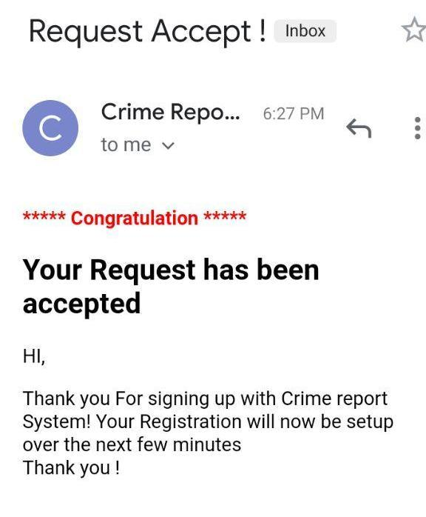
User Verification Email
User Verification Email
User Verification Email

Slide 6

User Section
OverView
User Section
User can Perform All Task Associated With
Crime Report System

Slide 7
User Section Over-View
Fir Status
Home
Contact
Fir Report
Profile
Police Station
Manage Profile
Change Profile

Slide 8
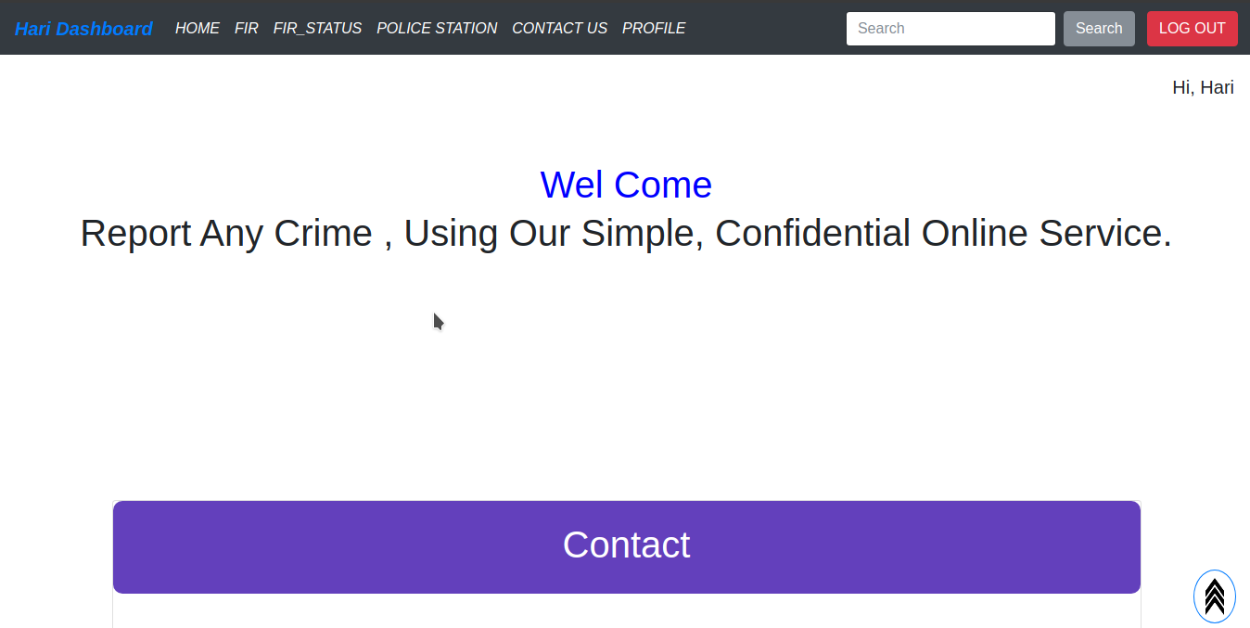
User Section Over-View

Slide 9
User Fir Registration Process
Fir Accepted case
Confirmation Message Send to User / Victum
Fir Response
Either Fir Accepted Or Rejected
Viewed By sub-Admin
Confirm Wheather Fir is True ir Not
Fir Report Section
Report Fir From User Side

Slide 10
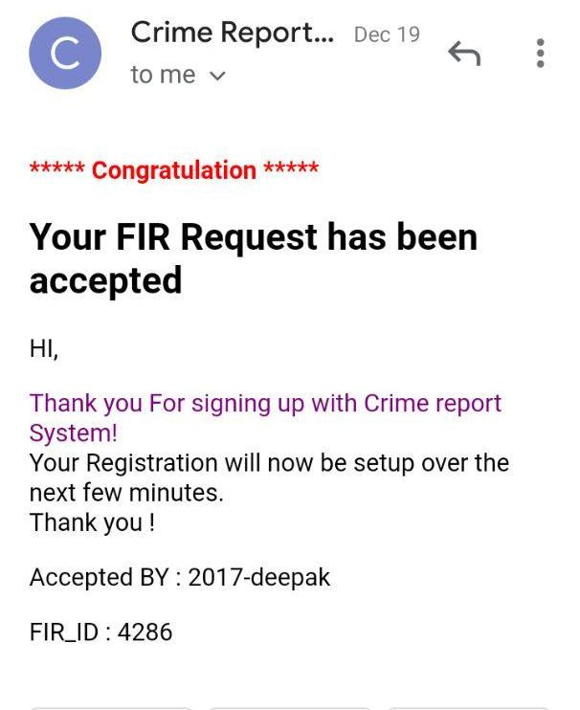
FIR Verification Email
FIR Verification Email
FIR Verification Email

Slide 11
FIR Verification Email
FIR Verification Email
FIR Verification Email

Slide 12
Sub-Admin Section
OverView
Sub-Admin Section
Manage all task associated with the Crime Report System

Slide 13
Sub-Admin Task Details
DASHBOARD
User Request
Unsolved FIR
FIR Request
DashBoard
Registered Fir / Registered Users
Running FIR
clearance Cerificate
CONTACT
- Admin
- User's

Slide 14
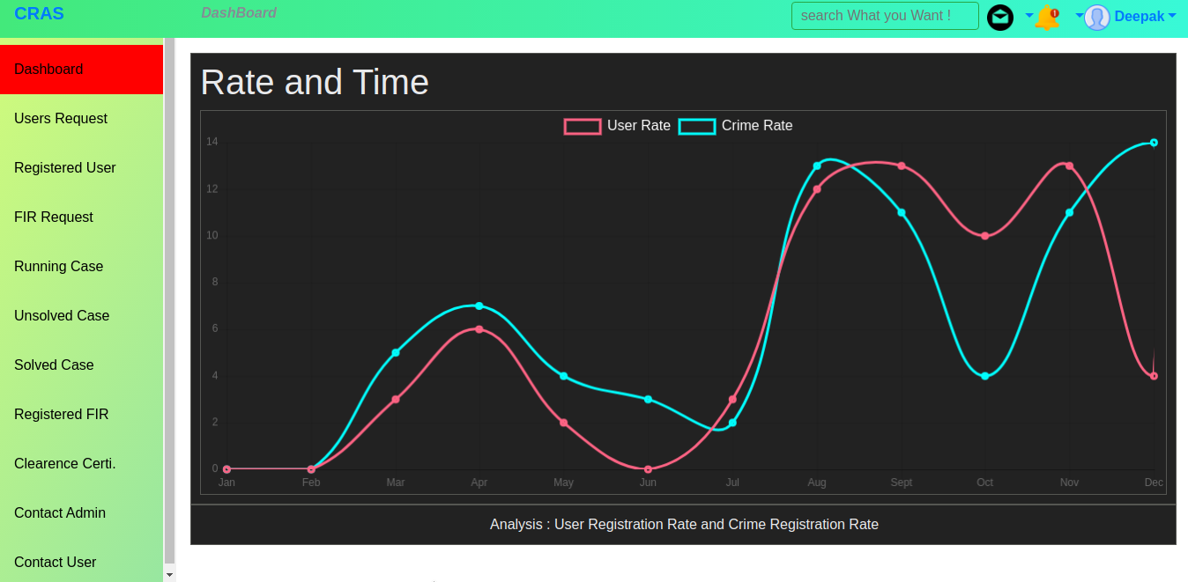
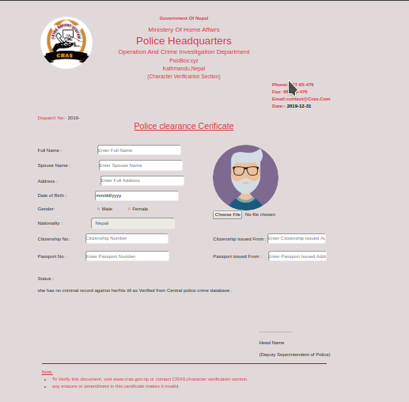
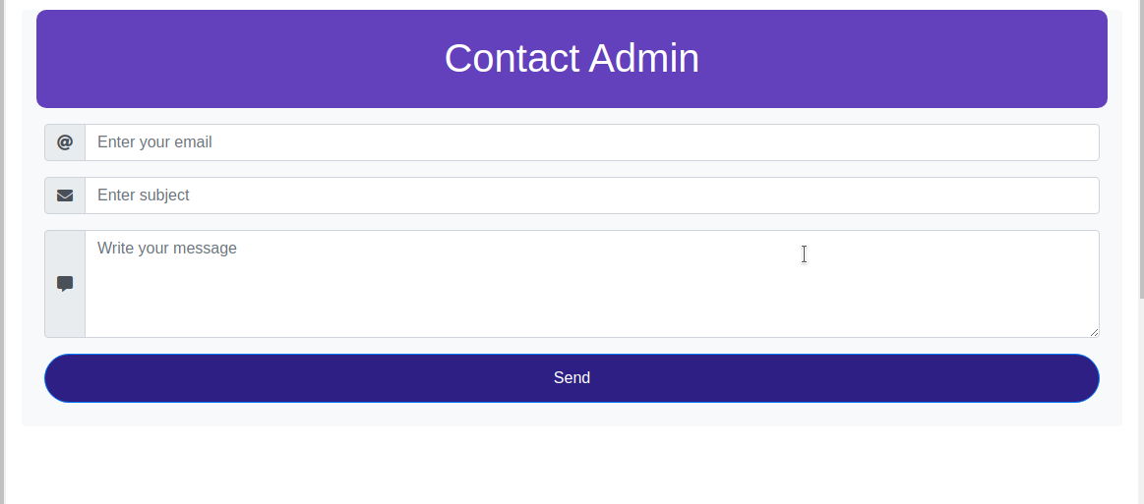
Sub-Admin Section Overview

Slide 15
Admin Section
OverView
Admin Section
Admin can Perform All Task Associated High level task associated with Crime Report System

Slide 16
Admin Section
Add
Sub-
Admin
Admin Section Intro.
Admin
- Responsible for setting up and maintaining the crime Report system.
- Planning and Responding to service outages and other problems Associated With the System.
Add
Admin
Admin
Admin
Contact
Maintaining system.
Verify that peripherals
are working properly.
Manage Police Stat.
Monitor system performance.
Analysis The System And Planing for future.
Manage Police Stat.

Slide 17
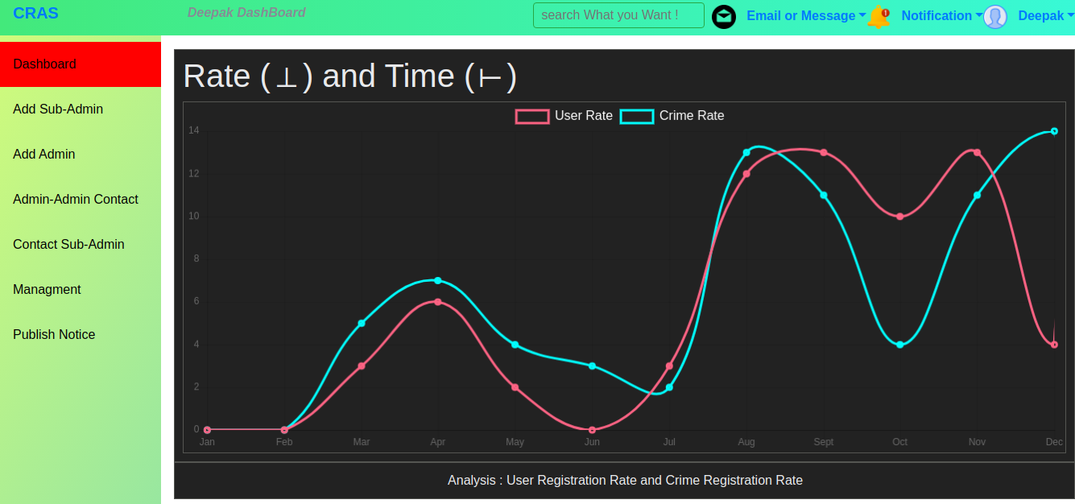
Admin Section Over-View

Slide 18
CONCLUSION
The project entitled as "Implementation Of Online Crime Reporting System" is a web based application it will be very useful for police department as well as common peoples.
This software provides facility for reporting online crimes, complaints and show related sections.
This software is develop with scalability in mind. Additional modules can be easily added when necessary.
The software is developed with modular approach.

Slide 19
CONCLUSION
Contd...
All modules in the system have been tested with valid data and invalid data and everything work successfully.
Thus the system has fulfilled all the objectives identified and is able to replace the existing system.
The Application is made users friendly to the maximum so that anyone can run the application provided the could access to the system via the login password.
This project manages all details without any risk. The project provides much security.

Slide 20

Web Based Crime Report & Analysis System

