Slide 1
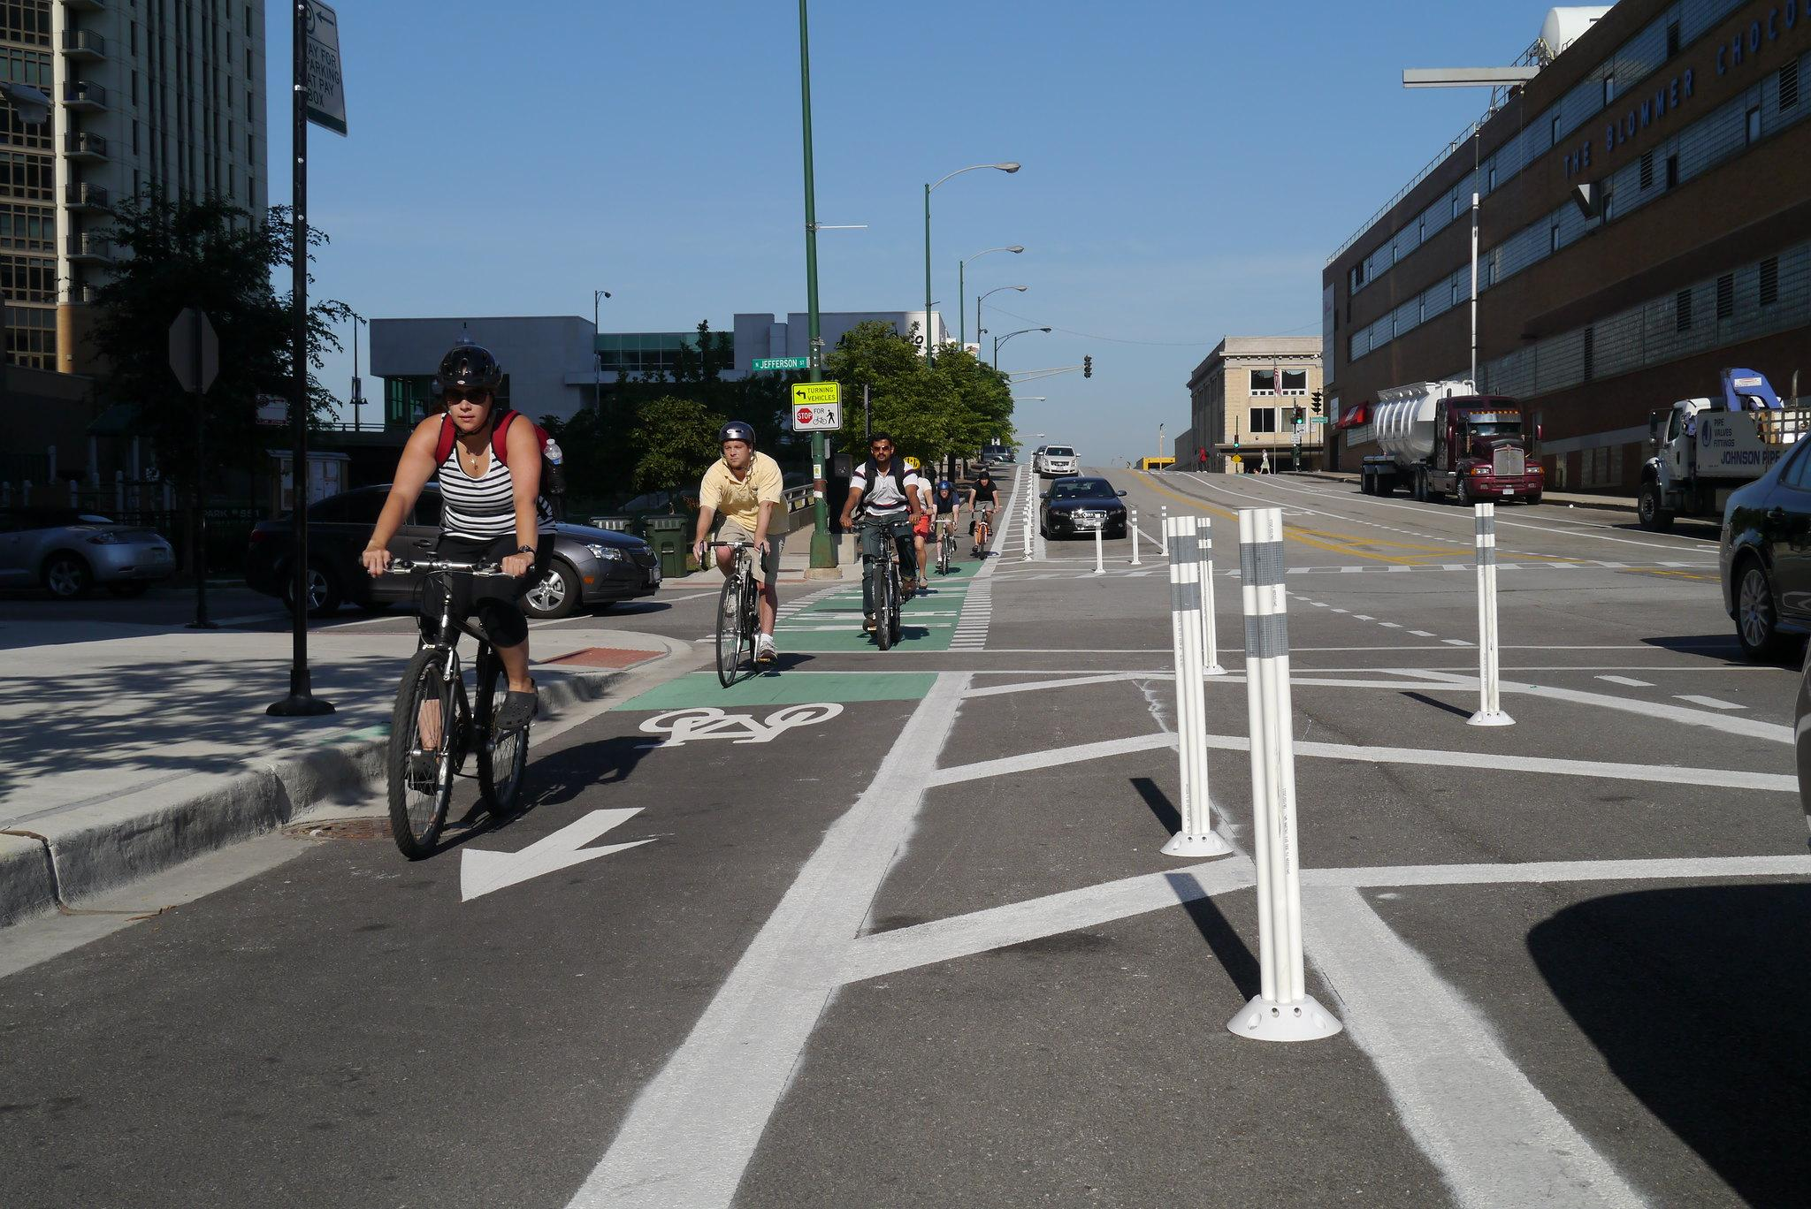
Bike Infrastructure in Chicago
Samantha Goodman
Updated 12/13/21

Slide 2
Guiding Questions
Questions this project attempted to answer were:
Which community areas (neighborhoods) in Chicago have the most bike infrastructure, and which have the least?
Are there areas that show an unmet demand for bike infrastructure?
Can I predict bike infrastructure levels based on demographic data?

Slide 3
Background
Chicago is divided into 77 official “Community Areas”
They typically represent 1-3 neighborhoods grouped together
Why choose Community Areas for my analysis?
Easiest way to convey neighborhood information to typical Chicago residents
More static and concise than Wards

Slide 4
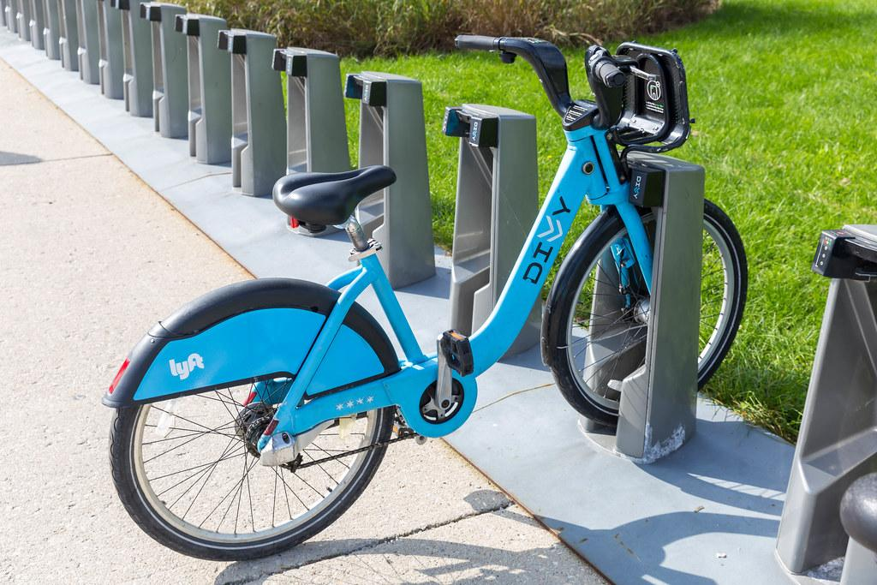
Bike Infrastructure
Bike Lanes
Bike Shops (repair and sales)
Bike Racks
Divvy Stations (bike sharing program)

Slide 5
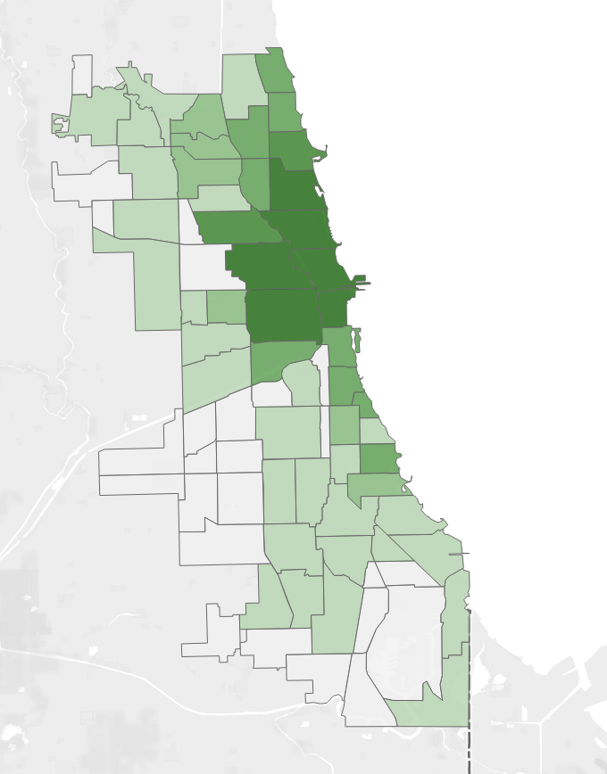
Results
Darker green = higher bike infrastructure score
See Tableau Dashboard for more detailed map [link]

Slide 6
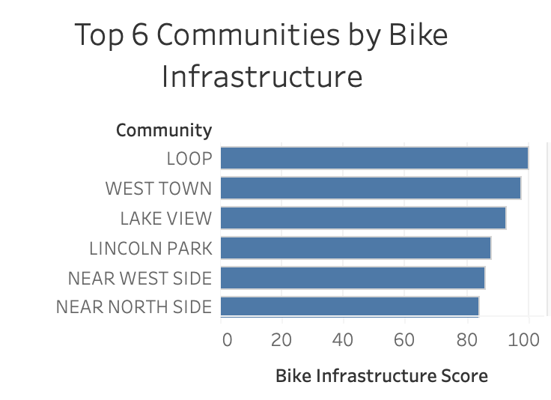
Results

Slide 7
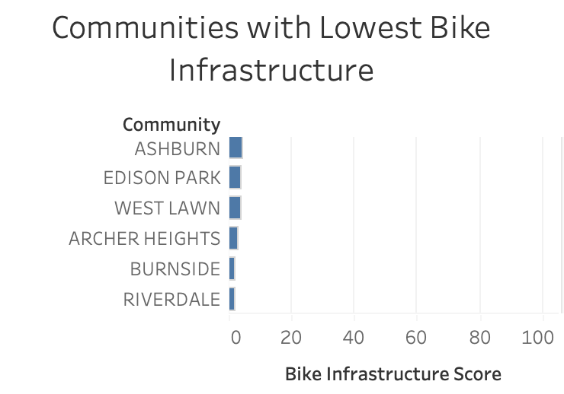
Results

Slide 8
Data Sources and Processing
Source:
City of Chicago
Data Portal
Bike Lanes
QGIS Mapping Software
Added Community Area
Analysis
Python / Tableau
Bike Racks
Divvy Stations
Source:
FourSquare
Bike Shops

Slide 9
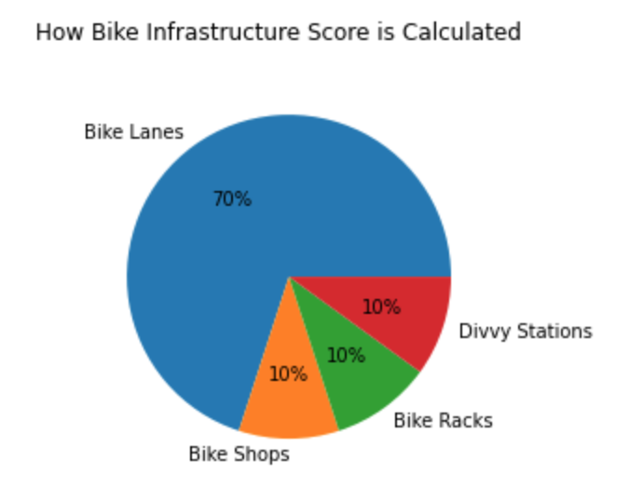
Bike Infrastructure Score Calculation
Bike Lanes were calculated as a percent of total length of street within community area
Bike Shops, racks and Divvy stations were calculated per capita within community area
These calculations were then normalized and combined into a score 0-100

Slide 10
Bike Infrastructure Need Calculation
To calculate comparative need for bike infrastructure, I used Divvy bike trips as a proxy for bike usage within a community
I sampled the Divvy trip data, and used the month of June 2019 for my calculations
[Bike Usage Score] - [Bike Infrastructure Score] = Need

Slide 11
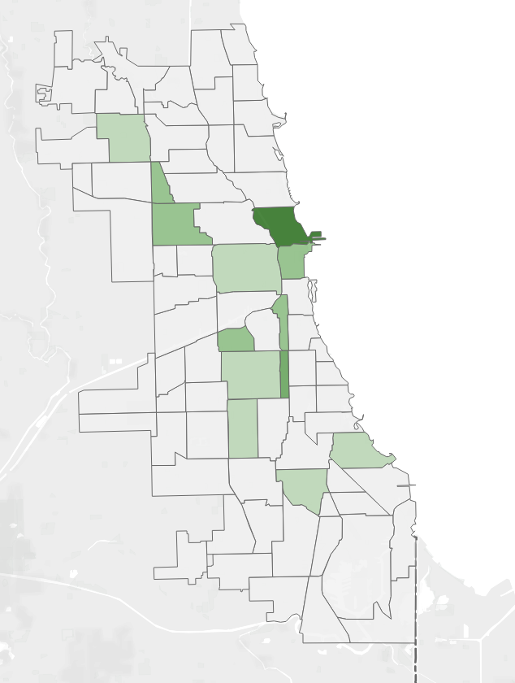
Infrastructure Need Results
Darker green = higher bike infrastructure need score
See Tableau Dashboard for more detailed map [link]

Slide 12
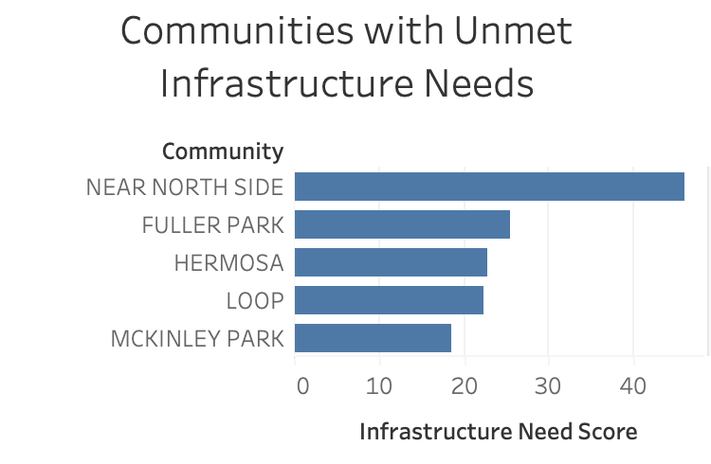
Results

Slide 13
Machine Learning
As machine learning was a requirement of my project, I applied K Means clustering to the community areas using demographic data
The communities were clustered into 4 groups, according to similar demographic data

Slide 14
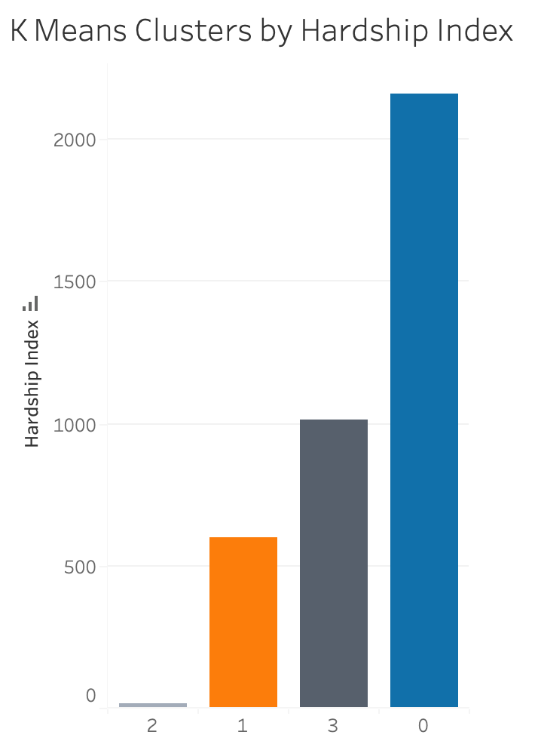
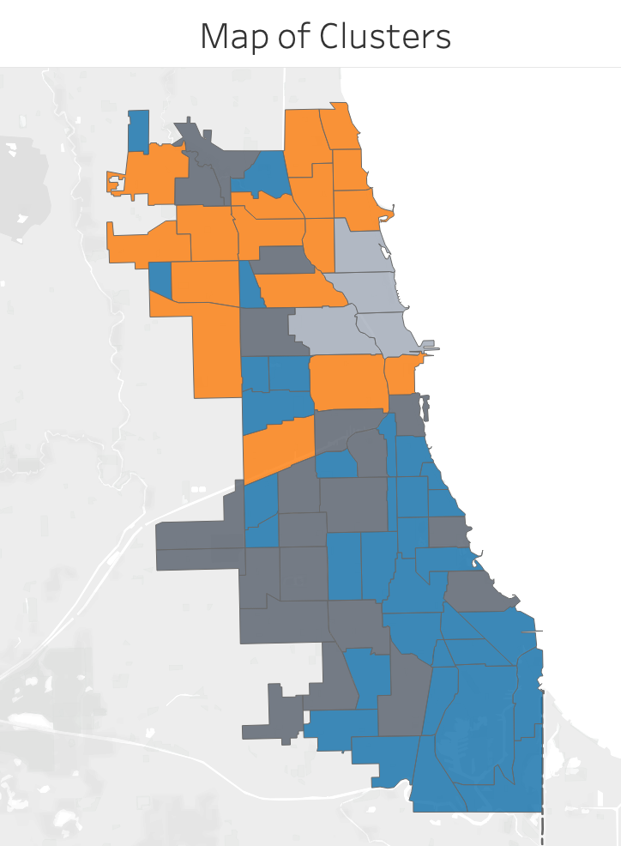
Machine Learning Results

Slide 15
Conclusion
Bike infrastructure is not evenly distributed throughout the city
The neighborhoods on the north side of the city, as well as along the lake, have more bike infrastructure

Slide 16
Conclusion
The Near North Side has a strong need for more bike infrastructure, namely more bike lanes
Other areas (Fuller Park, Hermosa) would benefit immediately from more bike infrastructure

Slide 17
Limitations
No bike lane usage data was available - Divvy trips were used as a proxy, but not all cyclists use Divvy
Bike infrastructure score as calculated in an arbitrary way (based on my experience as a cyclist in Chicago and interviewing others)
Community areas are good for communicating with the public, but aldermanic wards are probably a better way if the goal is to add more bike lanes

Slide 18
Further Directions
Update data are more bike lanes are installed and maps are updated
Analyze data by wards in order to communicate with member of City Council

