Slide 1
Credit One
Data Science Plan of Action
Samantha Goodman

Slide 2
What are the goals?
Improve on the existing model, which is currently rating customers inaccurately, resulting in many loan defaults
Create a new model that will evaluate potential customers accurately, determining if they should receive credit or not, and ideally how much credit to extend to them

Slide 3
What process will I follow?
I’ve chosen to follow Zumel and Mount’s “Framework One” from Practical Data Science with R, chapter 1
It has 6 steps for building a machine learning model

Slide 4
What is the data source?
The data has been obtained from Credit One’s database
It contains 30,000 records from April to September 2005
Included is demographic information (age, sex, education, marriage status)
Also included is credit limit, payment status for those 6 months, bill and payment amounts, and whether customer is in default of the loan or not

Slide 5
How will I manage the data?
The data has been downloaded and is ready for analysis
It will be cleaned (removing any errors or formatting mistakes)
Then I will look for patterns and insights, and then build a model to predict future customer behavior

Slide 6
Are there any issues with the data?
I’ve done some basic cleaning - removing duplicates and extraneous information
There doesn’t appear to be any major missing information or errors

Slide 7
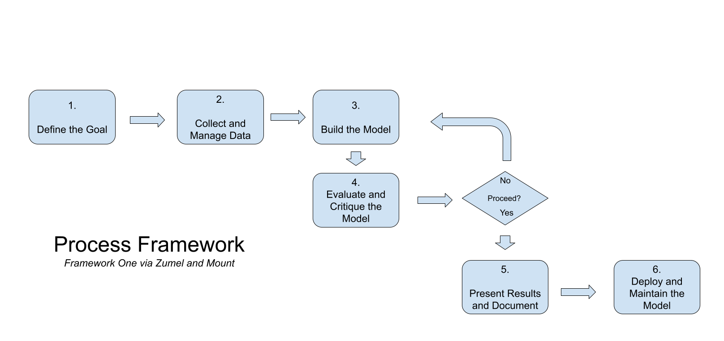
What process will I follow?

Slide 8
What are the initial insights?
At first glance, the age of the customer does not appear to have much effect on default rates
Customers who are in default have a lower credit limit
Older customers have higher credit limits

