Slide 1
UV-vis experiments
Jesse Sutherland
Summer 2024 – Mittermaier lab

Slide 2
Sample: IDJ1
pH: 5 to 8 in 0.5 increments
Wavelengths: 260nm, 295nm
Salt/buffer: KH2PO4/NaOAc(25mM) & KCl(75mM)
Temperature range: 5°C to 95°C
Scan rates: 3,2,1 °C/min

Slide 3
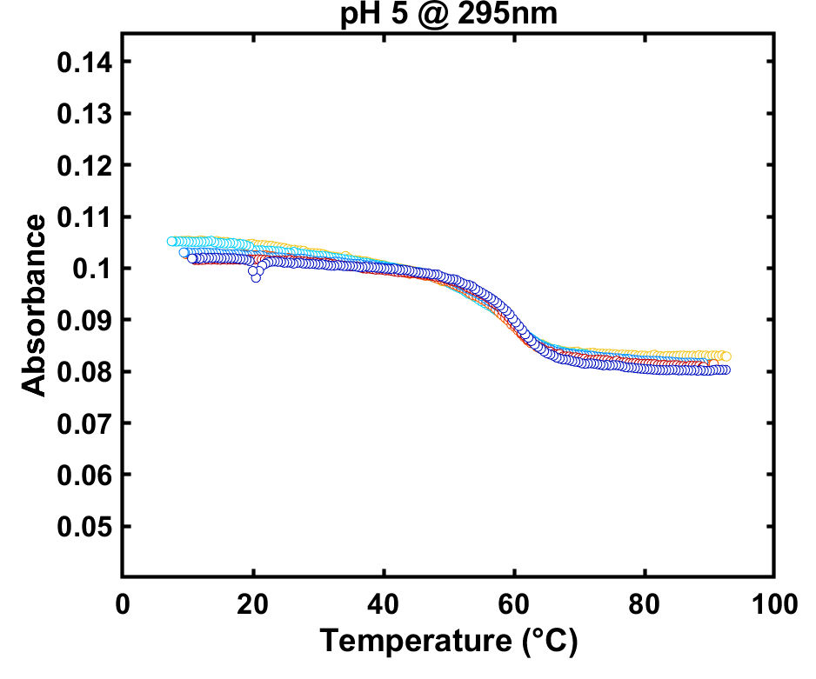
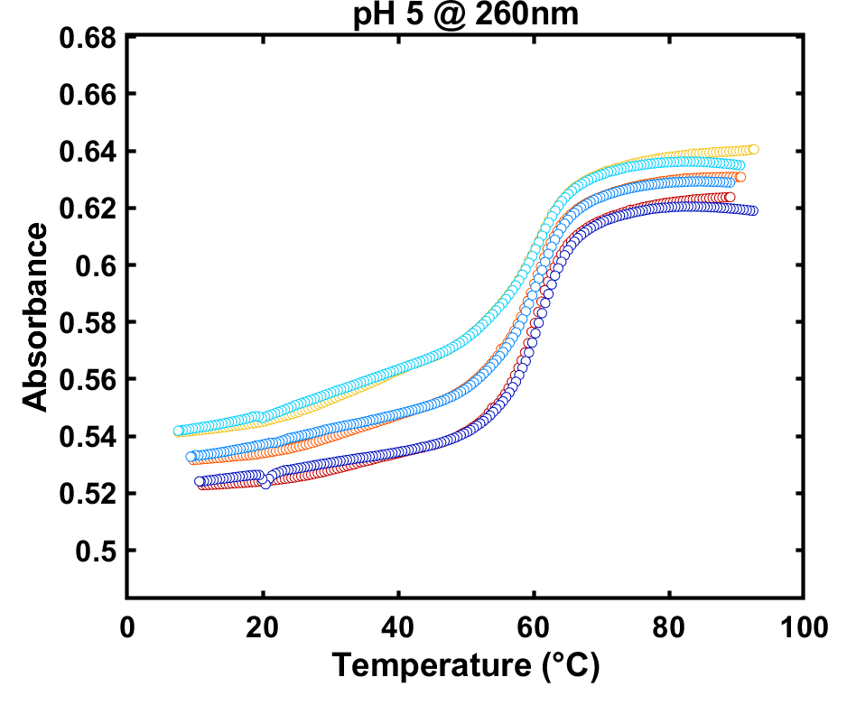
IDJ1 raw data – pH 5

Slide 4
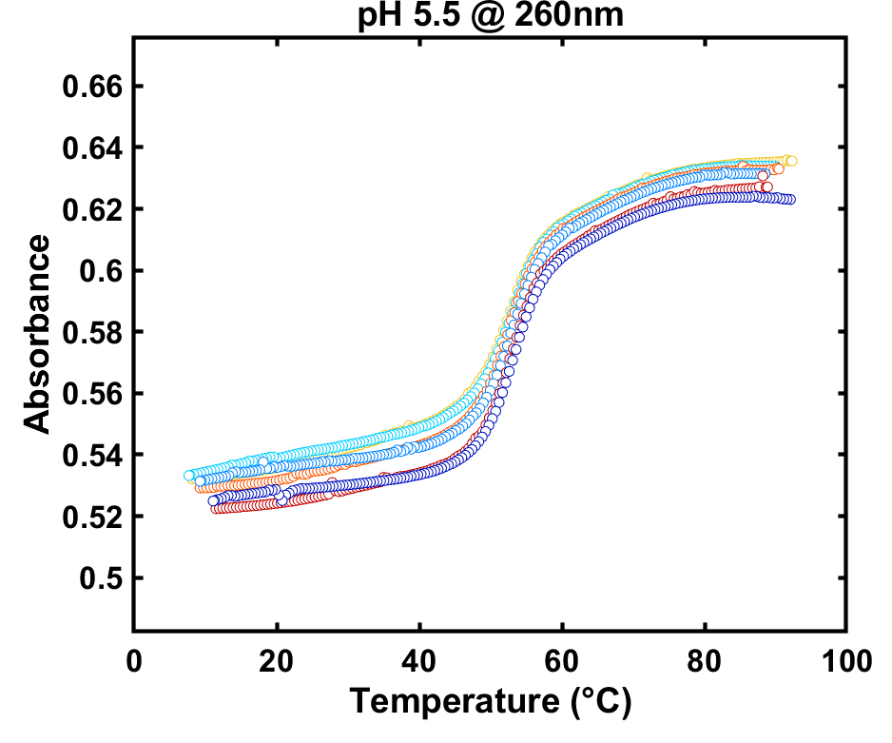
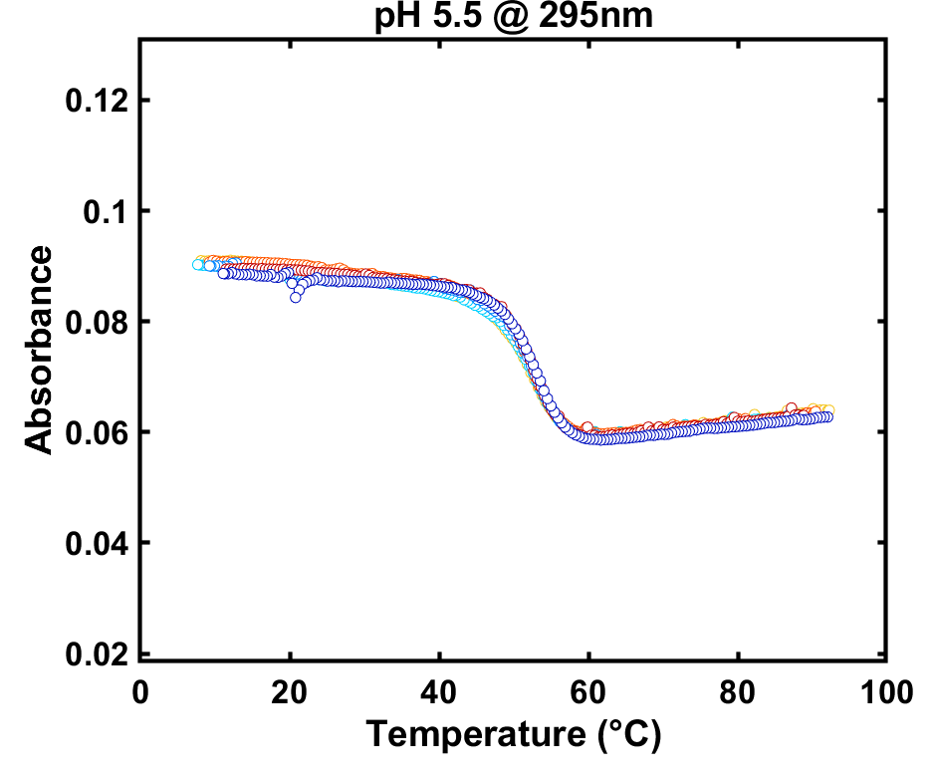
IDJ1 raw data – pH 5.5

Slide 5
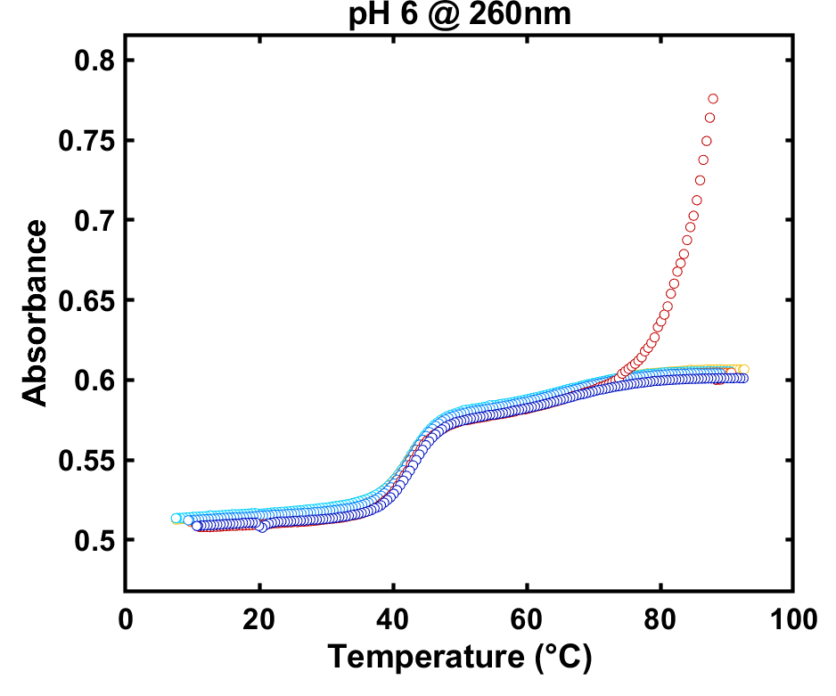
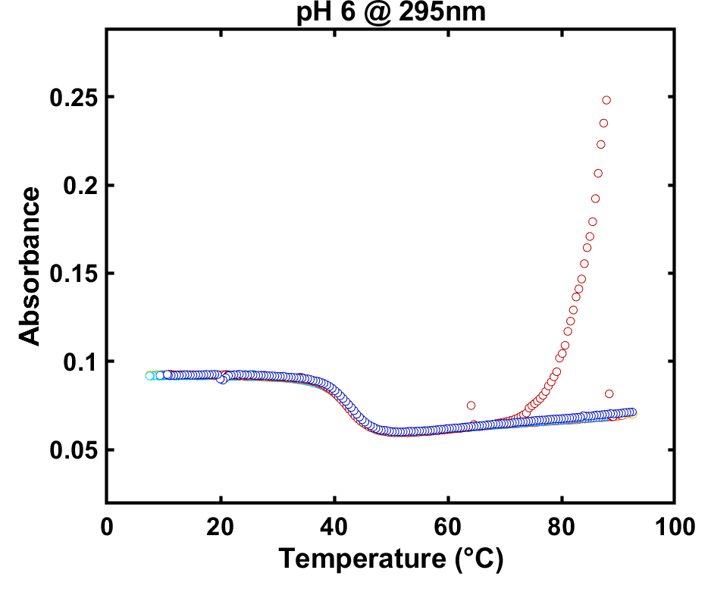
IDJ1 raw data – pH 6

Slide 6
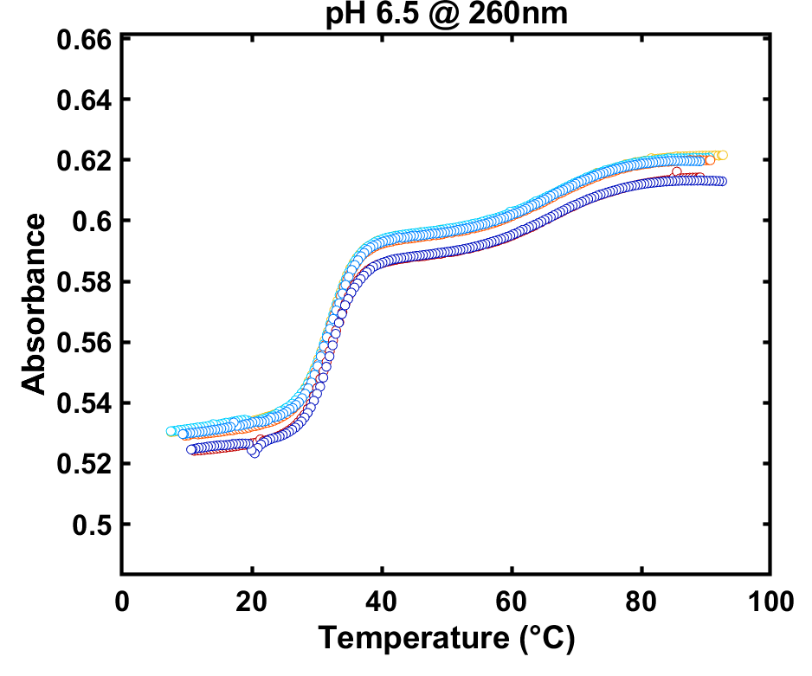
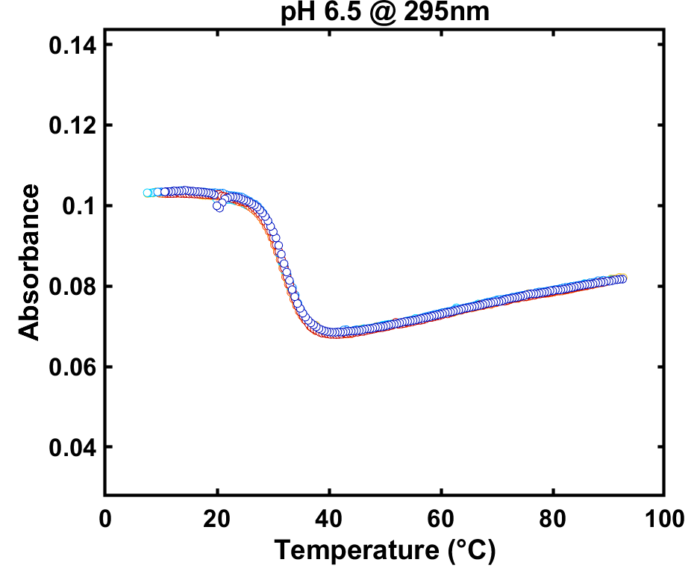
IDJ1 raw data – pH 6.5

Slide 7
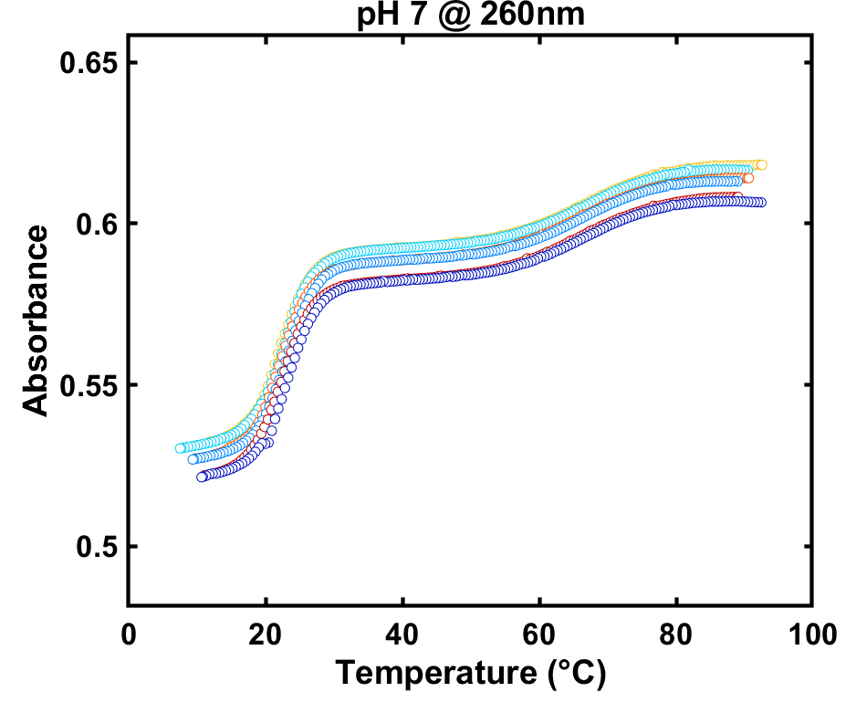
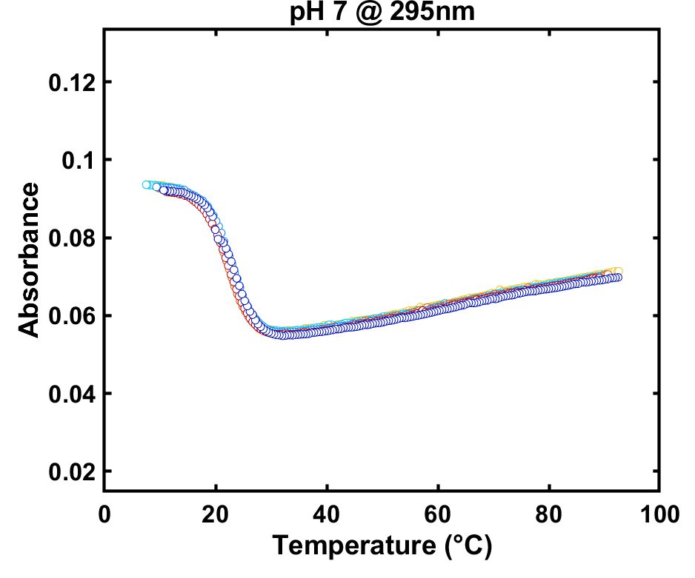
IDJ1 raw data – pH 7

Slide 8
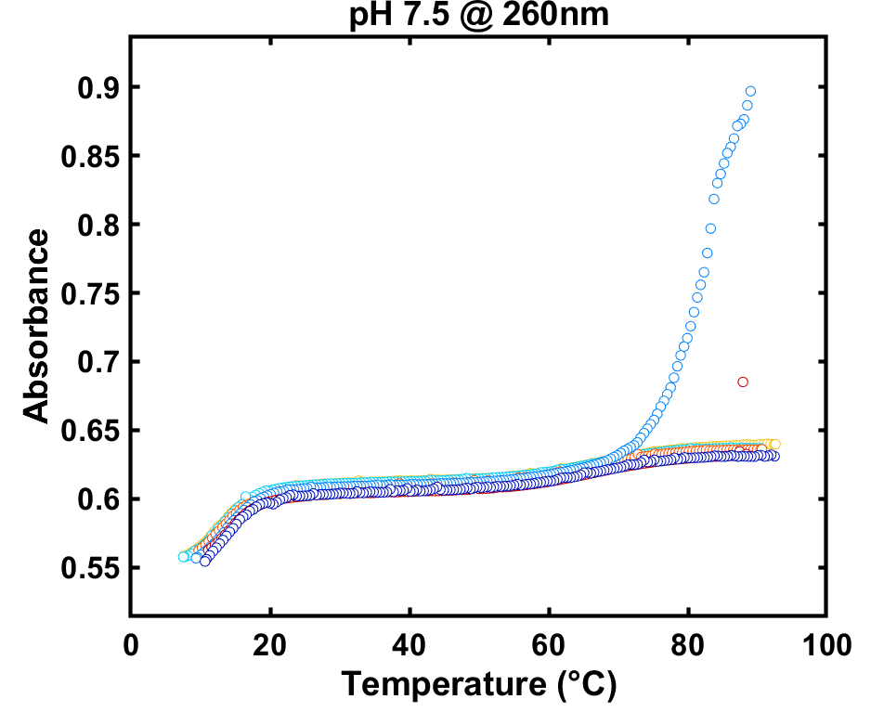
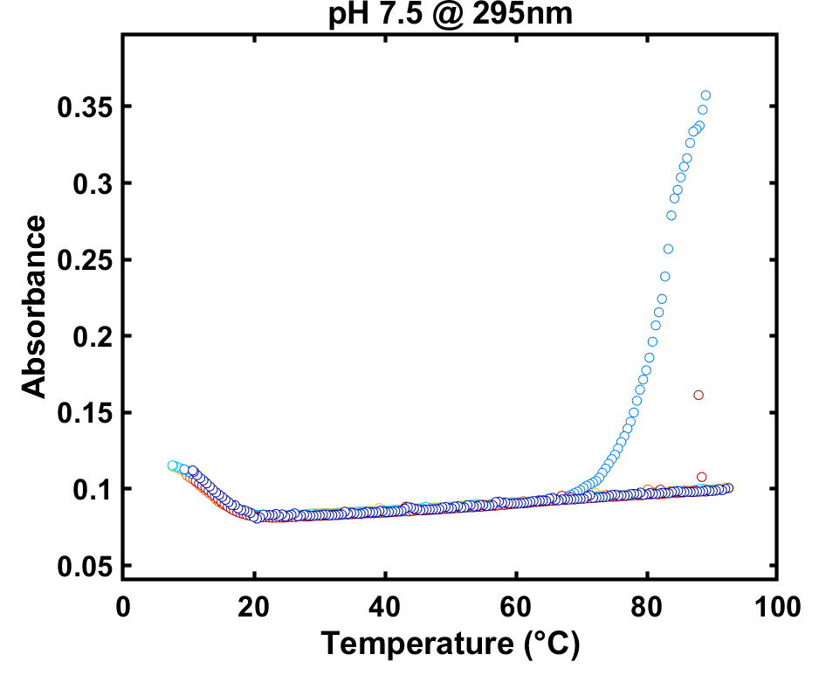
IDJ1 raw data – pH 7.5

Slide 9
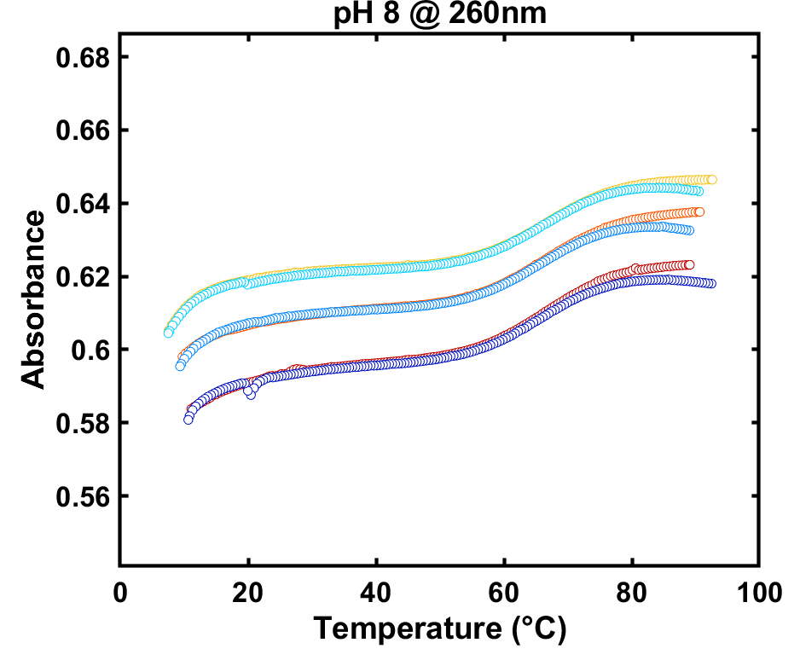
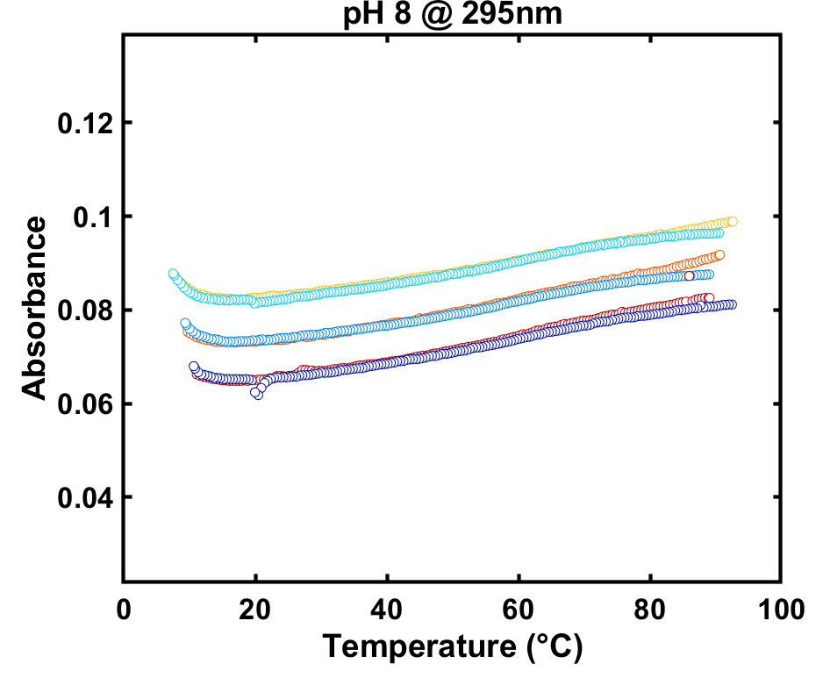
IDJ1 raw data – pH 8

Slide 10
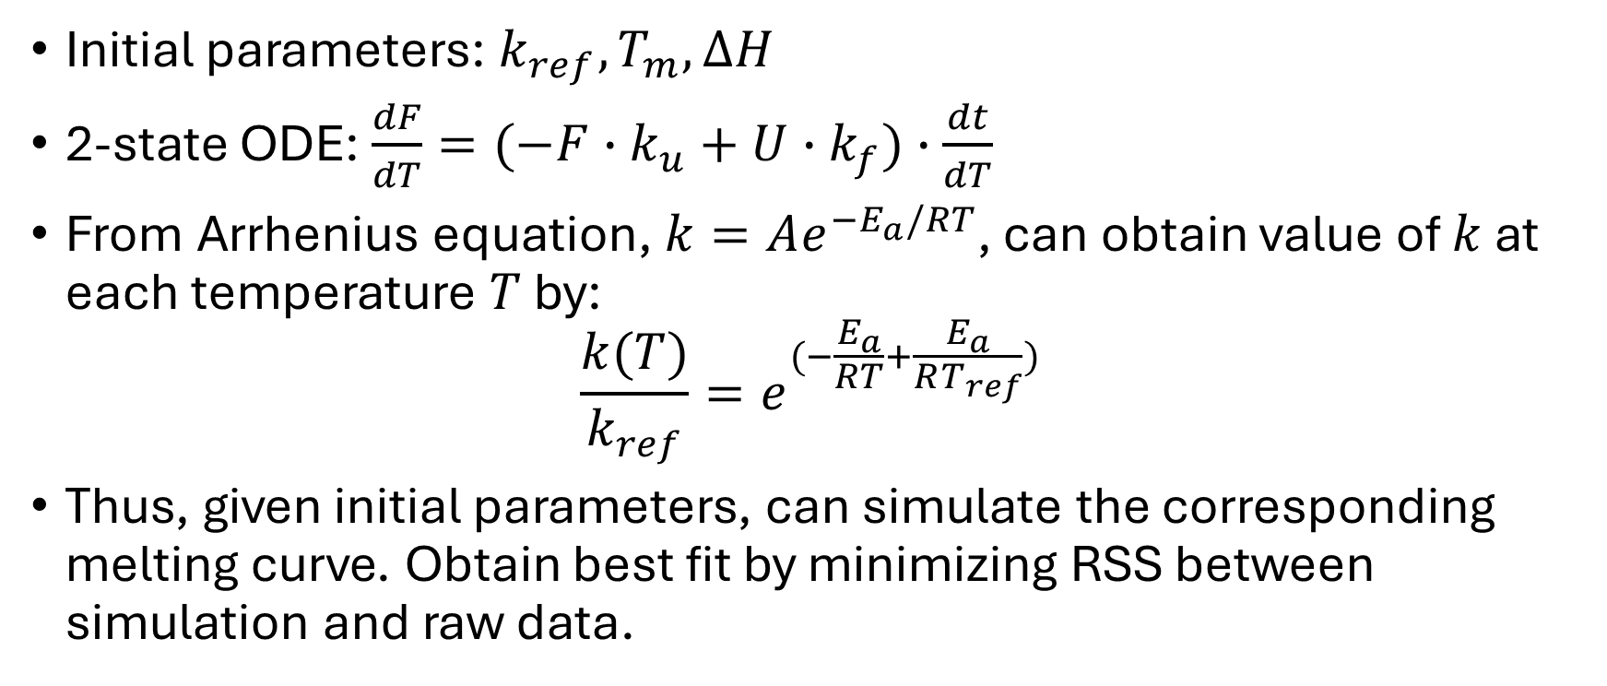
Kinetic fitting
Initial parameters: $k_{ref}, T_{m}, ∆H$
2-state ODE: $\frac{dF}{dT}=(−F∙k_{u}+U∙k_{f})∙\frac{dt}{dT}$
From Arrhenius equation, $k=Ae^{−E_{a}/RT}$, can obtain value of $k$ at each temperature $T$ by:
$$\frac{k(T)}{k_{ref}}=e^{(−\frac{E_{a}}{RT}+\frac{E_{a}}{RT_{ref}})}$$
Thus, given initial parameters, can simulate the corresponding melting curve. Obtain best fit by minimizing RSS between simulation and raw data.

Slide 11
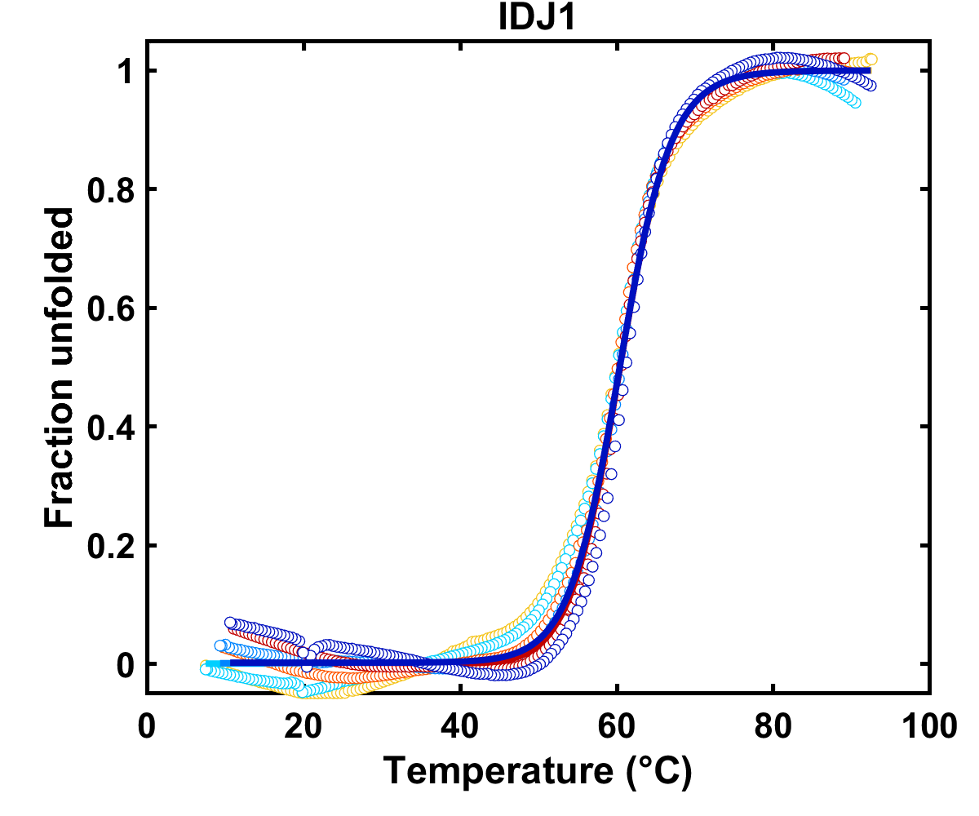
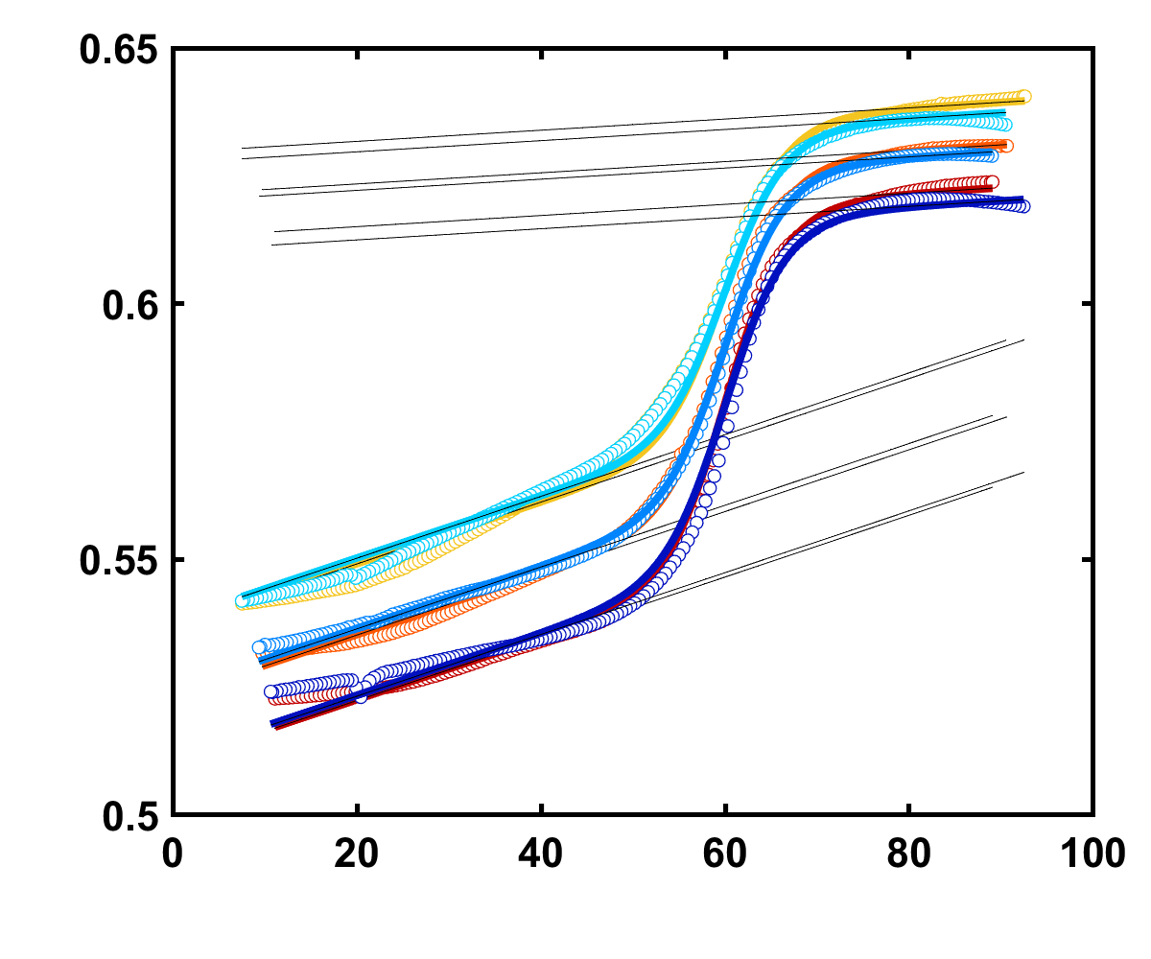
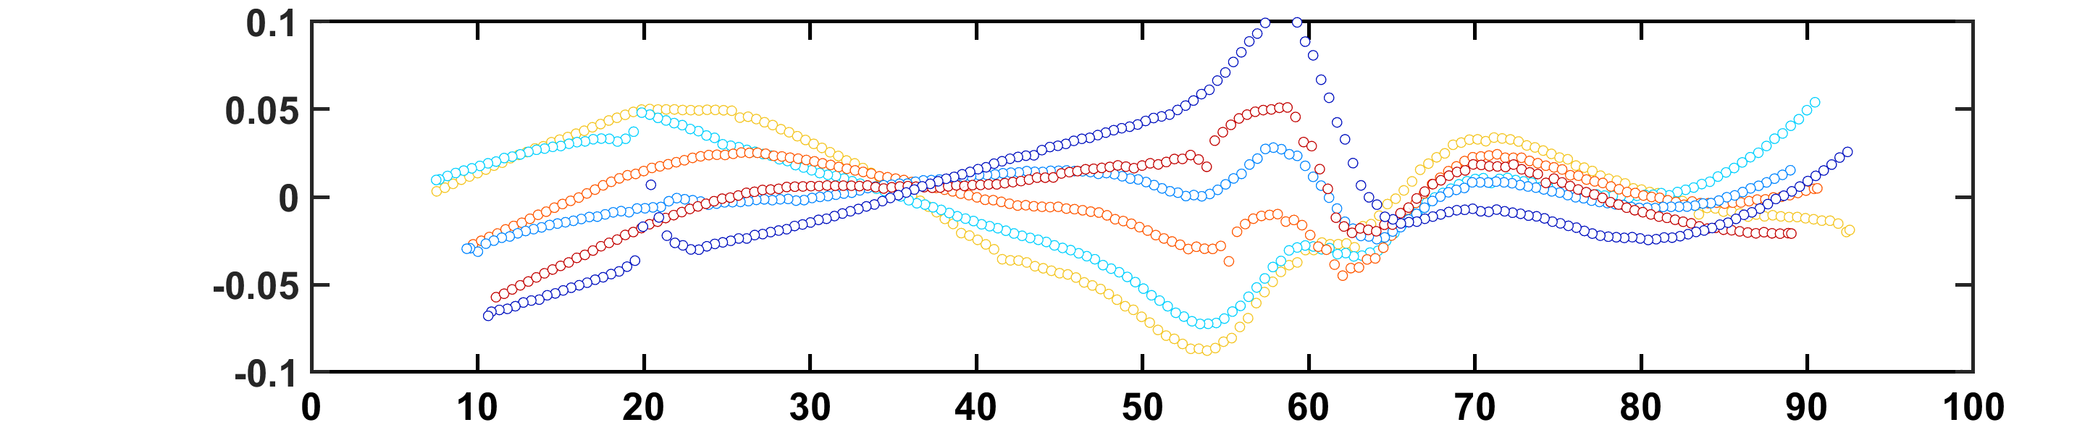
Kinetic fitting example:
Normalized curve
Baselines fitted to raw data
Absorbance
Temperature (°C)

Slide 12
IDJ1 fit results
nm | pH | Tm (°C) | ΔG (kJ/mol) | ΔH (kJ/mol) | ΔS (kJ/mol/K)
260 | 5 | 60.39396 | -283.81 | -0.85089 | -30.1164
295 | 5 | 59.07281 | -250.516 | -0.75406 | -25.6929
260 | 5.5 | 53.10481 | -311.656 | -0.95525 | -26.8472
295 | 5.5 | 52.54999 | -393.512 | -1.20821 | -33.286
295 | 6 | 42.59998 | -371.265 | -1.17582 | -20.6944
260 | 6.5 | 32.13573 | -361.696 | -1.18478 | -8.45425
295 | 7 | 22.75022 | -311.705 | -1.05341 | 2.369943

Slide 14
Folding rate constants
nm | pH | k1 (s^-1) | k2 (s^-1)
260 | 5 | 0.011629 | 6.15E-08
295 | 5 | 2.633137 | 8.30E-05
260 | 5.5 | 1.117284 | 2.21E-05
295 | 5.5 | 28.12226 | 4.14E-05
295 | 6 | 49.54645 | 0.01173
260 | 6.5 | 38.19638 | 1.261304
295 | 7 | 19.56203 | 50.89007

