Slide 1

for Industrial Policy
Data Science

Slide 2
Data Science for Industrial Policy
Introduction to the Project
Understanding the Data
Probability Analysis
Confidence Intervals for Decision-Making
Comparing Industries Using T-Test
Clustering Analysis for Grouping Industries
Predicting Outcomes with Regression Analysis
Building a Growth Strategy with Visualizations
Integrating Insights for Policy-Making
Conclusion & Next Steps

Slide 3

Introduction to the Project
Welcome and Introduction: I’m excited to share my journey in data science, particularly using Python for impactful analytics.
Context of Analysis: This analysis targets industrial policy formulation, focusing on real-world data pertinent to Andhra Pradesh.
Importance of Insights: Extracting insights from data drives informed decision-making, enabling sustainable growth and resource allocation.

Slide 4

Understanding the Data
Data Loading and Preparation: Utilizing Python’s Pandas library, I import CSV data that characterizes various industries in Andhra Pradesh.
Descriptive Statistics Overview: Calculating mean and median workforce sizes reveals central tendencies essential for assessing industry performance.
Implications for Policy-Making: Understanding basic statistics empowers policy-makers to identify underperforming sectors needing targeted support and intervention.

Slide 5

Probability Analysis
Probability Fundamentals: Understanding probability theory provides the foundation for assessing risks associated with industrial growth variability.
Normal Distribution Visualization: Plotting normal distribution visualizes growth rates, showcasing how data points cluster around industry averages.
Risk Assessment Applications: Leveraging these statistical concepts allows decision-makers to predict trends and minimize potential industrial risks.

Slide 6
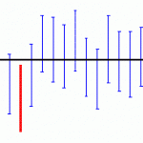
Confidence Intervals for Decision-Making
Understanding Confidence Intervals: Confidence intervals estimate the range around the sample mean for workplace sizes with specified certainty.
95% Confidence Interval Calculation: The code calculates a 95% confidence interval, indicating where the true workforce size likely resides.
Significance for Policy Makers: These intervals reveal variability in workforce sizes, enabling more accurate benchmarks within industrial policies.

Slide 7
Comparing Industries Using T-Test
Hypothesis Testing Overview: The T-test allows comparison of output performance metrics across different industries to identify significant differences.
T-Test Code Snippet: The provided Python code snippet demonstrates executing a T-test for analyzing outputs between Manufacturing and IT.
Understanding T-Statistic and P-Value: A low p-value indicates statistical significance, whereas the t-statistic quantifies performance differences across industries.

Slide 8
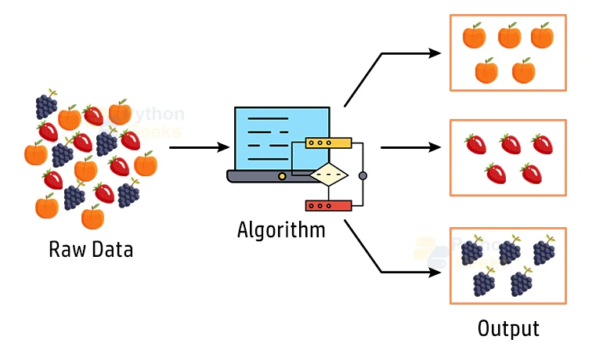
Clustering Analysis for Grouping Industries
K-Means Clustering Introduction: K-means clustering groups industries based on workforce size and output characteristics for targeted analysis.
Scatter Plot Illustration: The scatter plot exhibits clustered data, showcasing industry similarities vital for effective policy decisions.
Resource Allocation Value: Effective clustering supports focused resource allocation, enabling tailored strategies based on industry-specific needs.

Slide 9
Predicting Outcomes with Regression Analysis
Linear Regression Basics: Linear regression uncovers dependencies between workforce size and output, driving better predictive policy strategies.
Training the Model: Python's scikit-learn library was utilized to train the regression model for predicting industrial outputs.
Visualizing Outcomes: The plotted graph illustrates actual versus predicted values, essential for verifying workforce planning accuracy.

Slide 10
Building a Growth Strategy with Visualizations
Data Visualization Significance: Effective visualization clarifies complex data, making insights accessible for quick interpretation and decision-making.
Utilization of Scatter Plots: Scatter plots were employed to visualize industry clusters, highlighting trends and similarities across varied sectors.
Line Graph Insights: Line graphs illustrated regression trends effectively, aiding in understanding the relationship between workforce size and output.

Slide 11
Integrating Insights for Policy-Making
Integrating Analyses: Combining statistics, probability, and regression analysis yields rich insights vital for industrial policy formulation.
Informed Policy Creation: Insights from analyses guide targeted policies, promoting growth by addressing specific industry needs strategically.
Examples of Application: Policies developed utilize statistical predictions and clustering data to optimize resource allocation effectively.

Slide 12

Conclusion & Next Steps
Summary of Recommendations: Data science techniques provided actionable insights, guiding effective industrial growth recommendations for Andhra Pradesh policymaking.
Future Analytical Enhancements: Plans include refining analyses with additional data to enhance accuracy and comprehensiveness of findings moving forward.
Broader Metrics Inclusion: Expanding the scope will integrate environmental and social metrics, promoting holistic policy development for sustainable growth.

