Slide 1

MitoImpute
Mitochondrial DNA reference panel and imputation pipeline
Tim McInerney

Slide 2
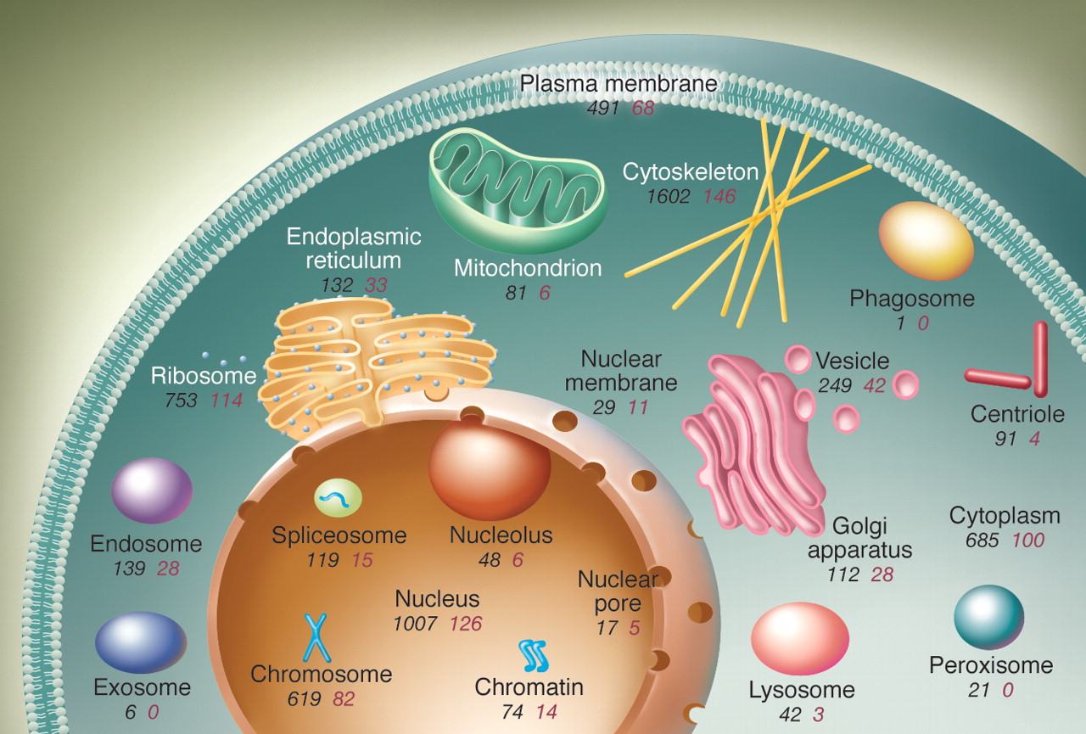
The mitochondrial genome
Genome of mitochondrion organelles found within cytosol of eukaryotic organisms
Genome separate from nuclear genome
Some mitochondrial genes are encoded in nuclear genome
Kurland, et al. (2006) Genomics and the irreducible nature of eukaryote cells. Science 312(5776): 1011-1014.

Slide 3
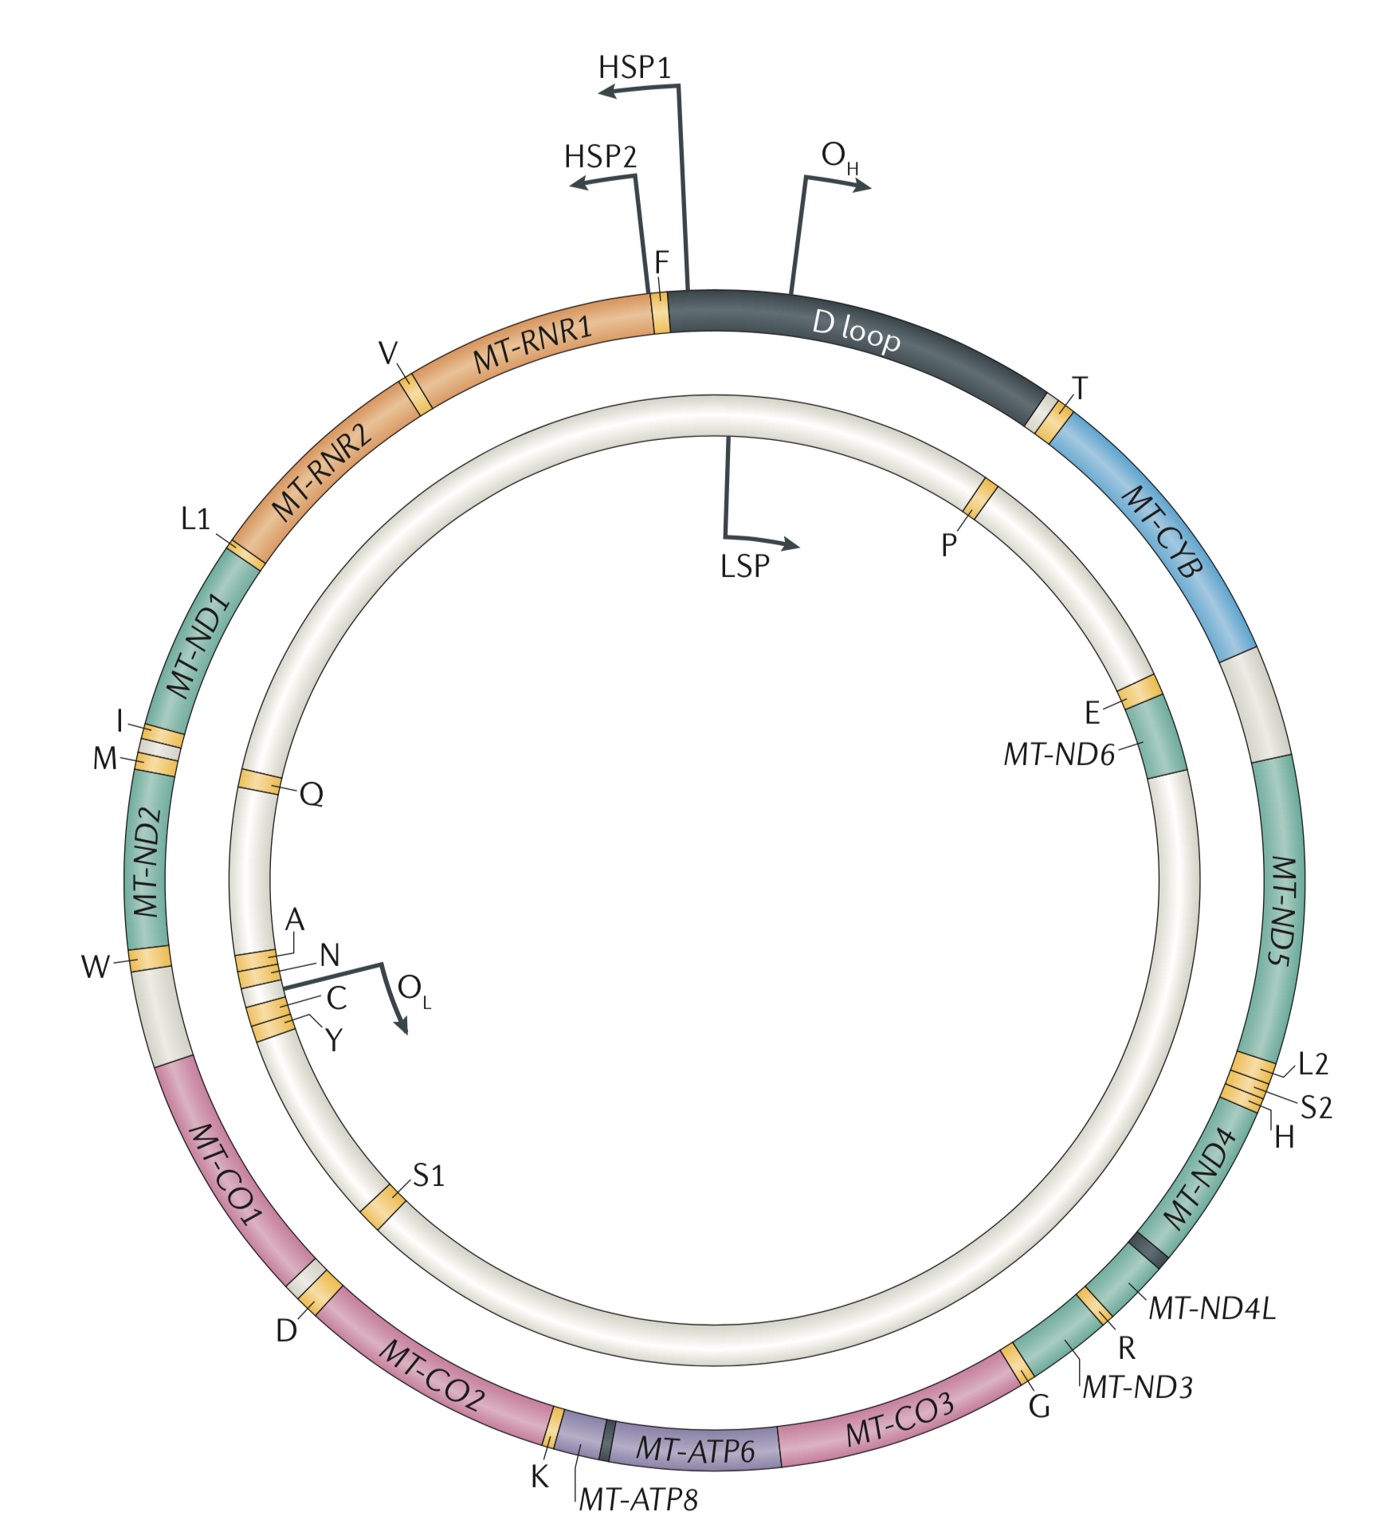
The mitochondrial genome
Circular genome
~16.6kb
Haploid inheritance
Gorman, et al. (2016) Mitochondrial diseases. Nature Reviews Disease Primers 2: 16080.

