Slide 1
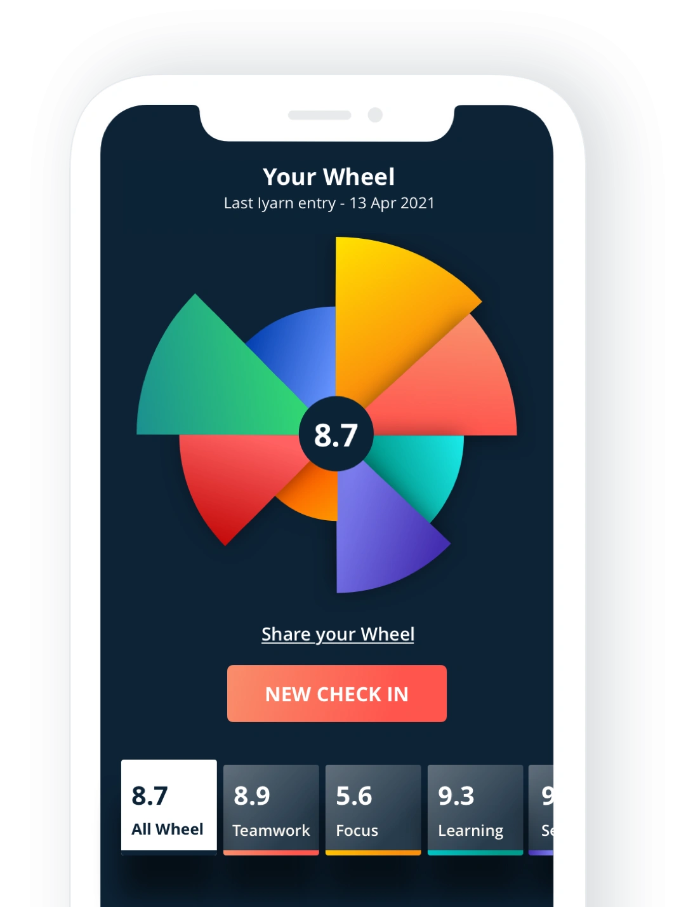

How to “check-in”

Slide 2
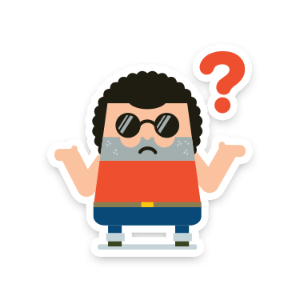
How we’ll check-in
Checking in helps you to understand how you are feelings and connect to others. The iyarn tool helps you do this. It involves:
[ADAPT TO SCHOOL STRUCTURE]:
Giving a rating on 6 questions about wellbeing, and a comment if you like
Twice a week, during home-room time on Tuesdays and Thursdays
Reflecting on how you’re feeling and why; we’ll use the tool and resources to help everyone build skills
Notes:
"Checking in helps you to understand how you are feelings and connect to others.

Slide 3
Why check-in?
Checking in helps you to understand how you are feeling and connecting. You can talk to others or ask for help from your teacher, and access some resources through the tool.
It can help you to:
Reflect on the different parts of your life and how you feel about them.
Learn about the various factors that contribute to how you're feeling.
Identify key learning by reflecting on your ratings over time and drawing on the resources to build your skills.
Notes:
"Checking in helps you to understand how you are feelings and connect to others.

Slide 4
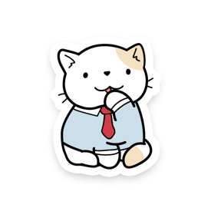
Why check-in?
Remember:
It can be normal for your ratings to fluctuate in some segments for a variety of reasons (e.g., illness, a disagreement with a friend/family member, or an assignment you are particularly struggling with etc.) that happen in everyone’s lives.
Setting goals can help if you identify things you want to change. Use the checking reflections to think about specific goals. The resources help you learn, lift your mood, develop skills, and plan to meet your goals.

Slide 5

How will my check-in scores be used?
Your check-in scores will be used to help your teacher identify areas where you may want additional support and resources that might help.
[INSERT SCHOOL POLICIES RE ACCESS TO CHECK-IN SCORES]:
[e.g., when will a student’s scores be flagged as requiring intervention]
[will any information be shared with parents] etc.

Slide 6
When checking-in
[INSERT CHECK-IN CONTEXT AND ADAPT THESE POINTS FOR YOUR CONTEXT]:
BE HONEST WITH YOURSELF – Check ins are intended to be a safe space for reflection. Consider how you’re really feeling in relation to each of the segments.
RESPECT EACH OTHER – Check ins are about our personal and shared values, people may want privacy to reflect and check in, and sometimes people might want to talk to a trusted friend about things.
LEAVE A COMMENT – Comments can be really helpful to explain why a segment is high or low. This can be useful when looking back over your check ins, or when trying to find a way to get better or identify something that is holding you back.
TRY TO IDENTIFY A KEY LEARNING – From each check in, try to identify at least one thing that you can learn from your scores and comments. For example: my score for “Sleep” was low this week, and that’s something that I can work on for next week.
CHECK IN REGULARLY – Most people get more from checking in if they complete their check ins regularly. Using a regular time can help to make this a habit.
USE YOUR CHECK INS TO IDENTIFY HELPFUL MENTORS – It can really help to have people you trust to talk with. As you identify a particular thing that you might want to develop your abilities, look for someone who can help with that thing. Maybe it’s a friend who has experienced something similar, or a teacher who can do what you’d like to do. Maybe it’s someone older in your life.

Slide 7
Checking-in

Slide 8
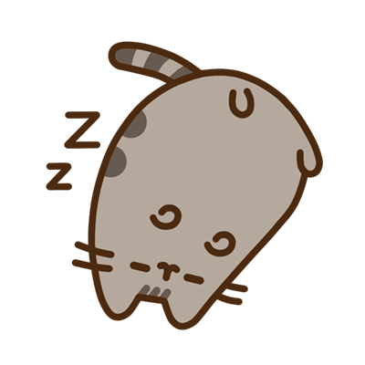
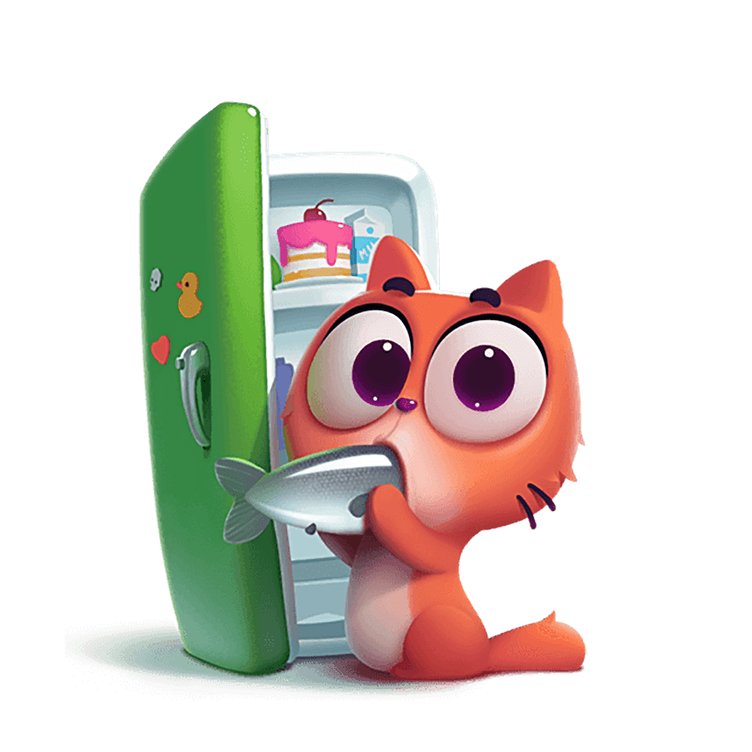
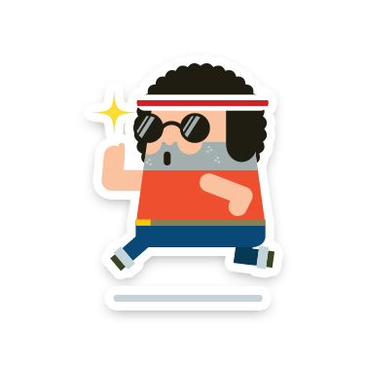
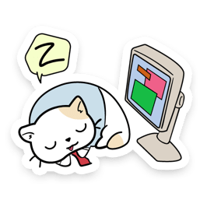
Healthy Body/Be Active
Powerful relationship with mental (+ physical) wellbeing:
Create chemicals that can improve mood (e.g., endorphins)
Increase energy, concentration and confidence – helping you to thrive and pursue your goals!
Work together
Improvements in one area can create improvements in another (e.g., eating well can improve sleep and give you the energy to exercise more!)
Sleep
Nutrition
Exercise
Tech/Life balance
Can be fun
Exercising and eating well, in particular, can become hobbies, and a way of connecting with others. Technologies can also be part of this, as part of a healthy digital diet.
Require balance
(e.g., you can exercise too much, as well as too little; technology can help us connect & learn, but it’s important to have offline moments too)

Slide 9
Healthy Body/Be Active
Try asking yourself:
Do I feel like I am getting the right amount of restful sleep?
Am I eating well and feeling energised?
Am I being active regularly, and in ways that feel good and I enjoy?
Do I spend too much time using digital devices?
Sleep
Nutrition
Exercise
Tech/Life balance

Slide 10
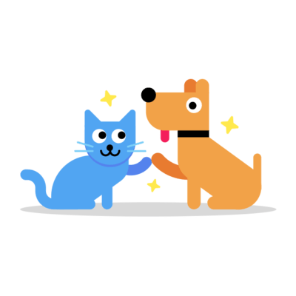
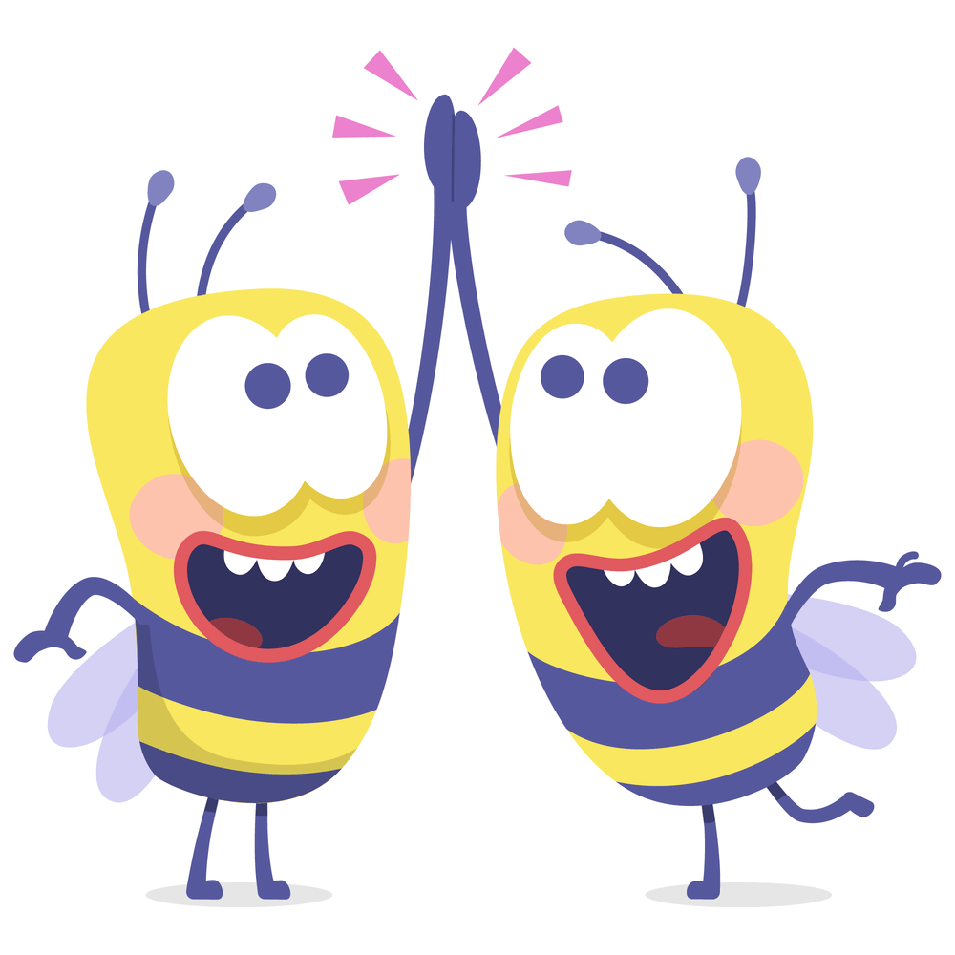
Friendship & Connection
Connection has a positive impact on wellbeing
Healthy relationships can provide support, encouragement, enjoyment, meaning and a sense of ‘connectedness’.
Everyone has different needs
Different people have different social needs and preferences – there is no ‘golden standard’ for the amount or types of relationships you should have in your life.
Friends
Family
Peers
Your relationship with yourself is important!
You spend all of your time with you, and can not expect all of your needs to be met by any single relationship with another person.
Relationships change and fluctuate
It can be normal for your friendships to fluctuate, go through natural transitions, good and not-as-good periods, and take time to develop and build.

Slide 11
Friendship & Connection
Try asking yourself:
Are my relationships contributing to my sense of wellbeing (e.g., am I having fun? Do I feel supported?)
Am I being a good friend to myself?
Am I being good friend to the people in my life (e.g., am I supporting my friends/siblings etc.?)
Friends
Family
Peers

Slide 12
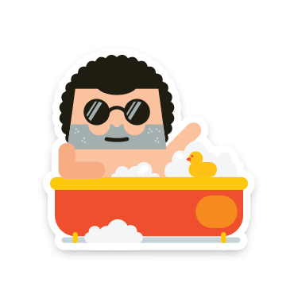
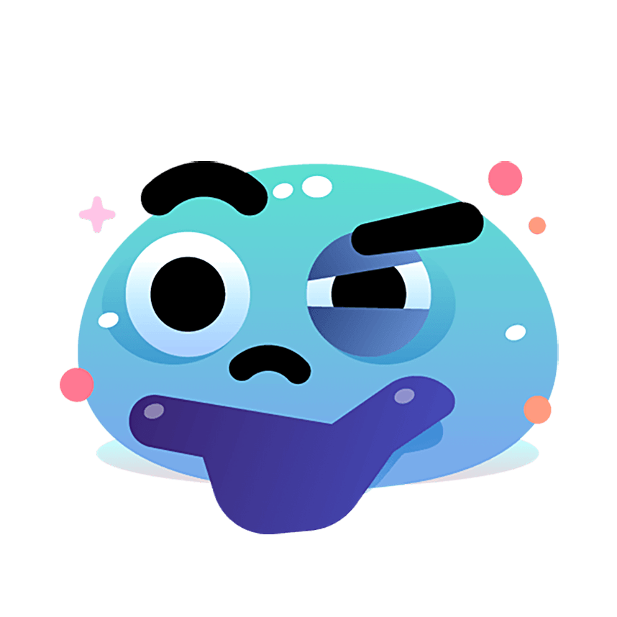
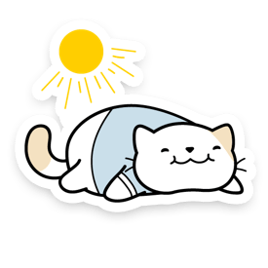
Self-care, Awareness & Positive Emotion
Self-Care & Positive Emotion
Emotional Awareness
Mindfulness
Engaging in activities that make you happy (e.g., listening to music) can improve physical, social and emotional health!
Observing your thoughts and feelings objectively, learning about their evolutionary roots, and accepting them for what they are can help you to better understand yourself and your values, and cope with life’s challenges.
Practising mindfulness and paying attention to the present moment – e.g., by meditating, doing yoga or gratitude journaling – can support emotional awareness and wellbeing.

Slide 13
Self-care, Awareness & Positive Emotion
Self-Care & Positive Emotion
Emotional Awareness
Mindfulness
Try asking yourself:
Am I taking time to relax and do things I enjoy (e.g., having a bath, listening to music)?
Am I listening to myself?
Do I need help to understand my emotions?
Am I taking notice of the world around me?

Slide 14
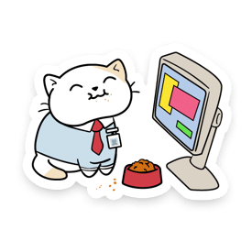
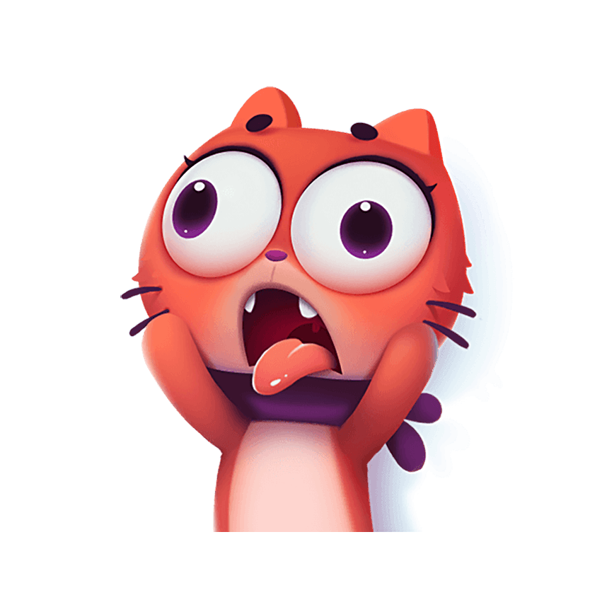
Learning & School
Learning can build confidence
Learning can improve your knowledge, thinking skills and capability to do what is important to you! This can make you feel more confident and help you better connect with others.
Learning interests
Workload
Exam stress
People learn about different things
Different individuals have different interests when it comes to learning and time management. Staying focused and interested all the time can be hard!
So, if you are feeling frustrated and unmotivated by schoolwork, it may be that trying something new, or going back to an old interest will help.
Learning can help you learn about yourself!
What you learn and do at school can help you to understand what you want to do with your life, and develop the skillsets needed to actually do it.

Slide 15
Learning & School
Learning interests
Workload
Exam stress
Try asking yourself:
Am I feeling stressed and overwhelmed by schoolwork, assignments or an upcoming exam?
Do I think I feel confident managing my workload?
Am I feeling capable and motivated in my learning?

Slide 16
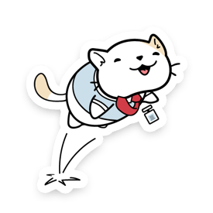
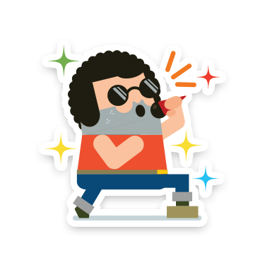
Growth, Challenge & Passion
Goal Setting can help you grow and improve your confidence
Working toward realistic goals in areas that matter to us can challenge us to move beyond our comfort zones and develop new skills, expose us to opportunities that allow us to thrive and grow, and improve our self-esteem and sense of accomplishment.
Goal Setting
Self-Development
Challenge
Passion & Hobbies
It can be hard to figure out what you are passionate about
Whilst some people are exposed to and, therefore, find the activities that they are passionate about early on in life, others are not as lucky. If you can not think of an activity like this in your life, that does not necessarily mean you “lack passion” but that you should keep searching for it by trying out lots of different activities where you can.
Hobbies and passions can contribute purpose and meaning to our lives
Engaging with activities that we are passionate about (e.g., art, music, sport, coding, volunteering etc.) can bring us innate satisfaction or ‘flow’, and contribute to our sense of meaning and purpose in life.

Slide 17
Growth, Challenge & Passion
Try asking yourself:
What am I passionate about?
Am I engaging in activities that inspire and motivate me?
Am I challenging myself to try new things and develop new skills?
Are there any goals I want to work toward?
Goal Setting
Self-Development
Challenge
Passion & Hobbies

Slide 18
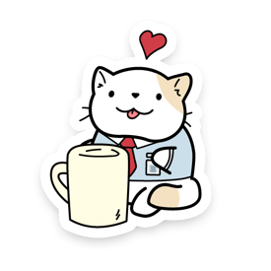
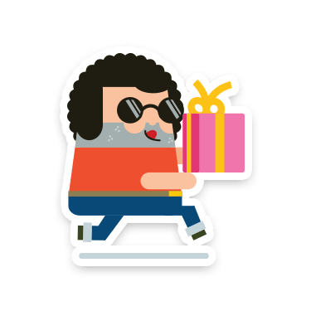
Giving Back & Community
Giving back to others also gives to yourself
Giving back is associated with a number of individual benefits, including positive emotions, improved self-esteem and feelings of competence
Gratitude
Reciprocity
Giving Back
Spirituality
Community is important for your wellbeing
Your place in your community and the ‘broader’ relationships in your life (e.g., with peers, neighbours, or team members) can support your sense of familiarity, connectedness and self-worth. These relationships may even grow into friendships, or provide you support in times of crises.
Giving back can improve your connections with others
Giving back is also associated with supporting trust and social bonding.

Slide 19
Giving Back & Community
Gratitude
Reciprocity
Giving Back
Spirituality
Try asking yourself:
What do I feel grateful for?
Do I understand how my community contributes to my life and wellbeing?
Do I feel like I am giving back to my community, in the ways that I can?

