Slide 1
Responsible AI Audit of Social Media Recommendation Systems
Case Study: YouTube Recommendation Ecosystem
Understanding algorithmic bias and fairness issues in large-scale social media recommender systems.
Author
Sambhav Jain

Slide 2
Why Recommendation Systems Matter
Social media platforms rely heavily on AI-driven recommendation systems to personalize user content.
These systems determine:
Which videos appear in feeds
Which creators gain visibility
Which information spreads widely
3.8B+
Algorithms strongly influence public discourse and information exposure
Daily social media users
Ethical Concern
70%
Maximizing engagement does not always maximize user well-being.
Algorithmic optimization can unintentionally lead to:
YouTube watch time driven by
recommendations
Polarization
Content amplification bias
Inequality among creators

Slide 3
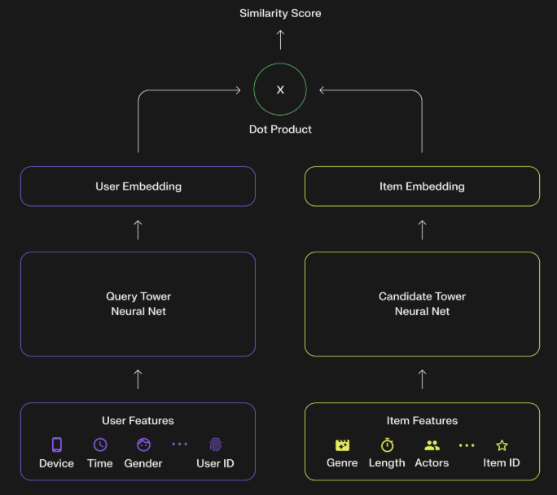
Two-Tower Recommendation Architecture
Modern large-scale recommender systems use a Two-Tower neural architecture to efficiently match users with relevant content.
User Tower
User behavior is converted into numerical embeddings using:
Watch history
Likes and subscriptions
Interaction patterns
Item Tower
Encodes video information into an embedding vector using:
Title and description
Tags and categories
Video metadata
Engagement statistics
Matching & Ranking
The system computes similarity between:
User embedding ↔ Video embedding
Retrieved candidates are ranked based on:
Predicted engagement
Recency
Diversity
Fairness constraints
The final output becomes the personalized recommendation feed.

Slide 4
Real-World Ethical Failures of Recommendation Systems
Multiple studies have documented algorithmic harms in social media platforms.
YouTube Radicalization Pathways (Ribeiro et al., 2019)
Recommendation systems often guided users from mainstream videos to increasingly extreme content through
engagement optimization.
Facebook Algorithm Amplification (WSJ Files, 2021)
Internal reports showed algorithms prioritized anger-inducing content because it generated higher engagement.
TikTok Content Suppression (Bandy & Diakopoulos, 2021)
Moderation policies suppressed visibility of creators based on appearance, disability, or perceived vulnerability.
Twitter Political Amplification (Twitter Engineering, 2021)
Analysis showed political content amplification asymmetry across ideological groups.

Slide 5
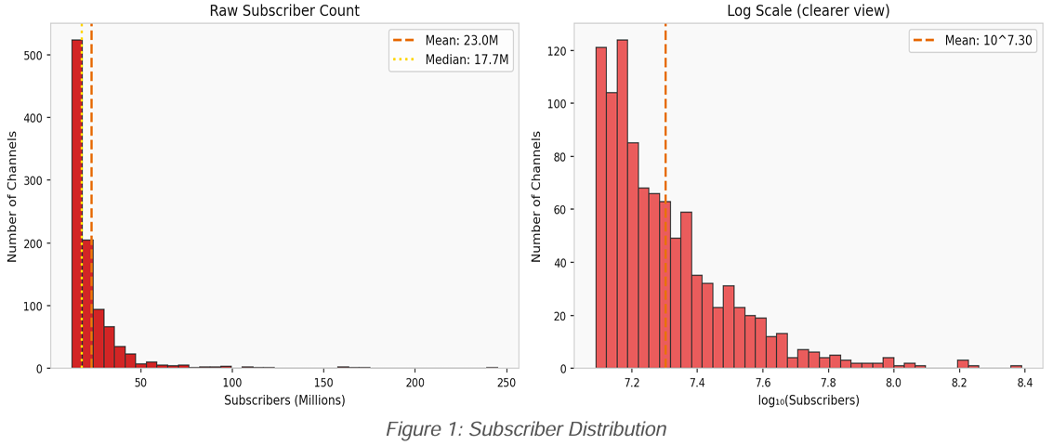
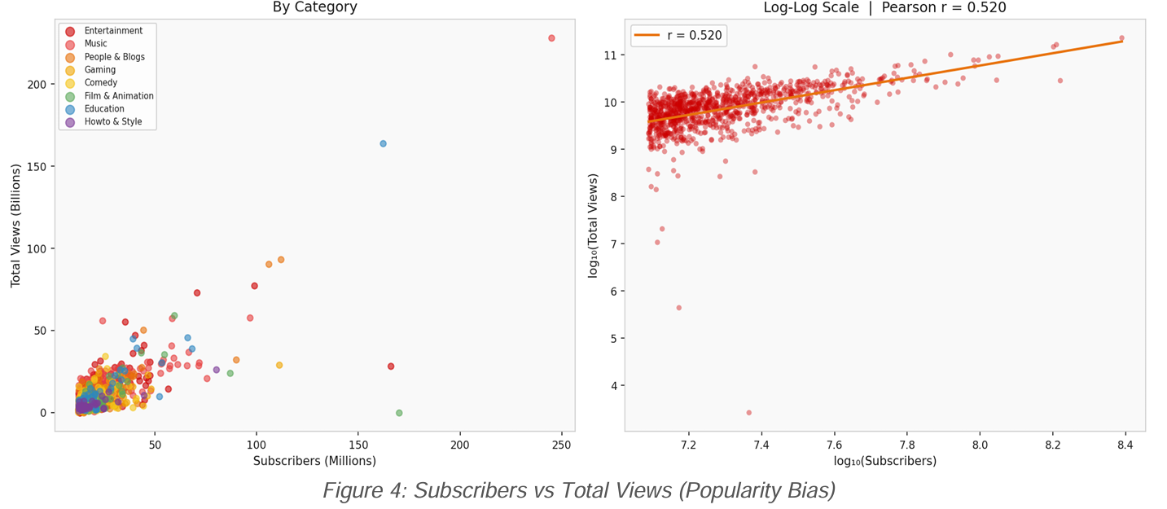
Exploratory Data Analysis
Dataset Overview
995 top YouTube channels
47 countries represented
28 platform features analyzed
Popularity Bias in Recommendation Systems
Subscriber distribution is heavily right-skewed.
Example:
T-Series: ~245M subscribers
Median channel: ~17.7M
High subscribers → more recommendations → more views → more subscribers
This creates a self-reinforcing feedback loop.
The correlation between subscribers and total views is r ≈ 0.7, confirming the Matthew Effect (“rich get richer”)
Smaller creators struggle to gain visibility even if their content quality is high.

Slide 6
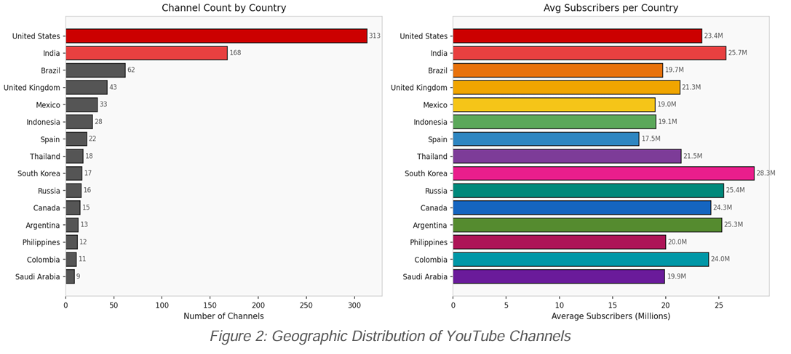
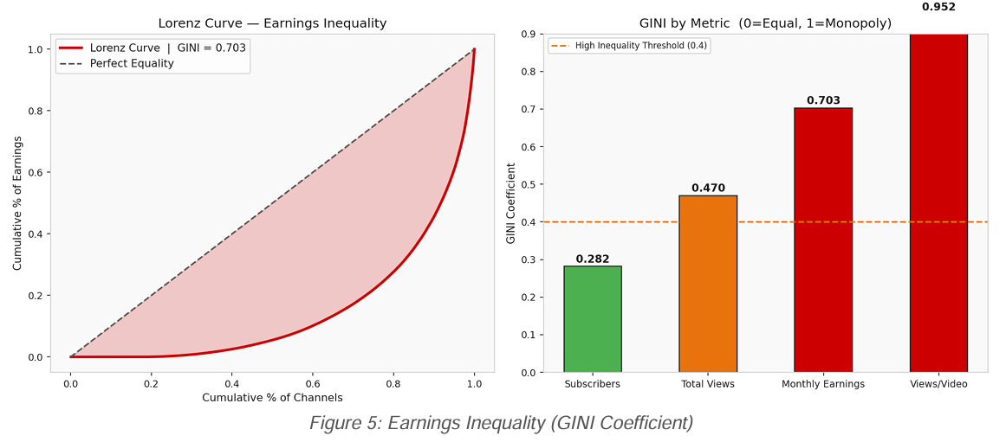
Geographic Bias in the YouTube Ecosystem
The United States dominates top channels.
35.9% of channels are from the US
US population share globally: ~4.2%
Many regions such as Saudi Arabia are under-represented
Algorithms may be optimized around English-language user behavior.
Creators from the Global South face structural disadvantages.
Earnings Inequality Among Creators
We measured inequality using the GINI coefficient. (GINI = 0.703)
Interpretation:
0 → perfect equality
1 → extreme inequality
A value above 0.5 indicates severe concentration of wealth.
The top 10% of channels earn a disproportionate share of revenue.
This suggests that the platform's recommendation algorithm amplifies a small elite group of creators.
Extreme inequality discourages diversity in content creation.

Slide 7
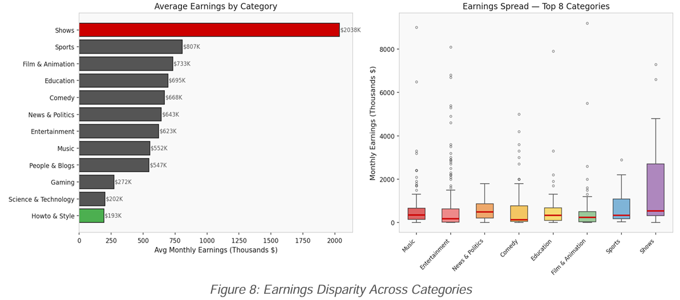
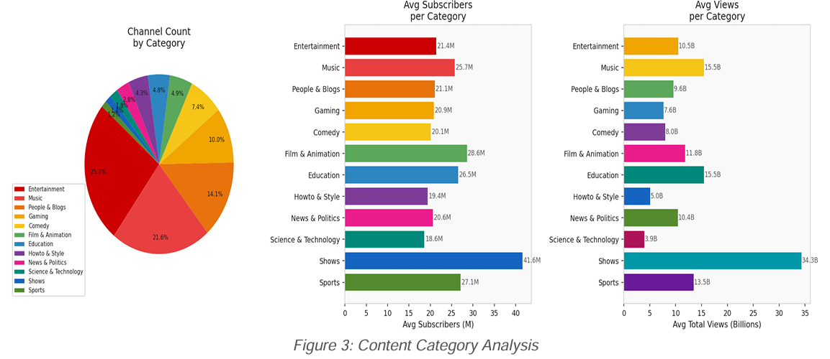
Earnings Disparity Across Categories
Shows category has the highest average monthly earnings.
Entertainment and Sports also generate significant revenue.
Education and Science categories earn much less comparatively.
Indicates financial bias toward entertainment content.
Content Category Analysis
Entertainment and Music dominate top YouTube channels.
Shows category has the highest average subscribers.
Educational and science channels have lower visibility and views.
Suggests engagement-driven algorithm preference.

Slide 8
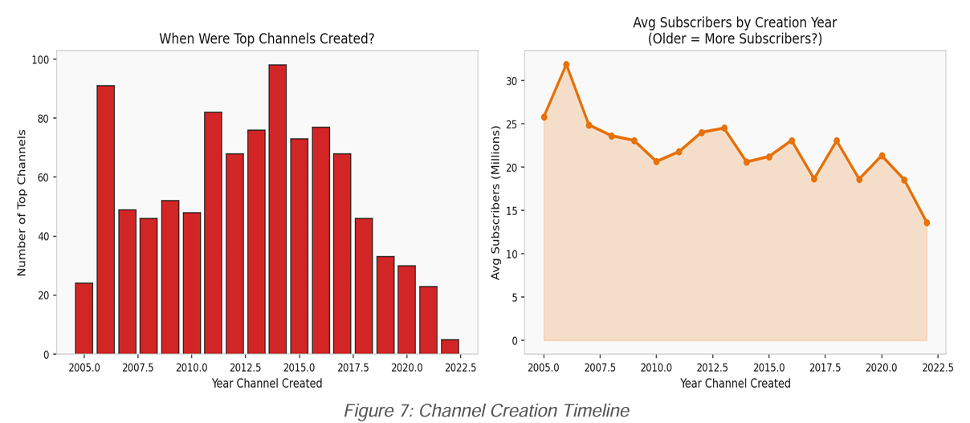
Channel Creation Timeline
Most top channels were created between 2006–2015.
Very few new channels appear among top creators.
Older channels generally have higher subscriber counts.
Demonstrates first-mover advantage in recommendations.

Slide 9
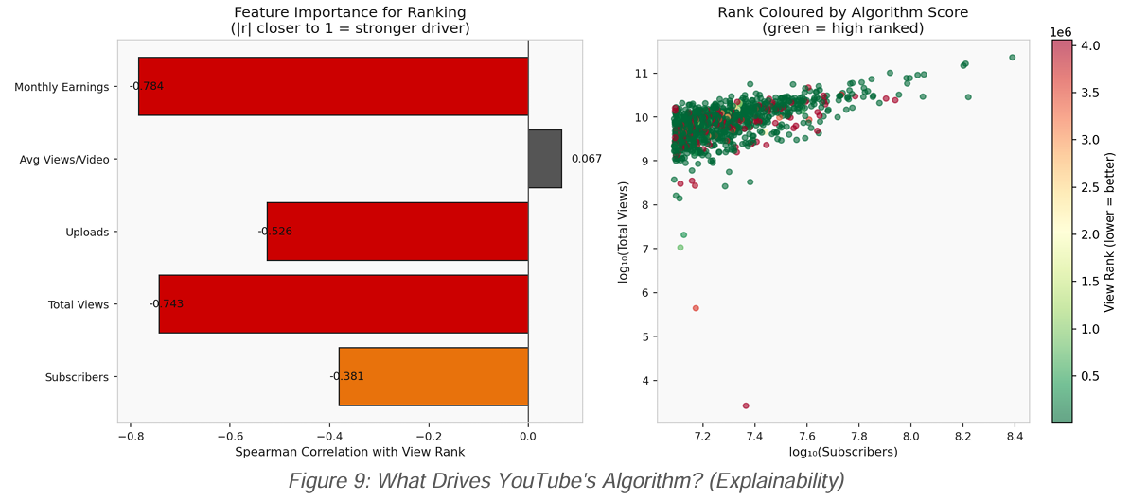
Algorithm Explainability Analysis
What the Plot Shows
Analyzes which features influence YouTube channel ranking.
Uses correlation with view rank to estimate feature importance.
Scatter plot shows relationship between subscribers, views, and ranking.
Key Findings
Total views and subscribers are the strongest predictors of rank.
Channels with higher subscribers and views consistently rank better.
Upload frequency and views per video have much weaker influence.
Indicates the algorithm favors existing popularity over content quality.
Responsible AI Concern
Ranking factors are not transparent to creators.
Lack of explainability makes it hard to understand or improve rankings.
Raises concerns related to algorithmic transparency and fairness.

Slide 10
Responsible AI Solutions
To mitigate bias, several Responsible AI methods can be applied.
Bias Type | Metric Found | Severity | Recommended Fix
Popularity Bias | Subscribers strongly influence ranking | HIGH | Diversity-aware re-ranking
Geographic Bias | US channels = 35.9% of top channels | HIGH | Country diversity quota in Top-K results
Earnings Inequality | GINI coefficient > 0.5 | CRITICAL | Add inequality penalty in ranking loss
Category Bias | Educational content earns less than entertainment | MEDIUM | Category fairness weighting
First-Mover Bias | Older channels dominate top rankings | MEDIUM | Recency boost for new creators
Explainability Gap | Ranking drivers not transparent | HIGH | SHAP-based explanation for rankings
Data Privacy Issue | 12.3% channels missing country data | MEDIUM | Federated learning for metadata

Slide 11
QnA

Slide 12
Thank You

