Slide 1
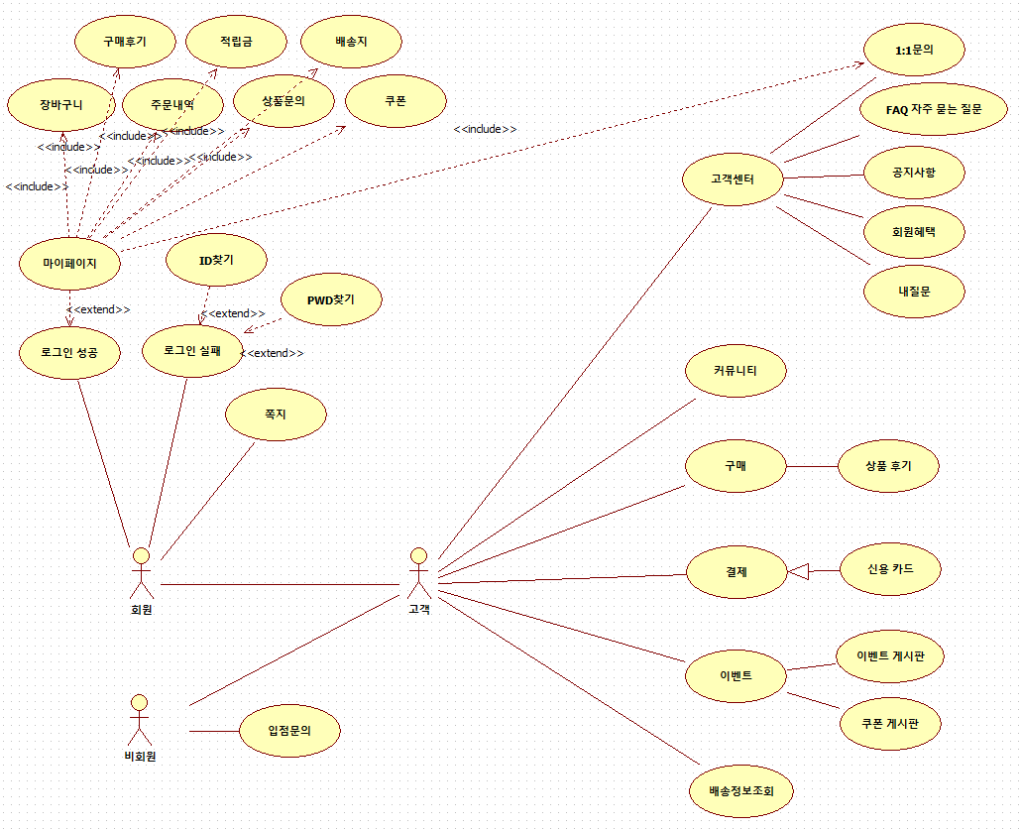
Use Case Diagram - User

Slide 2
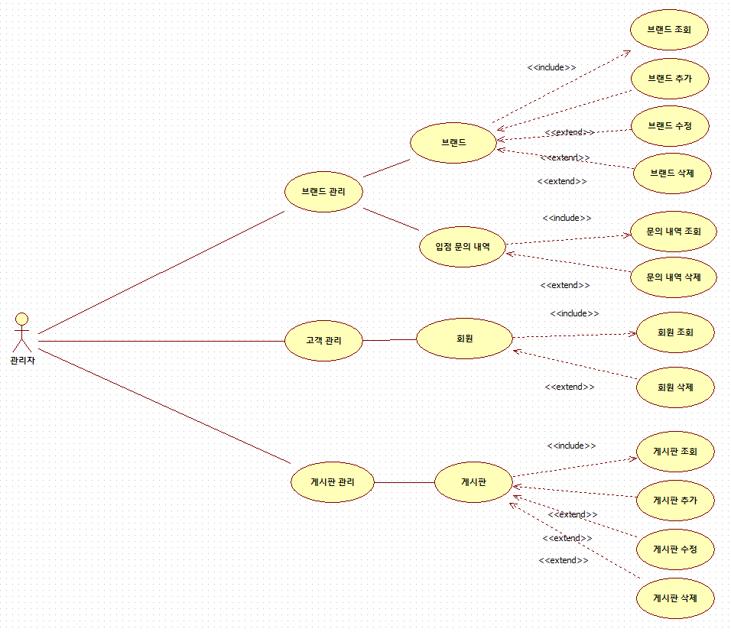
Use Case Diagram - Manager

Slide 3
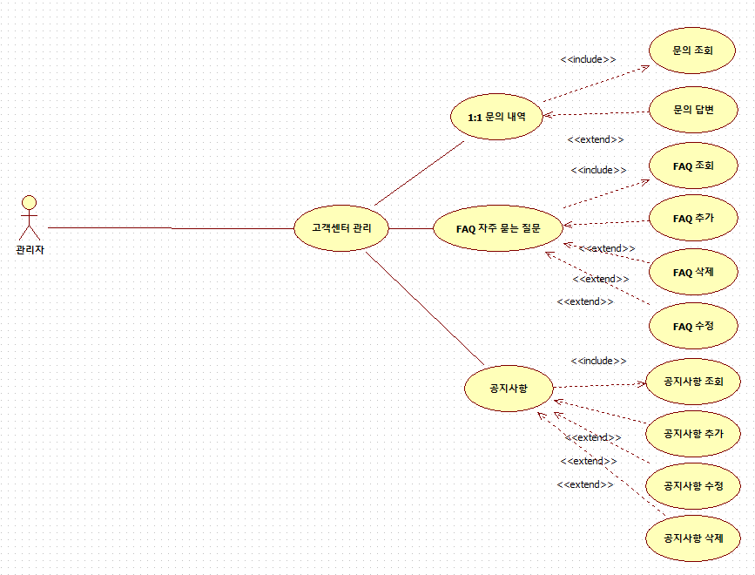
Use Case Diagram - Manager

Slide 4
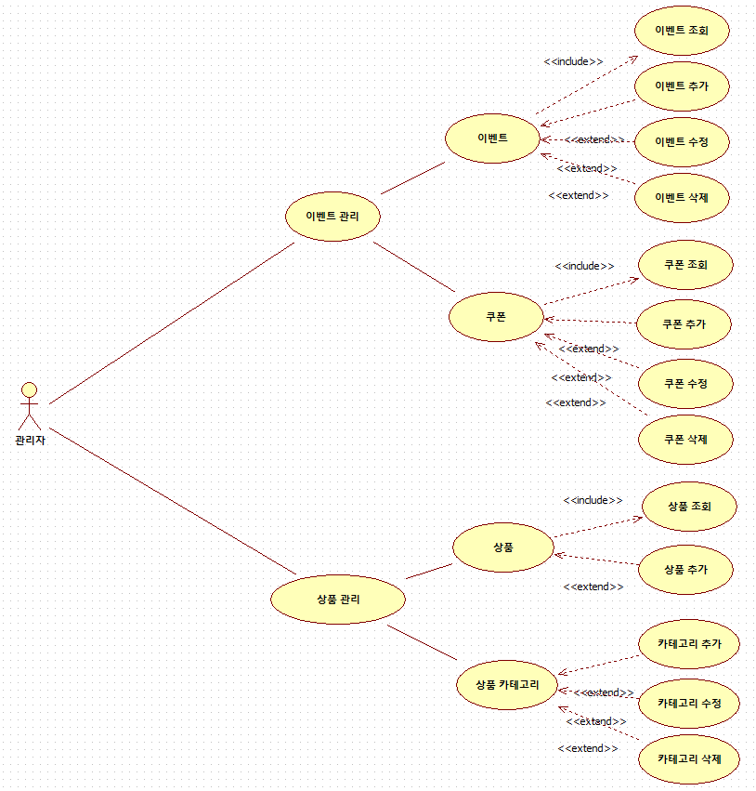
Use Case Diagram - Manager

