Slide 1
EzFans
An app to increase the efficiency of travel for sports fans
Founded By: Sam Hedrick, Brett Burton, and Jonathan Ko

Slide 2
Problem: Large Sports Events Overwhelm Public Transport & Have Slow Entry
When fans buy their tickets to a game they are normally not given specific directions to the stadium
They often use other apps for directions are always the fastest/shortest routes and are similar to everyone
When everyone takes the same/similar routes they all arrive at the same time, same gate and use the same transport
When fans arrive to the stadium there is always a long line to enter, normally all at a single gate or two
This is because a lot of people arrive at the same point near the stadium, and people usually look for popular sights before heading to the nearest gate
People need to be spread out across the stadium, but the directions will normally all say the closest gate to the drop off point/current location

Slide 3
Solution: EZFANS
When fans buy their tickets to a game they are given directions and gates tailored to them and the conditions expected on game day
This takes into account everyone that is buying tickets and can spread the people out evenly
For large sports events people usually buy their tickets far in advance, so we should not have many issues with too many people buying the day of
These directions will also spread the fans across metros, busses, and walking methods to the stadium based off of their preferences
Because everyone has directions that are tailored to them we can spread fans across the different gates
We can take preferences from people to have them arrive at different points of the stadium which will naturally spread them out
This helps not only the fans but also the stadium workers

Slide 4
Development Plan
Step 3: Allow user to enter information and send the order ID back to the user after ordering
Step 1: Set up the database, assign transports and even gates
Step 5: Travel preferences
Step 2: Send the directions and gates by ticket ID, then send them their preferred method
Step 4: Allow user to order in groups

Slide 5
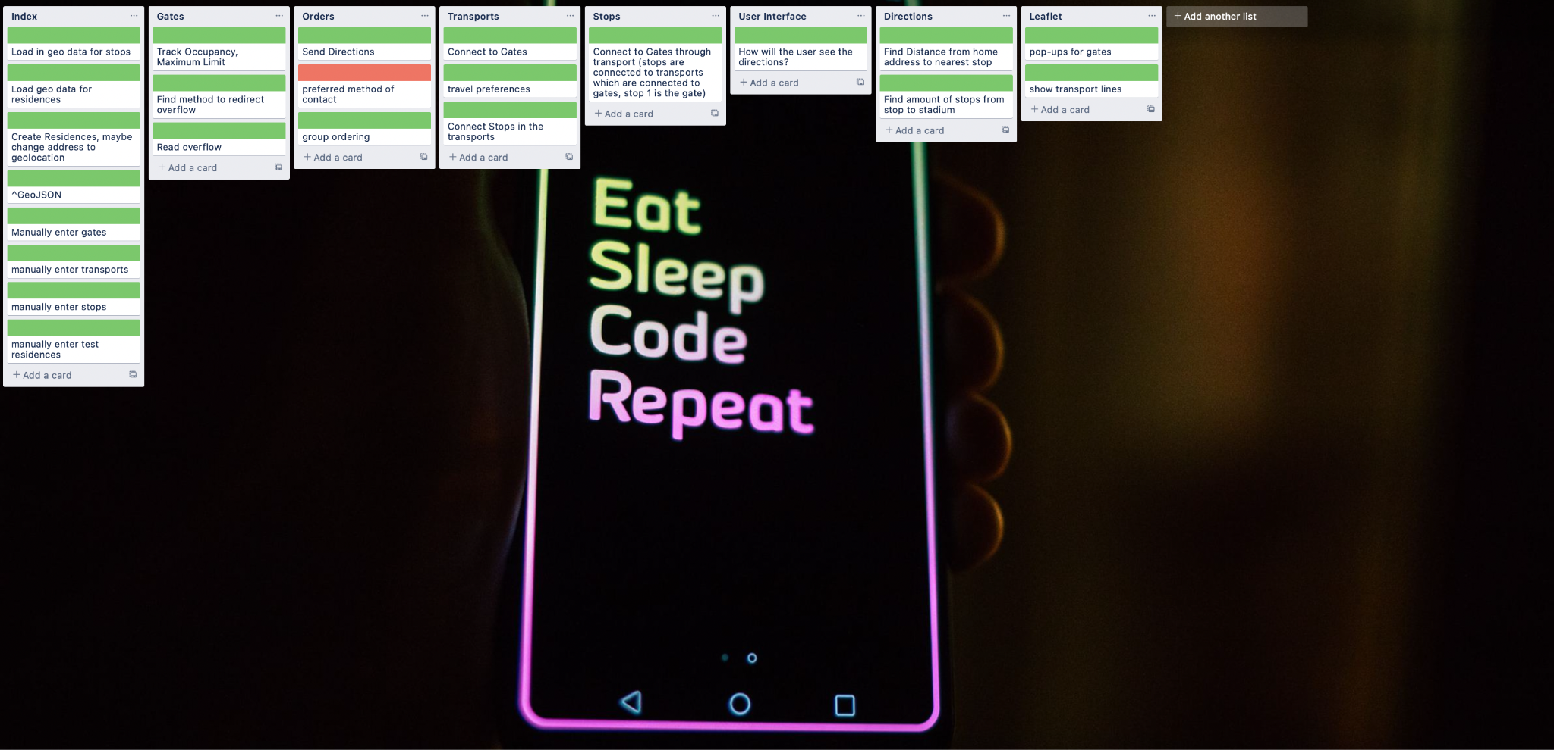

Slide 6
Basic Software Architecture
Backend
Tables with the stops, orders, transports, and gates
Process the directions, gates, and transports needed for orders, and send it back to the frontend
Frontend
Leaflet displays a base map layer
Add all of the stops gates, and transports to the map
Add captions and textboxes to help users enter their information
After the user submits their information, send back their order number

Slide 7
Thank You

