Slide 1
Cultural outlets as correlated with city characteristics in the United States
IBM Data Science – Course 9 Final Project

Slide 2
Introduction
Different cities across the United States offer different cultural outlets.
With the advantage of access to all of these outlets can often come a cost in terms of quality of life.
It is desirable to determine to what extent quality of life must be sacrificed to gain access to cultural outlets.

Slide 3
Analysis performed
Data was collected on socionomic characteristics of different US cities.
Cost of living, population and population density, city location.
Data was also collected on access to various culture outlets in these cities.
Number of comedy, music, and performing arts venues.
Various means of comparing these two data sets were used to determine whether access to culture implied higher cost of living and other undesirable sacrifices.

Slide 4
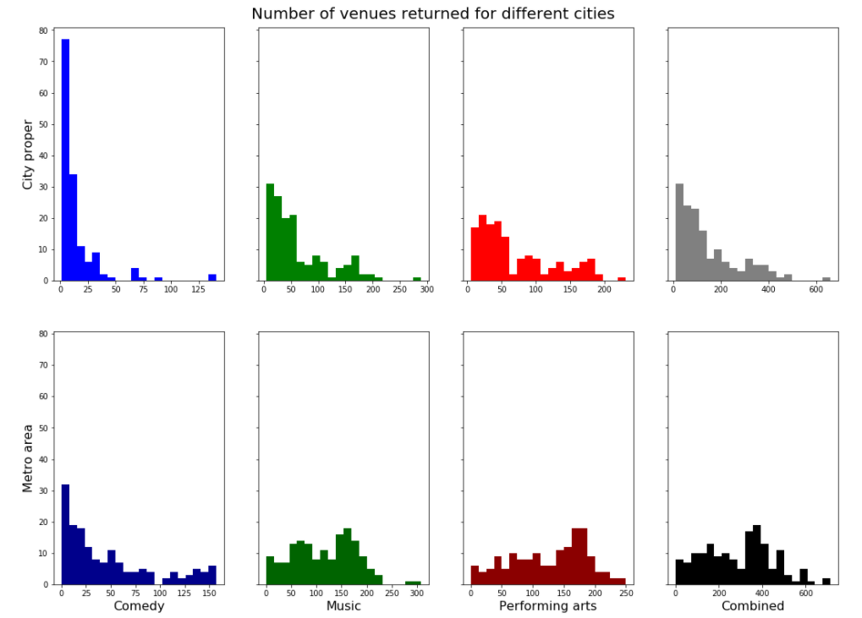
Results
Distributions of number of cities with different types of venue vary by venue type and city area considered.
More even distributions for greater metro areas than for cities proper.
More even distributions for performing arts and music venues than for comedy venues.

Slide 5
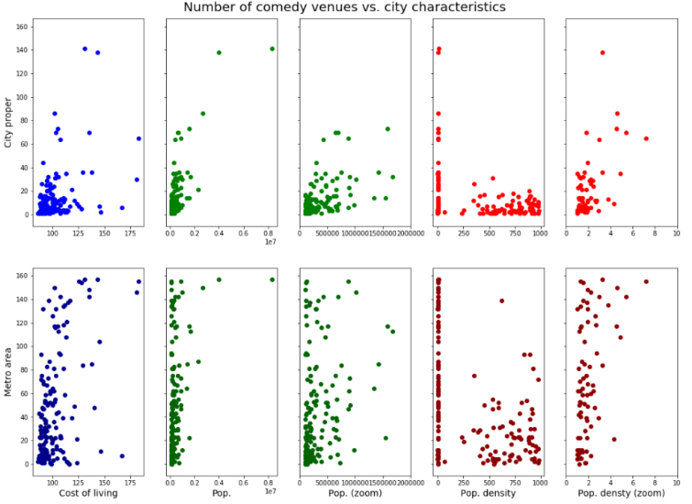
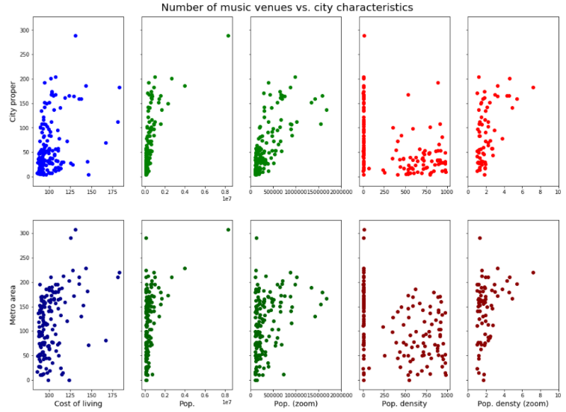
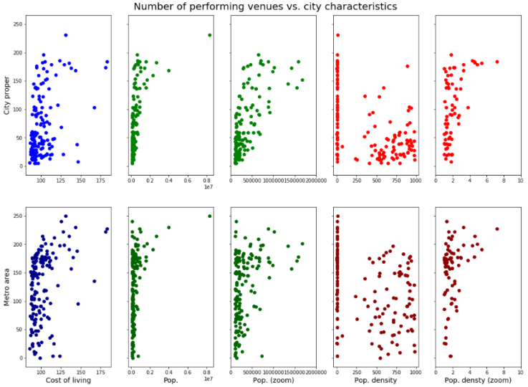
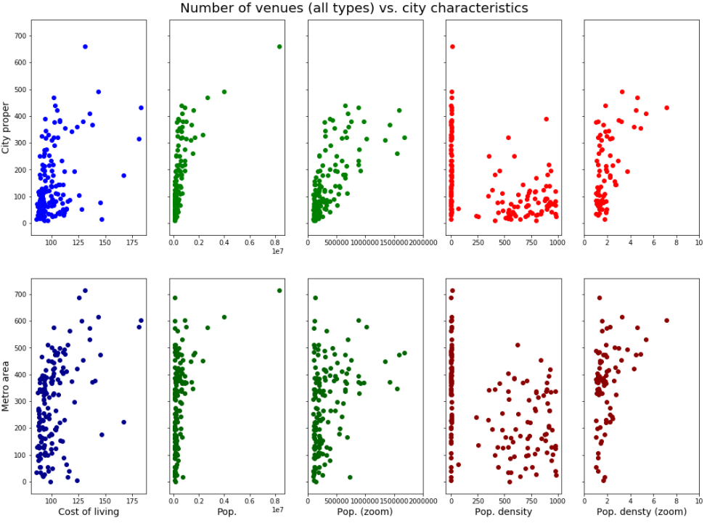
Results
Correlation between socioeconomic city characteristics and number of venues.
However, this correlation is very loose.
This is encouraging – there are plenty of cities with many cultural venues, but reasonable city characteristics.

Slide 6
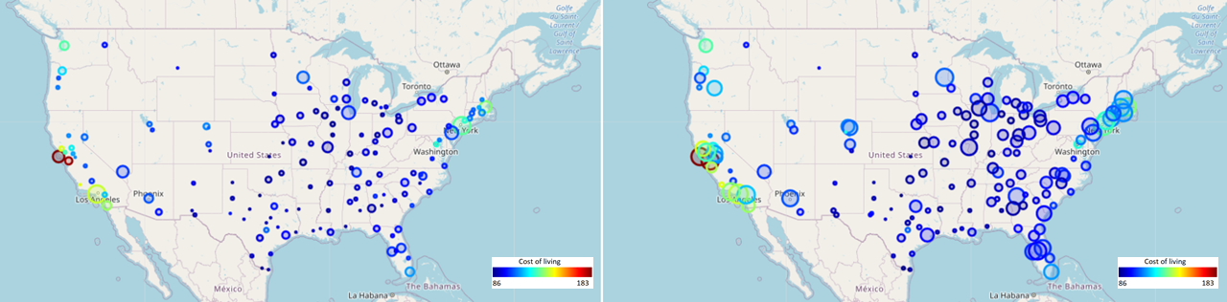
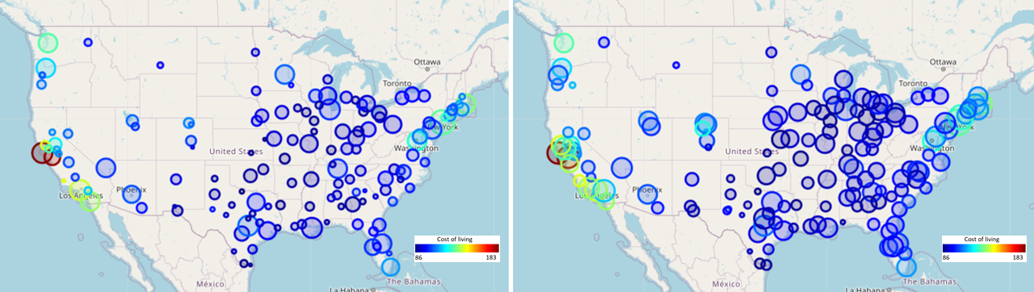
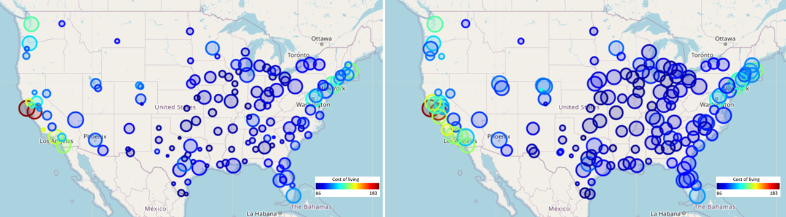
Results
City proper
Metro area
Comedy
West coast and northeast have highest cost of living.
Many cities throughout country with reasonable cost of living, and access to entertainment of various types.
Most of these are located in region spanning from Texas to the Great Lakes.
Music
Performing arts

Slide 7
Conclusions
If someone is interested in artistic venues and entertainment, there are many options as far as areas to live in the United States.
These options increase if one is willing and able to transport themselves to city’s metro area, rather than staying within city limits.
There are whole regions of the country with low cost of living and access to fun entertainment.
Even if one is limited in where they can live, as long as that limit is not to only a handful of cities, they can likely find a city to live with plenty of fun to be had at a reasonable cost.

Slide 8
Thank you

