Slide 1
Testing on Real Data
06/27/2023

Slide 2
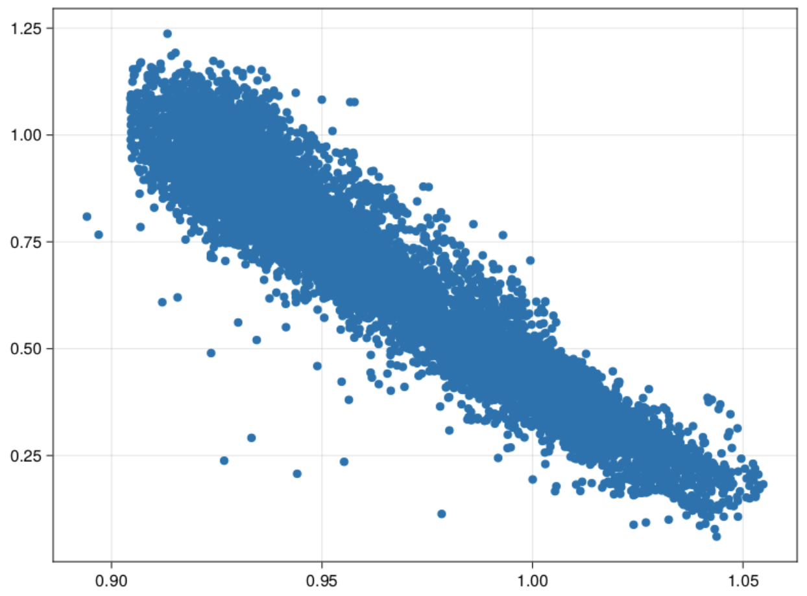
Powerplant Data

Slide 3
Cumulant Truncation Testing
 | sin(x)cos(y) | tan(x)ln(y) | x^2*I(y > x)
2 stored moments | 0.01680270599724165 | 0.320285873641558 | 0.03986445993548135
3 stored moments | 0.0034749415814915308 | 0.21501340159449567 | 0.042685547393598255
2 stored, 6 pseudo | 0.00038402038588691845 | 0.11070823852538203 | 0.0006331358215851957
3 stored, 6 pseudo | 8.757036909268212e-5 | 0.12863585742767703 | 0.002760513292185629
2 stored, 7 pseudo | 0.00038807338610180597 | 0.048115655701158944 | 0.0005738524902775266
3 stored, 7 pseudo | 9.175469233368982e-5 | 0.07015339198415627 | 0.00018533511824692095
max product 2, order 6 | 0.00013909392235000873 | 0.004977216731540168 | 0.016411322116429816
max product 3, order 6 | 7.667898313379329e-5 | 0.078559257473375 | 0.0013099908592628662
max product 2, order 7 | 0.000136596045228643 | 0.011106874292518776 | 0.043329690981465
max product 3, order 7 | 8.215745407025299e-5 | 0.03605885493487937 | 0.0015031791127871896

Slide 4
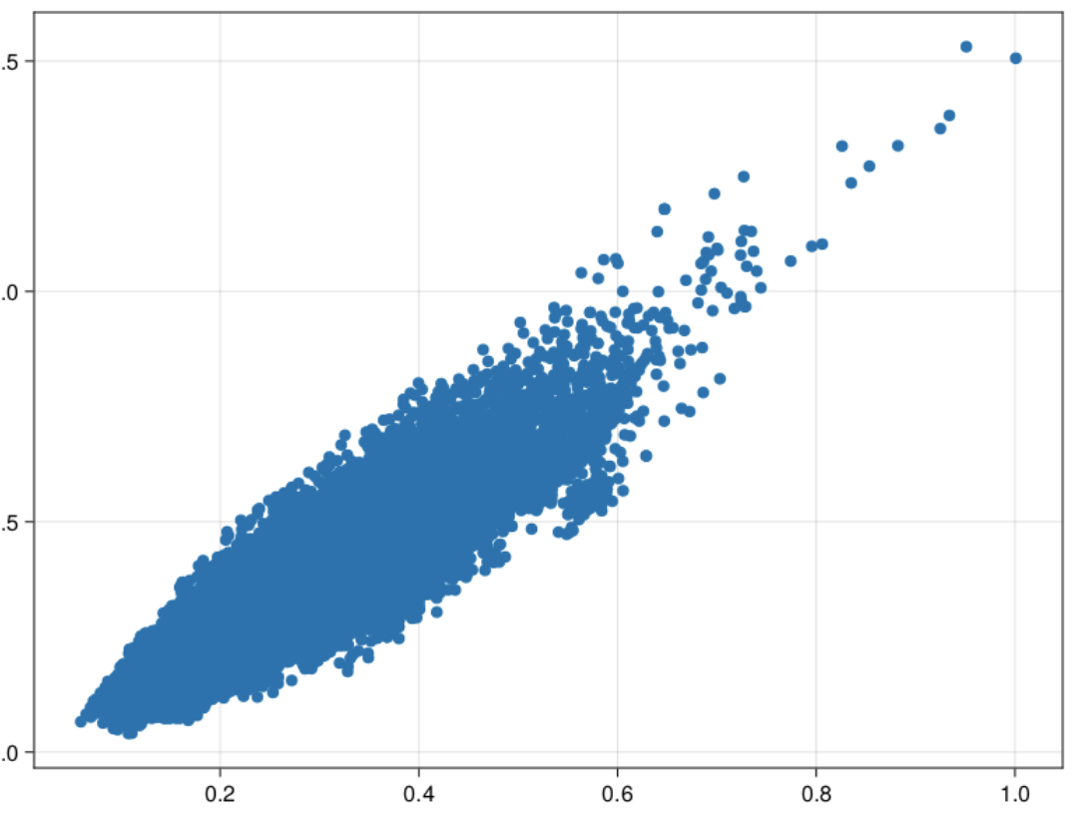
CASP Data

Slide 5
CASP (1)
 | sin(x)cos(y) | tan(x)ln(y) | x^2*I(y > x)
2 stored moments | 0.004197184661665049 | 0.37091835168623155 | 0.027178422259569034
3 stored moments | 0.0013674416084137053 | 0.17738896662348846 | 0.0371505929367713
2 stored, 6 pseudo | 0.0010280822494268538 | 0.0003086692756859577 | 0.02684630407306278
3 stored, 6 pseudo | 6.693365633431148e-5 | 0.028269552018261646 | 0.031198019094539932
2 stored, 7 pseudo | 0.0010272045973829524 | 0.0391294472937313 | 0.018751693060950363
3 stored, 7 pseudo | 6.892550491002791e-5 | 0.03824753592936336 | 0.012786563707363169
max product 2, order 6 | 0.0009202193716734142 | 0.011118991581243798 | 0.03150862872082112
max product 3, order 6 | 0.00010110489935150069 | 0.025740168450183842 | 0.027841958944587873
max product 2, order 7 | 0.0009180941059240277 | 0.01477458620731592 | 0.013737752743411616
max product 3, order 7 | 0.00010226582745045953 | 0.008071018803943175 | 0.01869327340890054

Slide 6
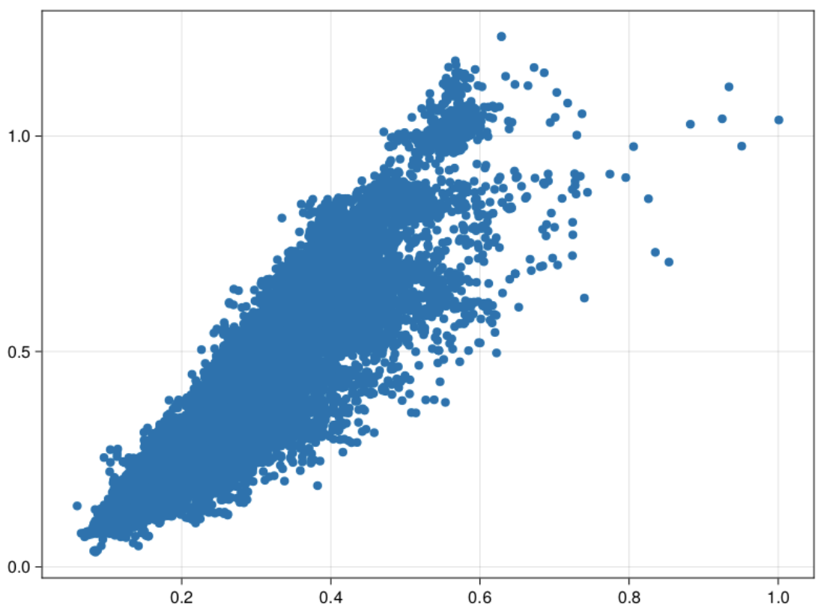
CASP Data

Slide 7
CASP (2)
 | sin(x)cos(y) | tan(x)ln(y) | x^2*I(y > x)
2 stored moments | 0.007116522650914697 | 0.3922353009894233 | 0.03784156859704949
3 stored moments | 0.001438984136697602 | 0.19362898753318547 | 0.031072874771298012
2 stored, 6 pseudo | 0.0015161932908631937 | 0.008050160850987198 | 0.02511731421988827
3 stored, 6 pseudo | 6.906203426443325e-5 | 0.022165351453272197 | 0.03613983019683723
2 stored, 7 pseudo | 0.0015143925798874192 | 0.05191956677469056 | 0.014153153366246424
3 stored, 7 pseudo | 7.235686334844393e-5 | 0.050637313918861115 | 0.0005206683592127864
max product 2, order 6 | 0.0013049076024105044 | 0.009590046016677345 | 0.036392574698822816
max product 3, order 6 | 0.00013625877406864273 | 0.030358477045111076 | 0.02633719111688186
max product 2, order 7 | 0.0013010704591008004 | 0.024709393051357026 | 0.002864078738314804
max product 3, order 7 | 0.00013793956897320547 | 0.0033059531555514887 | 0.014232439294180818

Slide 8
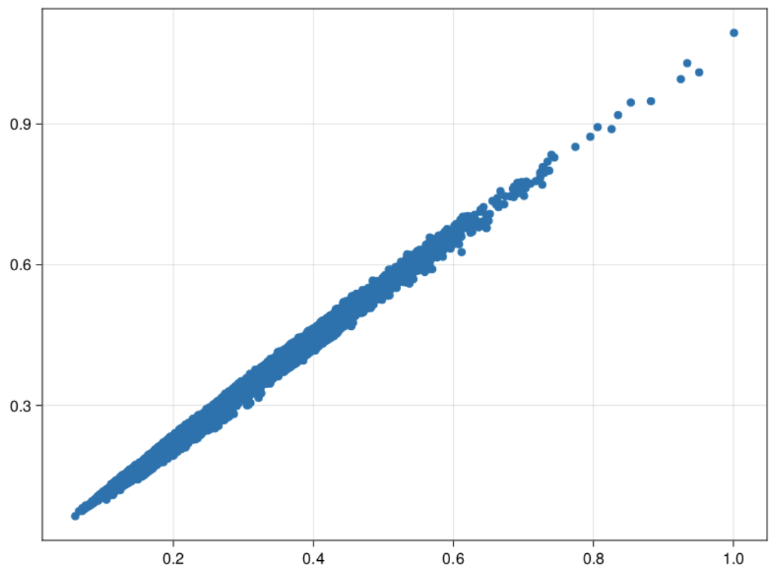
CASP Data

Slide 9
CASP (3)
 | sin(x)cos(y) | tan(x)ln(y) | x^2*I(y > x)
2 stored moments | 0.002172771704186477 | 0.35465807189298004 | 0.035006906775371355
3 stored moments | 0.002172771704186477 | 0.17108456834141544 | 0.056622388253354264
2 stored, 6 pseudo | 0.0007173777843126894 | 0.007658950639768125 | 0.04362462486165479
3 stored, 6 pseudo | 2.6744755456775682e-5 | 0.03048252534357837 | 0.04360432839019236
2 stored, 7 pseudo | 0.0007172560267086625 | 0.03112731849343975 | 0.03813153433774766
3 stored, 7 pseudo | 2.764593022397399e-5 | 0.030331997897600604 | 0.03792569473531436
max product 2, order 6 | 0.0006546835052249622 | 0.00951338089315179 | 0.044328658707022794
max product 3, order 6 | 4.480790888139463e-5 | 0.02505211205971397 | 0.04317128902193264
max product 2, order 7 | 0.0006537736659120719 | 0.009307599707726488 | 0.03765028968341713
max product 3, order 7 | 4.526625861397959e-5 | 0.012069370778507116 | 0.03859376021544887

Slide 10
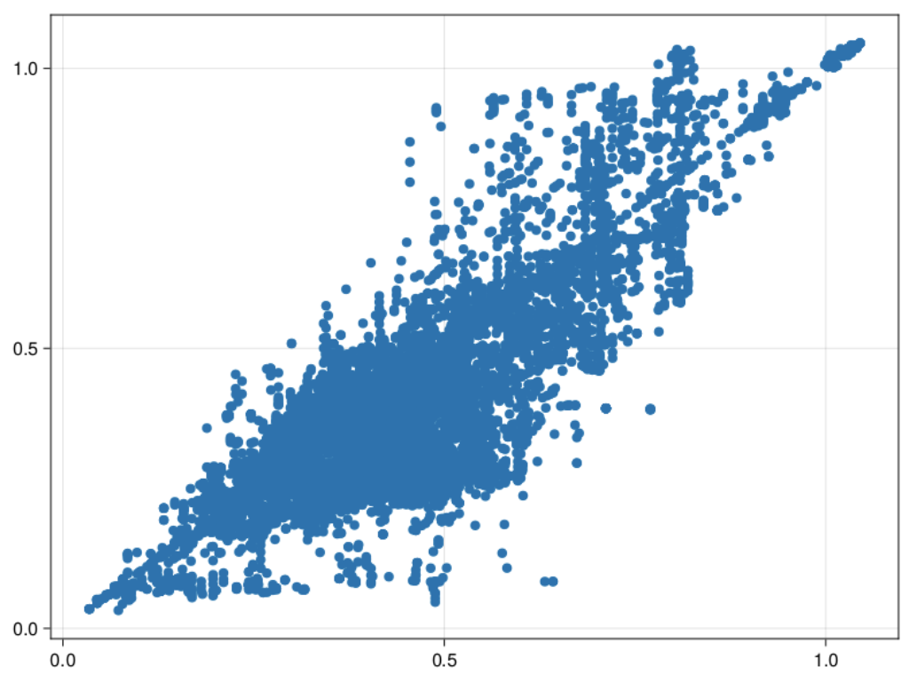
Superconductivity Data

Slide 11
Superconductivity (1)
 | sin(x)cos(y) | tan(x)ln(y) | x^2*I(y > x)
2 stored moments | 0.001568697163134014 | 0.2274023495097044 | 0.033854241348786854
3 stored moments | 0.0025363579685458437 | 0.1606732034954781 | 0.01823958786114624
2 stored, 6 pseudo | 0.0015842279020045757 | 0.01967278634557701 | 0.026669443738794193
3 stored, 6 pseudo | 0.0003738993112784583 | 0.021266964316489667 | 0.021866250557666264
2 stored, 7 pseudo | 0.0015862610641740327 | 0.03623524878683626 | 0.0017964985698616792
3 stored, 7 pseudo | 0.00037215226809156343 | 0.008419609001524275 | 0.003204726100827629
max product 2, order 6 | 0.0012202271173715196 | 0.0013600446126625365 | 0.0224687353629765
max product 3, order 6 | 0.0004543805014490254 | 0.03022129690493025 | 0.027663608029541417
max product 2, order 7 | 0.0012216545890459396 | 0.019104946089172126 | 0.0023053753171409924
max product 3, order 7 | 0.00045162946347937494 | 0.036162424364631574 | 0.004018349634306959

Slide 12
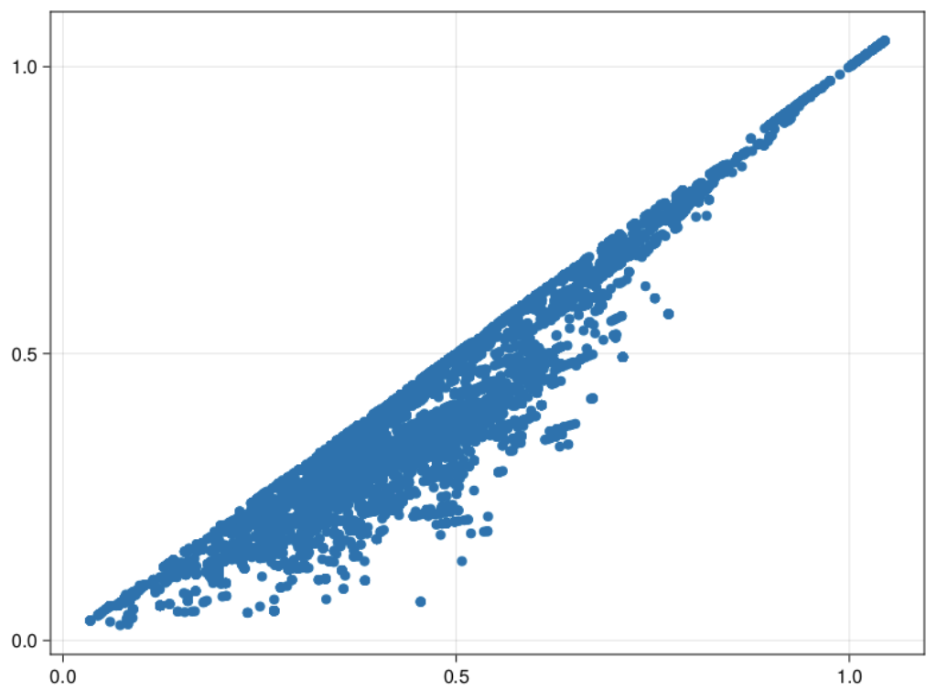
Superconductivity Data

Slide 13
Superconductivity (2)
 | sin(x)cos(y) | tan(x)ln(y) | x^2*I(y > x)
2 stored moments | 0.0024303878570984816 | 0.22546279054923074 | 0.07977778315121578
3 stored moments | 0.0023714236094433128 | 0.16728162413943576 | 0.02433027214240535
2 stored, 6 pseudo | 0.001427087321637599 | 0.026225721825544723 | 0.0716959722865421
3 stored, 6 pseudo | 0.0003540436337164943 | 0.017334269784779033 | 0.06695458358510518
2 stored, 7 pseudo | 0.0014298022058200077 | 0.03009968094524612 | 0.03741416218344523
3 stored, 7 pseudo | 0.0003516713272802563 | 0.005155055910170736 | 0.04297971088587249
max product 2, order 6 | 0.001076102195354367 | 0.0006649772093026973 | 0.06798546041157226
max product 3, order 6 | 0.00042599331193615697 | 0.03078500418827801 | 0.07128856579389178
max product 2, order 7 | 0.0010782780083960497 | 0.016810552403026924 | 0.042394028557999744
max product 3, order 7 | 0.000422735988776346 | 0.030652740934929146 | 0.03601908767817552

Slide 14
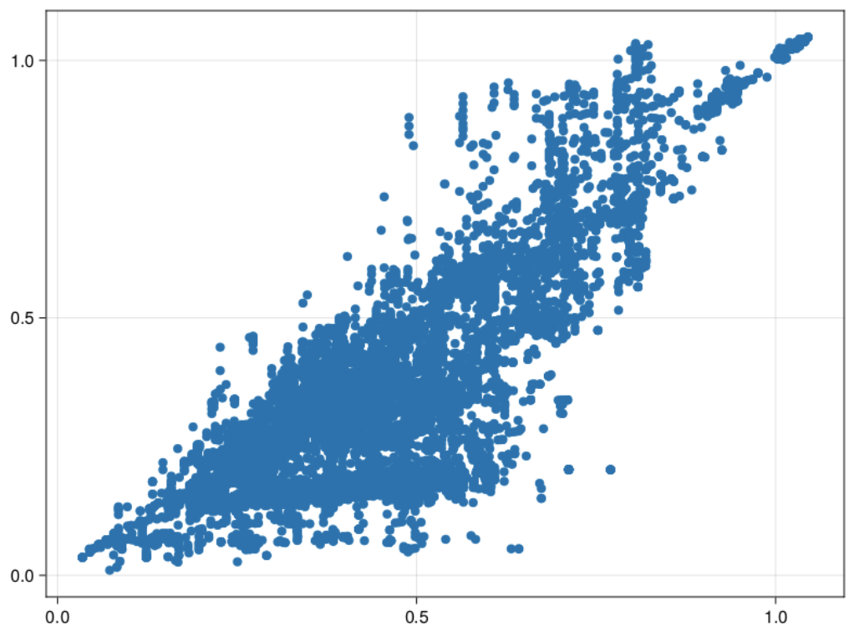
Superconductivity Data

Slide 15
Superconductivity (3)
 | sin(x)cos(y) | tan(x)ln(y) | x^2*I(y > x)
2 stored moments | 0.006273936360071619 | 0.1488615098366789 | 0.06470945692930732
3 stored moments | 0.0026573811847153683 | 0.15869231319416843 | 0.028606042080980956
2 stored, 6 pseudo | 0.002341226709171751 | 0.017364423343128932 | 0.03465493089330442
3 stored, 6 pseudo | 0.0004520987679416111 | 0.03936652901688109 | 0.0163491883240822
2 stored, 7 pseudo | 0.0023442039405141 | 0.08587052642377269 | 0.010335055951516112
3 stored, 7 pseudo | 0.0004506705398847344 | 0.042328873960427615 | 0.0075190824598336675
max product 2, order 6 | 0.0019615896287308865 | 0.017221471407987132 | 0.024215111384219196
max product 3, order 6 | 0.0005773147370199405 | 0.04015717323558843 | 0.02962983525346053
max product 2, order 7 | 0.0019629516341191366 | 0.017127217205287204 | 0.0025205378382818777
max product 3, order 7 | 0.0005738909929430269 | 0.0452243584763975 | 0.01331408759542442

