Slide 1
Testing on Real Data cont.
07/12/2023

Slide 2
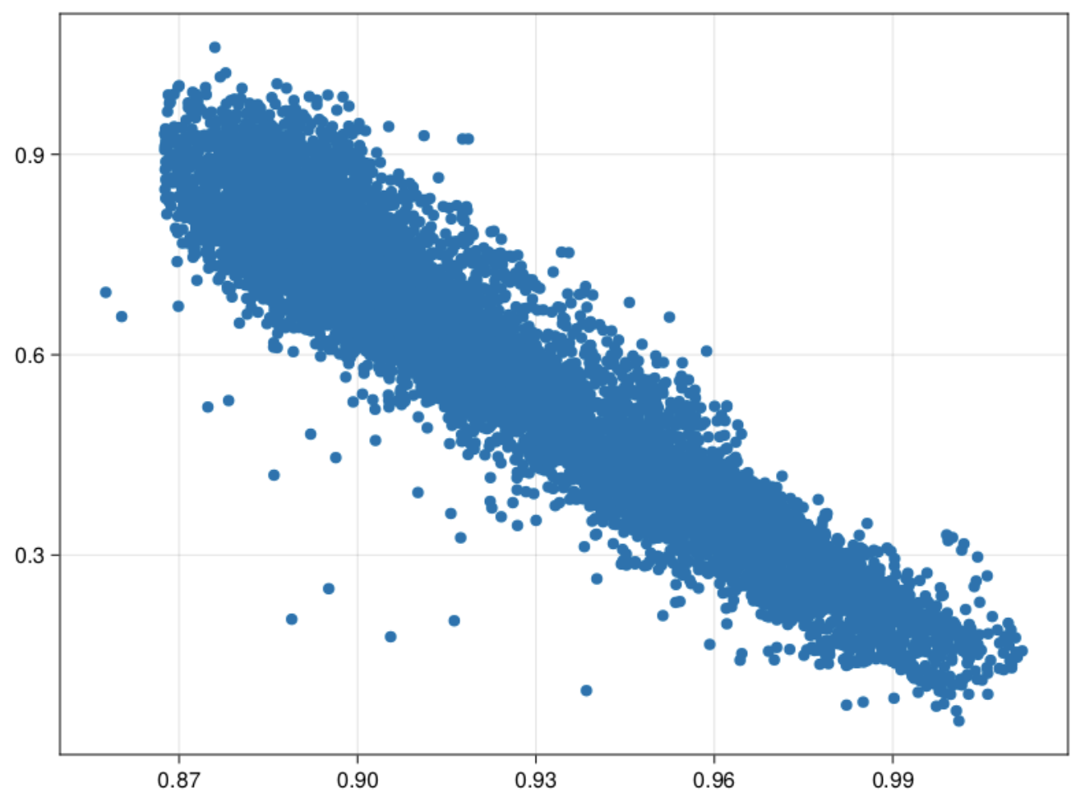
Scatter plot of Data

Slide 3
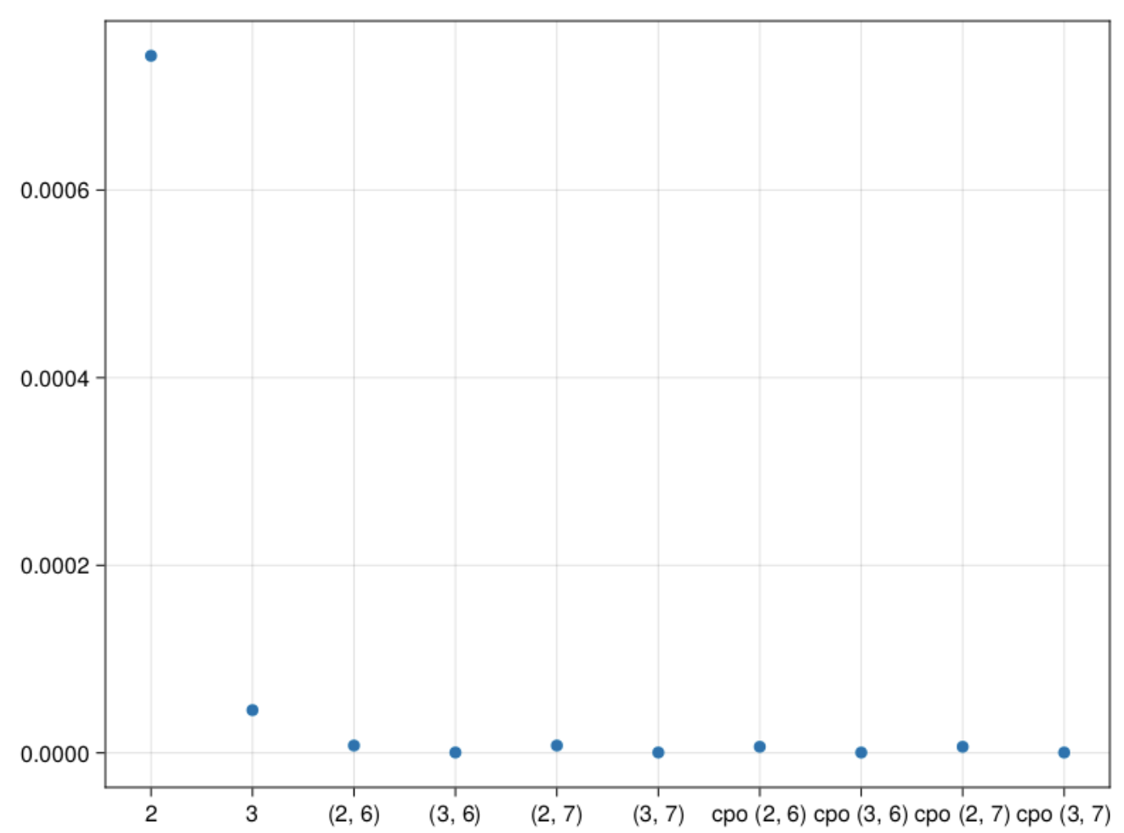
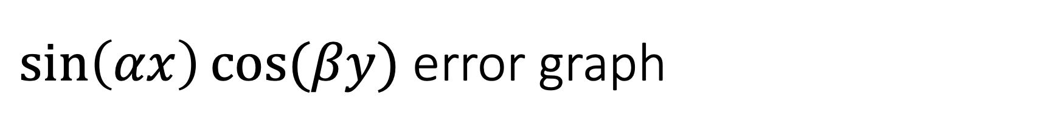
$\sin\left(αx\right)cos⁡(βy)$ error graph
2 – 2 stored moments
3 – 3 stored moments
(2,6) – 2 stored, 6 pseudo
(3,6) – 3 stored, 6 pseudo
(2,7) - 2 stored, 7 pseudo
(3,7) – 3 stored, 7 pseudo
cpo(2,6) – max cumulant order 2, order 6
cpo(3,6) – max cumulant order 3, order 6
cpo(2,7) – max cumulant order 3, order 7
cpo(3,7) – max cumulant order 3, order 7

Slide 4
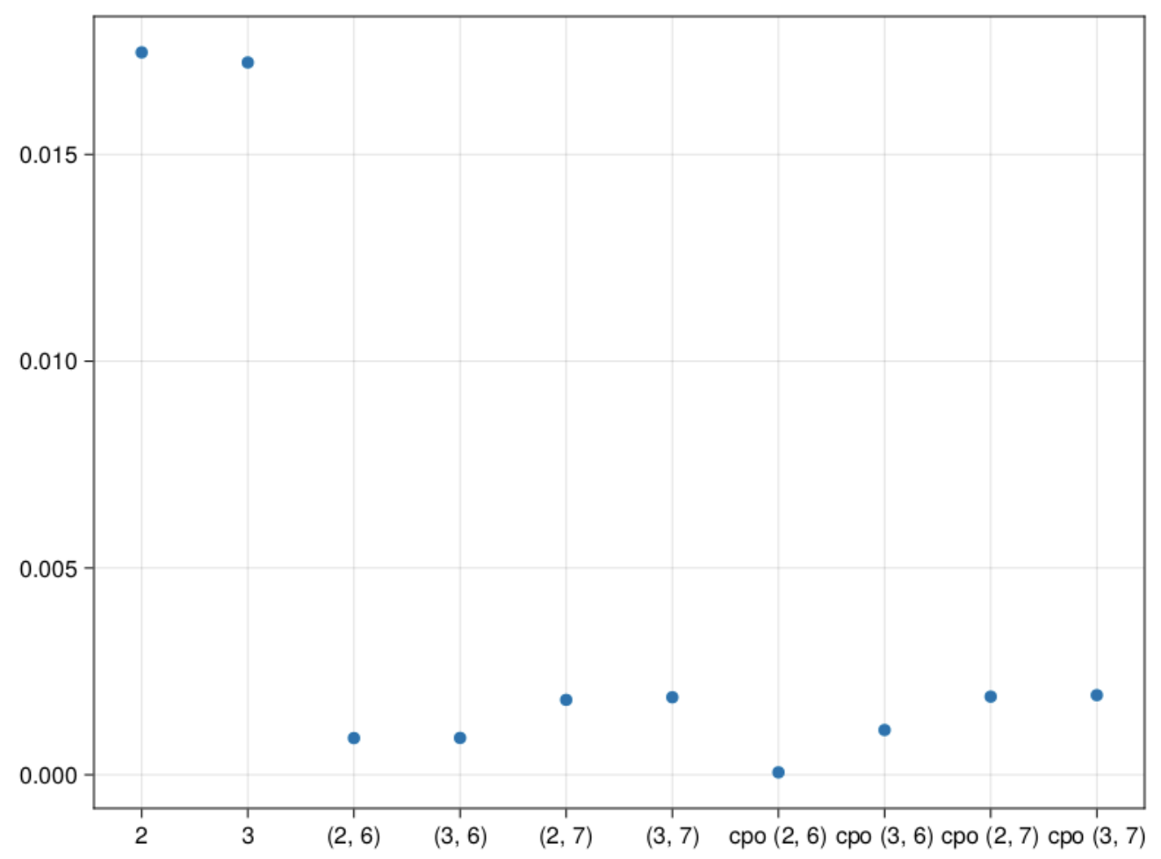
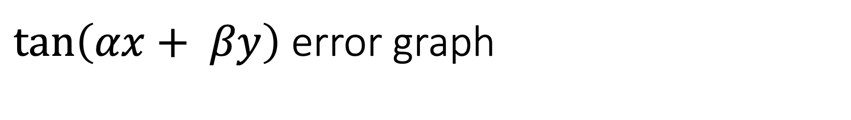
$\tan\left(αx+ βy\right)$ error graph
2 – 2 stored moments
3 – 3 stored moments
(2,6) – 2 stored, 6 pseudo
(3,6) – 3 stored, 6 pseudo
(2,7) - 2 stored, 7 pseudo
(3,7) – 3 stored, 7 pseudo
cpo(2,6) – max cumulant order 2, order 6
cpo(3,6) – max cumulant order 3, order 6
cpo(2,7) – max cumulant order 3, order 7
cpo(3,7) – max cumulant order 3, order 7

Slide 5
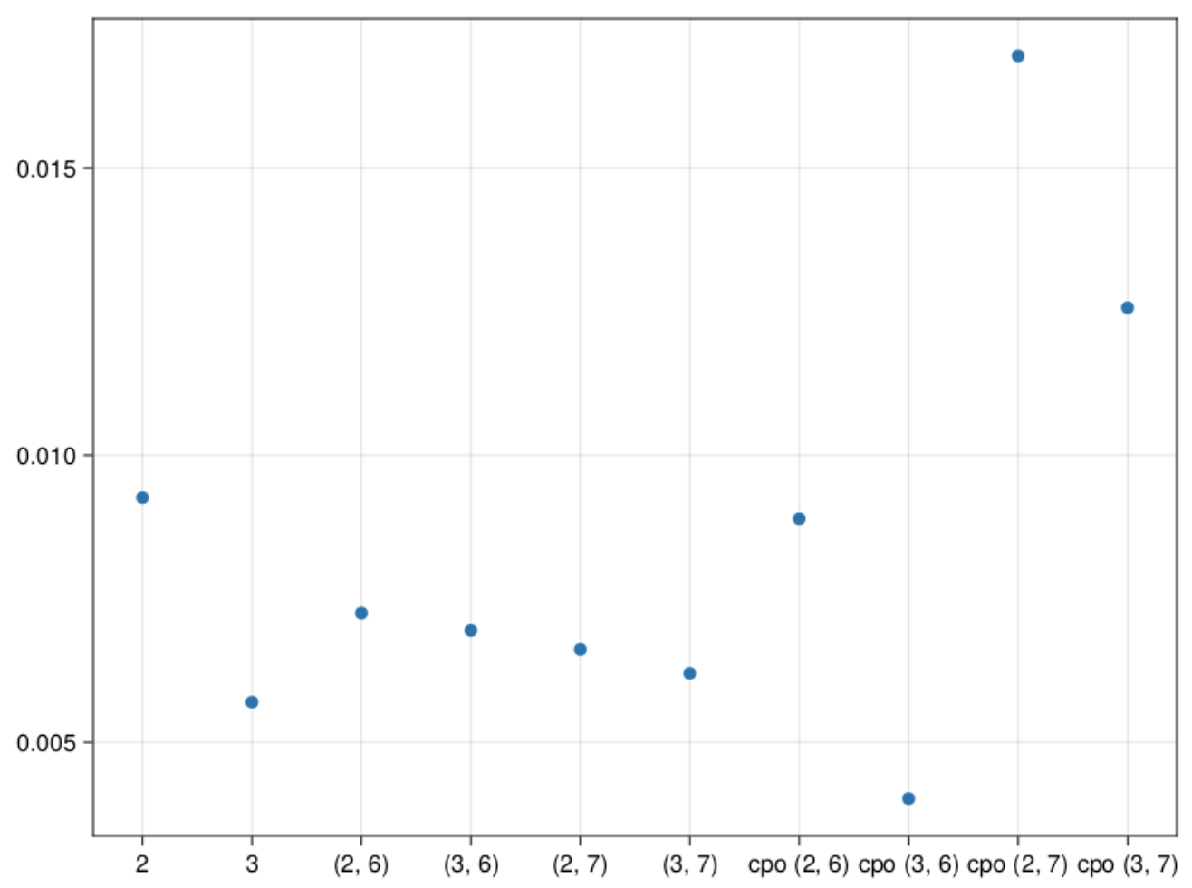
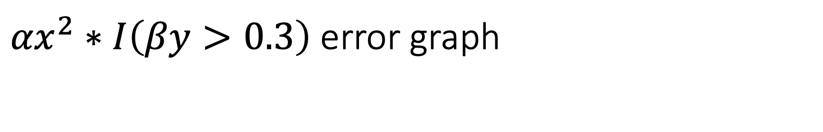
${αx}^{2}∗I\left(βy>0.3\right)$ error graph
2 – 2 stored moments
3 – 3 stored moments
(2,6) – 2 stored, 6 pseudo
(3,6) – 3 stored, 6 pseudo
(2,7) - 2 stored, 7 pseudo
(3,7) – 3 stored, 7 pseudo
cpo(2,6) – max cumulant order 2, order 6
cpo(3,6) – max cumulant order 3, order 6
cpo(2,7) – max cumulant order 3, order 7
cpo(3,7) – max cumulant order 3, order 7

Slide 6
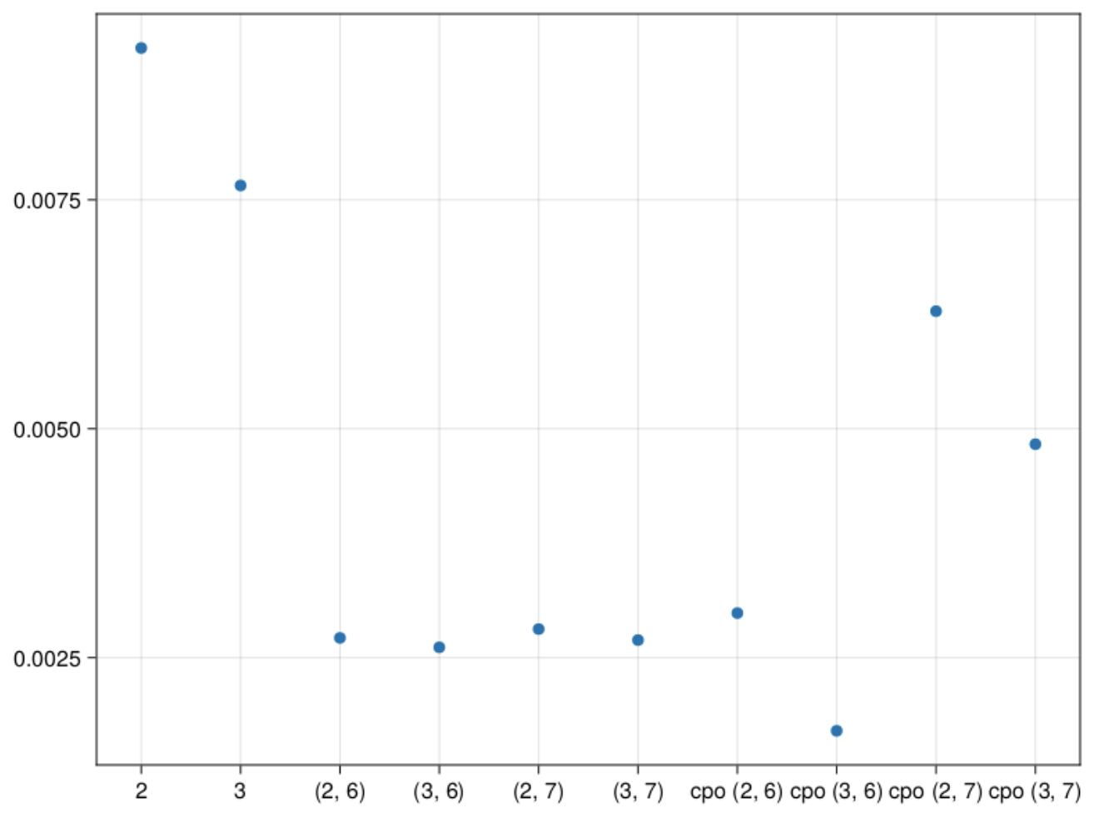
Average of previous 3
2 – 2 stored moments
3 – 3 stored moments
(2,6) – 2 stored, 6 pseudo
(3,6) – 3 stored, 6 pseudo
(2,7) - 2 stored, 7 pseudo
(3,7) – 3 stored, 7 pseudo
cpo(2,6) – max cumulant order 2, order 6
cpo(3,6) – max cumulant order 3, order 6
cpo(2,7) – max cumulant order 3, order 7
cpo(3,7) – max cumulant order 3, order 7

Slide 7
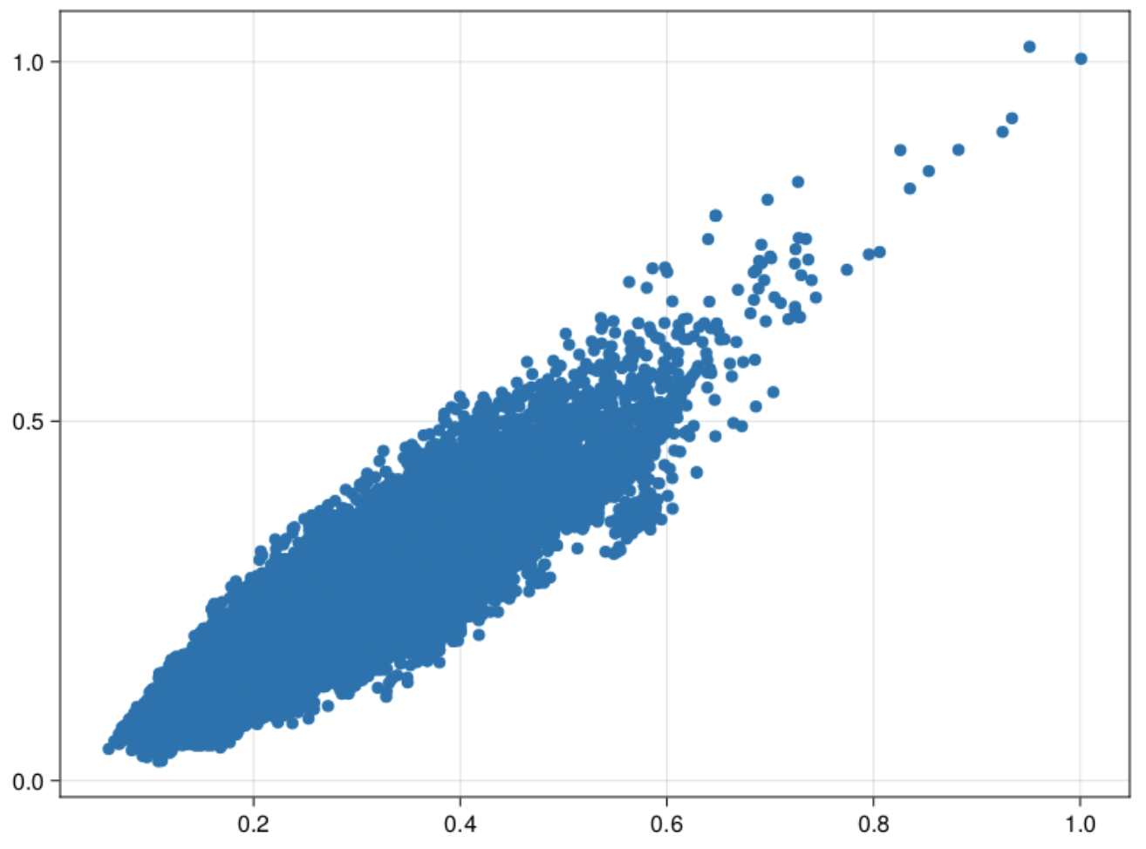
Scatter plot of Data

Slide 8
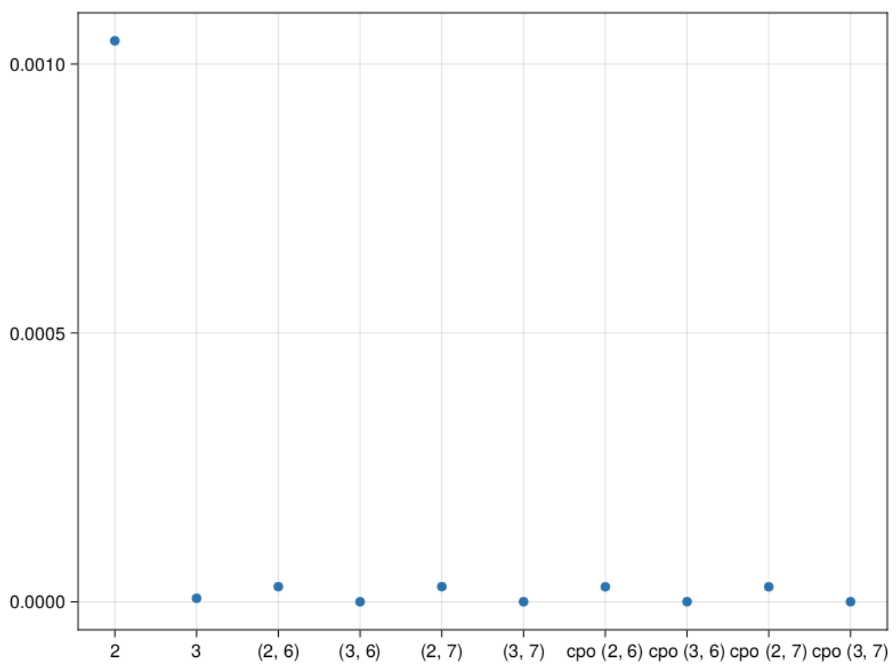
$\sin\left(αx\right)cos⁡(βy)$ error graph
2 – 2 stored moments
3 – 3 stored moments
(2,6) – 2 stored, 6 pseudo
(3,6) – 3 stored, 6 pseudo
(2,7) - 2 stored, 7 pseudo
(3,7) – 3 stored, 7 pseudo
cpo(2,6) – max cumulant order 2, order 6
cpo(3,6) – max cumulant order 3, order 6
cpo(2,7) – max cumulant order 3, order 7
cpo(3,7) – max cumulant order 3, order 7

Slide 9
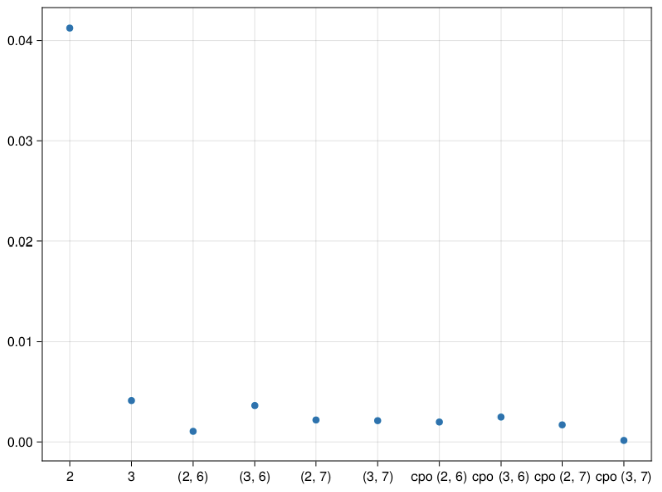
$\tan\left(αx+ βy\right)$ error graph
2 – 2 stored moments
3 – 3 stored moments
(2,6) – 2 stored, 6 pseudo
(3,6) – 3 stored, 6 pseudo
(2,7) - 2 stored, 7 pseudo
(3,7) – 3 stored, 7 pseudo
cpo(2,6) – max cumulant order 2, order 6
cpo(3,6) – max cumulant order 3, order 6
cpo(2,7) – max cumulant order 3, order 7
cpo(3,7) – max cumulant order 3, order 7

Slide 10
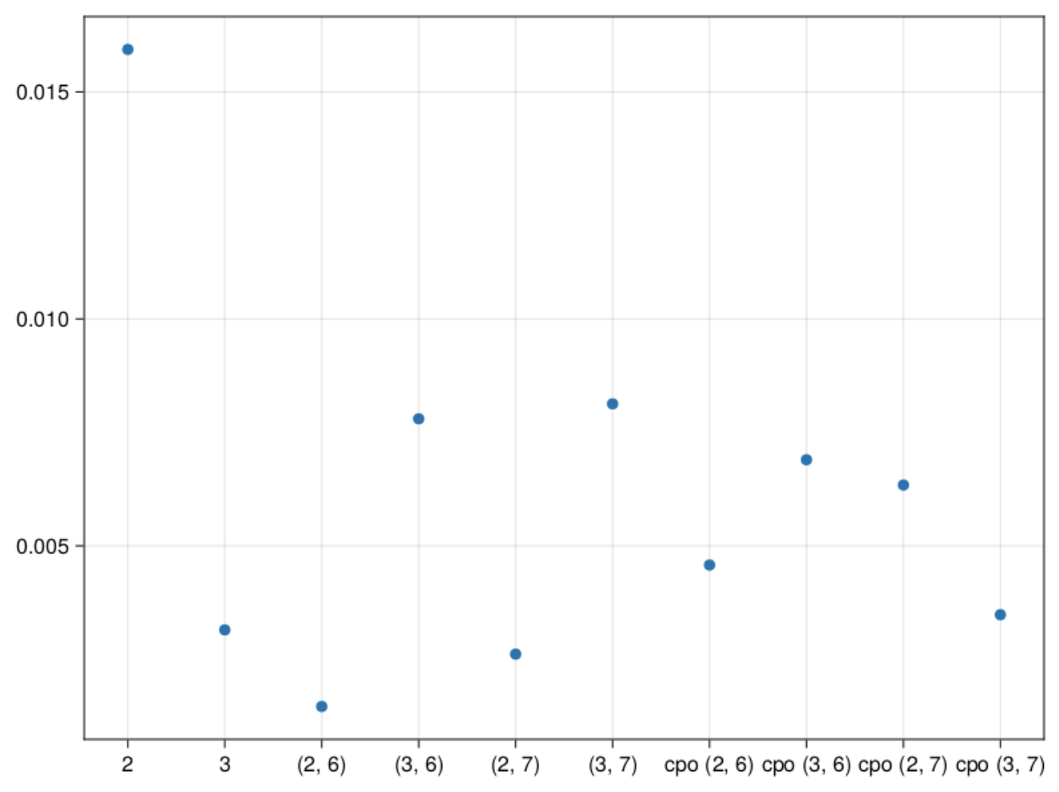
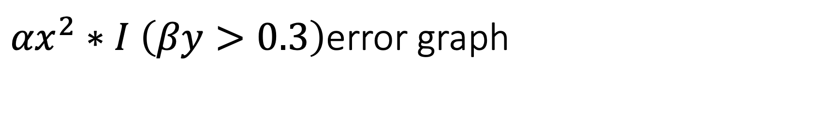
${αx}^{2}∗I$ $\left(βy>0.3\right)$error graph
2 – 2 stored moments
3 – 3 stored moments
(2,6) – 2 stored, 6 pseudo
(3,6) – 3 stored, 6 pseudo
(2,7) - 2 stored, 7 pseudo
(3,7) – 3 stored, 7 pseudo
cpo(2,6) – max cumulant order 2, order 6
cpo(3,6) – max cumulant order 3, order 6
cpo(2,7) – max cumulant order 3, order 7
cpo(3,7) – max cumulant order 3, order 7

Slide 11
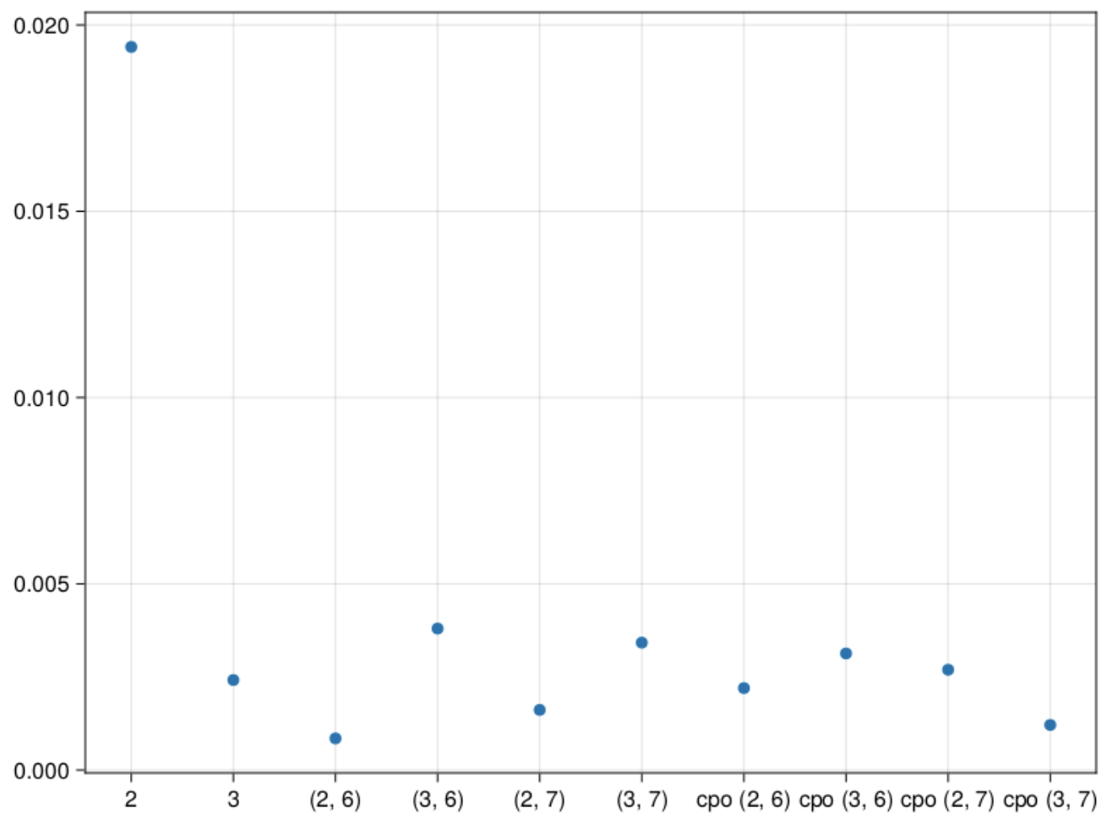
Average of previous 3
2 – 2 stored moments
3 – 3 stored moments
(2,6) – 2 stored, 6 pseudo
(3,6) – 3 stored, 6 pseudo
(2,7) - 2 stored, 7 pseudo
(3,7) – 3 stored, 7 pseudo
cpo(2,6) – max cumulant order 2, order 6
cpo(3,6) – max cumulant order 3, order 6
cpo(2,7) – max cumulant order 3, order 7
cpo(3,7) – max cumulant order 3, order 7

Slide 12
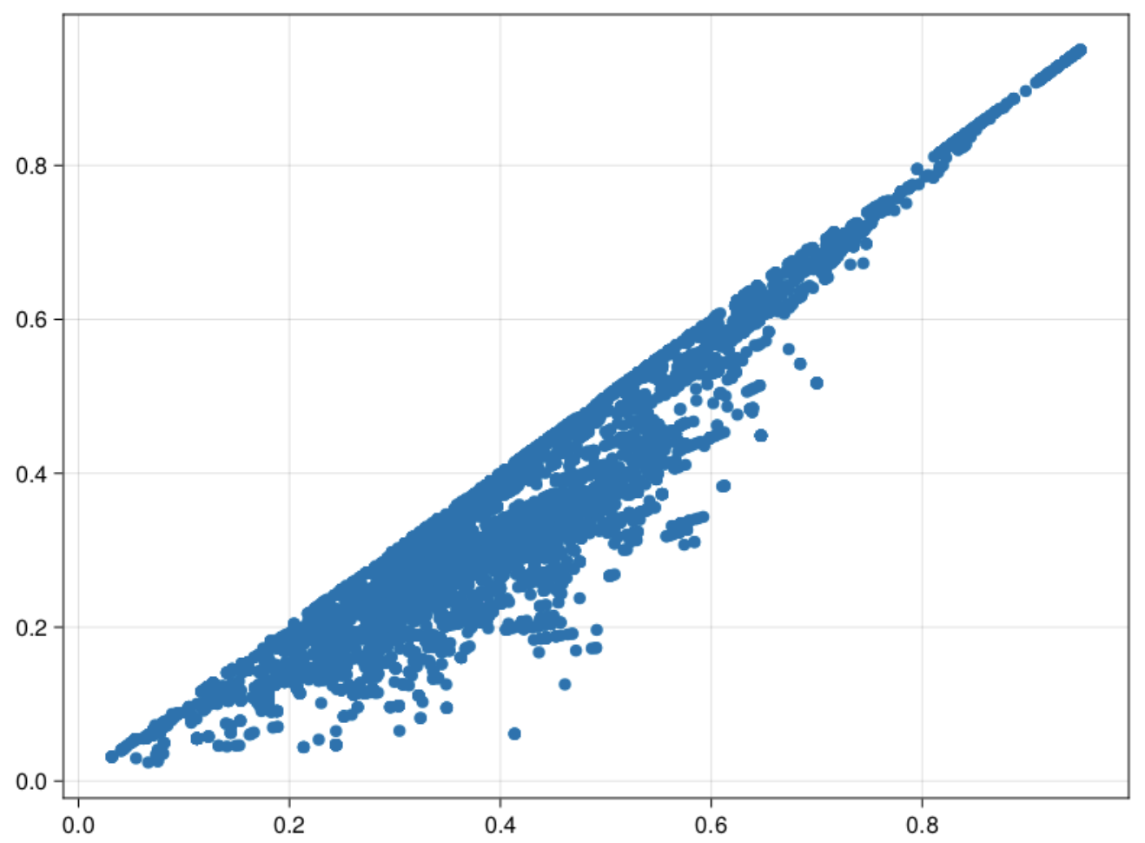
Scatter plot of Data

Slide 13
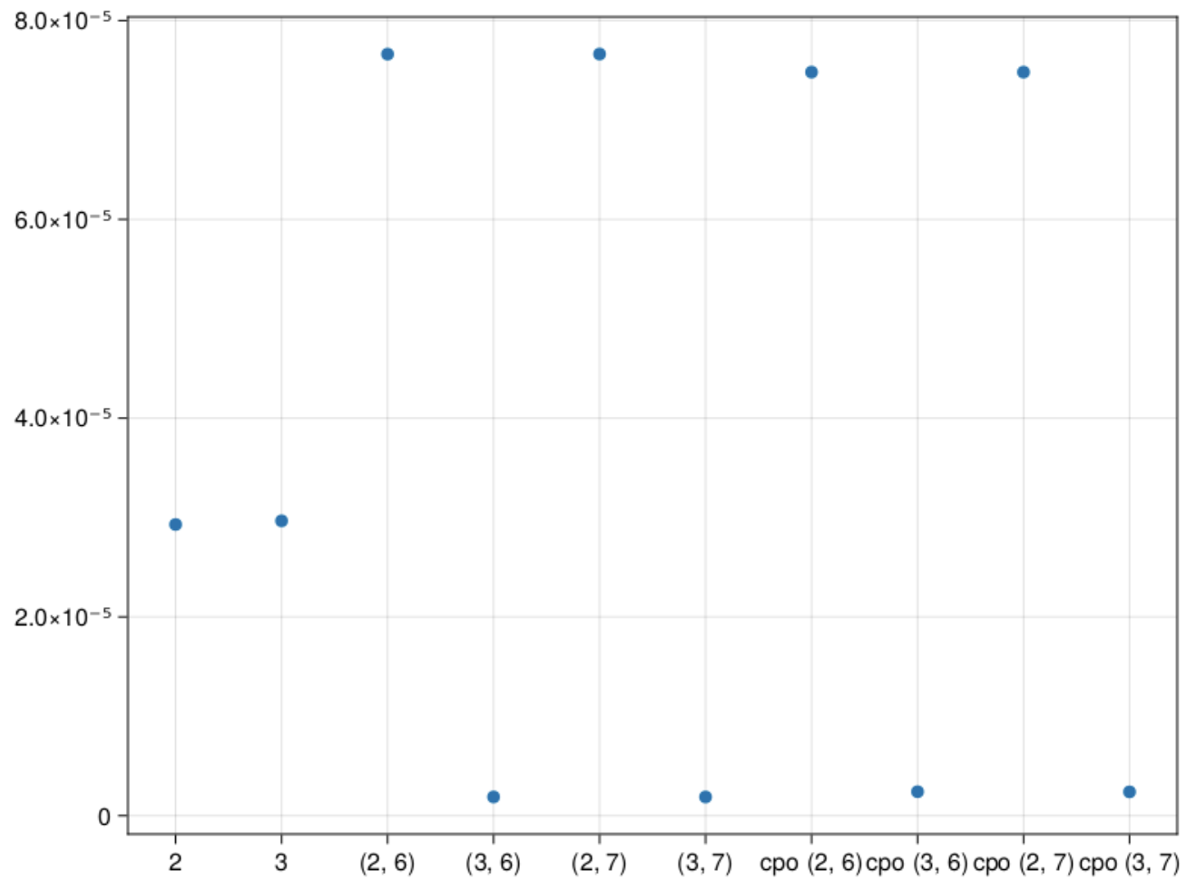
$\sin\left(αx\right)cos⁡(βy)$ error graph
2 – 2 stored moments
3 – 3 stored moments
(2,6) – 2 stored, 6 pseudo
(3,6) – 3 stored, 6 pseudo
(2,7) - 2 stored, 7 pseudo
(3,7) – 3 stored, 7 pseudo
cpo(2,6) – max cumulant order 2, order 6
cpo(3,6) – max cumulant order 3, order 6
cpo(2,7) – max cumulant order 3, order 7
cpo(3,7) – max cumulant order 3, order 7

Slide 14
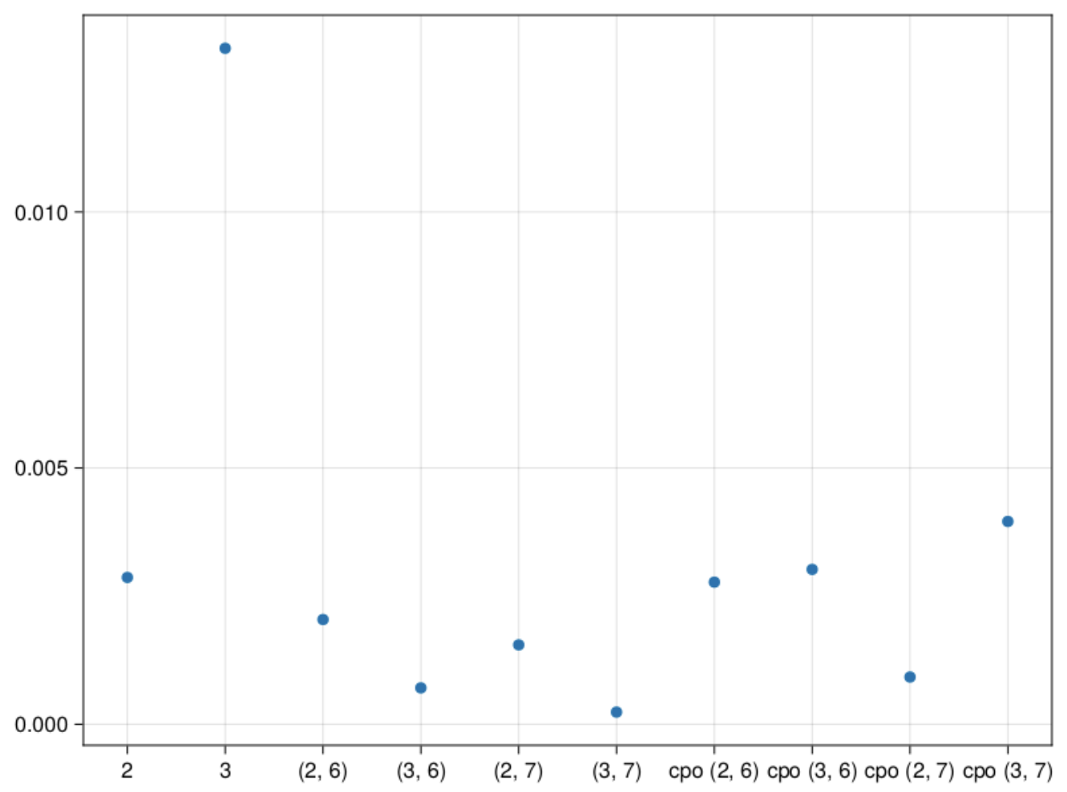
$\tan\left(αx+ βy\right)$ error graph
2 – 2 stored moments
3 – 3 stored moments
(2,6) – 2 stored, 6 pseudo
(3,6) – 3 stored, 6 pseudo
(2,7) - 2 stored, 7 pseudo
(3,7) – 3 stored, 7 pseudo
cpo(2,6) – max cumulant order 2, order 6
cpo(3,6) – max cumulant order 3, order 6
cpo(2,7) – max cumulant order 3, order 7
cpo(3,7) – max cumulant order 3, order 7

Slide 15
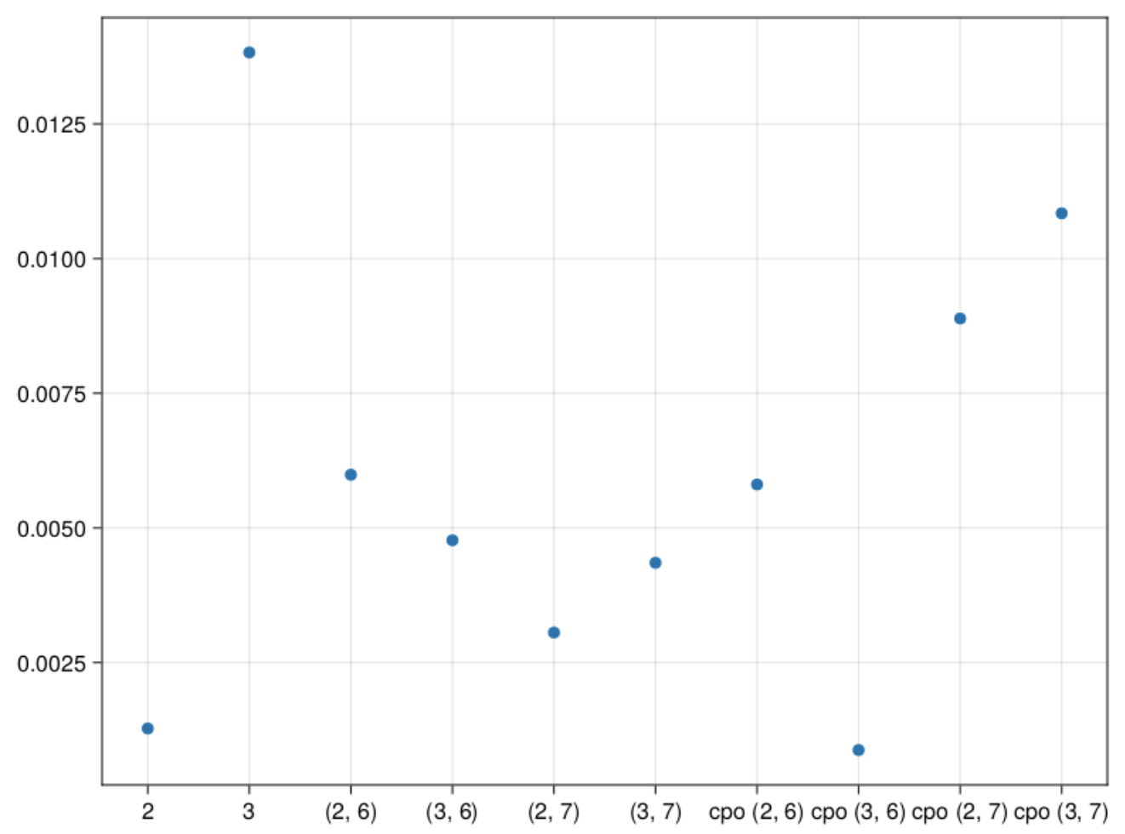
${αx}^{2}∗I\left(βy>0.3\right)$ error graph
2 – 2 stored moments
3 – 3 stored moments
(2,6) – 2 stored, 6 pseudo
(3,6) – 3 stored, 6 pseudo
(2,7) - 2 stored, 7 pseudo
(3,7) – 3 stored, 7 pseudo
cpo(2,6) – max cumulant order 2, order 6
cpo(3,6) – max cumulant order 3, order 6
cpo(2,7) – max cumulant order 3, order 7
cpo(3,7) – max cumulant order 3, order 7

Slide 16
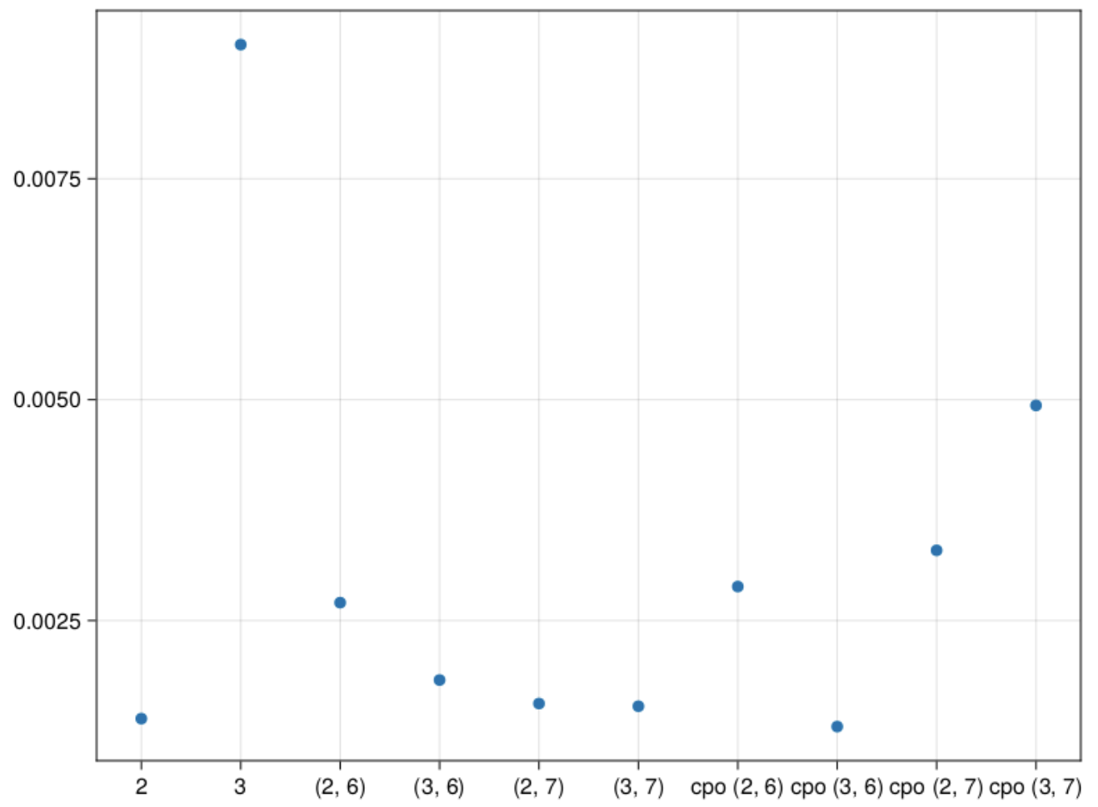
Average of previous 3
2 – 2 stored moments
3 – 3 stored moments
(2,6) – 2 stored, 6 pseudo
(3,6) – 3 stored, 6 pseudo
(2,7) - 2 stored, 7 pseudo
(3,7) – 3 stored, 7 pseudo
cpo(2,6) – max cumulant order 2, order 6
cpo(3,6) – max cumulant order 3, order 6
cpo(2,7) – max cumulant order 3, order 7
cpo(3,7) – max cumulant order 3, order 7

