Slide 1
Testing on Synthetic Data Continued
08/04/2023

Slide 2
Synthetic Data, Central-Limitized
X and Y are drawn from a skewed normal distribution
Z1 is a function dependent on X and Y
Z2 is a different function dependent on X and Y
Error is calculated as the absolute difference between the expectation of the sample and the approximate expectation through moments

Slide 3
Z1 = X^2 + Y^4; Z2 = X^2 + Y, Skewness = -4

Slide 4
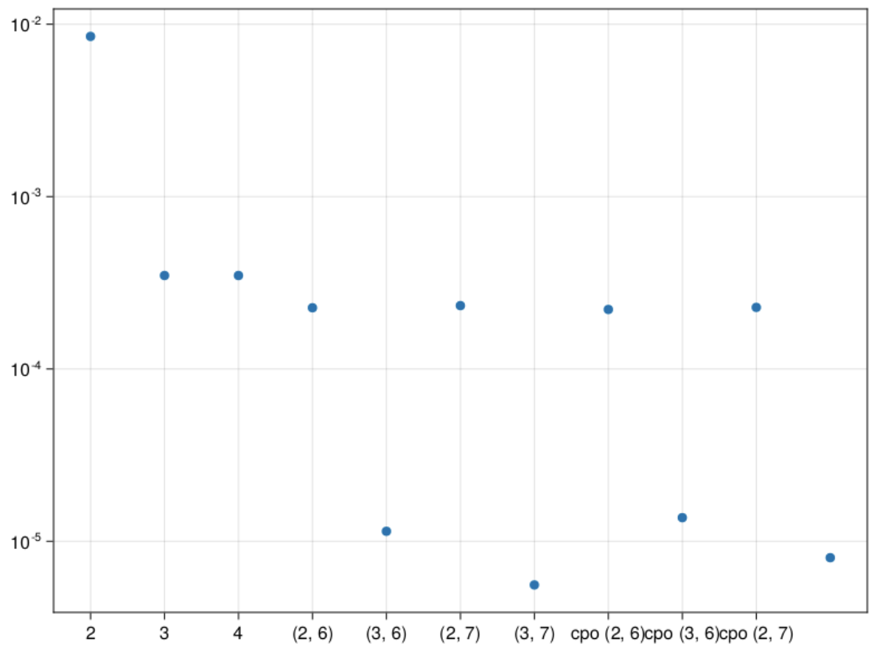
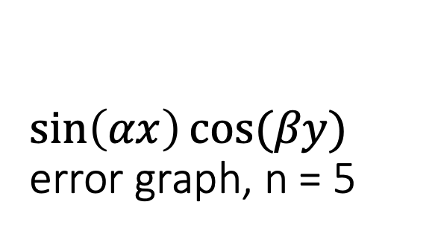
$\sin\left(αx\right)cos⁡(βy)$ error graph, n = 5
2 – 2 stored moments
3 – 3 stored moments
4 – 4 stored moments
(2,6) – 2 stored, 6 pseudo
(3,6) – 3 stored, 6 pseudo
(2,7) - 2 stored, 7 pseudo
(3,7) – 3 stored, 7 pseudo
cpo(2,6) – max cumulant order 2, order 6
cpo(3,6) – max cumulant order 3, order 6
cpo(2,7) – max cumulant order 3, order 7
cpo(3,7) – max cumulant order 3, order 7

Slide 5
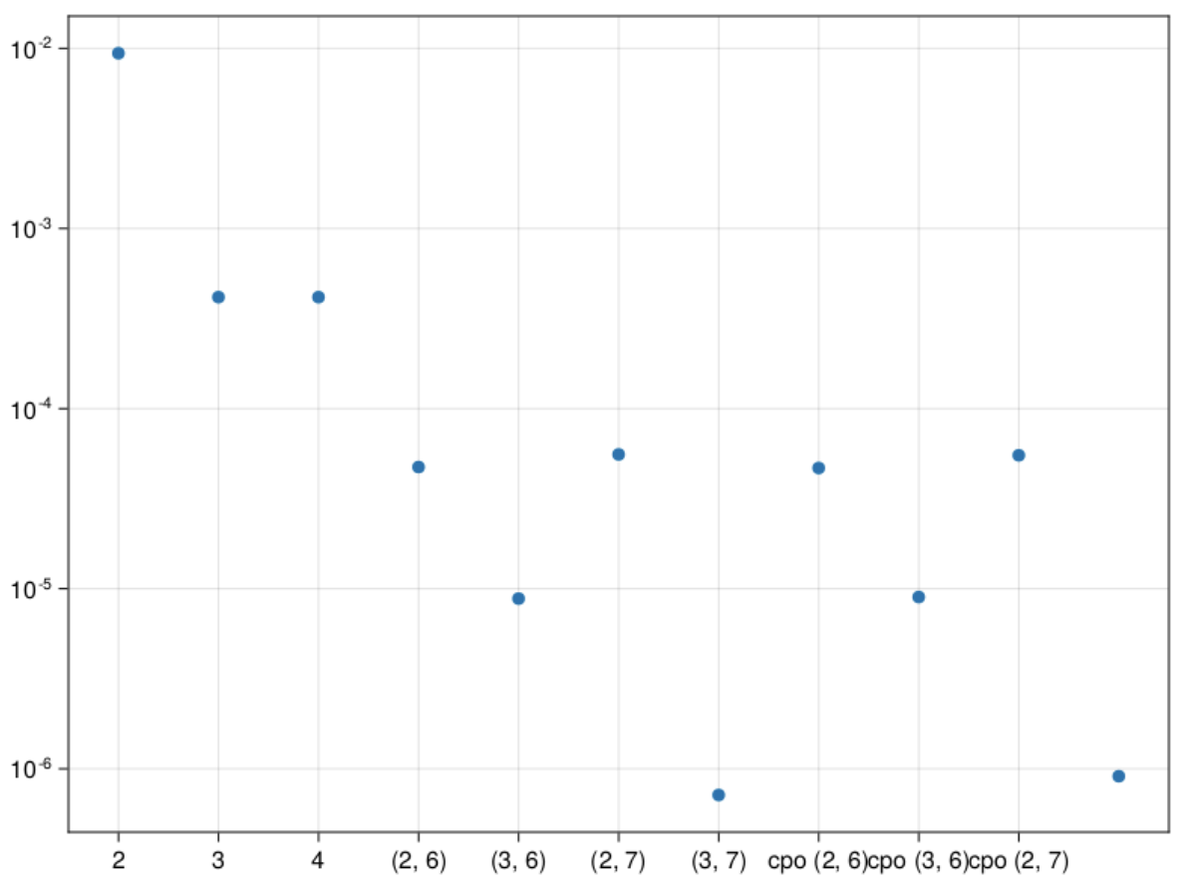
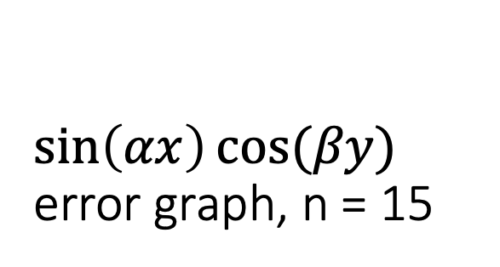
$\sin\left(αx\right)cos⁡(βy)$ error graph, n = 15
2 – 2 stored moments
3 – 3 stored moments
4 – 4 stored moments
(2,6) – 2 stored, 6 pseudo
(3,6) – 3 stored, 6 pseudo
(2,7) - 2 stored, 7 pseudo
(3,7) – 3 stored, 7 pseudo
cpo(2,6) – max cumulant order 2, order 6
cpo(3,6) – max cumulant order 3, order 6
cpo(2,7) – max cumulant order 3, order 7
cpo(3,7) – max cumulant order 3, order 7

Slide 6
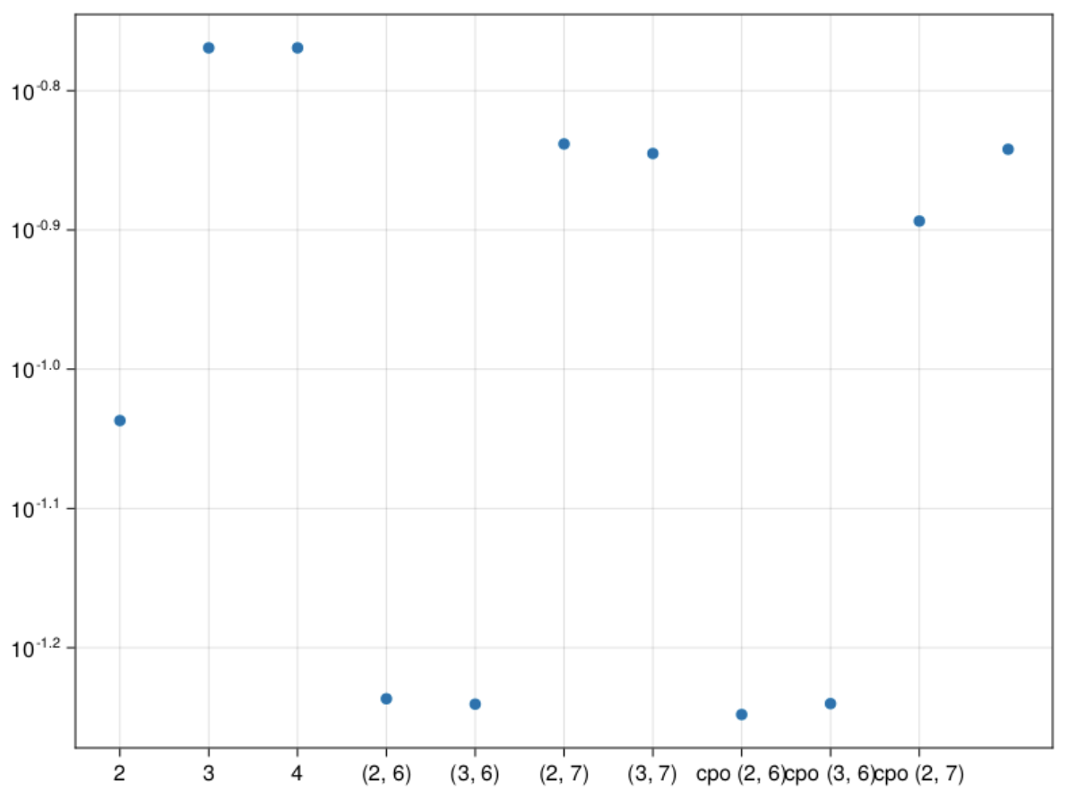
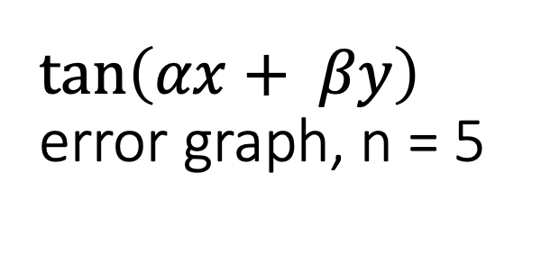
$\tan\left(αx+ βy\right)$ error graph, n = 5
2 – 2 stored moments
3 – 3 stored moments
(2,6) – 2 stored, 6 pseudo
(3,6) – 3 stored, 6 pseudo
(2,7) - 2 stored, 7 pseudo
(3,7) – 3 stored, 7 pseudo
cpo(2,6) – max cumulant order 2, order 6
cpo(3,6) – max cumulant order 3, order 6
cpo(2,7) – max cumulant order 3, order 7
cpo(3,7) – max cumulant order 3, order 7

Slide 7
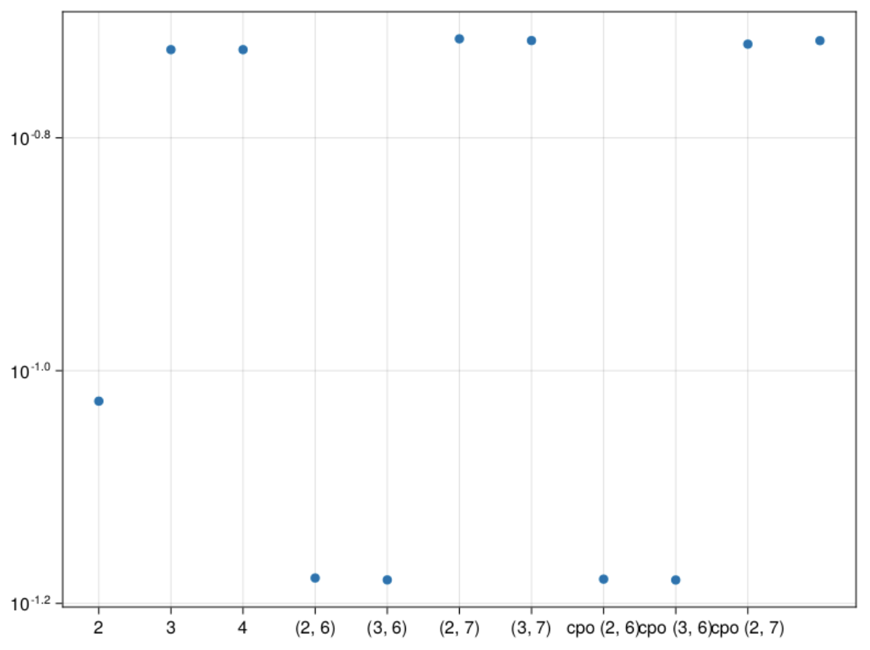
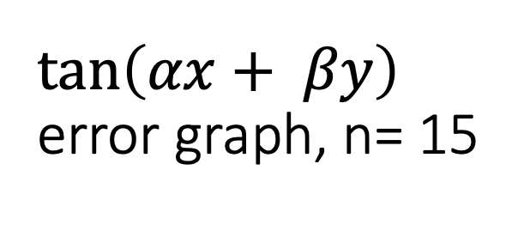
$\tan\left(αx+ βy\right)$ error graph, n= 15
2 – 2 stored moments
3 – 3 stored moments
(2,6) – 2 stored, 6 pseudo
(3,6) – 3 stored, 6 pseudo
(2,7) - 2 stored, 7 pseudo
(3,7) – 3 stored, 7 pseudo
cpo(2,6) – max cumulant order 2, order 6
cpo(3,6) – max cumulant order 3, order 6
cpo(2,7) – max cumulant order 3, order 7
cpo(3,7) – max cumulant order 3, order 7

Slide 8
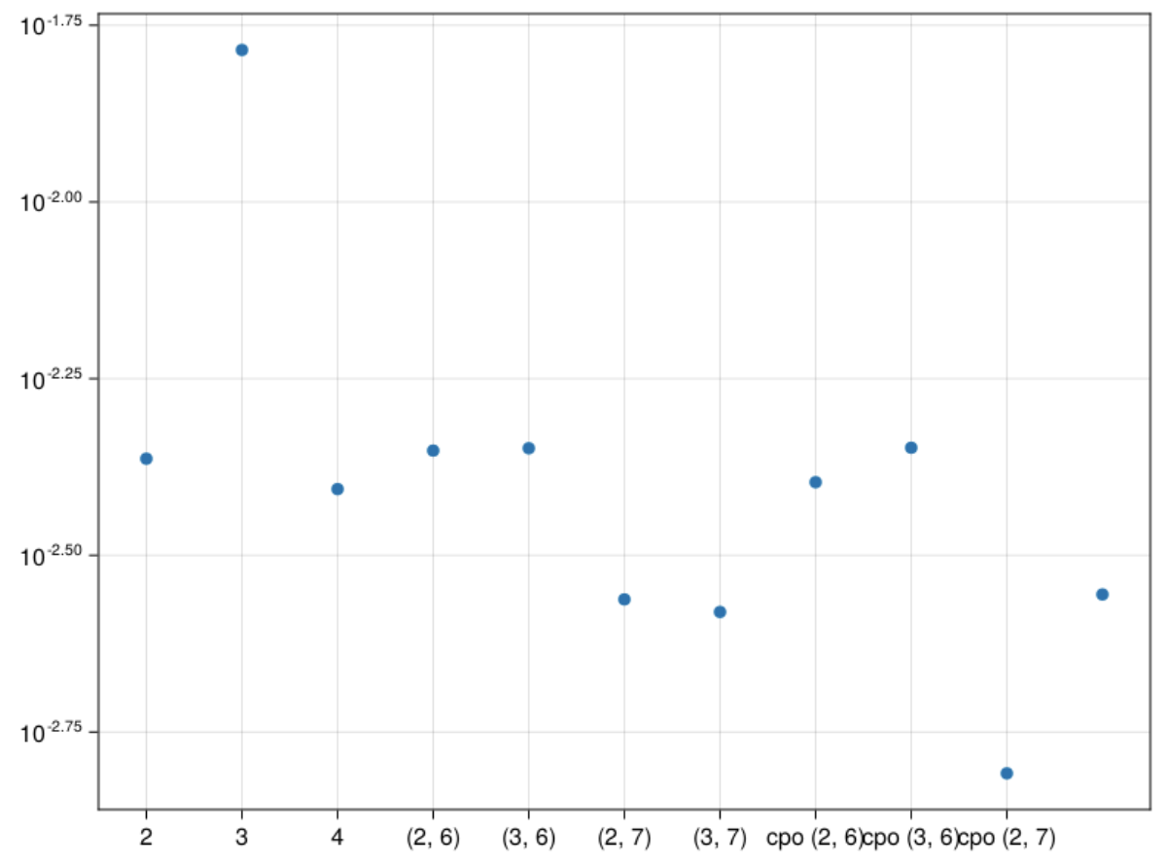

${αx}^{2}∗I\left(βy>0.3\right)$ error graph, n = 5
2 – 2 stored moments
3 – 3 stored moments
(2,6) – 2 stored, 6 pseudo
(3,6) – 3 stored, 6 pseudo
(2,7) - 2 stored, 7 pseudo
(3,7) – 3 stored, 7 pseudo
cpo(2,6) – max cumulant order 2, order 6
cpo(3,6) – max cumulant order 3, order 6
cpo(2,7) – max cumulant order 3, order 7
cpo(3,7) – max cumulant order 3, order 7

Slide 9
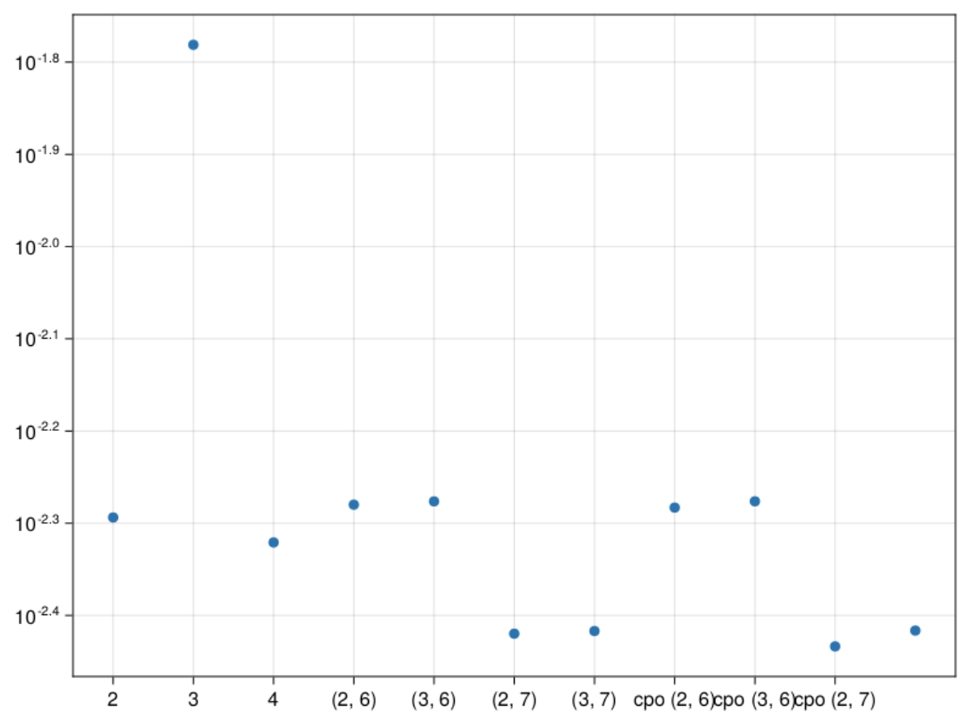

${αx}^{2}∗I\left(βy>0.3\right)$ error graph , n = 15
2 – 2 stored moments
3 – 3 stored moments
(2,6) – 2 stored, 6 pseudo
(3,6) – 3 stored, 6 pseudo
(2,7) - 2 stored, 7 pseudo
(3,7) – 3 stored, 7 pseudo
cpo(2,6) – max cumulant order 2, order 6
cpo(3,6) – max cumulant order 3, order 6
cpo(2,7) – max cumulant order 3, order 7
cpo(3,7) – max cumulant order 3, order 7

Slide 10
Z1 = X^2 + Y^4; Z2 = X^2 + Y, Skewness = -8

Slide 11
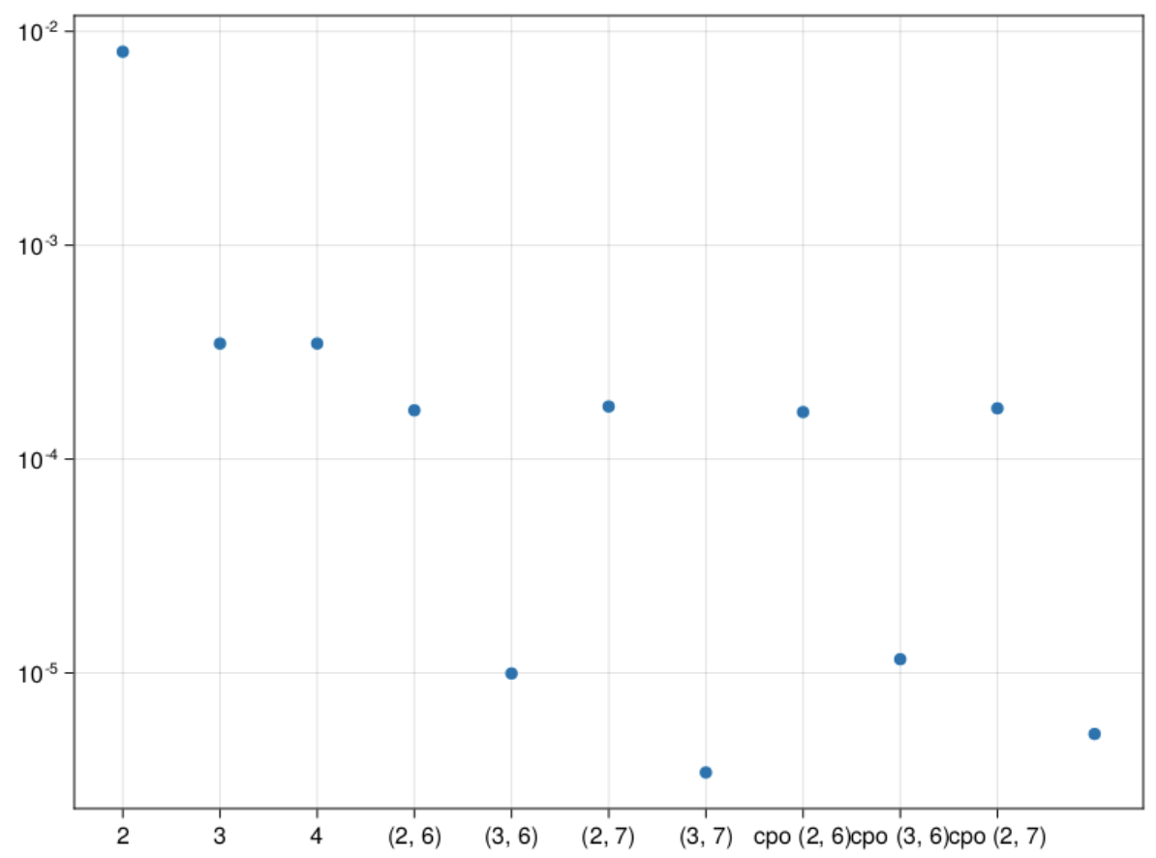
$\sin\left(αx\right)cos⁡(βy)$ error graph, n = 5
2 – 2 stored moments
3 – 3 stored moments
4 – 4 stored moments
(2,6) – 2 stored, 6 pseudo
(3,6) – 3 stored, 6 pseudo
(2,7) - 2 stored, 7 pseudo
(3,7) – 3 stored, 7 pseudo
cpo(2,6) – max cumulant order 2, order 6
cpo(3,6) – max cumulant order 3, order 6
cpo(2,7) – max cumulant order 3, order 7
cpo(3,7) – max cumulant order 3, order 7

Slide 12
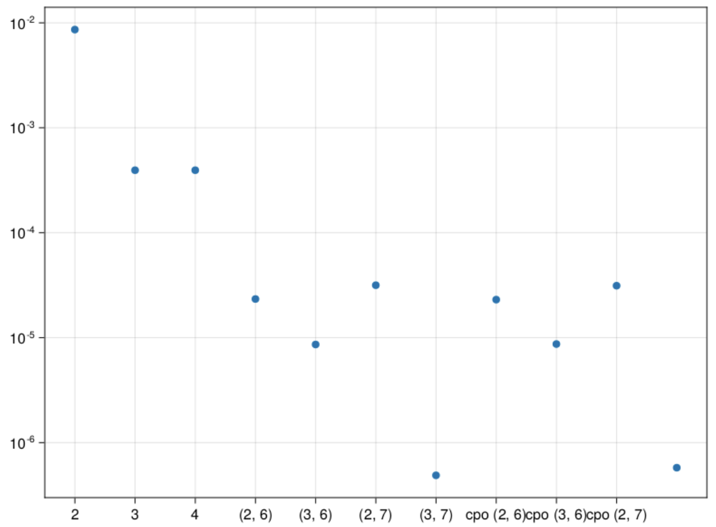
$\sin\left(αx\right)cos⁡(βy)$ error graph, n = 15
2 – 2 stored moments
3 – 3 stored moments
4 – 4 stored moments
(2,6) – 2 stored, 6 pseudo
(3,6) – 3 stored, 6 pseudo
(2,7) - 2 stored, 7 pseudo
(3,7) – 3 stored, 7 pseudo
cpo(2,6) – max cumulant order 2, order 6
cpo(3,6) – max cumulant order 3, order 6
cpo(2,7) – max cumulant order 3, order 7
cpo(3,7) – max cumulant order 3, order 7

Slide 13
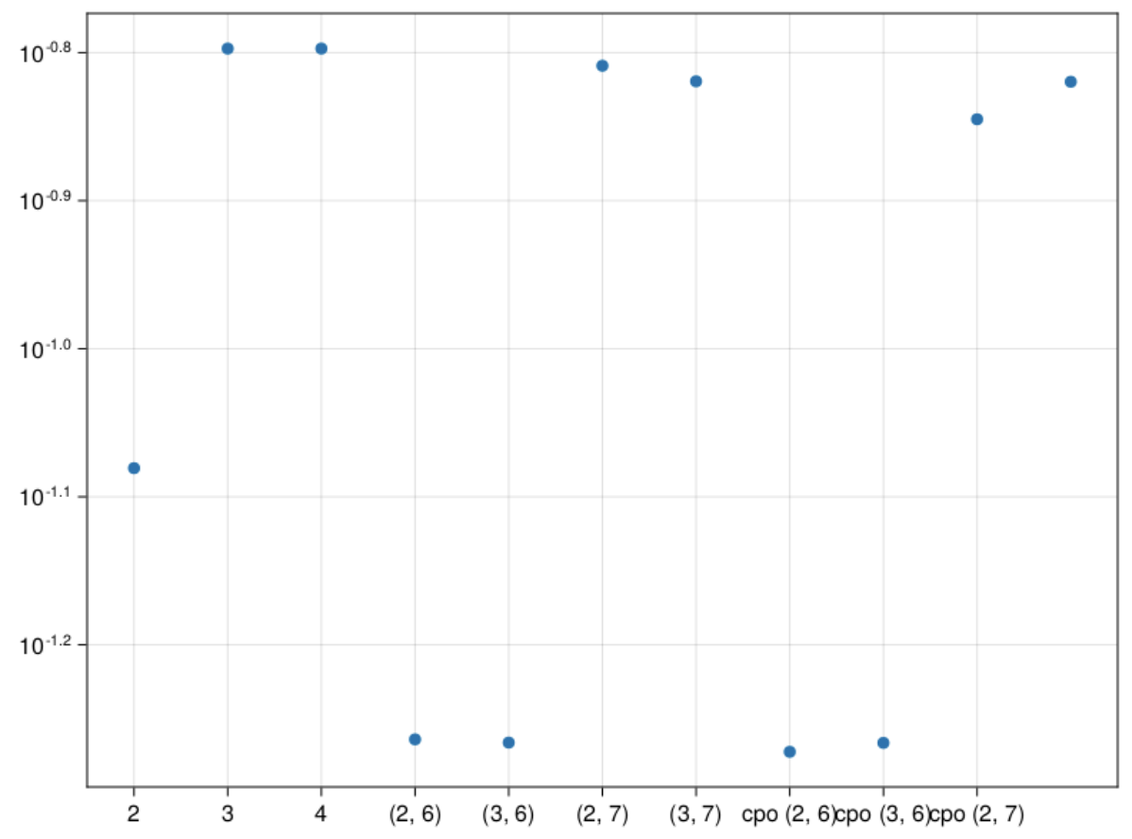
$\tan\left(αx+ βy\right)$ error graph, n = 5
2 – 2 stored moments
3 – 3 stored moments
(2,6) – 2 stored, 6 pseudo
(3,6) – 3 stored, 6 pseudo
(2,7) - 2 stored, 7 pseudo
(3,7) – 3 stored, 7 pseudo
cpo(2,6) – max cumulant order 2, order 6
cpo(3,6) – max cumulant order 3, order 6
cpo(2,7) – max cumulant order 3, order 7
cpo(3,7) – max cumulant order 3, order 7

Slide 14
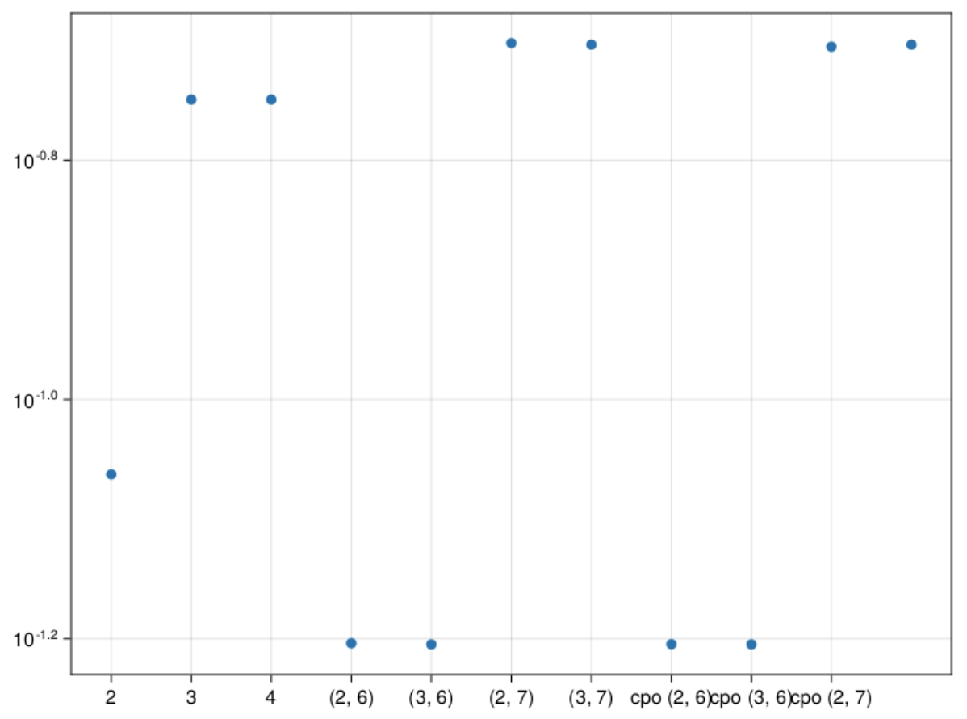
$\tan\left(αx+ βy\right)$ error graph, n= 15
2 – 2 stored moments
3 – 3 stored moments
(2,6) – 2 stored, 6 pseudo
(3,6) – 3 stored, 6 pseudo
(2,7) - 2 stored, 7 pseudo
(3,7) – 3 stored, 7 pseudo
cpo(2,6) – max cumulant order 2, order 6
cpo(3,6) – max cumulant order 3, order 6
cpo(2,7) – max cumulant order 3, order 7
cpo(3,7) – max cumulant order 3, order 7

Slide 15
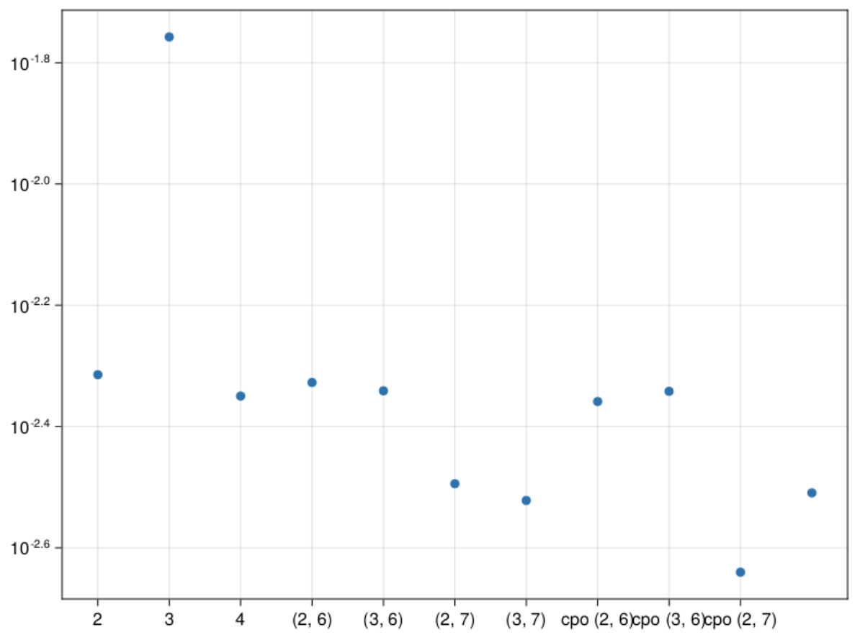
${αx}^{2}∗I\left(βy>0.3\right)$ error graph, n = 5
2 – 2 stored moments
3 – 3 stored moments
(2,6) – 2 stored, 6 pseudo
(3,6) – 3 stored, 6 pseudo
(2,7) - 2 stored, 7 pseudo
(3,7) – 3 stored, 7 pseudo
cpo(2,6) – max cumulant order 2, order 6
cpo(3,6) – max cumulant order 3, order 6
cpo(2,7) – max cumulant order 3, order 7
cpo(3,7) – max cumulant order 3, order 7

Slide 16
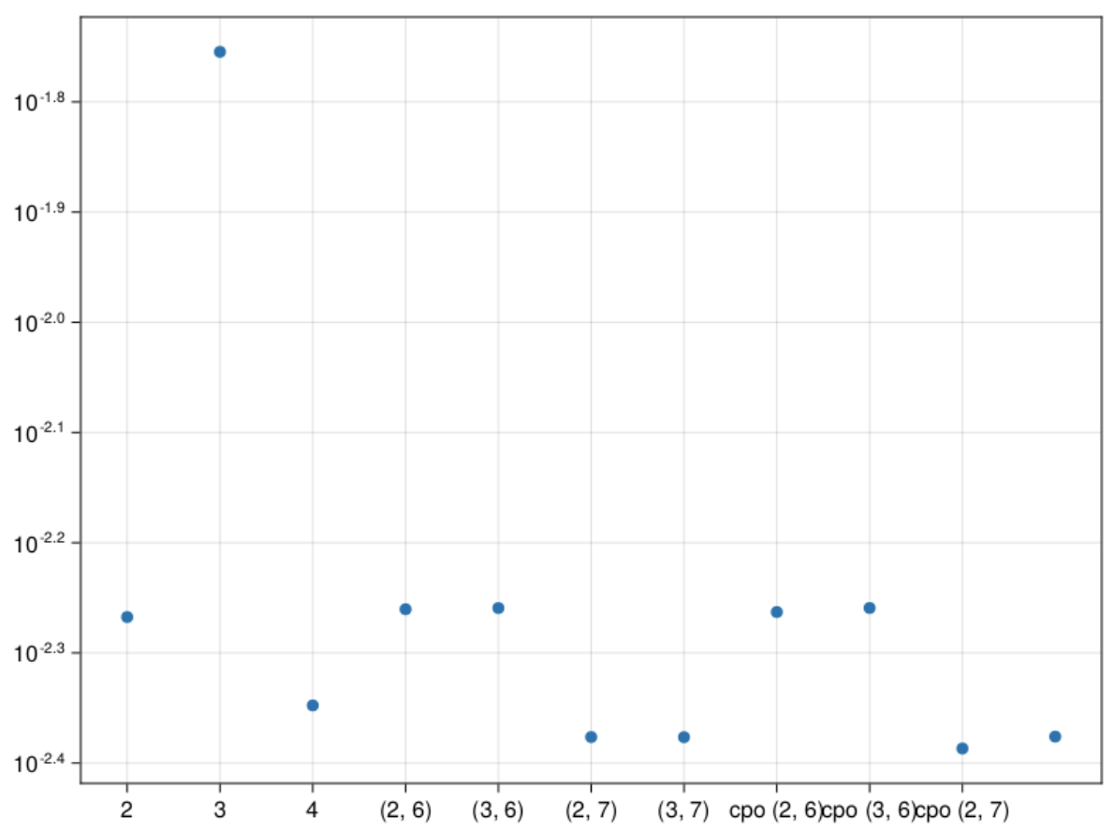
${αx}^{2}∗I\left(βy>0.3\right)$ error graph , n = 15
2 – 2 stored moments
3 – 3 stored moments
(2,6) – 2 stored, 6 pseudo
(3,6) – 3 stored, 6 pseudo
(2,7) - 2 stored, 7 pseudo
(3,7) – 3 stored, 7 pseudo
cpo(2,6) – max cumulant order 2, order 6
cpo(3,6) – max cumulant order 3, order 6
cpo(2,7) – max cumulant order 3, order 7
cpo(3,7) – max cumulant order 3, order 7

Slide 17
Z1 = X^2 + Y^4; Z2 = X^2 + Y, Skewness = -2

Slide 18
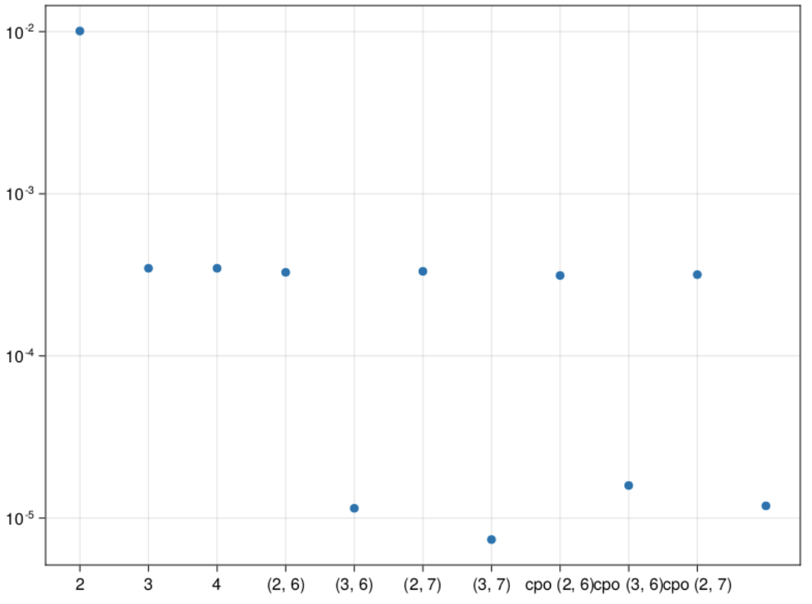
$\sin\left(αx\right)cos⁡(βy)$ error graph, n = 5
2 – 2 stored moments
3 – 3 stored moments
4 – 4 stored moments
(2,6) – 2 stored, 6 pseudo
(3,6) – 3 stored, 6 pseudo
(2,7) - 2 stored, 7 pseudo
(3,7) – 3 stored, 7 pseudo
cpo(2,6) – max cumulant order 2, order 6
cpo(3,6) – max cumulant order 3, order 6
cpo(2,7) – max cumulant order 3, order 7
cpo(3,7) – max cumulant order 3, order 7

Slide 19
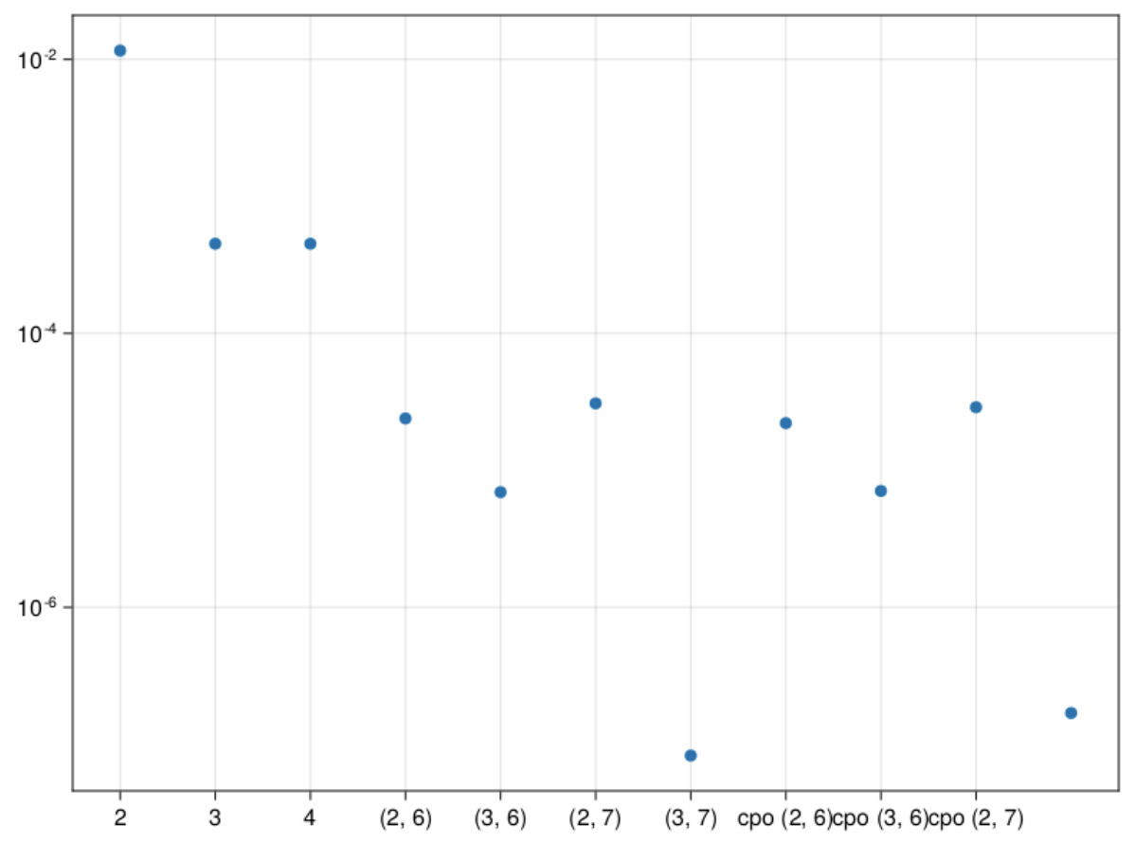
$\sin\left(αx\right)cos⁡(βy)$ error graph, n = 15
2 – 2 stored moments
3 – 3 stored moments
4 – 4 stored moments
(2,6) – 2 stored, 6 pseudo
(3,6) – 3 stored, 6 pseudo
(2,7) - 2 stored, 7 pseudo
(3,7) – 3 stored, 7 pseudo
cpo(2,6) – max cumulant order 2, order 6
cpo(3,6) – max cumulant order 3, order 6
cpo(2,7) – max cumulant order 3, order 7
cpo(3,7) – max cumulant order 3, order 7

Slide 20
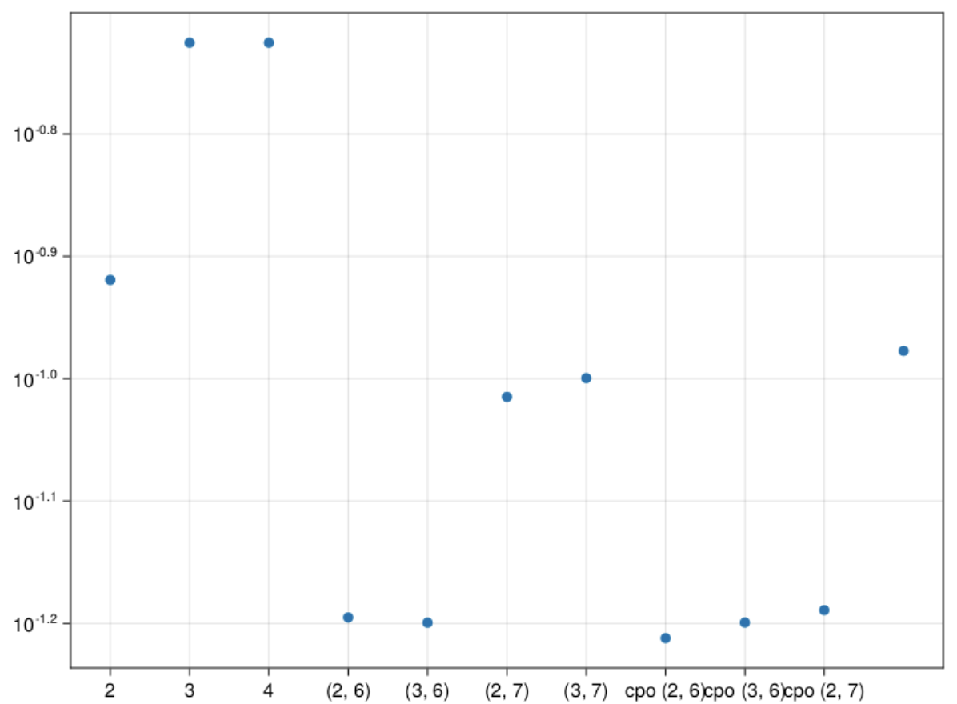
$\tan\left(αx+ βy\right)$ error graph, n = 5
2 – 2 stored moments
3 – 3 stored moments
(2,6) – 2 stored, 6 pseudo
(3,6) – 3 stored, 6 pseudo
(2,7) - 2 stored, 7 pseudo
(3,7) – 3 stored, 7 pseudo
cpo(2,6) – max cumulant order 2, order 6
cpo(3,6) – max cumulant order 3, order 6
cpo(2,7) – max cumulant order 3, order 7
cpo(3,7) – max cumulant order 3, order 7

Slide 21
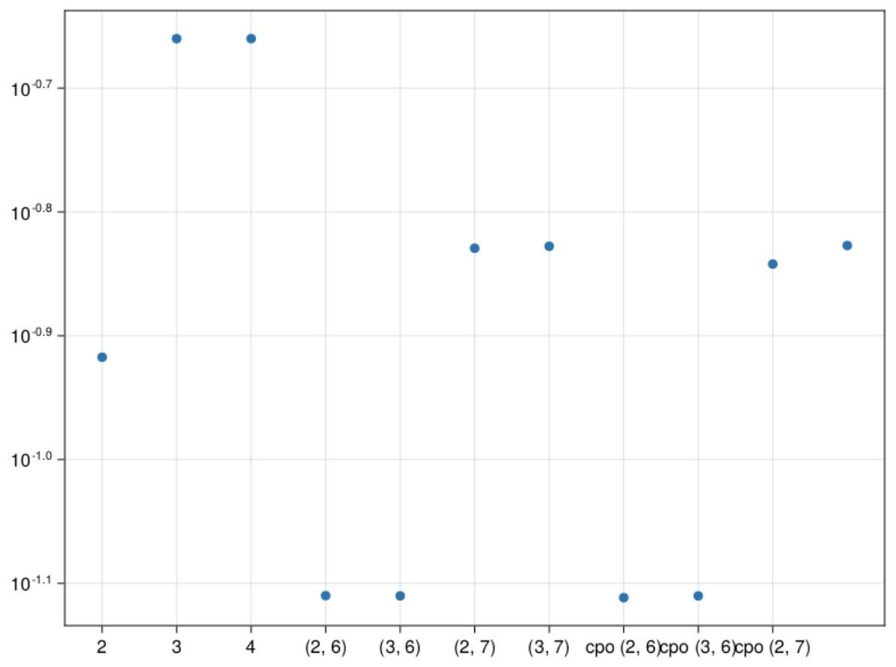
$\tan\left(αx+ βy\right)$ error graph, n= 15
2 – 2 stored moments
3 – 3 stored moments
(2,6) – 2 stored, 6 pseudo
(3,6) – 3 stored, 6 pseudo
(2,7) - 2 stored, 7 pseudo
(3,7) – 3 stored, 7 pseudo
cpo(2,6) – max cumulant order 2, order 6
cpo(3,6) – max cumulant order 3, order 6
cpo(2,7) – max cumulant order 3, order 7
cpo(3,7) – max cumulant order 3, order 7

Slide 22
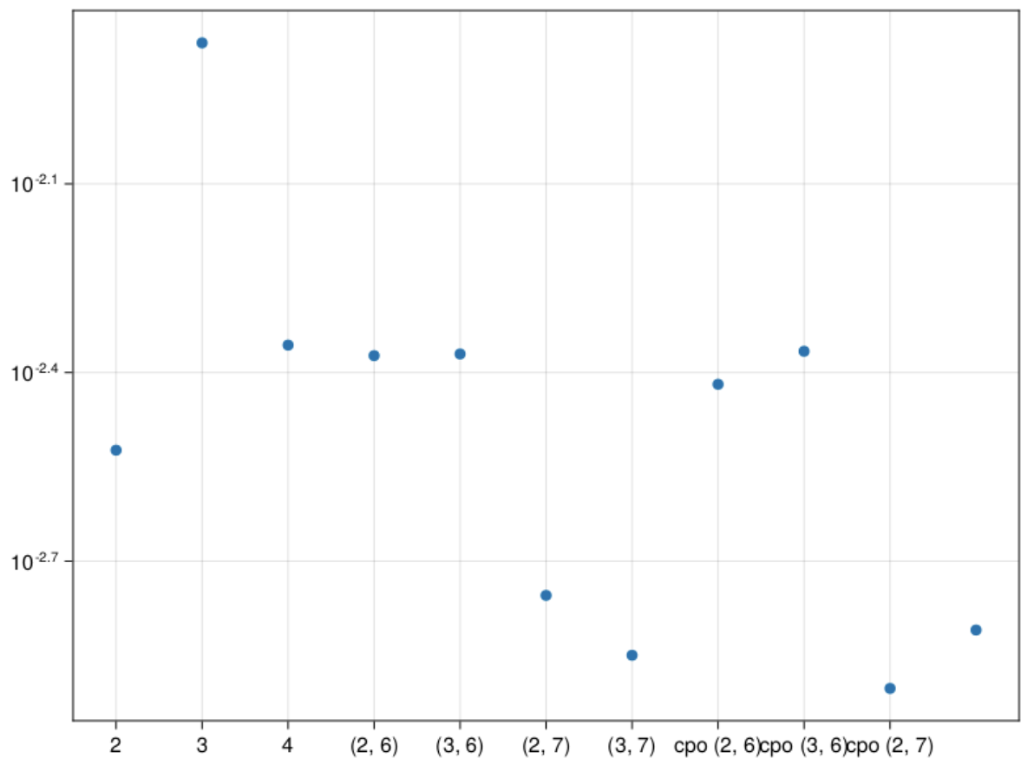
${αx}^{2}∗I\left(βy>0.3\right)$ error graph, n = 5
2 – 2 stored moments
3 – 3 stored moments
(2,6) – 2 stored, 6 pseudo
(3,6) – 3 stored, 6 pseudo
(2,7) - 2 stored, 7 pseudo
(3,7) – 3 stored, 7 pseudo
cpo(2,6) – max cumulant order 2, order 6
cpo(3,6) – max cumulant order 3, order 6
cpo(2,7) – max cumulant order 3, order 7
cpo(3,7) – max cumulant order 3, order 7

Slide 23
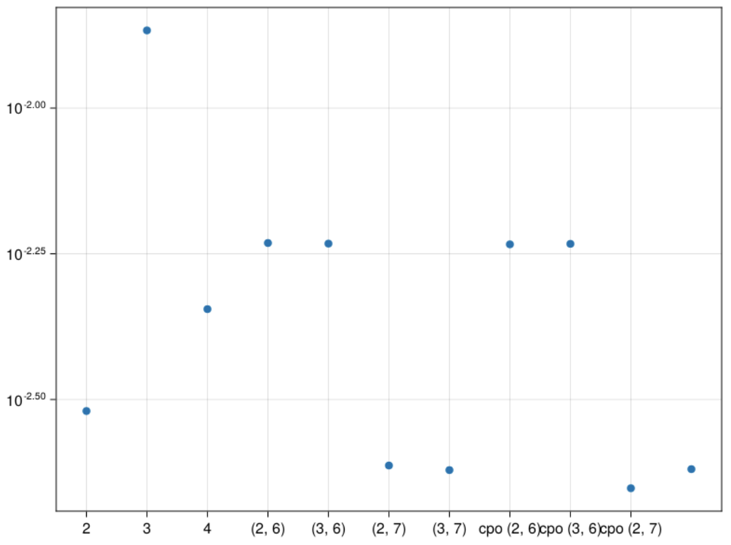
${αx}^{2}∗I\left(βy>0.3\right)$ error graph , n = 15
2 – 2 stored moments
3 – 3 stored moments
(2,6) – 2 stored, 6 pseudo
(3,6) – 3 stored, 6 pseudo
(2,7) - 2 stored, 7 pseudo
(3,7) – 3 stored, 7 pseudo
cpo(2,6) – max cumulant order 2, order 6
cpo(3,6) – max cumulant order 3, order 6
cpo(2,7) – max cumulant order 3, order 7
cpo(3,7) – max cumulant order 3, order 7

Slide 24
Z1 = 0.5X + Y^3; Z2 = X^2 + Y^2, Skewness = -4

Slide 25
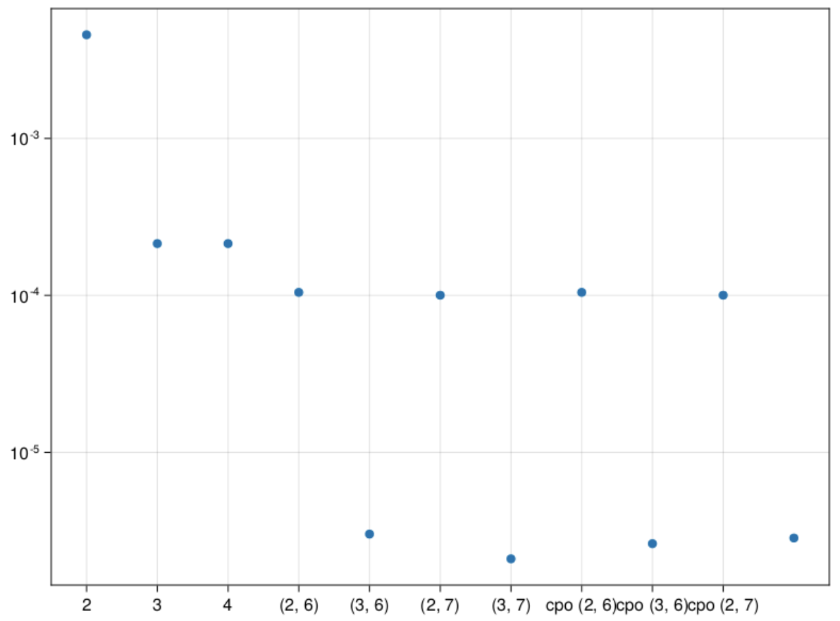
$\sin\left(αx\right)cos⁡(βy)$ error graph, n = 5
2 – 2 stored moments
3 – 3 stored moments
4 – 4 stored moments
(2,6) – 2 stored, 6 pseudo
(3,6) – 3 stored, 6 pseudo
(2,7) - 2 stored, 7 pseudo
(3,7) – 3 stored, 7 pseudo
cpo(2,6) – max cumulant order 2, order 6
cpo(3,6) – max cumulant order 3, order 6
cpo(2,7) – max cumulant order 3, order 7
cpo(3,7) – max cumulant order 3, order 7

Slide 26
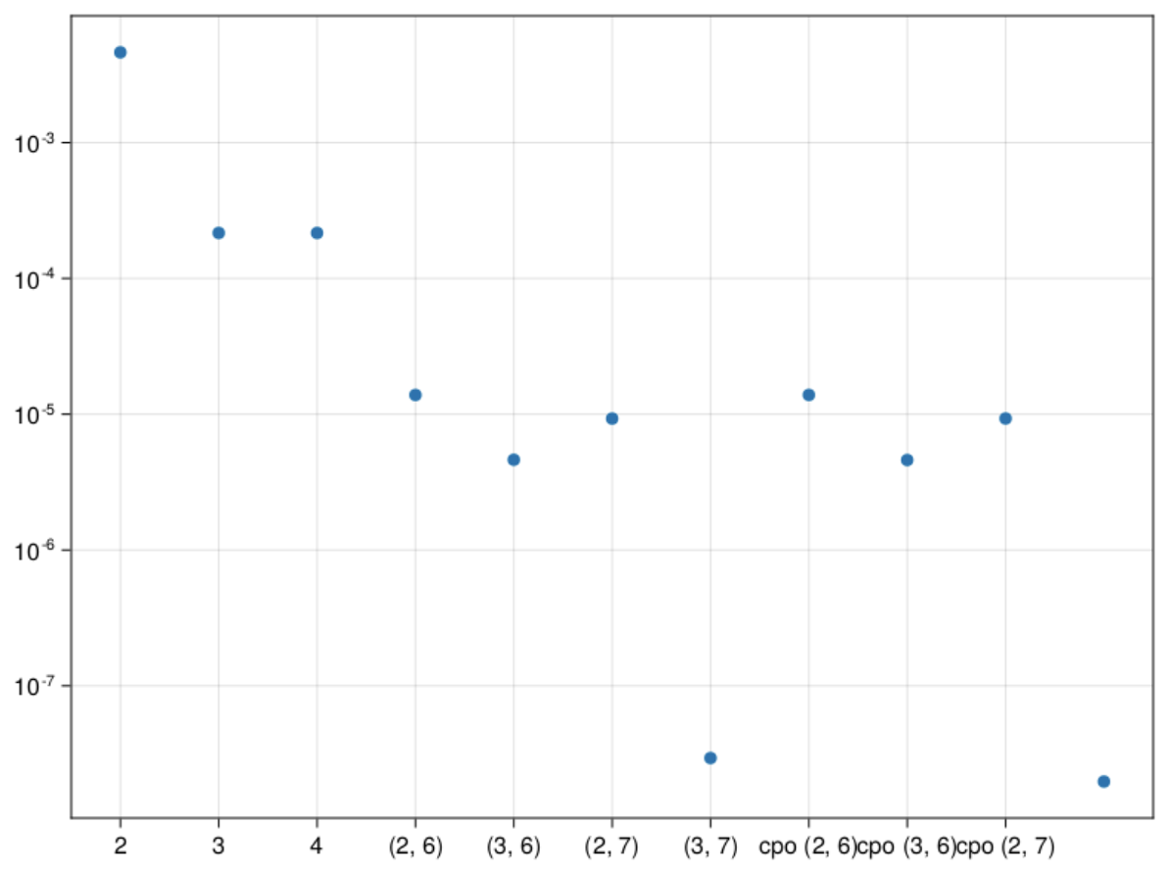
$\sin\left(αx\right)cos⁡(βy)$ error graph, n = 15
2 – 2 stored moments
3 – 3 stored moments
4 – 4 stored moments
(2,6) – 2 stored, 6 pseudo
(3,6) – 3 stored, 6 pseudo
(2,7) - 2 stored, 7 pseudo
(3,7) – 3 stored, 7 pseudo
cpo(2,6) – max cumulant order 2, order 6
cpo(3,6) – max cumulant order 3, order 6
cpo(2,7) – max cumulant order 3, order 7
cpo(3,7) – max cumulant order 3, order 7

Slide 27
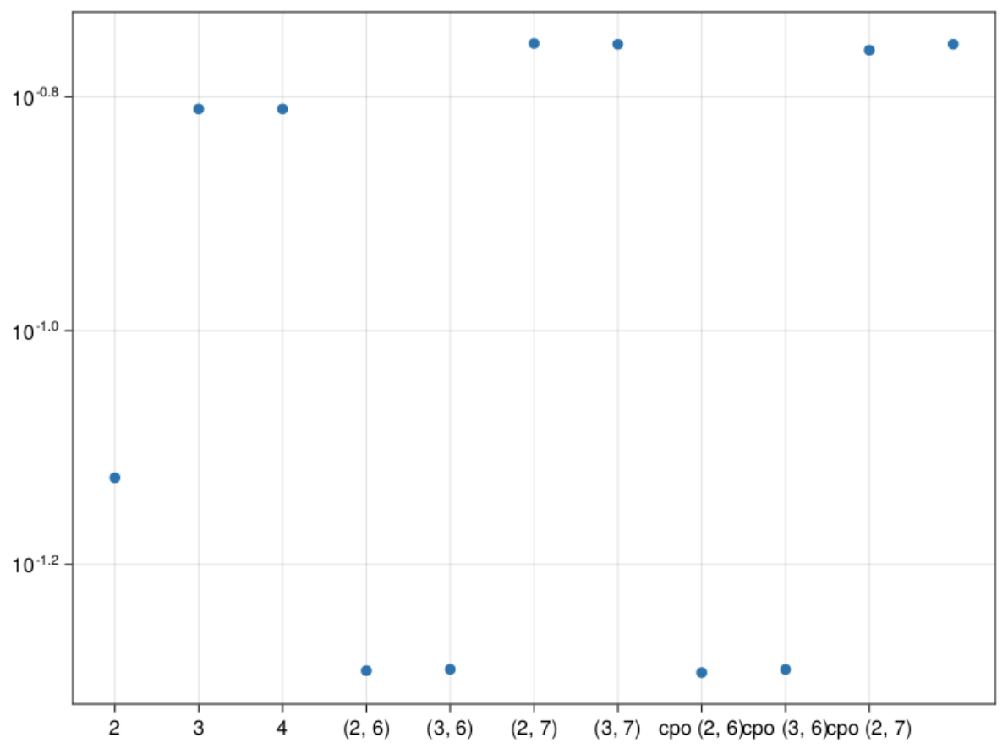
$\tan\left(αx+ βy\right)$ error graph, n = 5
2 – 2 stored moments
3 – 3 stored moments
(2,6) – 2 stored, 6 pseudo
(3,6) – 3 stored, 6 pseudo
(2,7) - 2 stored, 7 pseudo
(3,7) – 3 stored, 7 pseudo
cpo(2,6) – max cumulant order 2, order 6
cpo(3,6) – max cumulant order 3, order 6
cpo(2,7) – max cumulant order 3, order 7
cpo(3,7) – max cumulant order 3, order 7

Slide 28
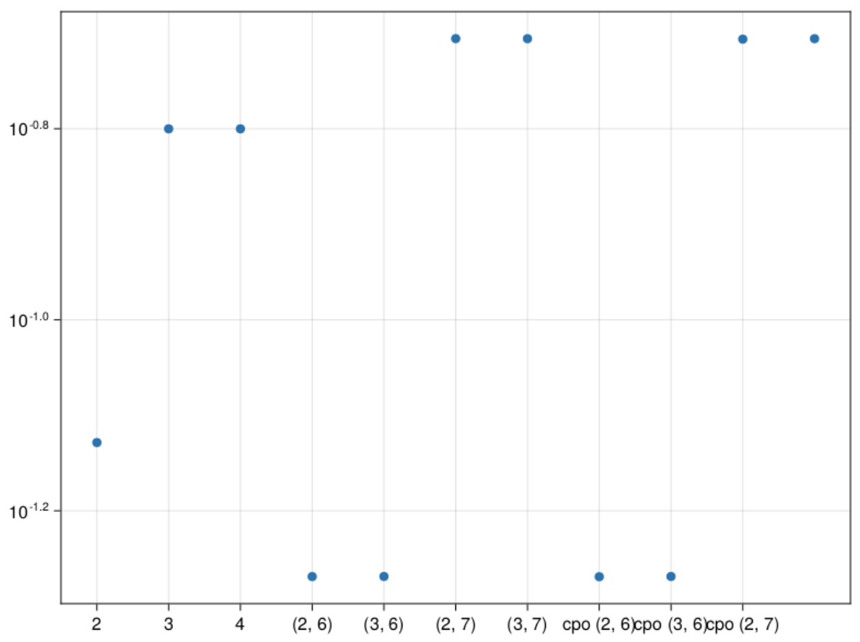
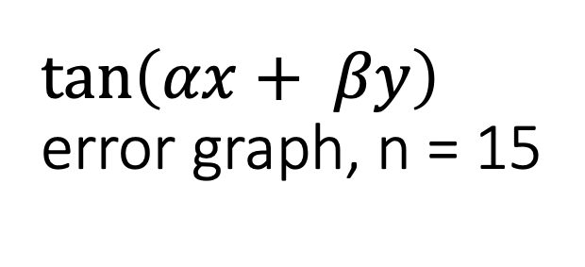
$\tan\left(αx+ βy\right)$ error graph, n = 15
2 – 2 stored moments
3 – 3 stored moments
(2,6) – 2 stored, 6 pseudo
(3,6) – 3 stored, 6 pseudo
(2,7) - 2 stored, 7 pseudo
(3,7) – 3 stored, 7 pseudo
cpo(2,6) – max cumulant order 2, order 6
cpo(3,6) – max cumulant order 3, order 6
cpo(2,7) – max cumulant order 3, order 7
cpo(3,7) – max cumulant order 3, order 7

Slide 29
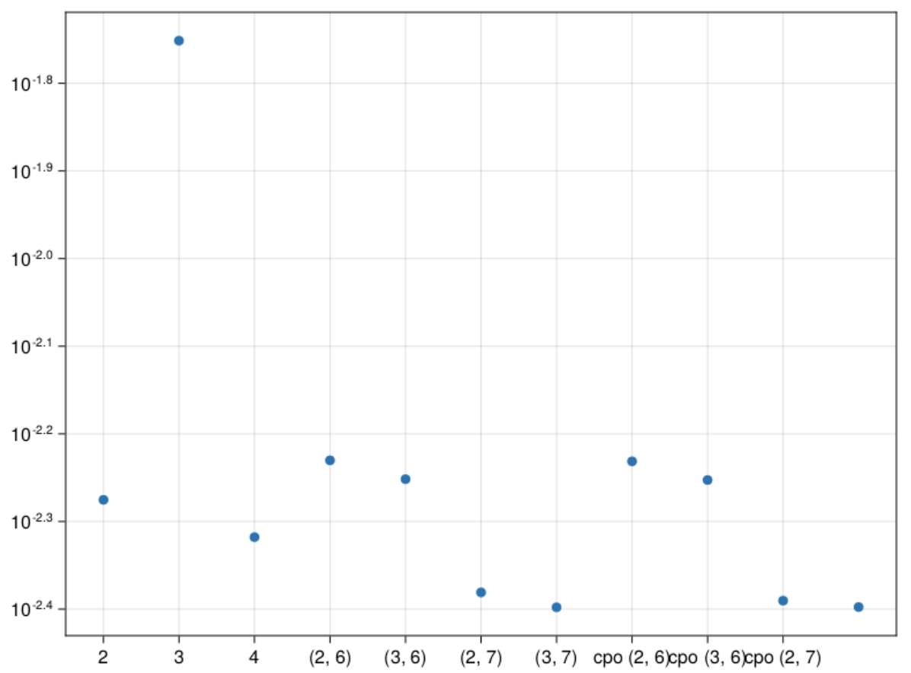
${αx}^{2}∗I\left(βy>0.3\right)$ error graph, n = 5
2 – 2 stored moments
3 – 3 stored moments
(2,6) – 2 stored, 6 pseudo
(3,6) – 3 stored, 6 pseudo
(2,7) - 2 stored, 7 pseudo
(3,7) – 3 stored, 7 pseudo
cpo(2,6) – max cumulant order 2, order 6
cpo(3,6) – max cumulant order 3, order 6
cpo(2,7) – max cumulant order 3, order 7
cpo(3,7) – max cumulant order 3, order 7

Slide 30
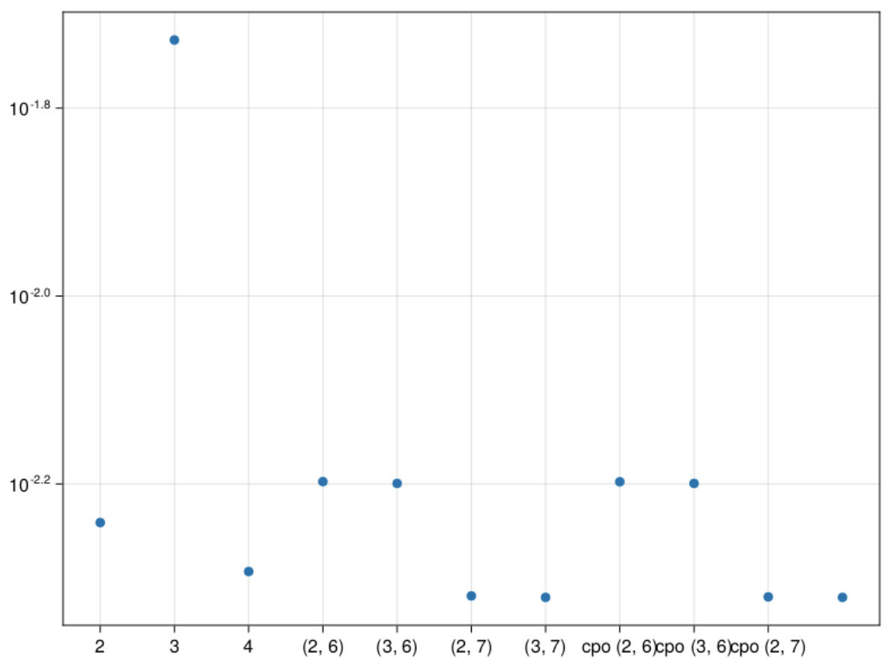
${αx}^{2}∗I\left(βy>0.3\right)$ error graph , n = 15
2 – 2 stored moments
3 – 3 stored moments
(2,6) – 2 stored, 6 pseudo
(3,6) – 3 stored, 6 pseudo
(2,7) - 2 stored, 7 pseudo
(3,7) – 3 stored, 7 pseudo
cpo(2,6) – max cumulant order 2, order 6
cpo(3,6) – max cumulant order 3, order 6
cpo(2,7) – max cumulant order 3, order 7
cpo(3,7) – max cumulant order 3, order 7

Slide 31
Z1 = 0.7X^2 + 0.4Y; Z2 = sin(X)cos(Y) Skewness = -4

Slide 32
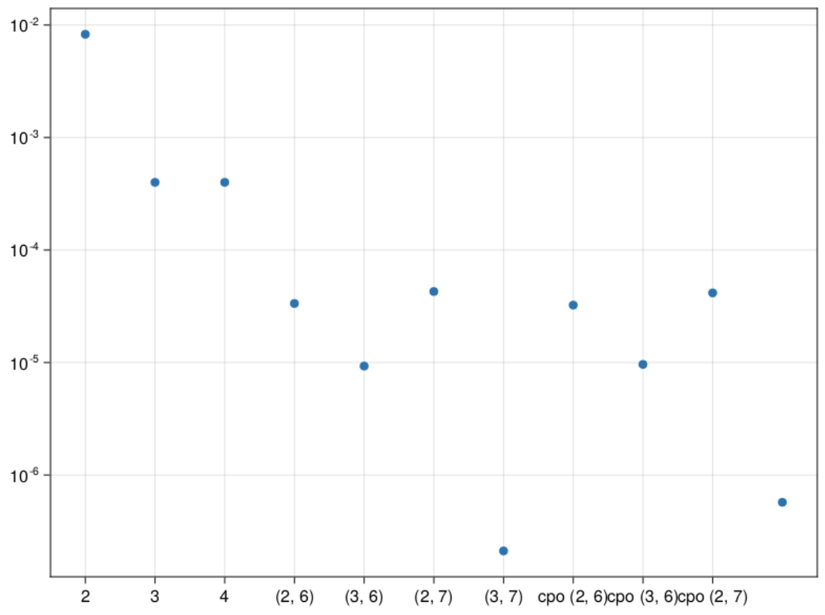
$\sin\left(αx\right)cos⁡(βy)$ error graph, n = 5
2 – 2 stored moments
3 – 3 stored moments
4 – 4 stored moments
(2,6) – 2 stored, 6 pseudo
(3,6) – 3 stored, 6 pseudo
(2,7) - 2 stored, 7 pseudo
(3,7) – 3 stored, 7 pseudo
cpo(2,6) – max cumulant order 2, order 6
cpo(3,6) – max cumulant order 3, order 6
cpo(2,7) – max cumulant order 3, order 7
cpo(3,7) – max cumulant order 3, order 7

Slide 33
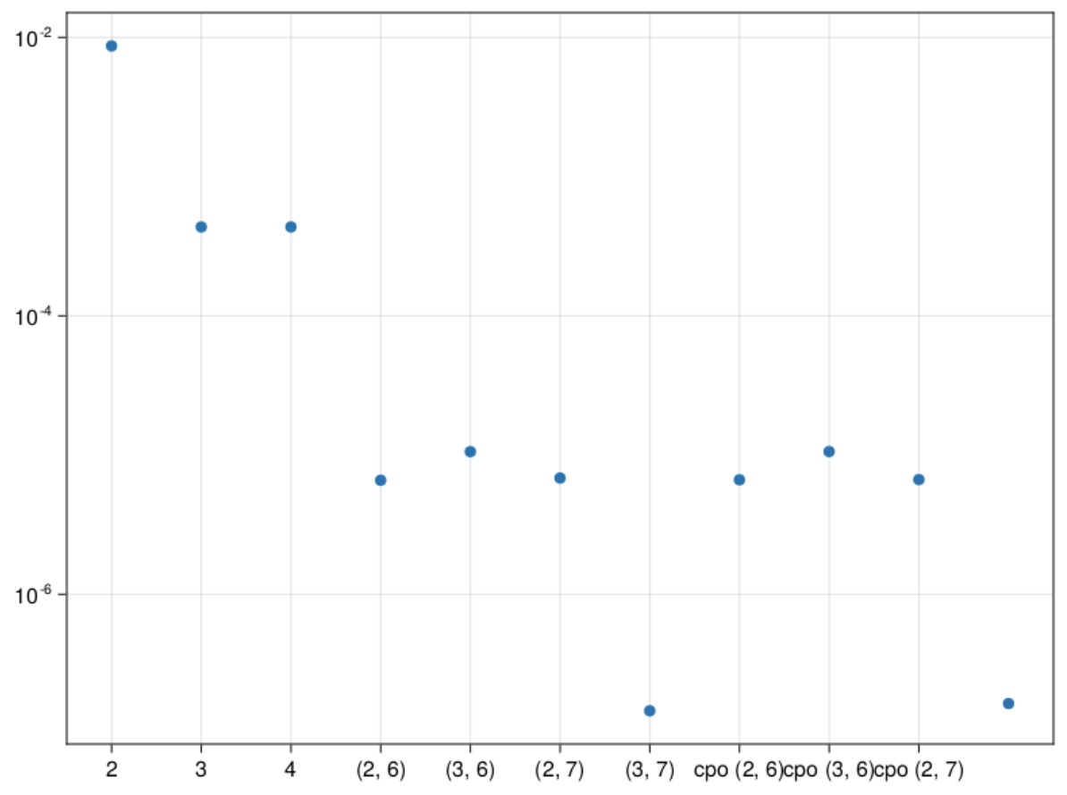
$\sin\left(αx\right)cos⁡(βy)$ error graph, n = 15
2 – 2 stored moments
3 – 3 stored moments
4 – 4 stored moments
(2,6) – 2 stored, 6 pseudo
(3,6) – 3 stored, 6 pseudo
(2,7) - 2 stored, 7 pseudo
(3,7) – 3 stored, 7 pseudo
cpo(2,6) – max cumulant order 2, order 6
cpo(3,6) – max cumulant order 3, order 6
cpo(2,7) – max cumulant order 3, order 7
cpo(3,7) – max cumulant order 3, order 7

Slide 34
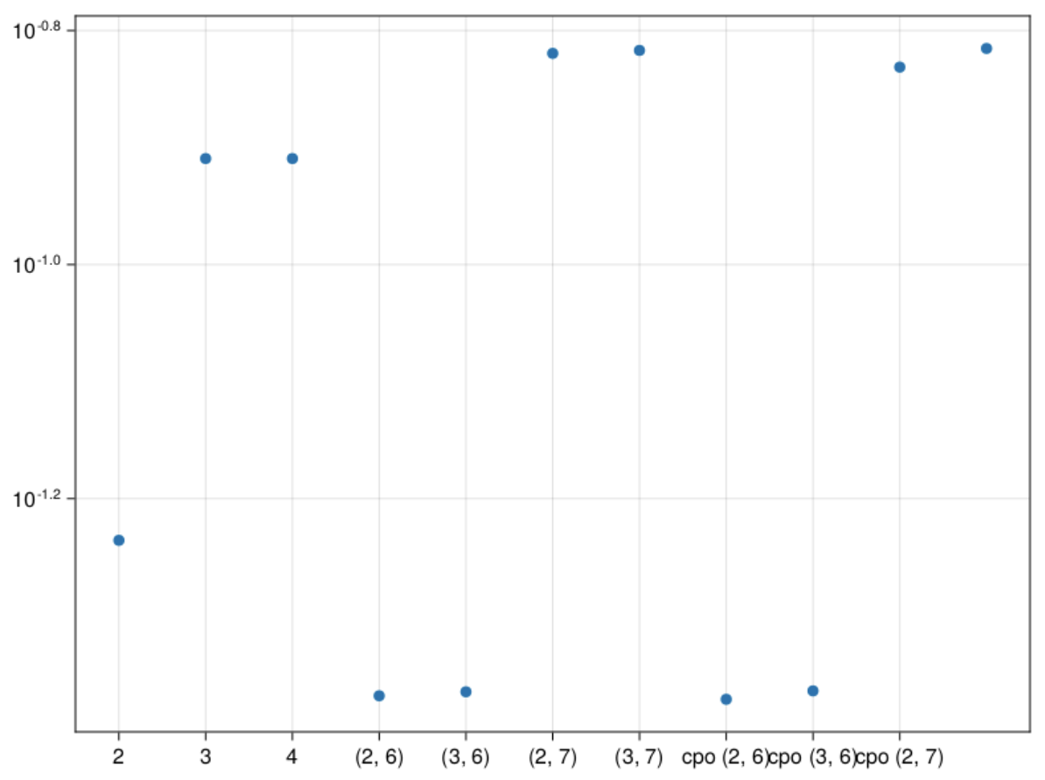
$\tan\left(αx+ βy\right)$ error graph, n = 5
2 – 2 stored moments
3 – 3 stored moments
(2,6) – 2 stored, 6 pseudo
(3,6) – 3 stored, 6 pseudo
(2,7) - 2 stored, 7 pseudo
(3,7) – 3 stored, 7 pseudo
cpo(2,6) – max cumulant order 2, order 6
cpo(3,6) – max cumulant order 3, order 6
cpo(2,7) – max cumulant order 3, order 7
cpo(3,7) – max cumulant order 3, order 7

Slide 35
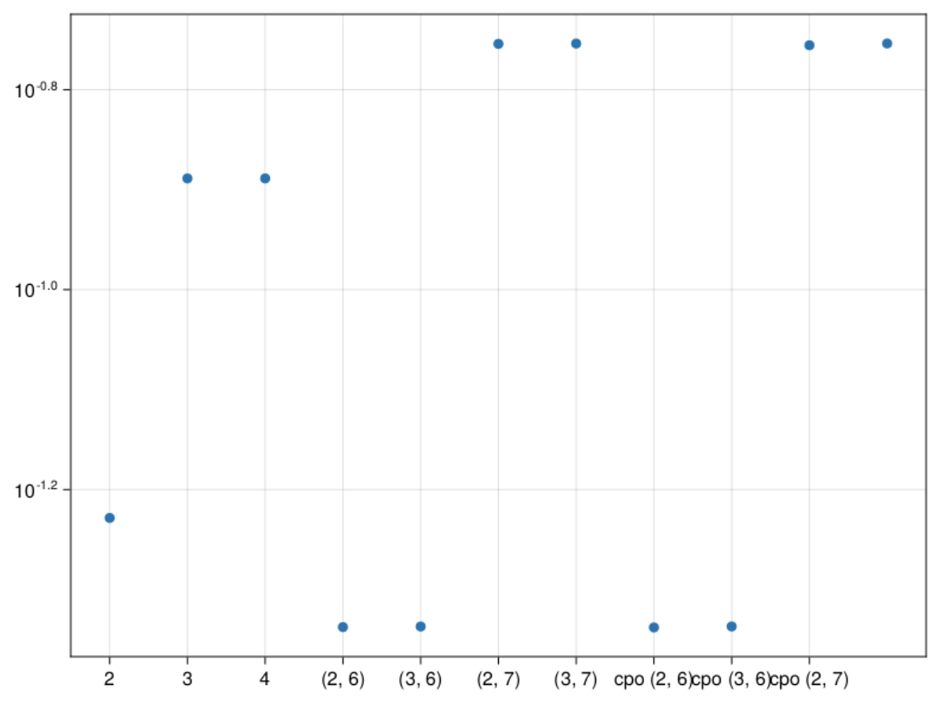
$\tan\left(αx+ βy\right)$ error graph, n = 15
2 – 2 stored moments
3 – 3 stored moments
(2,6) – 2 stored, 6 pseudo
(3,6) – 3 stored, 6 pseudo
(2,7) - 2 stored, 7 pseudo
(3,7) – 3 stored, 7 pseudo
cpo(2,6) – max cumulant order 2, order 6
cpo(3,6) – max cumulant order 3, order 6
cpo(2,7) – max cumulant order 3, order 7
cpo(3,7) – max cumulant order 3, order 7

Slide 36
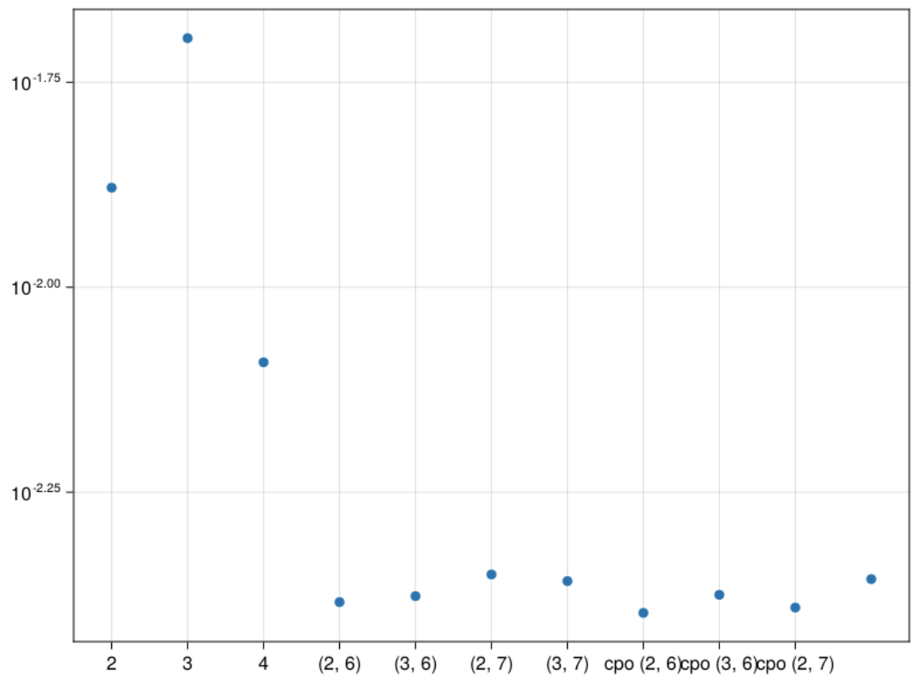
${αx}^{2}∗I\left(βy>0.3\right)$ error graph, n = 5
2 – 2 stored moments
3 – 3 stored moments
(2,6) – 2 stored, 6 pseudo
(3,6) – 3 stored, 6 pseudo
(2,7) - 2 stored, 7 pseudo
(3,7) – 3 stored, 7 pseudo
cpo(2,6) – max cumulant order 2, order 6
cpo(3,6) – max cumulant order 3, order 6
cpo(2,7) – max cumulant order 3, order 7
cpo(3,7) – max cumulant order 3, order 7

Slide 37
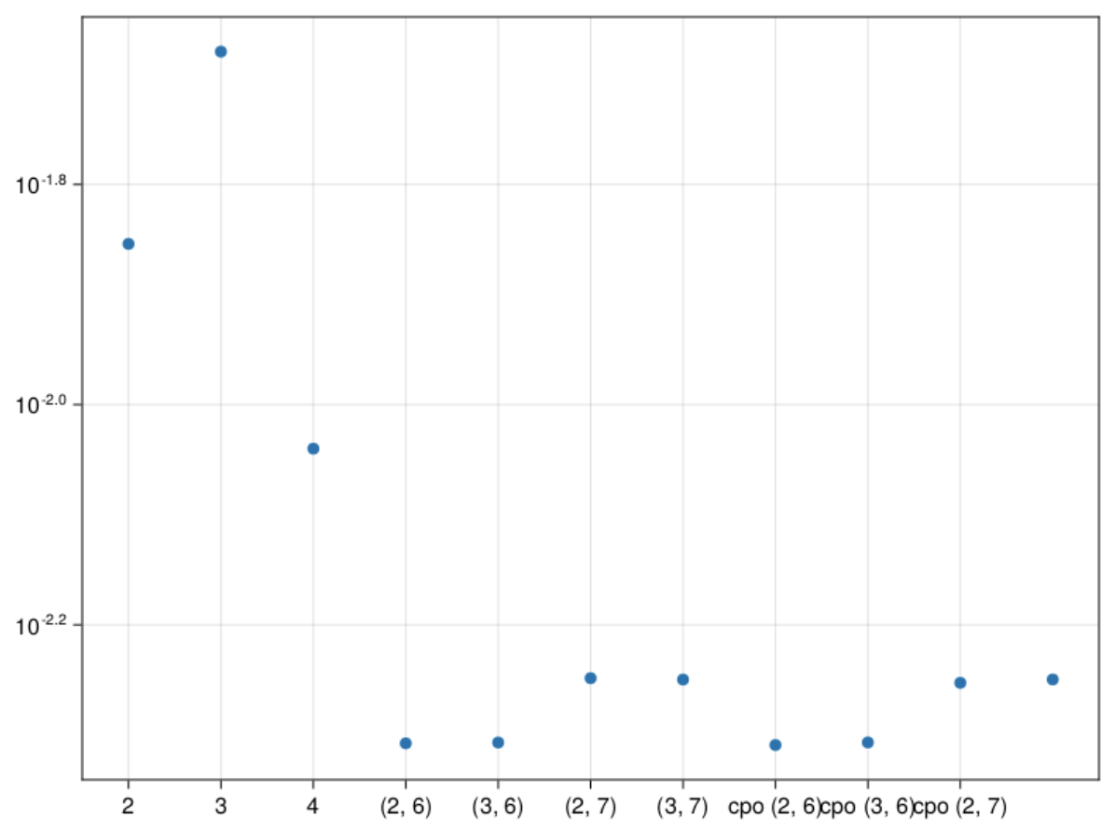
${αx}^{2}∗I\left(βy>0.3\right)$ error graph , n = 15
2 – 2 stored moments
3 – 3 stored moments
(2,6) – 2 stored, 6 pseudo
(3,6) – 3 stored, 6 pseudo
(2,7) - 2 stored, 7 pseudo
(3,7) – 3 stored, 7 pseudo
cpo(2,6) – max cumulant order 2, order 6
cpo(3,6) – max cumulant order 3, order 6
cpo(2,7) – max cumulant order 3, order 7
cpo(3,7) – max cumulant order 3, order 7

