Slide 1
SENNETT MIDDLE
2006-07
DATA: DEMOGRAPHICS
ACADEMIC ACHIEVEMENT
BEHAVIOR/DISCIPLINE
ATTENDANCE
CLIMATE SURVEY

Slide 2
STUDENT DEMOGRAPHICS

Slide 3
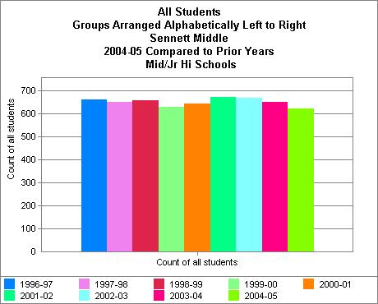
Notes:
Slight decrease in our overall enrollment (659 students in 1996-97 to 626 in 2005-06 with the high point being 669 students in 2001-02)

Slide 4
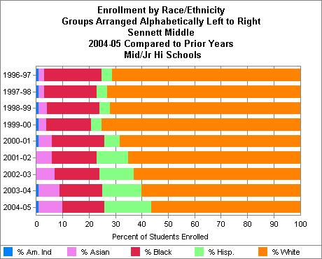
Notes:
Demographic Trends:
An increase in Asian students (2% in 1996-97 to 8.8% in 2005-06)
An increase in Latino studens (3.8% in 1996-97 to 17.3 % in 2005-06)
A decrease in White students (72.1% in 1996-97 to 55 % in 2005-06)
A decrease in Black students (21.5% in 1996-97 to 18.2% in 2005-06)

Slide 5
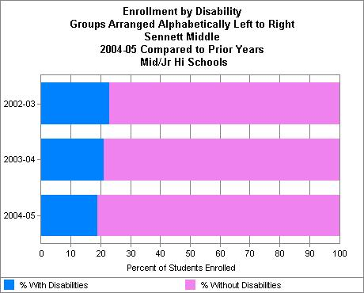
Notes:
There has been a decrease in the percent of students with disabilities (22.8% to 20.3%)

Slide 6
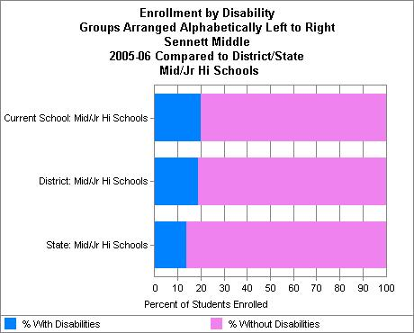
Notes:
The prevalence of special education students is higher at Sennett (20.3%) than MMSD (19.1%) and State averages (14.1%)

Slide 7
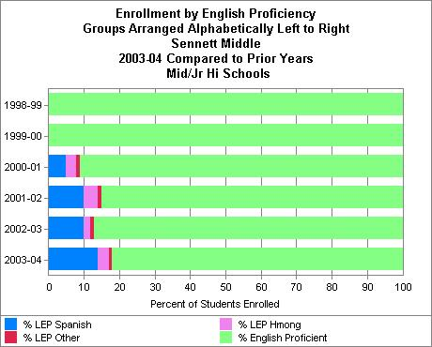
Notes:
This slide shows the increase in LEP students beginning in 2000-01. The most recent data available on WINNS is from 2003-04.
Spanish = 13.7%; Hmong = 3.4%; Other = 1.4 %

Slide 8
Sennett Middle School
Class of 2013 (current Grade 6) based on 2005 Test Results
Academic Achievement

Slide 9
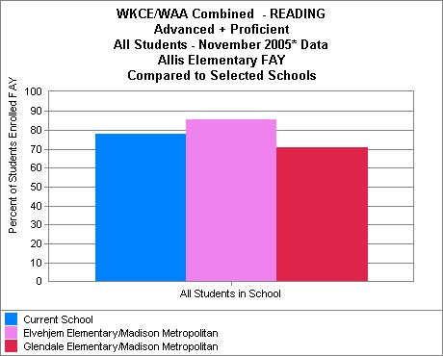
Notes:
Current Grade 6 Students; Reading
Allis (54 enrolled; 77.8% A/P)
LVM (76 enrolled; 85.5% A/P)
Glendale (41 enrolled; 70.7% A/P)

Slide 10
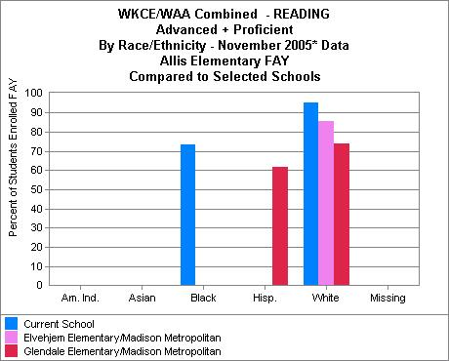
Notes:
Current Grade 6; Reading
African American
Allis (15 enrolled; 73.3%)
Latino
Glendale (13 enrolled; 61.5%)
Caucasian
Allis (21 enrolled; 95.2% A/P)
LVM (68 enrolled; 85.3% A/PA/P))
Glendale (19 enrolled; 73.7%

Slide 11
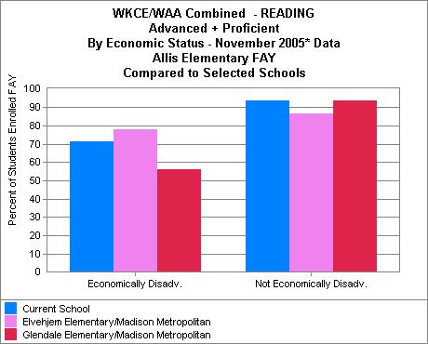
Notes:
Current Grade 6; Reading; Economic Disadvantage
Allis (38 enrolled; 71.1% A/P)
LVM (9 enrolled; 77.8% A/P)
Glendale (25 enrolled; 56% A/P)

Slide 12
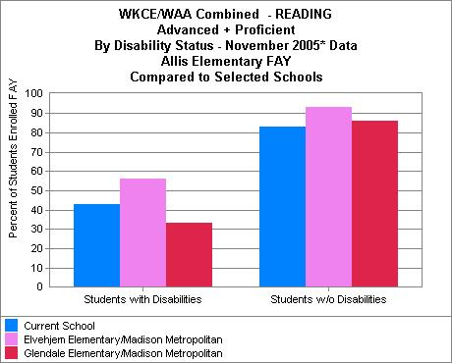
Notes:
Current Grade 6; Reading; by Disability
Allis (7 enrolled; 42.9% A/P)
LVM (16 enrolled; 56.3% A/P)
Glendale (12 enrolled; 33.3% A/P)

Slide 13
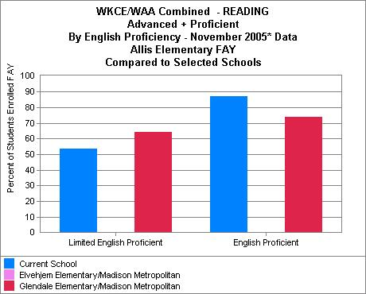
Notes:
Current Grade 6; Reading; LEP
Allis (15 enrolled; 53.3% A/P)
Glendale (14 enrolled; 64.3% A/P)

Slide 14
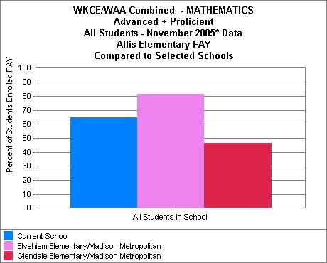
Notes:
Current Grade 6; Math
Allis (54 enrolled; 64.8% A/P)
LVM (76 enrolled; 81.8% A/P)
Glendale (41 enrolled; 46.3% A/P)

Slide 15
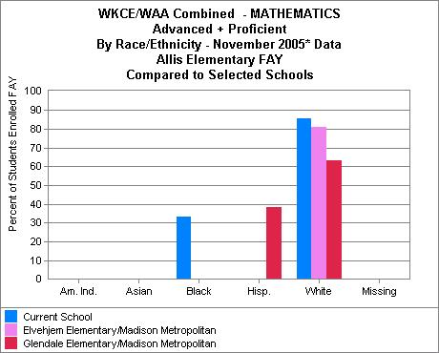
Notes:
Current Grade 6; Math; by Race
African American
Allis (15 enrolled; 33.3.%)
Latino
Glendale (13 enrolled; 38.5% A/P)
Caucasian
Allis (21 enrolled; 85.7% A/P)
LVM (68 enrolled; 80.9% A/P)
Glendale (19 enrolled; 63.2% A/P)

Slide 16
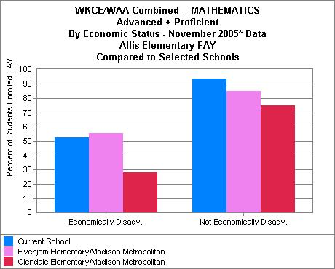
Notes:
Current Grade 6; Math; Economic Disadvantage
Allis (38 enrolled; 52.6% A/P)
LVM (9 enrolled; 55.6% A/P)
Glendale (25 enrolled; 28% A/P)

Slide 17
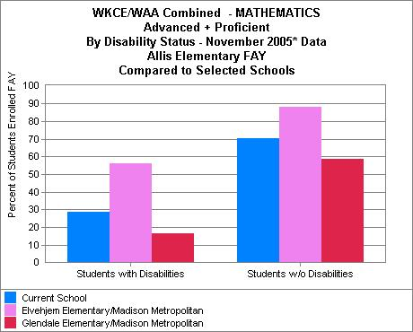
Notes:
Current Grade 6; Math; by Disabilities
Allis (7 enrolled; 28.6% A/P)
LVM (16 enrolled; 56.3% A/P)
Glendale (12 enrolled; 16.7% A/P)

Slide 18
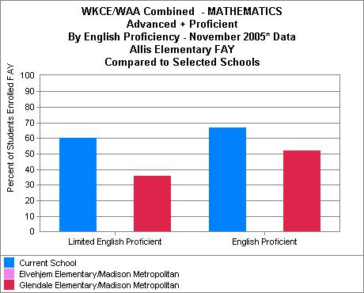
Notes:
Current Grade 6; Math; LEP
Allis (15 enrolled; 60% A/P)
Glendale (14 enrolled; 35.7% A/P)

Slide 19
Sennett Middle School
Class of 2012 (current Grade 7) based on 2005 Test Results
Academic Achievement

Slide 20
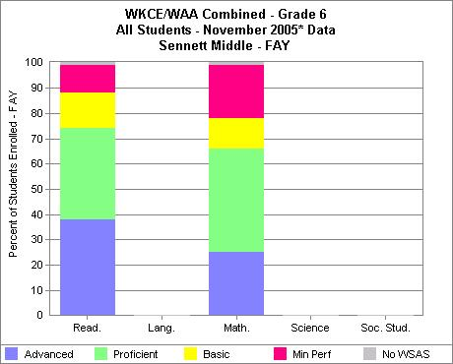
Notes:
Current Grade 7—Math & Reading—All Students
174 enrolled; 74.1% A/P in Reading and 64.9% A/P in Math

Slide 21
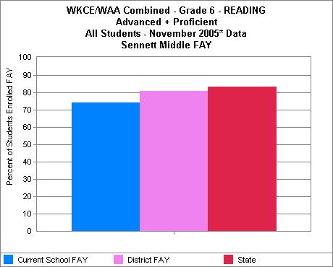
Notes:
Current Grade 7; Reading
Sennett (174 students enrolled; 74.1 % A/P) lagging when compared to MMSD (1,461 enrolled; 78.4% A/P) and State averages (63, 118 enrolled; 82.4% A/P)

Slide 22
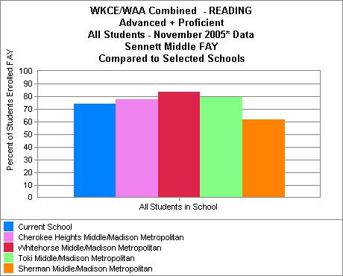
Notes:
Current Grade 7; Reading
Sennett (174 students enrolled; 74.1 % A/P)
Out performed by Cherokee (127 enrolled; 74.1% A/P), Whitehorse (118 enrolled; 83.9% A/P), and Toki (173 enrolled; 79.8% A/P)
Out performed Sherman Middle (168 enrolled; 61.9% A/P)

Slide 23
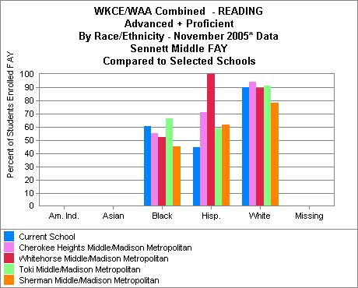
Notes:
Current Grade 7; Reading; by Race
African American
Sennett 33 enrolled; 60.6% A/P)
Out performed by Toki (54 enrolled/66.7% A/P)
Out performed Cherokee (29 enrolled; 55.2% A/P), Whitehorse (19 enrolled; 52.6% A/P), and Sherman 66 enrolled; 45.5% A/P)
Outperformed MMSD (334 enrolled; 58.7% A/P) and State averages (7, 012 enrolled; 55.2%)
Latino
Sennett (27 enrolled with 44.4% A/P)
Outperformed by Cherokee (28 students; 71.4% A/P), Whitehorse (none), Toki (22 students;59.1% A/P), and Sherman (21 students; 61.9% A/P)
Our Latino students significantly lag behind MMSD (169 enrolled; 60.4% A/P) and State averages (4,114 enrolled; 63.4%)
Caucasian
Sennett (95 enrolled; 90.5% A/P)
Our students performed comparable to Cherokee students (95 enrolled/90.5% A/P)
Outperformed by Whitehorse Students (53 enrolled; 94.3% A/P); and Toki students (85 enrolled;89.4% A/P)
Outperformed Sherman students (65 enrolled/78.5% A/P)
Our White students were slightly underperformed when compared to MMSD (787 enrolled; 92.5% A/P) but outperformed State averages (48,756 enrolled; 88.6%)
Note: There is an error on either the numbers or the chart above with regard to white students and Cherokee/Whitehorse look to be reversed
Sennett

Slide 24
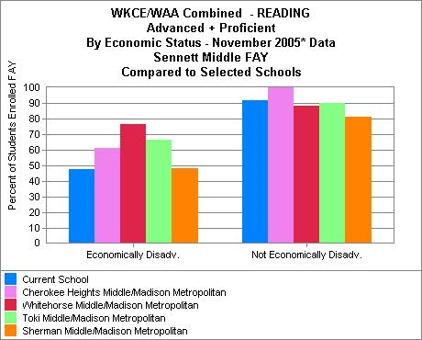
Notes:
Current Grade 7 students; Reading; Economic Disadvantage
Sennett has 71 students enrolled who are economically disadvantaged with 47.9% performing advanced/proficient.
This is an area where we are lagging behind the other schools.
Outperformed by all 4 comparison schools: Cherokee (72 enrolled; 61.1% A/P), Whitehorse (47 enrolled; 76.6% A/P), Toki (78 enrolled; 66.7% A/P) and Sherman (99 enrolled; 48.5% are advanced/proficient
Our economically disadvantaged students are lagging when compared to both MMSD (616 enrolled; 58.9% A/P) and State averages (20, 507 enrolled; 66.6% A/P)

Slide 25
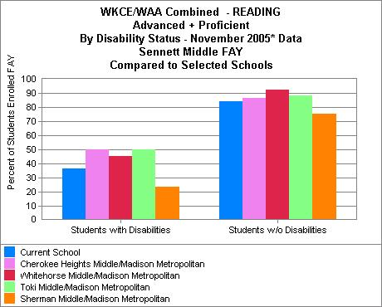
Notes:
Current Grade 7; Reading; Disabilities
Sennett students (36 enrolled; 36.1% A/P)
Outperformed by Cherokee (30 enrolled; 50% A/P), Whitehorse (22 enrolled; 45.5% A/P), Toki (40 enrolled; 50% A/P)
Outperformed Sherman (43 enrolled; 23.3% A/P)
Our students with disabilities were lagging when compared to MMSD (291 enrolled; 43.6% A/P) and State averages (8,949 enrolled; 41.4%)

Slide 26
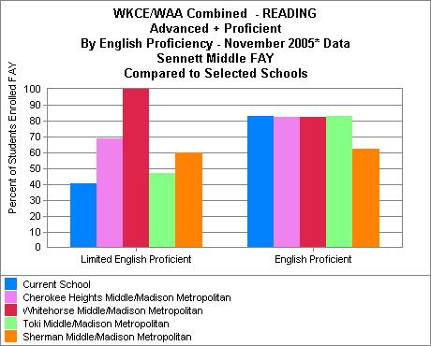
Notes:
Current Grade 7; Reading; Limited English Proficiency
Sennett has (37 LEP enrolled; 40.5% A/P)
Were outperformed by Cherokee (42 enrolled; 45.2% A/P), Whitehorse (9 enrolled; 100%), Toki (17 enrolled; 41.2% A/P), and Sherman (35 enrolled; 54.3% A/P)
At 40.5% A/P our LEP students are significantly lagging behind MMSD (238 enrolled; 61.3% A/P) or State averages (3,063 enrolled; 54.5% A/P).

Slide 27
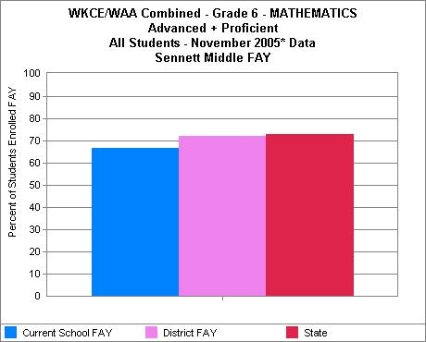
Notes:
Current Grade 7; Math; all students
Sennett has 174 students enrolled and 64.9% performed A/P
Our students were somewhat lagging in math performance when compared to MMSD (1,461 enrolled; 69.5% A/P) and State averages (63,118 enrolled; 72% A/P)

Slide 28
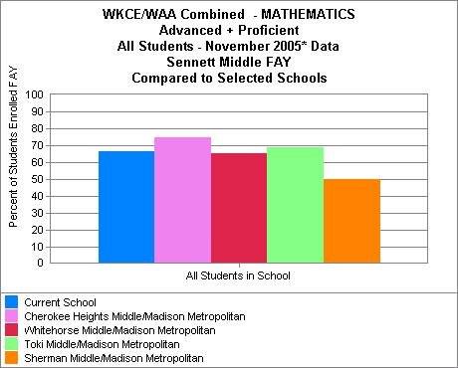
Notes:
Current Grade 7; Math; All Students
Sennett has 174 enrolled with 66.7% A/P
Outperformed by Cherokee (127 enrolled; 74.8% A/P) and Toki (173 enrolled; 68.8% A/P)
Outperformed Whitehorse (118 enrolled; 65.3% A/P), and Sherman (168 enrolled; 50% A/P)

Slide 29
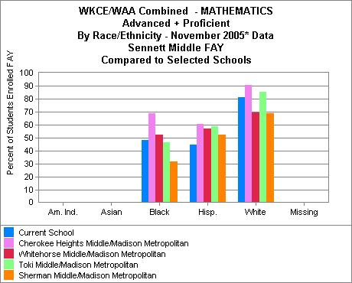
Notes:
Current Grade 7; Math; By Race
African American
Sennett has 33 enrolled; 48.5% A/P
Outperformed by Cherokee (29 enrolled; 69% A/P), Whitehorse (19 enrolled; 52.6% A/P)
Outperformed Toki (54 enrolled; 46.3% A/P) and Sherman (66 enrolled; 31.8% A/P)
Our AA students outperformed MMSD (334 enrolled; 47.3% A/P) and State averages (7, 012 enrolled; 36.4% A/P)
Latino
Sennett has 27 enrolled; 44.4% A/P
Outperformed by all 4 schools; Cherokee (28 enrolled; 60.7% A/P), Whitehorse 7 enrolled; 57.1% A/P), Toki (22 enrolled; 59.1% A/P), Sherman (21 enrolled; 52.4% A/P)
We were outperformed by both MMSD (169 enrolled; 60.9% A/P) and State averages (4,114 enrolled; 54.4% A/P)
Caucasian
Sennett has 95 enrolled; 81.1% A/P
Outperformed by Cherokee (53 enrolled; 90.6% A/P), Toki (83 enrolled; 85.5% A/P)
Outperformed Whitehorse (85 enrolled; 69.4% A/P) and Sherman (65 enrolled; 69.2% A/P)
Performed below MMSD average ( 787 enrolled; 85.9% A/P) but at a similar level to State averages (48,756 enrolled; 80.2% A/P)
African American
Sennett has 33 enrolled with 48.5% performing at Advanced/Proficient
Outperformed by Cherokee (29 enrolled; 69% A/P), whitehorse (19 enrolled; 52.6% A/P)
Outperformed Toki (54 enrolled; 46.3% A/P), and Sherman (66 enrolled; 31.8% A/P)
Latino Students
Sennett has (27 enrolled; 44.4% A/P)
Outperformed by Cherokee (28 enrolled; 60.7% A/P), Whitehorse (7 enrolled; 57.1% A/P)
Outperformed Toki (22 enrolled; 59.1% A/P), and Sherman (21 enrolled; 52.4% A/P)
White
Sennett (95 enrolled; 81.1% A/P)
Outperformed by Cherokee (53 enrolled; 90.6% A/P) and Toki (83 enrolled; 85.5% A/P)
Outperformed Whitehorse (85 enrolled; 69.4% A/P) and Sherman (65 enrolled; 69.2% A/P)

Slide 30
Notes:
Current Grade 7; Math; Economic Disadvantage
Sennett had 71 enrolled; 40.8% A/P)
Outperformed by Cherokee (72 enrolled; 58.3% A/P), and Toki (78 enrolled; 50% A/P)
Outperformed Whitehorse (47 enrolled; 53.2% A/P) and Sherman (99 enrolled; 37.4% A/P)
We are lagging in this area when compared to MMSD (618 enrolled; 50.8% A/P) and State averages (20,507 enrolled; 53.9% A/P)

Slide 31
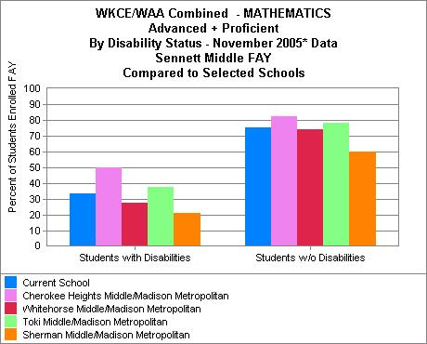
Notes:
Current Grade 7; Math; by Disability
Sennett (36 enrolled; 33.3% A/P)
Outperformed by Cherokee (30 enrolled; 50% A/P), Toki (40 enrolled; 37.5% A/P)
Outperformed Whitehorse (22 enrolled; 27.3% A/P) and Sherman (43 enrolled; 20.9% A/P)
Lagging when compared to MMSD (291 enrolled; 38.5% A/P) and State averages (8,949 enrolled; 37.4% A/P)

Slide 32
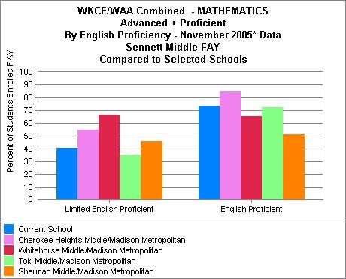
Notes:
Current Grade 7; Math; All students; LEP
Sennett (37 enrolled; 40.5% A/P)
Outperformed by Cherokee (42 enrolled; 54.8% A/P) and Sherman (35 enrolled; 45.7%)
Outperformed Whitehorse (9 enrolled; 66.7% A/P) and Toki (17 enrolled; 35.3% A/P)
Lagging when compared to MMSD (238 enrolled; 51.3% A/P) and State averages (3,063 enrolled; 50.6% A/P)

Slide 33
Sennett Middle School
Class of 2011 (current Grade 8)
2005 WKCE Test Results
Academic Performance

Slide 34
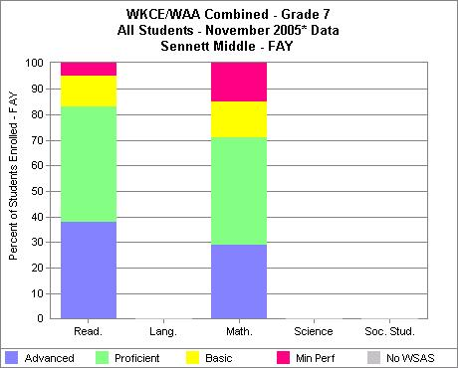
Notes:
Current Grade 8 Students; Reading and Math
173 enrolled; 83.2% A/P in Reading and 71% A/P in Math

Slide 35
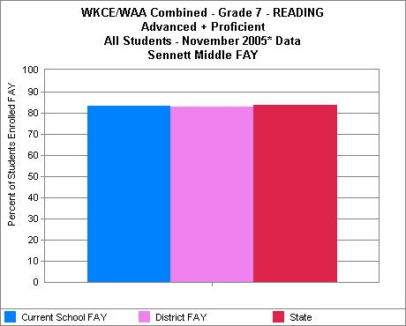
Notes:
Current Grade 8; Reading
Sennett (173 enrolled; 83.2% A/P) performed comparably to MMSD (1,602 enrolled; 82.8% A/P); and State averages (65,289 enrolled; 83.8% A/P)

Slide 36
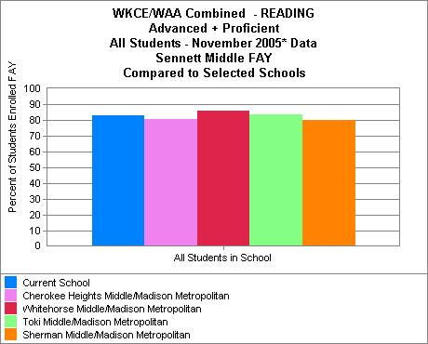
Notes:
Current Grade 8; Reading
Sennett (173 enrolled; 83.2% A/P)
Performed comparably to Toki (173 enrolled; 83.8% A/P)
Outperformed by Whitehorse (113 enrolled; 85.8% A/P)
Outperformed Cherokee (159 enrolled; 80.5% A/P), and Sherman (152 enrolled; 80.3% A/P)

Slide 37
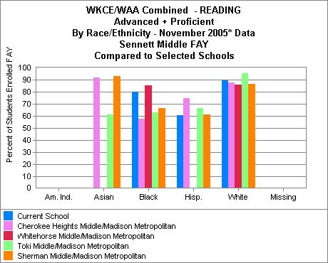
Notes:
Current Grade 8; Reading; By Race
African American
Sennett (25 enrolled; 80% A/P)
Outperformed by Whitehorse (14 enrolled; 85.7% A/P)
Outperformed Cherokee (26 enrolled; 57.7% A/P), Toki (35 enrolled; 62.9% A/P) and Sherman (21 enrolled; 66.7% A/P)
Significantly outperformed both MMSD (297 enrolled; 66.3% A/P) and State averages (7,051 enrolled;57.4% A/P)
Latino
Sennett (28 enrolled; 60.7% A/P)
Outperformed by Cherokee (36 enrolled; 75% A/P), Toki (15 enrolled; 66.7% A/P) and Sherman (26 enrolled; 61.5% A/P)
Lagging when compared to MMSD (192 enrolled; 65.1% A/P) and State averages (4, 101 enrolled; 66.8% A/P)
Caucasian
Sennett (104 enrolled; 89.4% A/P)
Outperformed by Toki (110 enrolled; 95.5% A/P)
Outperformed Cherokee (84 enrolled; 88.1% A/P), Whitehorse (93 enrolled; 86% A/P) and Sherman (90 enrolled; 86.7% A/P)
Performed comparably to MMSD (953 enrolled; 91.4% A/P) and State averages (50,775 enrolled; 89.5% A/P)

Slide 38
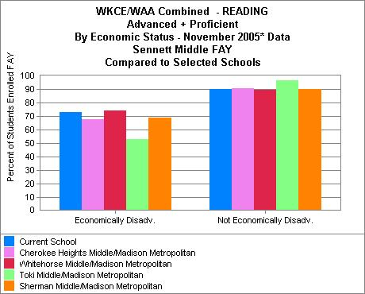
Notes:
Current Grade 8; Reading; Economic Disadvantage
Sennett (71 enrolled; 73.2% A/P)
Performed comparably to Whitehorse (27 enrolled; 74.1% A/P)
Outperformed Cherokee (71 enrolled; 67.7% A/P), Toki (51 enrolled; 52.9% A/P), and Sherman (71 enrolled; 69% A/P)
Performed at a higher level than MMSD (583 enrolled; 65.7% A/P) and State averages (20, 484 enrolled; 68.9% A/P)

Slide 39
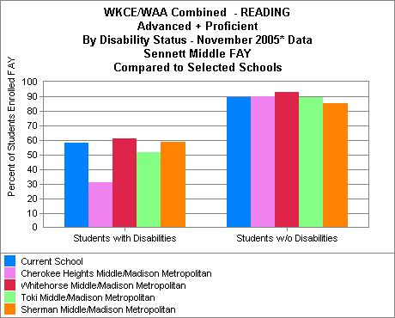
Notes:
Current Grade 8; Reading; Disabilities
Sennett (36 enrolled; 58.3% A/P)
Outperformed by Whitehorse (26 enrolled; 61.5% A/P)
Outperformed Cherokee (26 enrolled; 30.8% A/P), Toki (27 enrolled; 51.9% A/P), and Sherman (29 enrolled; 58.6% A/P)
At 58.3% A/P, our students with disabilities outperformed MMSD (311 enrolled; 51.1% A/P) and State averages (9,345 enrolled; 47.1% A/P)

Slide 40
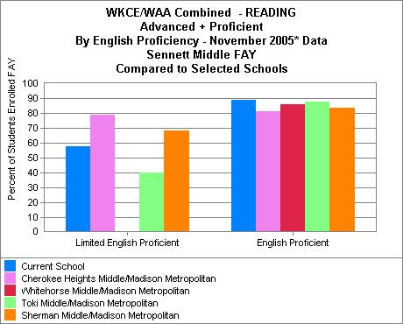
Notes:
Current Grade 8; Reading; LEP
Sennett (33 enrolled; 57.6% A/P)
Outperformed by Cherokee (48 enrolled; 79.2% A/P), and Sherman (35 enrolled; 68.6% A/P)
Outperformed Toki (15 enrolled; 40% A/P)
Our LEP students were outperformed by MMSD (244 enrolled; 62.3% A/P) but outperformed State averages (2, 789 enrolled; 52.1% A/P)

Slide 41
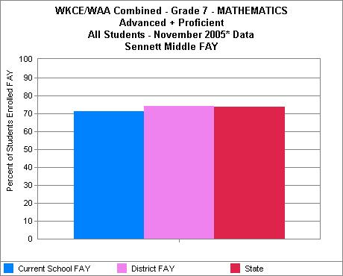
Notes:
Current Grade 8; Math
Sennett (173 enrolled; 69.9% A/P)
Outperformed by MMSD (1, 602 enrolled; 71.8% A/P) and State averages (65,289 enrolled; 72.8% A/P) by a narrow margin

Slide 42
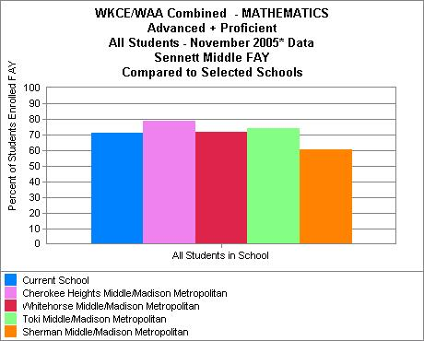
Notes:
Current Grade 8; Math
Sennett (173 enrolled; 69.9% A/P)
Outperformed by Cherokee (159 enrolled; 79.2% A/P), Whitehorse (113 enrolled; 71.1% A/P), and Toki (173 enrolled; 74% A/P)
Outperformed Sherman (152 enrolled; 60.5% A/P)

Slide 43
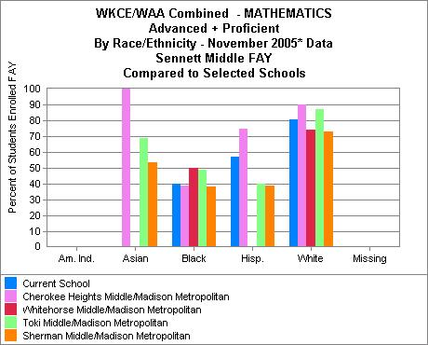
Notes:
Current Grade 8; Math; by Race
African American
Sennett (25 enrolled; 40% A/P)
Outperformed by Whitehorse (14 enrolled; 50% A/P), Toki (35 enrolled; 48.6 % A/P)
Outperformed Cherokee (26 enrolled; 38.5% A/P), and Sherman (21 enrolled; 33.3% A/P)
Sennett AA students were outperformed by MMSD averages (297 enrolled; 44.1% A/P) but outperformed State averages (7,051 enrolled; 34% A/P)
Latino
Sennett (28 enrolled; 53.6% A/P)
Outperformed by Cherokee (36 enrolled; 30.6% A/P)
Outperformed Toki (15 enrolled; 40% A/P) and Sherman (26 enrolled; 34.6% A/P)
Sennett Latino students performed slightly lower than MMSD averages (192 enrolled; 57.8% A/P) but slightly higher than State averages (4,101 enrolled; 55.2% A/P)
Caucasian
Sennett (104 enrolled; 79.8% A/P)
Outperformed by Cherokee (84 enrolled; 84.1% A/P), Toki (110 enrolled; 87.3% A/P)
Outperformed Whitehorse (93 enrolled; 73.1% A/P) and Sherman (90 enrolled; 72.2% A/P)
Sennett Caucasian students performed slightly lower than MMSD averages (953 enrolled; 86% A/P) and State averages (50,775 enrolled; 81.4% A/P)

Slide 44
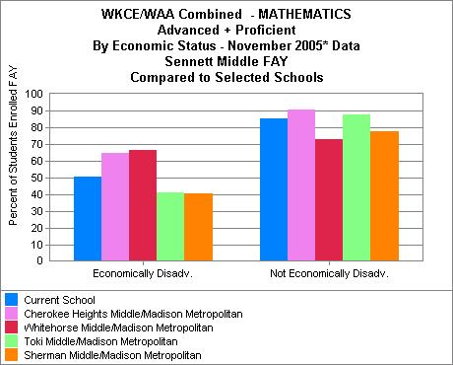
Notes:
Current Grade 8; Math; Economic Disadvantage
Sennett (71 enrolled; 50.7% A/P)
Outperformed by Cherokee (71 enrolled; 64.8% A/P) and Whitehorse (27 enrolled; 66.7% A/P)
Outperformed Toki (51 enrolled; 41.2% A/P) and Sherman (71 enrolled; 40.8% A/P)
Sennett students performed comparable to MMSD average (583 enrolled; 50.1% A/P) but slightly lower than State averages (20,484 enrolled; 53.5% A/P)

Slide 45
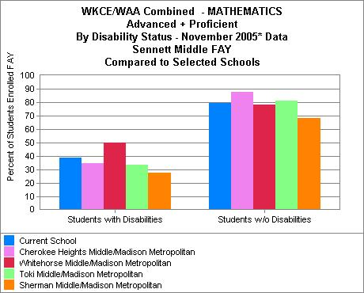
Notes:
Current Grade 8; Math; Disabilities
Sennett (71 enrolled; 49.3% A/P)
Slightly outperformed by Whitehorse (26 enrolled; 50% A/P)
Outperformed Cherokee (26 enrolled; 34.6% A/P), Toki (27 enrolled; 33.3% A/P), and Sherman (29 enrolled; 27.6% A/P)
Sennett students performed slightly above MMSD (311 enrolled; 37.9% A/P) and State averages (9,345 enrolled;36.3% A/P)

Slide 46
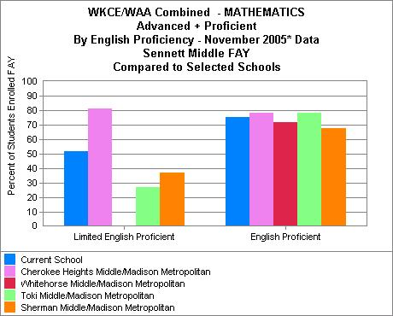
Notes:
Current Grade 8; Math; LEP
Sennett (33 enrolled; 51.5% A/P)
Outperformed by Cherokee (48 enrolled; 81.3% A/P)
Outperformed Toki (15 enrolled; 26.7% A/P), and Sherman (35 enrolled; 37.1% A/P)
Sennett students performed slightly below MMSD average (244 enrolled; 54.5% A/P) but slightly above the State average (2,789 enrolled; 47.8% A/P)

Slide 47
Attendance Data

Slide 48
How is attendance defined?
Attendance is face-to-face instructional contact between a student and a teacher. It is collected for the entire school year. The attendance rate is calculated by dividing actual days of attendance by possible days of attendance, and expressing the quotient as a percentage. The smallest reportable unit of attendance is one-half day.
Definition taken from DPI Website: http://data.dpi.state.wi.us/data/graphshell.asp?Detail=YES&GraphFile=ATTENDANCE&CompareTo=SELSCHOOLS&Group=AllStudentsFAY&STYP=5&ORGLEVEL=SC&FULLKEY=023269040665&DN=Madison+Metropolitan&SN=Sennett+Middle

Slide 49
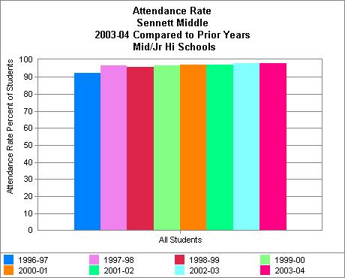
Notes:
Most current data from DPI WINNS is 2003-04
Sennett 98.2% in 2003-04; comparable to State average (98.8%) and higher than the District average (95.8%)
There is a continuing trend of strong student attendance with a slight increases each year

Slide 50
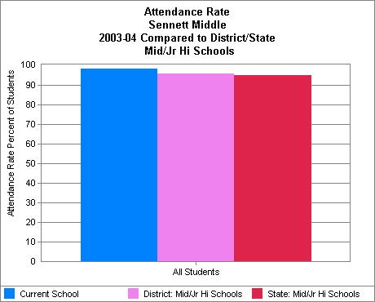

Slide 51
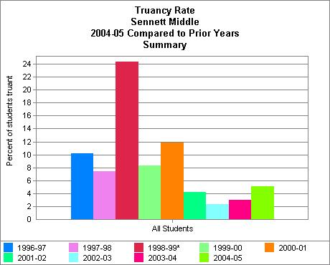
Notes:
Truancy Rate

Slide 52
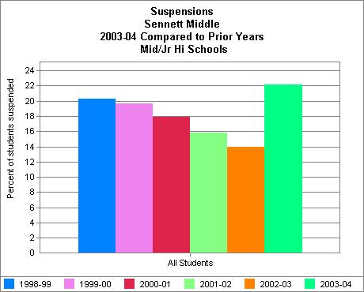

Slide 53
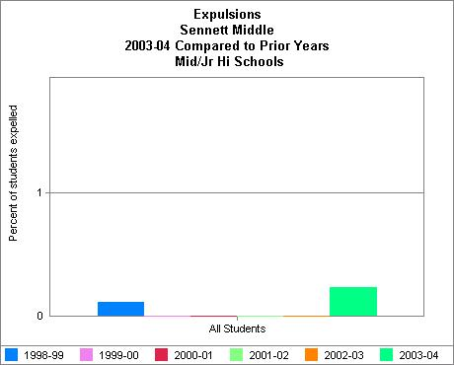

Slide 54
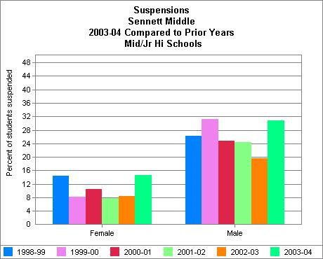

Slide 55
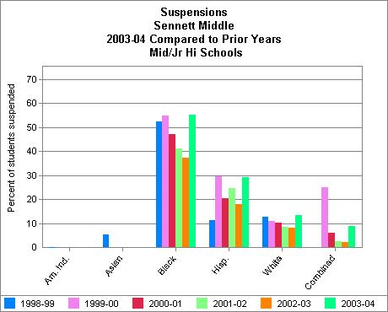

Slide 56
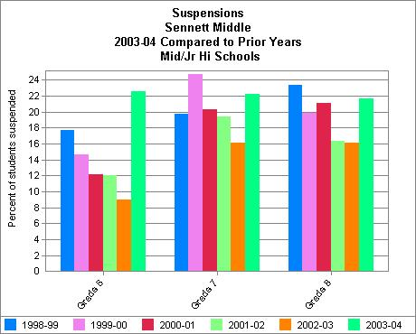

Slide 57
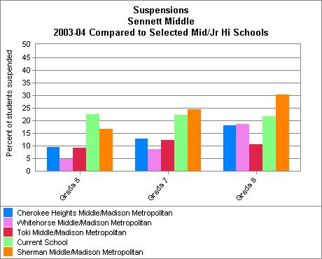

Slide 58
REFLECTIONS & IMPLICATIONS:

