Slide 1

Predicting 30-days Unplanned Readmission Using Deep Learning Model with Electronic Health Records
ShanShan Jiang, Yin Yuan, Zheng Fu
Georgia Institute of Technology, Atlanta, Georgia

Slide 2
Motivation
30-days unplanned readmission is a common and costly problem for U.S. hospitals. It was defined as the admission to a hospital within 30-days after discharge.
Medicare Payment Advisory Committee has reported that 17.6% of hospital-admitted patients were readmitted within 30 days of discharge. It gave rise to $17.9 billion Medicare spending per year and 76% of them could be avoidable.

Slide 3
Challenge
The challenge here is how to predict individual 30-days readmission risk accurately due to the heterogeneity of the patient population along with the complicated health conditions of patients.
In recent years, several pioneering studies were published focusing on 30-days hospital readmission prediction on the basis of patient Electronic Health Records (EHRs) with multivariate regression model. Yet such model is hard to deal with unstructured free-text EHRs.

Slide 4
Our Goal
The primary goal of this project, is to extract meaningful signals from unstructured text and refine them with deep learning models to accurately predict the 30-days unplanned readmission.
The beauties of deep learning models are their end-to-end learning capabilities, and we wish the information derived from our models could intervene on behalf of patients at risk of unplanned readmission.

Slide 5
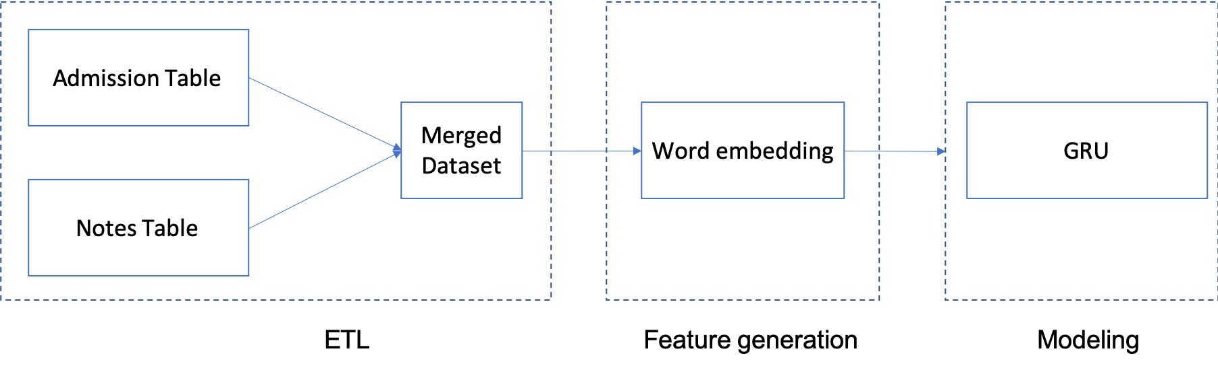
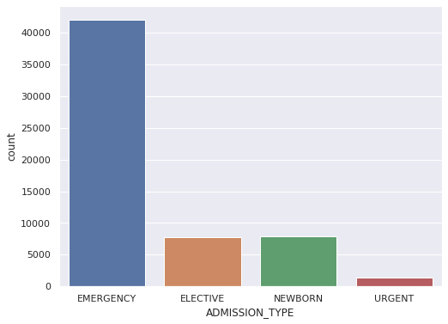
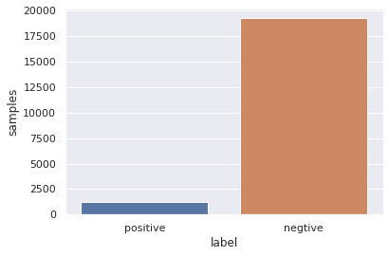
Methodology
MIMIC-III is a public-access database contains EHRs data from over 40,000 patients who were admitted to Beth Israel Deaconess Medical Center from 2001 to 2012. We downloaded the entire MIMIC-III dataset and focused on the “ADMISSION” and “NOTEEVENTS” tables.
Notes:
The range of SZ-related endophenotypes from automatic to volitional. PPI and MMN are neurophysiological endophenotypes representing automatic, or preattentive, processes that can be elicited with no active participation from the test subject. PPI is measured as the percent inhibition (i.e., gating) of the startle reflex in response to a weak prestimulus. MMN is measured as the difference between the waveforms for a standard stimulus ERP and a deviant stimulus ERP. Neurocognitive endophenotypes like CPT and LNS are volitional, or attentive, and require active participation from the subject. CPT measures sustained attention as the signal/noise discrimination ratio (d’) of blurred target stimuli (in the DS-CPT) or pairs of identically presented stimuli (in the CPT-IP). LNS measures working memory as the correct reordering of a verbally presented list of intermixed numbers and letters. AS is measured as the ratio of correct antisaccades (i.e., looking in the opposite direction of the presented stimulus) to total interpretable saccades (i.e., eye movements in any direction).

Slide 6
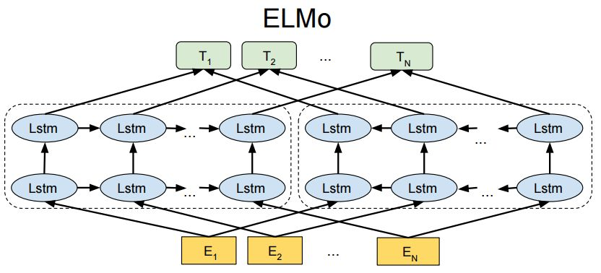
Feature Engineering
Notes:
A key limitation faced by researchers in SZ is that the heterogeneous clinical phenotype complicates the diagnosis, therefore diluting the genetic signal. To address this issue, Gottesman and Shields introduced the concept of “endophenotypes” in SZ [44], and the application of endophenotypes to the study of SZ has become known as “deep phenotyping.” These state-independent traits are associated with illness, are observed in unaffected family members at a higher rate than in the general population, and co-segregate with illness in families [44]. To be useful in genetic studies, an endophenotype must also be significantly heritable, reliably measured, and stable over time [45,46]. Given that endophenotypes fall within the genotype-to-phenotype pathway of the disease process, they form a critical link between genetic risk variants and the more direct lower-level biological processes that contribute to observable symptoms [47,48]. In other polygenic, complex conditions, like hypercholesterolemia, endophenotypes (i.e., cholesterol) have been particularly useful in helping to characterize the underlying biological dysfunction and to develop targetable treatments [49].

Slide 7
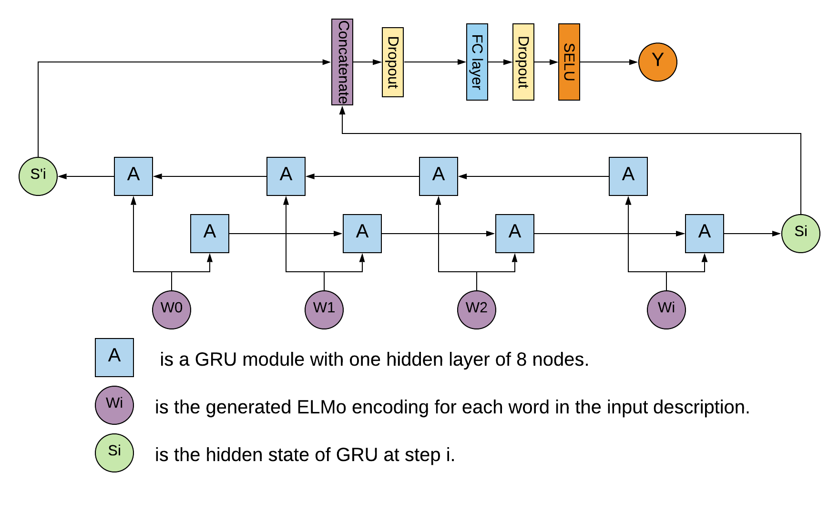
GRU RNN Model for Prediction
We tuned up the model with 30000 training observations, 15334 validation observations and 15334 testing observations, and the following are the optimized parameters of our final model:
ELMO_DIM = 1024, HIDDEN_DIM = 8, OUTPUT_DIM = 2, N_LAYERS = 2, BIDIRECTIONAL = True, DROPOUT = 0.5
Notes:
A key limitation faced by researchers in SZ is that the heterogeneous clinical phenotype complicates the diagnosis, therefore diluting the genetic signal. To address this issue, Gottesman and Shields introduced the concept of “endophenotypes” in SZ [44], and the application of endophenotypes to the study of SZ has become known as “deep phenotyping.” These state-independent traits are associated with illness, are observed in unaffected family members at a higher rate than in the general population, and co-segregate with illness in families [44]. To be useful in genetic studies, an endophenotype must also be significantly heritable, reliably measured, and stable over time [45,46]. Given that endophenotypes fall within the genotype-to-phenotype pathway of the disease process, they form a critical link between genetic risk variants and the more direct lower-level biological processes that contribute to observable symptoms [47,48]. In other polygenic, complex conditions, like hypercholesterolemia, endophenotypes (i.e., cholesterol) have been particularly useful in helping to characterize the underlying biological dysfunction and to develop targetable treatments [49].

Slide 8
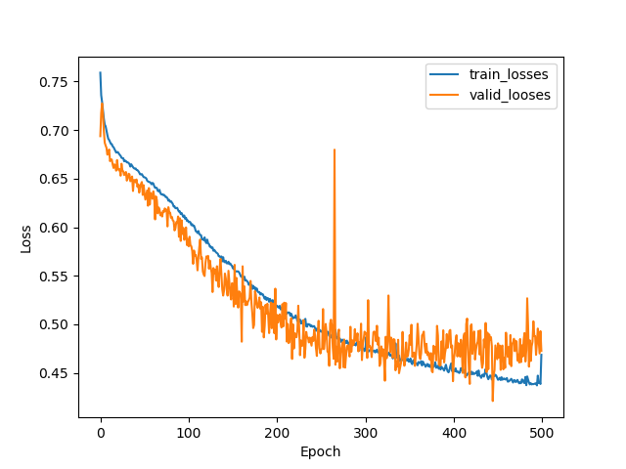
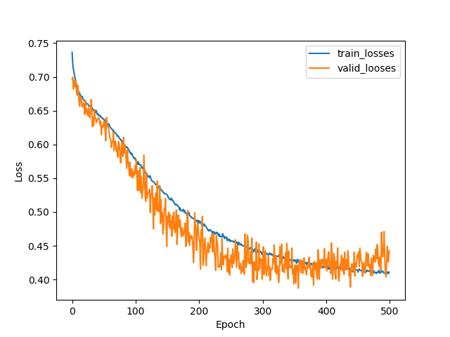
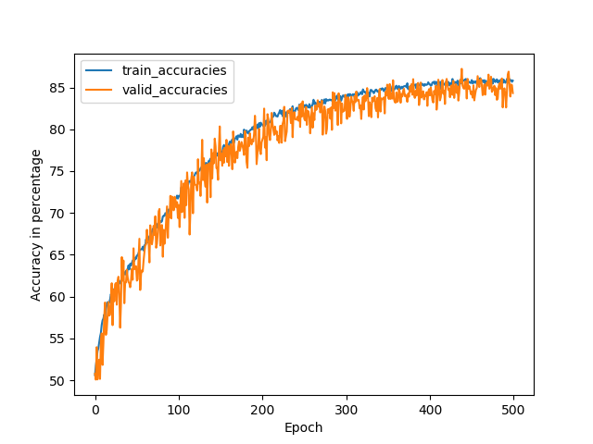
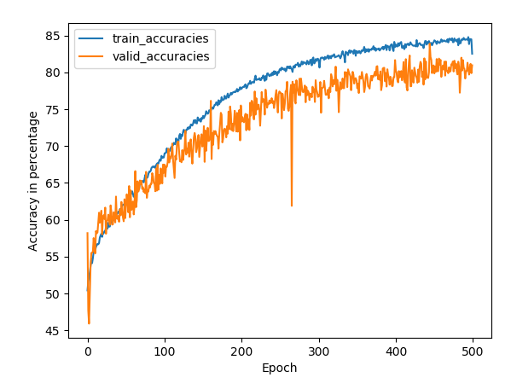
Model Performance
Single
Direction
Bi-direction
Notes:
A key limitation faced by researchers in SZ is that the heterogeneous clinical phenotype complicates the diagnosis, therefore diluting the genetic signal. To address this issue, Gottesman and Shields introduced the concept of “endophenotypes” in SZ [44], and the application of endophenotypes to the study of SZ has become known as “deep phenotyping.” These state-independent traits are associated with illness, are observed in unaffected family members at a higher rate than in the general population, and co-segregate with illness in families [44]. To be useful in genetic studies, an endophenotype must also be significantly heritable, reliably measured, and stable over time [45,46]. Given that endophenotypes fall within the genotype-to-phenotype pathway of the disease process, they form a critical link between genetic risk variants and the more direct lower-level biological processes that contribute to observable symptoms [47,48]. In other polygenic, complex conditions, like hypercholesterolemia, endophenotypes (i.e., cholesterol) have been particularly useful in helping to characterize the underlying biological dysfunction and to develop targetable treatments [49].

Slide 9
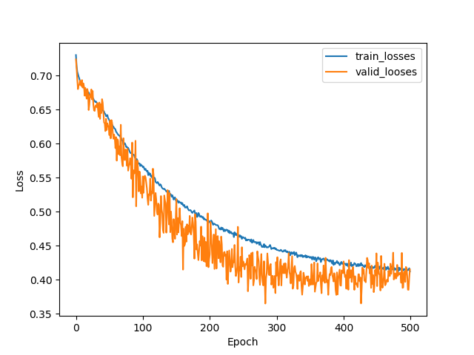
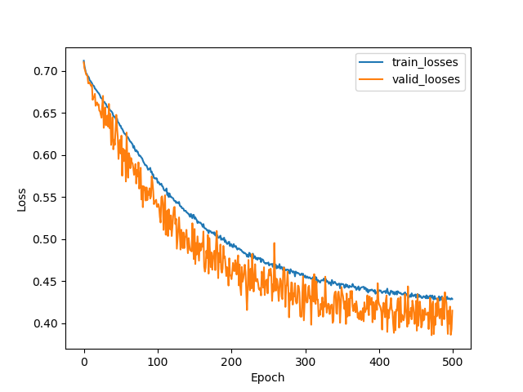
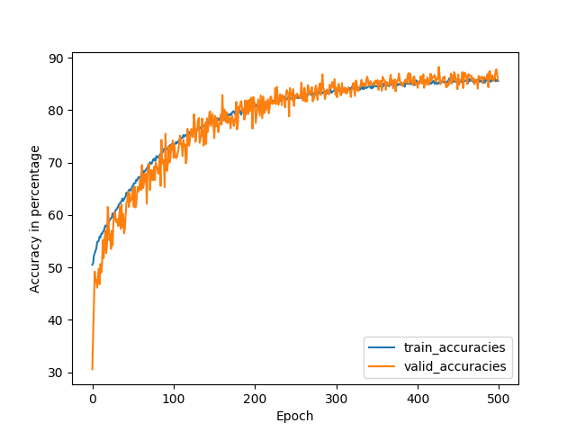
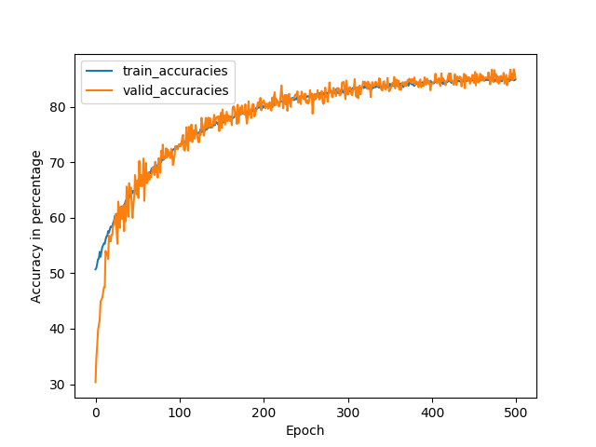
Model Performance
One internal layer
Two internal layers
Four internal layers
Notes:
A key limitation faced by researchers in SZ is that the heterogeneous clinical phenotype complicates the diagnosis, therefore diluting the genetic signal. To address this issue, Gottesman and Shields introduced the concept of “endophenotypes” in SZ [44], and the application of endophenotypes to the study of SZ has become known as “deep phenotyping.” These state-independent traits are associated with illness, are observed in unaffected family members at a higher rate than in the general population, and co-segregate with illness in families [44]. To be useful in genetic studies, an endophenotype must also be significantly heritable, reliably measured, and stable over time [45,46]. Given that endophenotypes fall within the genotype-to-phenotype pathway of the disease process, they form a critical link between genetic risk variants and the more direct lower-level biological processes that contribute to observable symptoms [47,48]. In other polygenic, complex conditions, like hypercholesterolemia, endophenotypes (i.e., cholesterol) have been particularly useful in helping to characterize the underlying biological dysfunction and to develop targetable treatments [49].

Slide 10
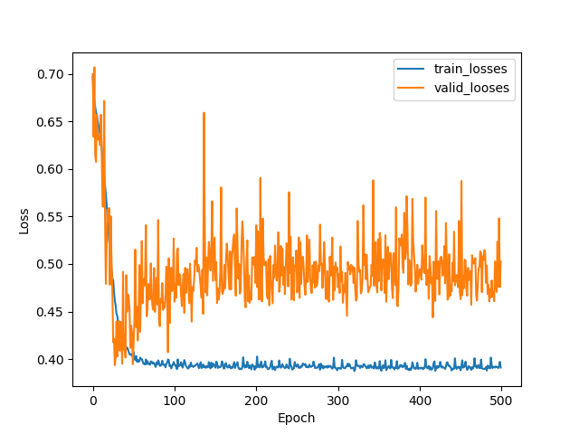
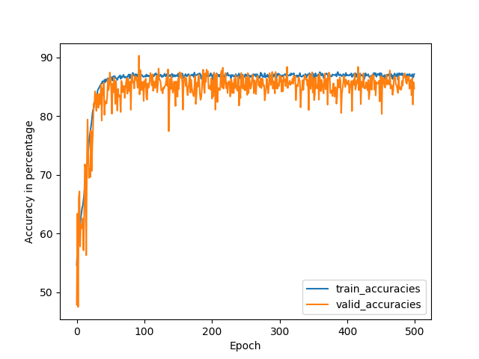
Model Performance
Internal Nodes = 8
Internal Nodes = 128
Notes:
A key limitation faced by researchers in SZ is that the heterogeneous clinical phenotype complicates the diagnosis, therefore diluting the genetic signal. To address this issue, Gottesman and Shields introduced the concept of “endophenotypes” in SZ [44], and the application of endophenotypes to the study of SZ has become known as “deep phenotyping.” These state-independent traits are associated with illness, are observed in unaffected family members at a higher rate than in the general population, and co-segregate with illness in families [44]. To be useful in genetic studies, an endophenotype must also be significantly heritable, reliably measured, and stable over time [45,46]. Given that endophenotypes fall within the genotype-to-phenotype pathway of the disease process, they form a critical link between genetic risk variants and the more direct lower-level biological processes that contribute to observable symptoms [47,48]. In other polygenic, complex conditions, like hypercholesterolemia, endophenotypes (i.e., cholesterol) have been particularly useful in helping to characterize the underlying biological dysfunction and to develop targetable treatments [49].

Slide 11
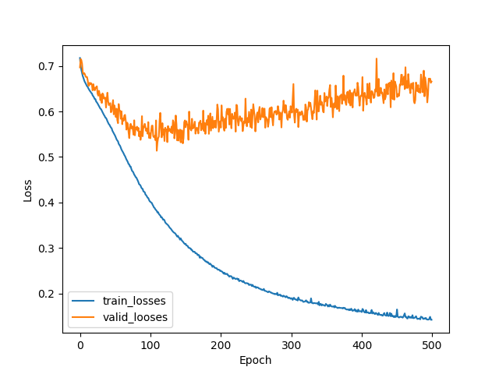
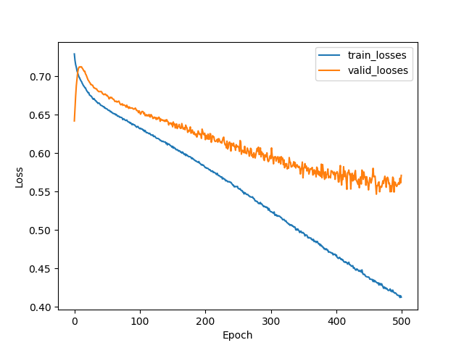
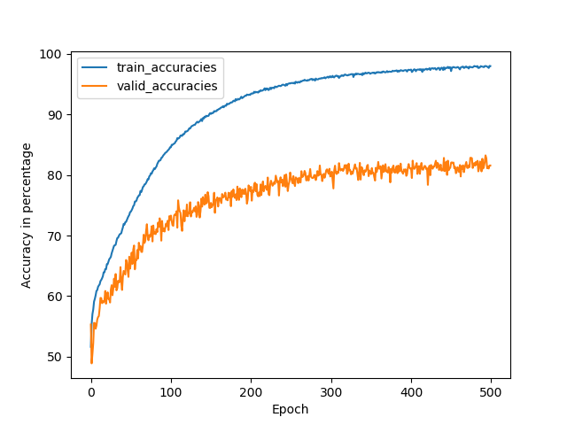
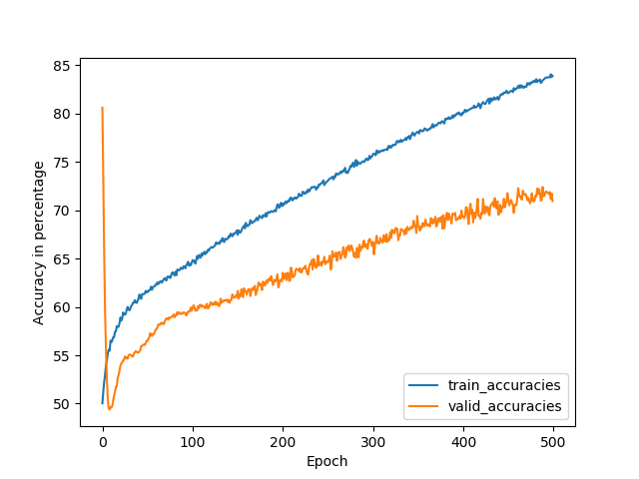
Model Performance
Dropout = 0.5
Dropout = 0.2
Dropout = 0.8
Notes:
A key limitation faced by researchers in SZ is that the heterogeneous clinical phenotype complicates the diagnosis, therefore diluting the genetic signal. To address this issue, Gottesman and Shields introduced the concept of “endophenotypes” in SZ [44], and the application of endophenotypes to the study of SZ has become known as “deep phenotyping.” These state-independent traits are associated with illness, are observed in unaffected family members at a higher rate than in the general population, and co-segregate with illness in families [44]. To be useful in genetic studies, an endophenotype must also be significantly heritable, reliably measured, and stable over time [45,46]. Given that endophenotypes fall within the genotype-to-phenotype pathway of the disease process, they form a critical link between genetic risk variants and the more direct lower-level biological processes that contribute to observable symptoms [47,48]. In other polygenic, complex conditions, like hypercholesterolemia, endophenotypes (i.e., cholesterol) have been particularly useful in helping to characterize the underlying biological dysfunction and to develop targetable treatments [49].

Slide 12
Conclusion
Our GRU RNN model has demonstrated that combining NLP techniques and machine learning algorithms could effectively predict the 30-days unplanned hospital readmission using unstructured free-text data.
And there are lots of rooms to improve the prediction accuracy using cutting-edge NLP embedding methods with ensemble different deep learning models, which will be the primary object of our future work.
Notes:
A key limitation faced by researchers in SZ is that the heterogeneous clinical phenotype complicates the diagnosis, therefore diluting the genetic signal. To address this issue, Gottesman and Shields introduced the concept of “endophenotypes” in SZ [44], and the application of endophenotypes to the study of SZ has become known as “deep phenotyping.” These state-independent traits are associated with illness, are observed in unaffected family members at a higher rate than in the general population, and co-segregate with illness in families [44]. To be useful in genetic studies, an endophenotype must also be significantly heritable, reliably measured, and stable over time [45,46]. Given that endophenotypes fall within the genotype-to-phenotype pathway of the disease process, they form a critical link between genetic risk variants and the more direct lower-level biological processes that contribute to observable symptoms [47,48]. In other polygenic, complex conditions, like hypercholesterolemia, endophenotypes (i.e., cholesterol) have been particularly useful in helping to characterize the underlying biological dysfunction and to develop targetable treatments [49].

Slide 13
References
lvennan CK, Eapen ZJ and Allen LA. “Hospital readmissions reduction program”. Circulation. 2015;131:1796-1803.
Shadmi E, Flaks-Manov N, Hoshen M, Goldman O, Bitterman H, Balicer RD. “Predicting 30-days readmissions with preadmission electronic health record data”. Med Care. 2015 Mar;53(3):283-9.
Nguyen OK, Makam AN, Clark C, Zhang S, Xie B, Velasco F, Amarasingham R, Halm EA. “Predicting all-cause readmissions using electronic health record data from the entire hospitalization: Model development and comparison”. J Hosp Med. 2016 Jul;11(7):473-80.
Baillie CA, VanZandbergen C, Tait G, Hanish A, Leas B, French B, Hanson CW, Behta M, Umscheid CA. “The readmission risk flag: using the electronic health record to automatically identify patients at risk for 30-days readmission”. J Hosp Med. 2013 Dec;8(12):689-95.
Hebert C, Shivade C, Foraker R, Wasserman J, Roth C, Mekhjian H, Lemeshow S, Embi P. “Diagnosis-specific readmission risk prediction using electronic health data: a retrospective cohort study”. BMC Med Inform Decis Mak. 2014 Aug 4;14:65.
Cholleti S, Post A, Gao J, Lin X, Bornstein W, Cantrell D, Saltz J. “Leveraging derived data elements in data analytic models for understanding and predicting hospital readmissions”. AMIA Annu Symp Proc. 2012;2012:103-11.
Cai X, Perez-Concha O, Coiera E, Martin-Sanchez F, Day R, Roffe D, Gallego B. “Real-time prediction of mortality, readmission, and length of stay using electronic health record data”. J Am Med Inform Assoc. 2016 May;23(3):553-61.
Rumshisky A, Ghassemi M, Naumann T, Szolovits P, Castro VM, McCoy TH, Perlis RH. “Predicting early psychiatric readmission with natural language processing of narrative discharge summaries”. Transl Psychiatry. 2016 Oct 18;6(10):e921.
Rajkomar A, Oren E, Chen K, Dai AM, Hajaj N, Hardt M, Liu PJ, Liu X, Marcus J, Sun M, Sundberg P, Yee H, Zhang K, Zhang Y, Flores G, Duggan GE, Irvine J, Le Q, Litsch K, Mossin A, Tansuwan J, Wang, Wexler J, Wilson J, Ludwig D, Volchenboum SL, Chou K, Pearson M, Madabushi S, Shah NH, Butte AJ, Howell MD, Cui C, Corrado GS, Dean J. "Scalable and accurate deep learning with electronic health records". NPJ Digit Med. 2018 May 8;1:18.
Johnson AE, Pollard TJ, Shen L, Lehman LW, Feng M, Ghassemi M, Moody B, Szolovits P, Celi LA, Mark RG. "MIMIC-III, a freely accessible critical care database". Sci Data. 2016 May 24;3:160035.
Matthew P, Mark N, Mohit I, Matt G, Christopher C, Kenton L, and Luke Z. “Deep contextualized word representations”. In Proceedings of the 2018 Conference of the North American Chapter of the Association for Computational Linguistics: Human Language Technologies, 2018, Volume 1 (Long Papers), pages 2227–2237, New Orleans, LA.
Notes:
A key limitation faced by researchers in SZ is that the heterogeneous clinical phenotype complicates the diagnosis, therefore diluting the genetic signal. To address this issue, Gottesman and Shields introduced the concept of “endophenotypes” in SZ [44], and the application of endophenotypes to the study of SZ has become known as “deep phenotyping.” These state-independent traits are associated with illness, are observed in unaffected family members at a higher rate than in the general population, and co-segregate with illness in families [44]. To be useful in genetic studies, an endophenotype must also be significantly heritable, reliably measured, and stable over time [45,46]. Given that endophenotypes fall within the genotype-to-phenotype pathway of the disease process, they form a critical link between genetic risk variants and the more direct lower-level biological processes that contribute to observable symptoms [47,48]. In other polygenic, complex conditions, like hypercholesterolemia, endophenotypes (i.e., cholesterol) have been particularly useful in helping to characterize the underlying biological dysfunction and to develop targetable treatments [49].

Slide 14
Thanks!

