Slide 1
Calculus: Limit, Derivative & Partial Derivative

Slide 2
Why do we need calculus?
To study rate of change(Physics context)
To solve optimization problems(Data science context)

Slide 3
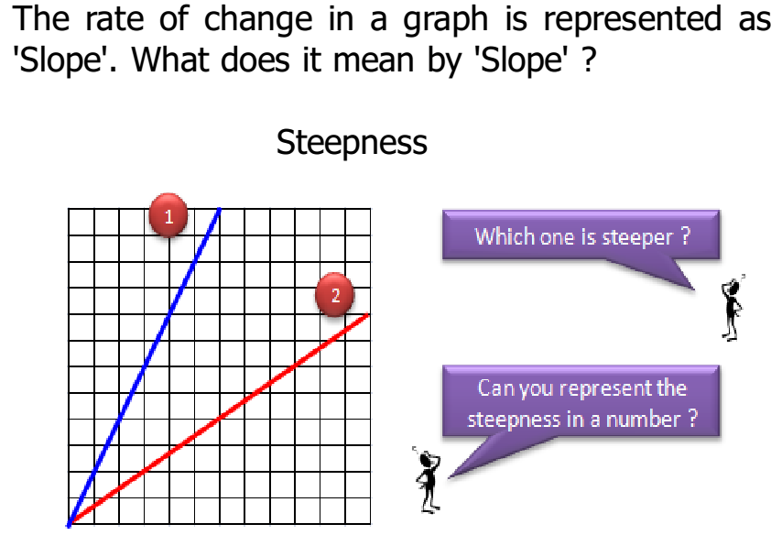

Slide 4
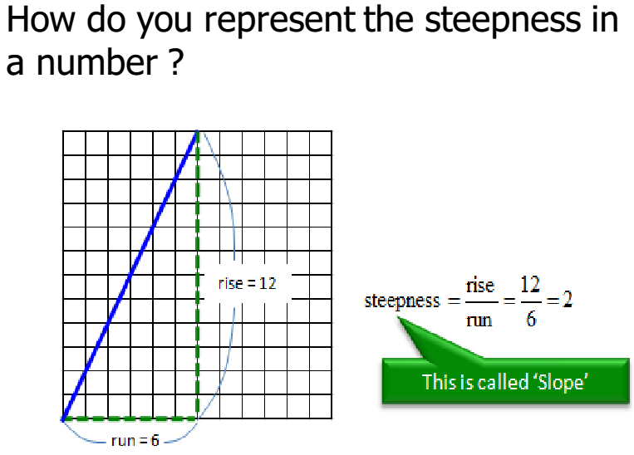

Slide 5
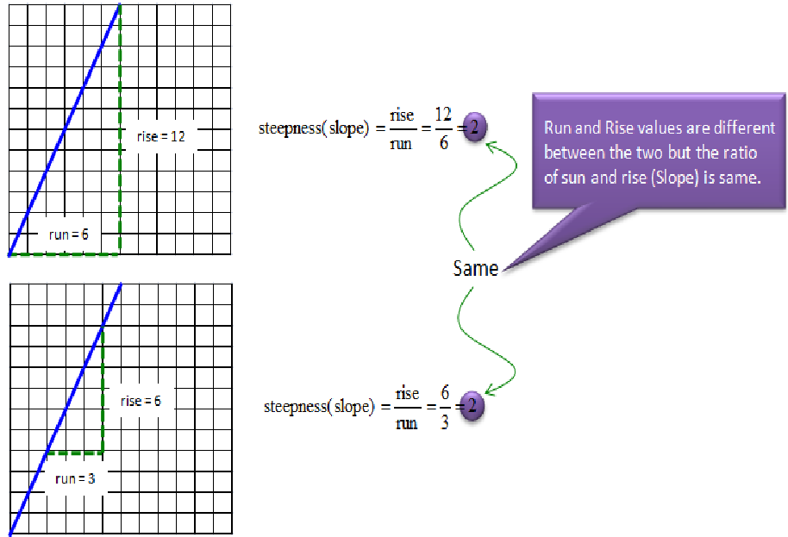

Slide 6
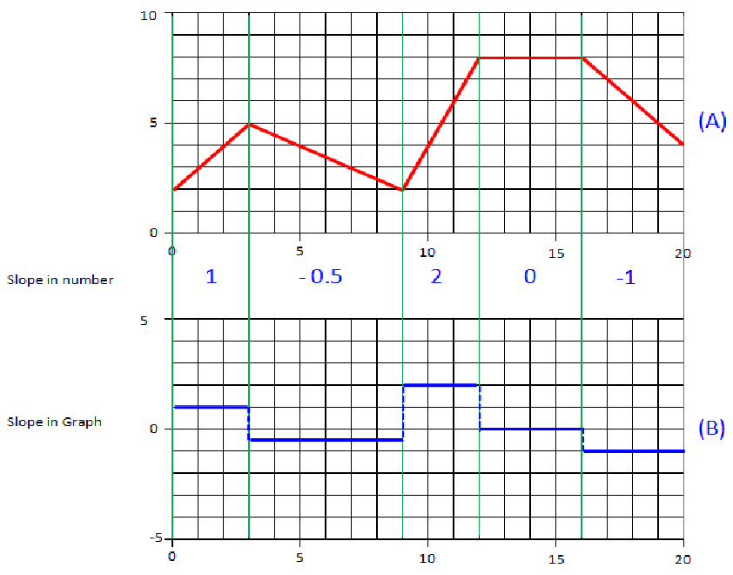

Slide 7
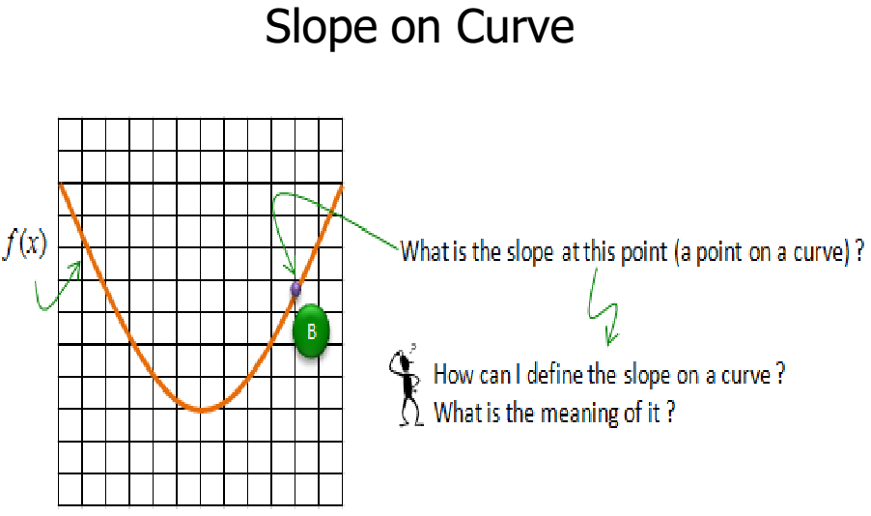

Slide 8
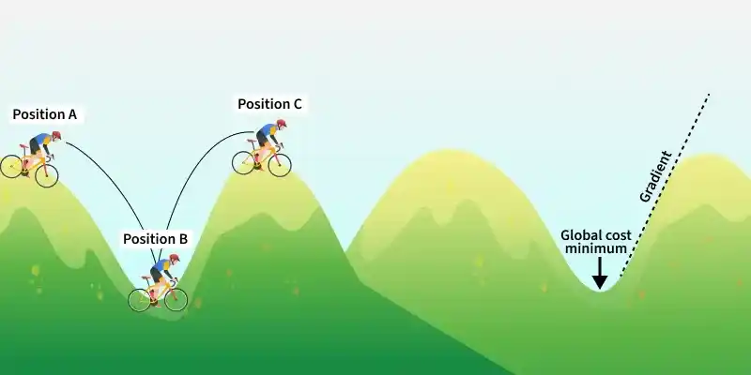
Try to reach global minima where error is minimum

Slide 9
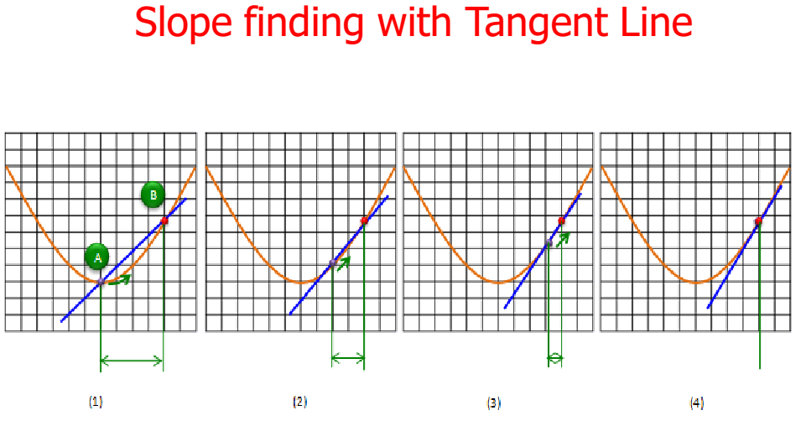

Slide 10
Limit helps us to find the slope of a tangent line at any point

Slide 11
Limit
Value of function when its variables are having specific value
Value of function when its variables are approaching some value

Slide 12
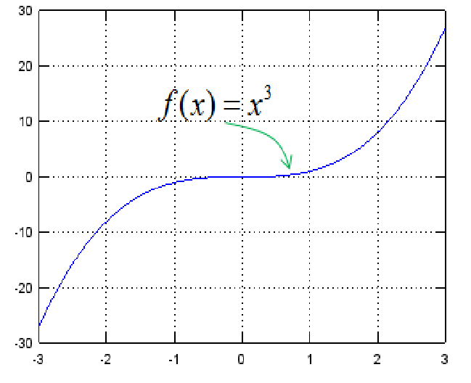
Example1

Slide 13
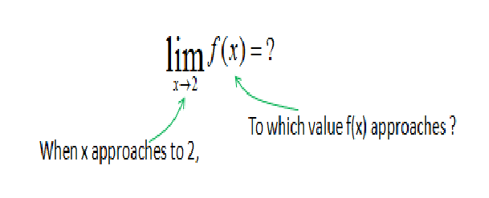
Limit

Slide 14
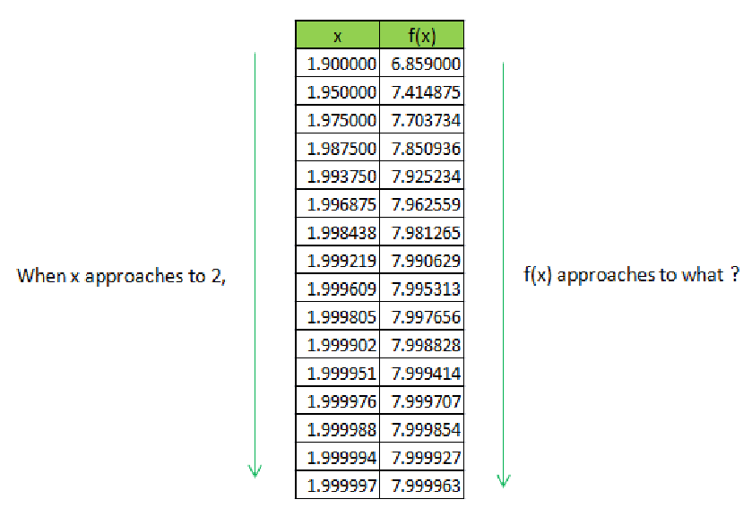

Slide 15
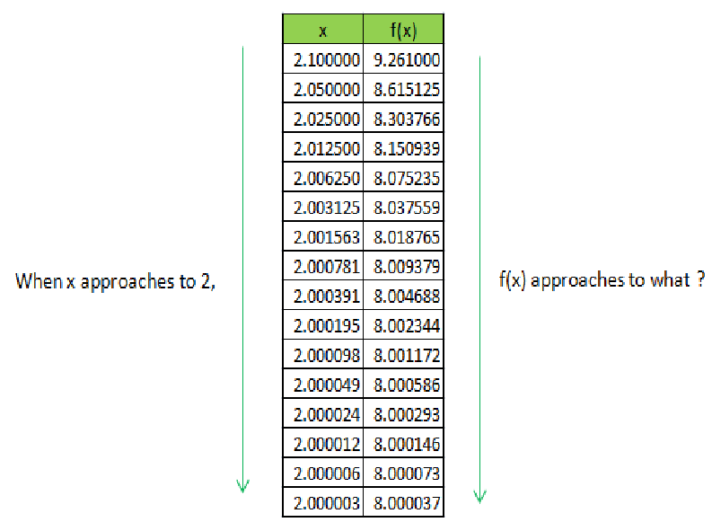

Slide 16
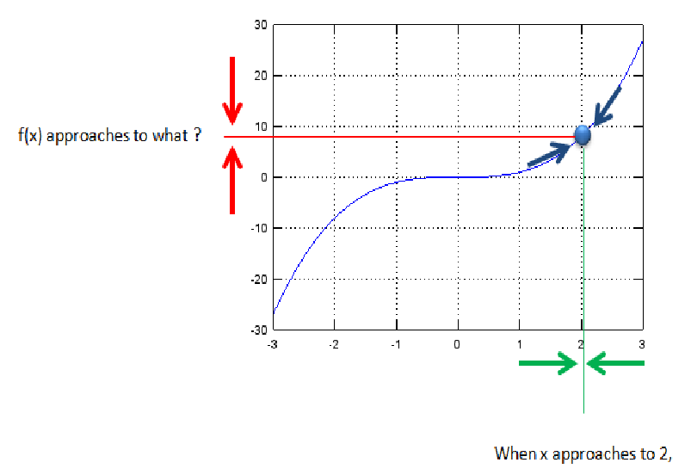

Slide 17
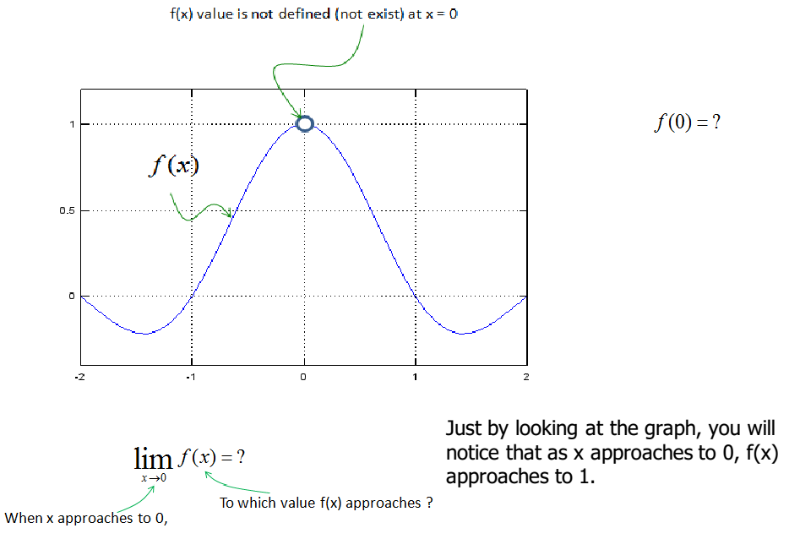
Example2

Slide 18
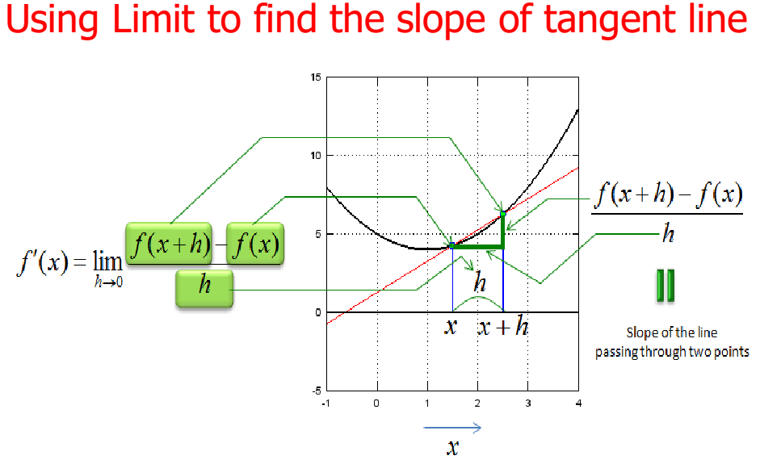

Slide 19
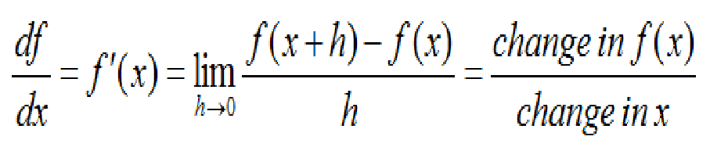
Derivative
Derivative of a function allows us to compute the slope/gradient of a function at any point on its curve.

Slide 20
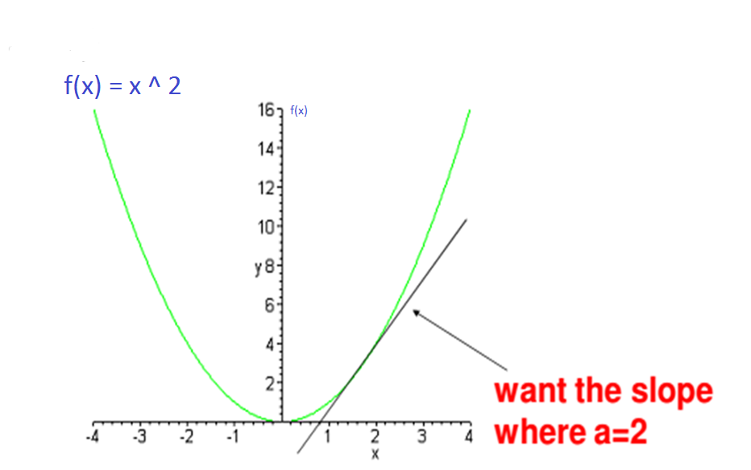
Slope – 1 D Example

Slide 21
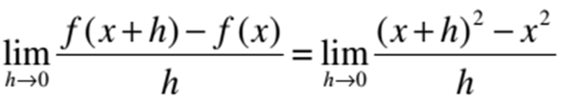

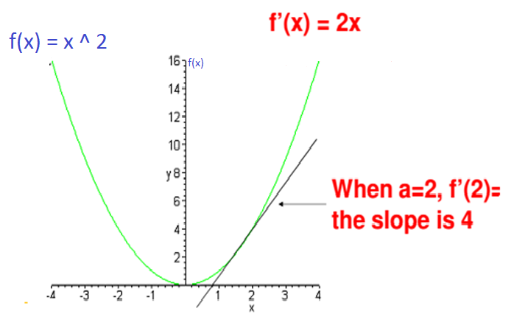
Slope – 1 D Example

Slide 22
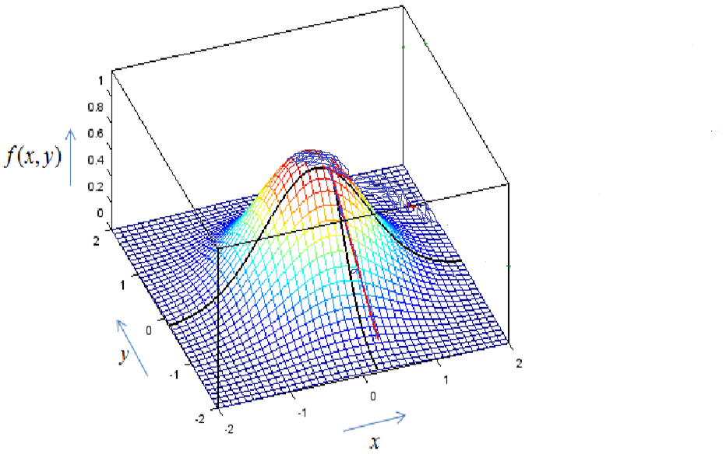
Slope/gradient in 2-dimensions
How do you find slope at this point?

Slide 23

Slope/gradient in 2-dimensions
How do you find slope at this point?
Draw a tangent line along x direction by keeping y unchanged
Draw one more tangent line along y direction by keeping x unchanged.
Find slopes of each tangent line separately.

Slide 24
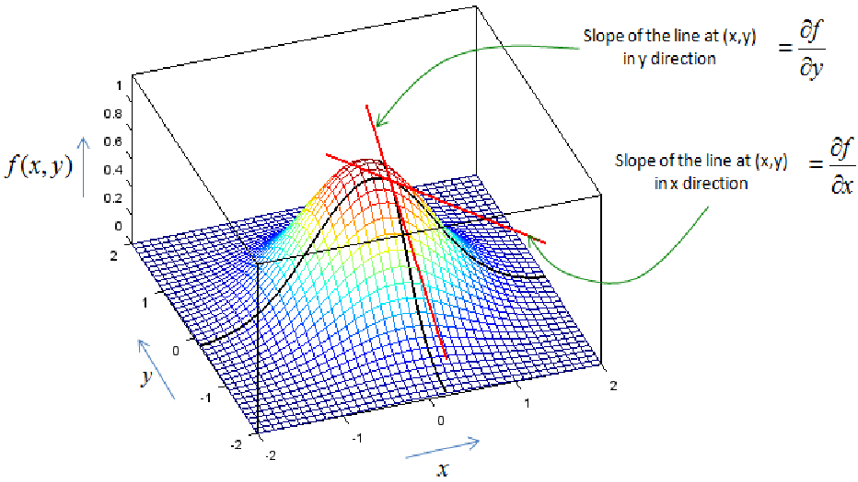
Slope/gradient in 2-dimensions
Partial derivatives allows us to compute slope of a curve at any point in multiple dimensions

Slide 25
Slope – 2 D Example
Find the slope of function f(x,y) = x² + y² at (1,1) and (2,3)

Slide 26
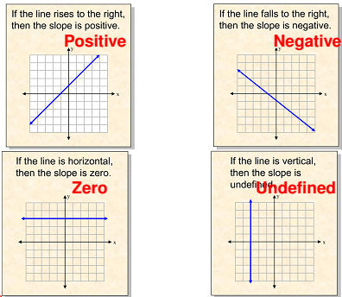
Slope

