Slide 1
Collecting, categorizing and analyzing Emails from top Free Disposable Email Address Services
CSE508: Network Security
By Shubham Jindal
SBU ID: 112129688

Slide 2
DEA Services
Unique public email address
Disposable if compromised (spam, phishing)
Free or paid
Uses: Online registration/middle layer mailbox

Slide 3
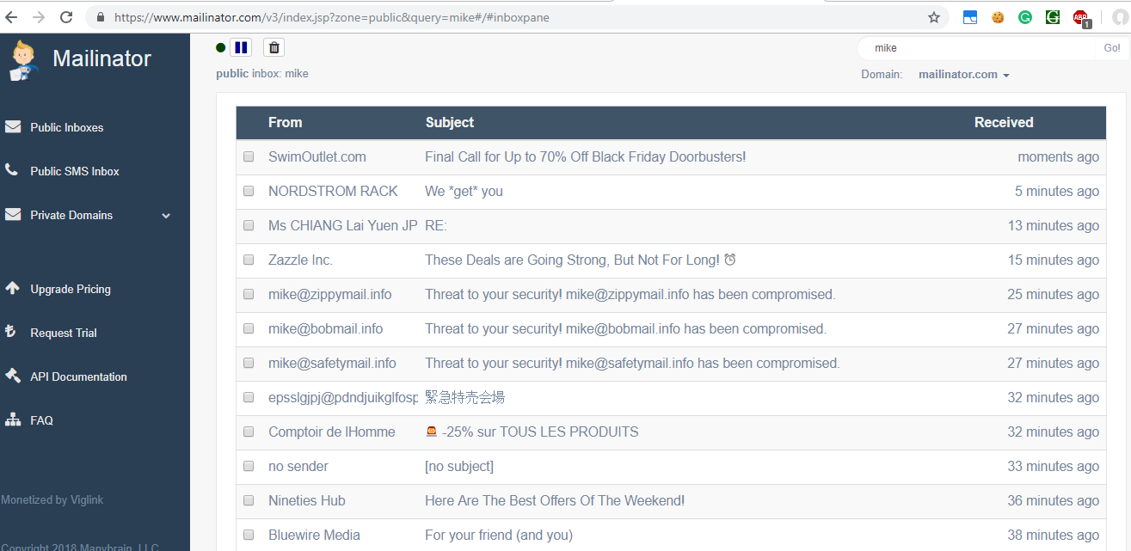
mike@mailinator.com

Slide 4
Problem
Analyze the kinds of mails present in DEA mailboxes.
Requirements:
Collection of mails
Categorization of mails
Draw insights

Slide 5
Challenges
C1: pages took time to load
C2: mailinator has request limit and is protected by cloudFlare, number one service for protection against DOS and DDOS attacks.
C3: mailinator blocks TOR proxy
C4: Access lost after crossing limits.
C5: Mailinator empties the email data at a certain point of time every day.
C6: every run of the mailinator started fetching the emails from the start.

Slide 6
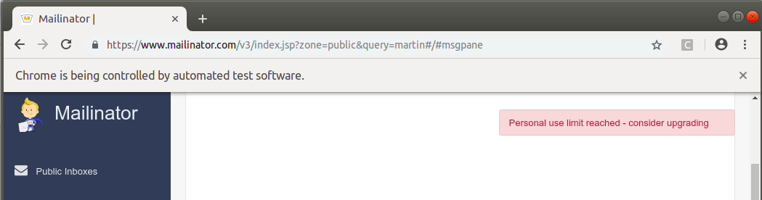
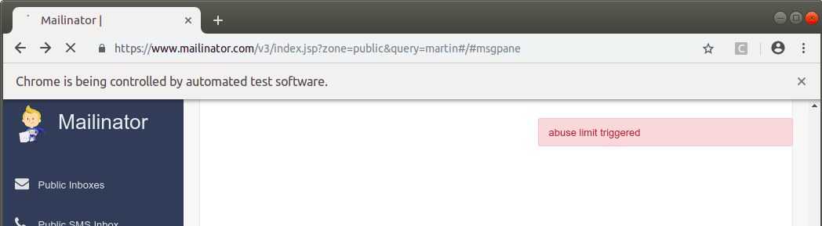
Usage limit
Abuse limit
Blocks IP after abuse limit is crossed

Slide 7
Results
Collection: Selenium + python + cron + timing adjustments
Classification: python + ML(scikit learn)
100 common names
Top Google bad words:1703
Collection results:
Total Mailboxes checked : 101
Total Mails : 2808

Slide 8
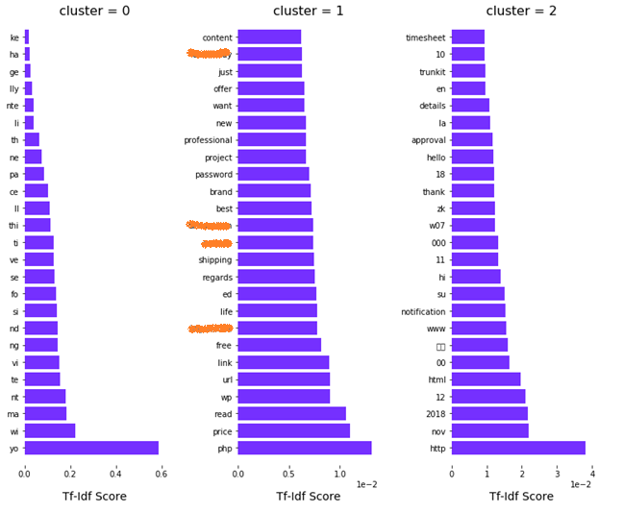
Classification Result and Insights
SimpleClassifier:
Profane Mail :539/2808
Pharma Mails :15
Profanity :19%
Pharma :0.5%
DEA Used :{'yopmail.com': 5}
MLClassifier:
-Top categories : Profanity/promotion/offer
-Some mails in Mandarin and Russian
-26 extortion mails by hackers with BTC Wallet id.
-Presence of vulnerable urls

Slide 9
Future Work
Crawling links in mail.
Analyzing source email addresses, time stamp.
Image and OCR for mails
Translating emails from Language Unicode to English (Google translater api - 1000000 words/ $20).
Include scripts for yopmail, tempr.email.
Project link: https://github.com/sjindal94/DEAemailscraper

