Slide 1
Intrusion Detection and Hackers Exploits
IP Spoofing Attack
Yousef Yahya & Ahmed Alkhamaisa
Prepared for
Arab Academy for Banking and Financial Sciences (AABFS)

Slide 2
IP spoofing
IP spoofing is a technique used to gain unauthorized access to computers, where by the attacker sends messages to a computer with a forging IP address indicating that the message is coming from a trusted host.
Attacker puts an internal, or trusted, IP address as its source. The access control device sees the IP address as trusted and lets it through.
Notes:
1- The creation of IP packets with counterfeit (spoofed) IP source addresses.
2- A method of attack used by network intruders to defeat network security measures such as authentication based on IP addresses.
There are attacks where the attacker “spoofs” the source IP address of a “trusted” IP address to slip by security measures in the network. This attack uses the trust relationships established by IP addresses that are considered trusted (usually internal) versus untrusted

Slide 3
IP Spoofing
  IP spoofing occurs when a hacker inside or outside a network impersonates the conversations of a trusted computer.
  Two general techniques are used during IP spoofing:
    A hacker uses an IP address that is within the range of trusted IP addresses.
    A hacker uses an authorized external IP address that is trusted.
  Uses for IP spoofing include the following:
    IP spoofing is usually limited to the injection of malicious data or commands into an existing stream of data.
    A hacker changes the routing tables to point to the spoofed IP address, then the hacker can receive all the network packets that are addressed to the spoofed address and reply just as any trusted user can.

Slide 4
Basic Concept of IP Spoofing
A
www.carleton.ca
10.10.10.1
134.117.1.60
http://www.carleton.ca
10.10.10.1
134.117.1.60
Any (>1024)
80
Src_IP
dst_IP
Src_port
dst_port
spoofed
11.11.11.1
134.117.1.60
Any (>1024)
80
Src_IP
dst_IP
Src_port
dst_port

Slide 5
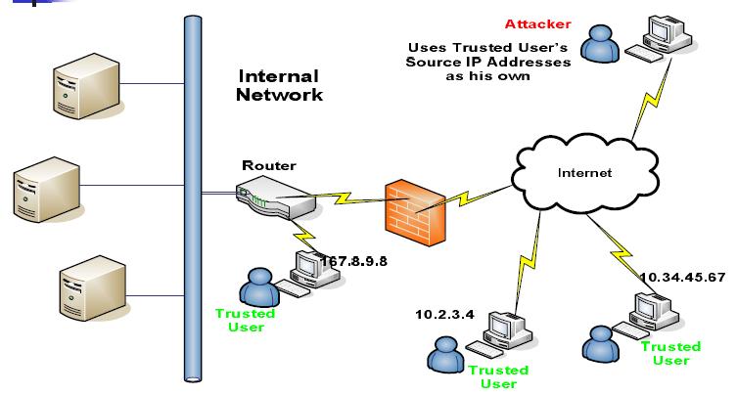
IP Spoofing
Notes:
IP spoofing attack occurs when an attacker outside your network pretends to be a trusted user either by using an IP address that is within the range of IP addresses for your network or by using an authorized external IP address that you trust and to which you want to provide access to specified resources on your network. Should an attacker get access to your IPSec security parameters, that attacker can masquerade as the remote user authorized to connect to the corporate network.

Slide 6
Why IP Spoofing is easy?
Problem with the Routers.
Routers look at Destination addresses only.
Authentication based on Source addresses only.
To change source address field in IP header field is easy.

Slide 7
Spoofing Attacks:
There are a few variations on the types of attacks that using IP spoofing.
Spoofing is classified into :-
1.non-blind spoofing
This attack takes place when the attacker is on the same subnet as the target that could see sequence and acknowledgement of packets.
Using the spoofing to interfere with a connection that sends packets along your subnet.
Notes:
The threat of this type of spoofing is session hijacking and an attacker could bypass any authentication measures taken place to build the connection. This is accomplished by corrupting the DataStream of an established connection, then re-establishing it based on correct sequence and acknowledgement numbers with the attack machine.

Slide 8

Spoofing Attacks:
impersonation
sender
partner
ip spoofed packet
src: partner
dst: victim
Oh, my partner sent me a packet. I’ll process this.
victim
Notes:
session hijack or reset
TCP SESSION HIJACKING
Send RST packet with spoofed source IP address and appropriate sequence number to one end
SYN-flood that end send ACK packets to target at other end

Slide 9

IP Spoofing
Three-way handshake
Intruder
SYN(A)
ACK(A+1) SYN(B)
ACK(B+1)
A
B
trusted host

Slide 10
Spoofing Attacks:
2. Blind spoofing
This attack may take place from outside where sequence and acknowledgement numbers are unreachable. Attackers usually send several packets to the target machine in order to sample sequence numbers, which is doable in older days .
Using the spoofing to interfere with a connection (or creating one), that does not send packets along your cable.
Notes:
Today, most OSs implement random sequence number generation, making it difficult to predict them accurately. If, however, the sequence number was compromised, data could be sent to the target.

Slide 11

Spoofing Attacks:
flooding attack
sender
ip spoofed packet
src: random
dst: victim
Oops, many packets are coming. But, who is the real source?
victim
Notes:
hide

Slide 12
Spoofing Attacks:
3.Man in the Middle Attack
This is also called connection hijacking. In this attacks, a malicious party intercepts a legitimate communication between two hosts to controls the flow of communication and to eliminate or alter the information sent by one of the original participants without their knowledge.
Notes:
A type of attack where a user gets between the sender and receiver of information and sniffs any information being sent. In some cases, users may be sending unencrypted data, which means the man-in-the-middle can easily obtain any unencrypted information. In other cases, a user may be able to obtain the information from the attack but have to unencrypt the information before it can be read.

Slide 13
Spoofing Attacks:
reflection
sender
ip spoofed packet
src: victim
dst: reflector
reflector
reply packet
src: reflector
dst: victim
Oops, a lot of replies without any request…
victim
Notes:
ip reflected attack

Slide 14
Spoofing Attacks:
4.Denial of Service Attack
conducting the attack, attackers spoof source IP addresses to make tracing and stopping the DoS as difficult as possible. When multiple compromised hosts are participating in the attack, all sending spoofed traffic, it is very challenging to quickly block the traffic.
IP spoofing is almost always used in denial of service attacks (DoS), in which attackers are concerned with consuming bandwidth and resources by flooding the target with as many packets as possible in a short amount of time. To effectively

Slide 15
Spoofing Attacks:
IP spoofing can also be a method of attack used by network intruders to defeat network security measures, such as authentication based on IP addresses. This method of attack on a remote system can be extremely difficult, as it involves modifying thousands of packets at a time. This type of attack is most effective where trust relationships exist between machines.
For example, it is common on some corporate networks to have internal systems trust each other, so that a user can log in without a username or password provided they are connecting from another machine on the internal network (and so must already be logged in). By spoofing a connection from a trusted machine, an attacker may be able to access the target machine without authenticating.

Slide 16
SMURF ATTACK
Send ICMP ping packet with spoofed IP source address to a LAN which will broadcast to all hosts on the LAN
Each host will send a reply packet to the spoofed IP address leading to denial of service
Notes:
ICMP datagrams
• ICMP (Internet Control Message Protocol) datagrams are signaling messages, encapsulated within IP datagrams, used by the network layer to notify special events such as destinations unreachable, redirection, congestion control, testing network connectivity and others.

Slide 17
Misconception of IP Spoofing:
A common misconception is that "IP Spoofing" can be used to hide your IP address while surfing the Internet, chatting on-line, sending e-mail, and so forth.
This is generally not true. Forging the source IP address causes the responses to be misdirected, meaning you cannot create a normal network connection. However, IP spoofing is an integral part of many networks that do not need to see responses.

Slide 18
Impact
Current intruder activity in spoofing source IP addresses can lead to unauthorized remote root access to systems behind a filtering-router firewall. After gaining root access and taking over existing terminal and login connections, intruders can gain access to remote hosts.

Slide 19
Detection of IP Spoofing:
1. If you monitor packets using network-monitoring software such as netlog, look for a packet on your external interface that has both its source and destination IP addresses in your local domain. If you find one, you are currently under attack.
Notes:
We can monitor packets using network-monitoring software.
A packet on an external interface that has both its source and destination IP addresses in the local domain is an indication of IP spoofing.
Another way to detect IP spoofing is to compare the process accounting logs between systems on your internal network. If the IP spoofing attack has succeeded on one of your systems, you may get a log entry on the victim machine showing a remote access; on the apparent source machine, there will be no corresponding entry for initiating that remote access

Slide 20
Detection of IP Spoofing:
2. Another way to detect IP spoofing is to compare the process accounting logs between systems on your internal network. If the IP spoofing attack has succeeded on one of your systems, you may get a log entry on the victim machine showing a remote access; on the apparent source machine, there will be no corresponding entry for initiating that remote access.

Slide 21
Source Address Validation :
Check the source IP address of IP packets
  filter invalid source address
  filter close to the packets origin as possible
  filter precisely as possible
If no networks allow IP spoofing, we can eliminate these kinds of attacks

Slide 22

close to the origin
You are spoofing!
You are spoofing!
You are spoofing!
srcip: 0.0.0.0
×
srcip: 0.0.0.0
10.0.0.0/23
×
srcip: 0.0.0.0
RT.a
RT.b
×
×
srcip: 10.0.0.1
10.0.3.0/24
srcip: 10.0.0.1
×
Hmm, this looks ok...but..
srcip: 10.0.0.1
You are
spoofing!
You are
spoofing!
we can check and drop the packets which have unused address everywhere, but used space can be checked before aggregation

Slide 23
Prevention IP spoofing
The best method of preventing the IP spoofing problem is to install a filtering router that restricts the input to your external interface (known as an input filter) by not allowing a packet through if it has a source address from your internal network. In addition, you should filter outgoing packets that have a source address different from your internal network in order to prevent a source IP spoofing attack originating from your site.

Slide 24
Prevention IP spoofing
If your vendor’s router does not support filtering on the inbound side of the interface or if there will be a delay in incorporating the feature into your system, you may filter the spoofed IP packets by using a second router between your external interface and your outside connection. Configure this router to block, on the outgoing interface connected to your original router, all packets that have a source address in your internal network.
Notes:
For this purpose, you can use a filtering router or a UNIX system with two interfaces that supports packet filtering. Disabling source routing at the router does not protect you from this attack, but it is still good security practice to do so.

Slide 25
Prevention of IP Spoofing:
To prevent IP spoofing happen in your network, the following are some common practices:
1- Avoid using the source address authentication. Implement cryptographic authentication system-wide.
2- Configuring your network to reject packets from the Net that claim to originate from a local address.
3- Implementing ingress and egress filtering on the border routers and implement an ACL (access control list) that blocks private IP addresses on your downstream interface.
If you allow outside connections from trusted hosts, enable encryption sessions at the router.

Slide 26
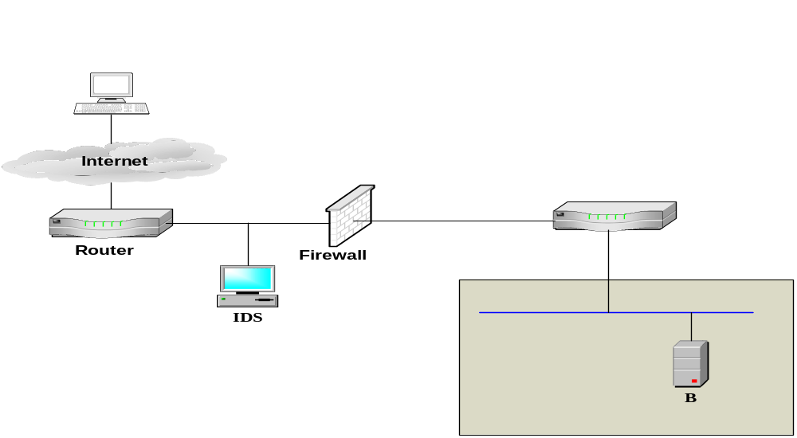
Filtering
if src_addr is from 10.10.0.0
then drop
else forward
10.10.0.0
10.10.10.0
if src_addr is from 10.10.0.0
then forward
else drop

