Slide 1
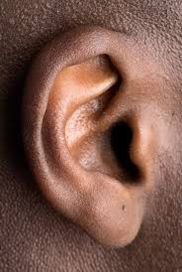
EARS

Slide 2
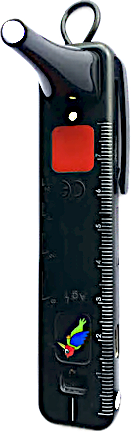
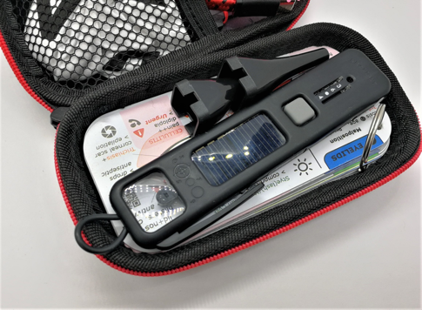
Objectives - Ears
Take a history
Test hearing
Examine ears

Slide 3
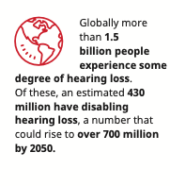
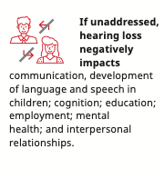
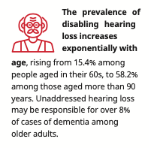
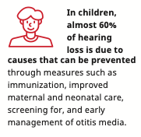
Ear Health and Hearing Impairment

Slide 4
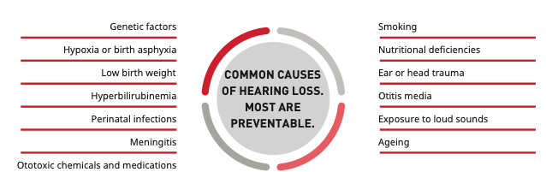
Ear Health and Hearing Impairment
Otitis Media
Impacted Wax
OTITIS MEDIA & IMPACTED WAX

Slide 5
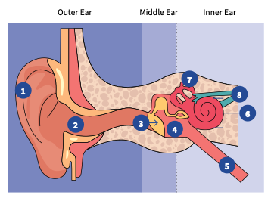
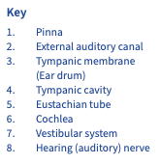

Slide 6
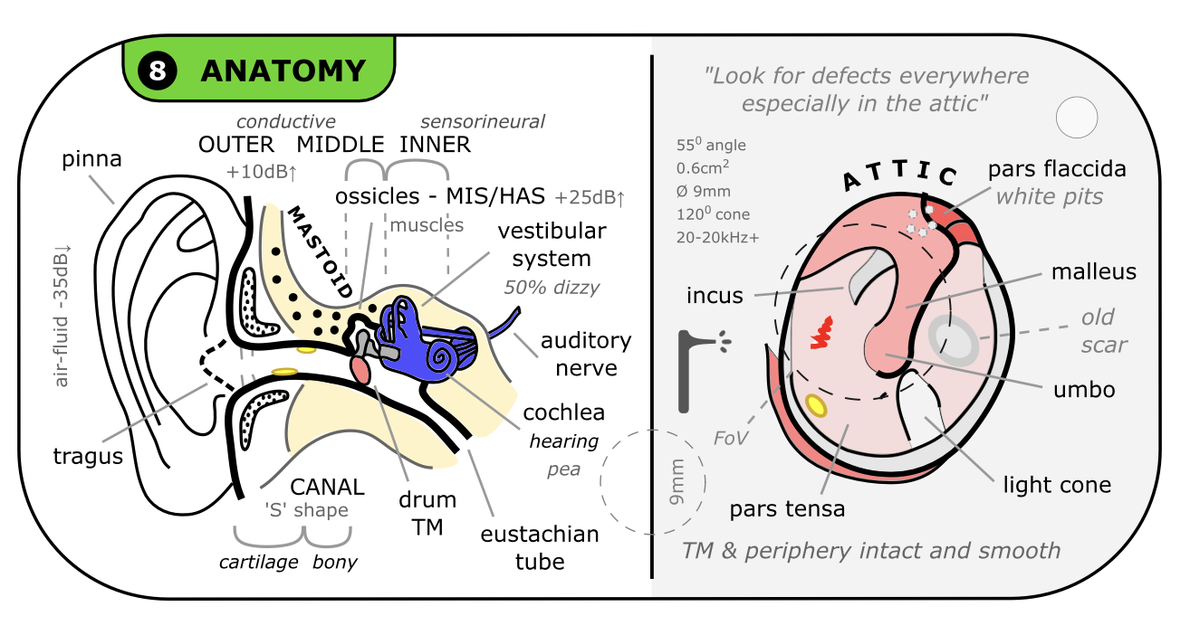

Slide 7
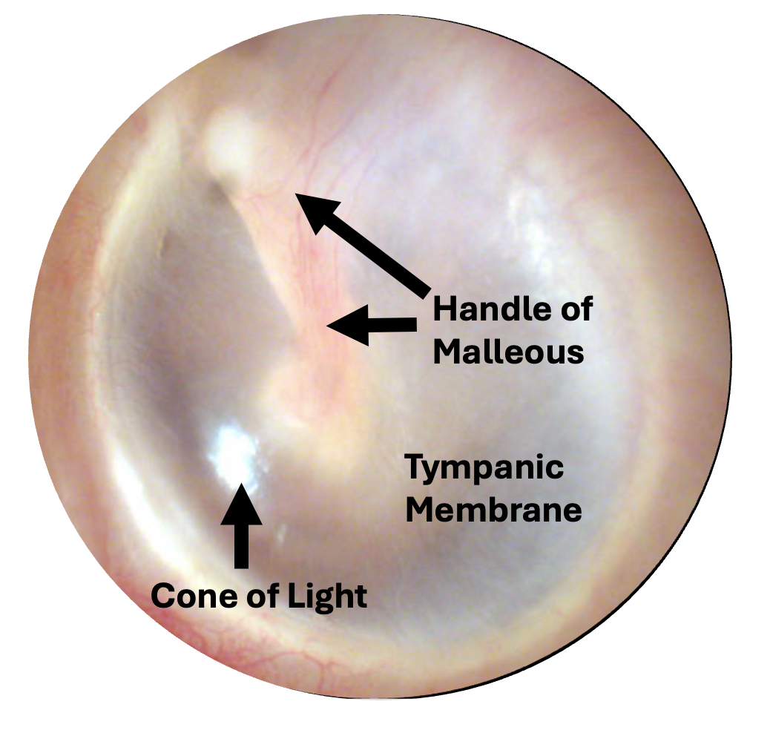
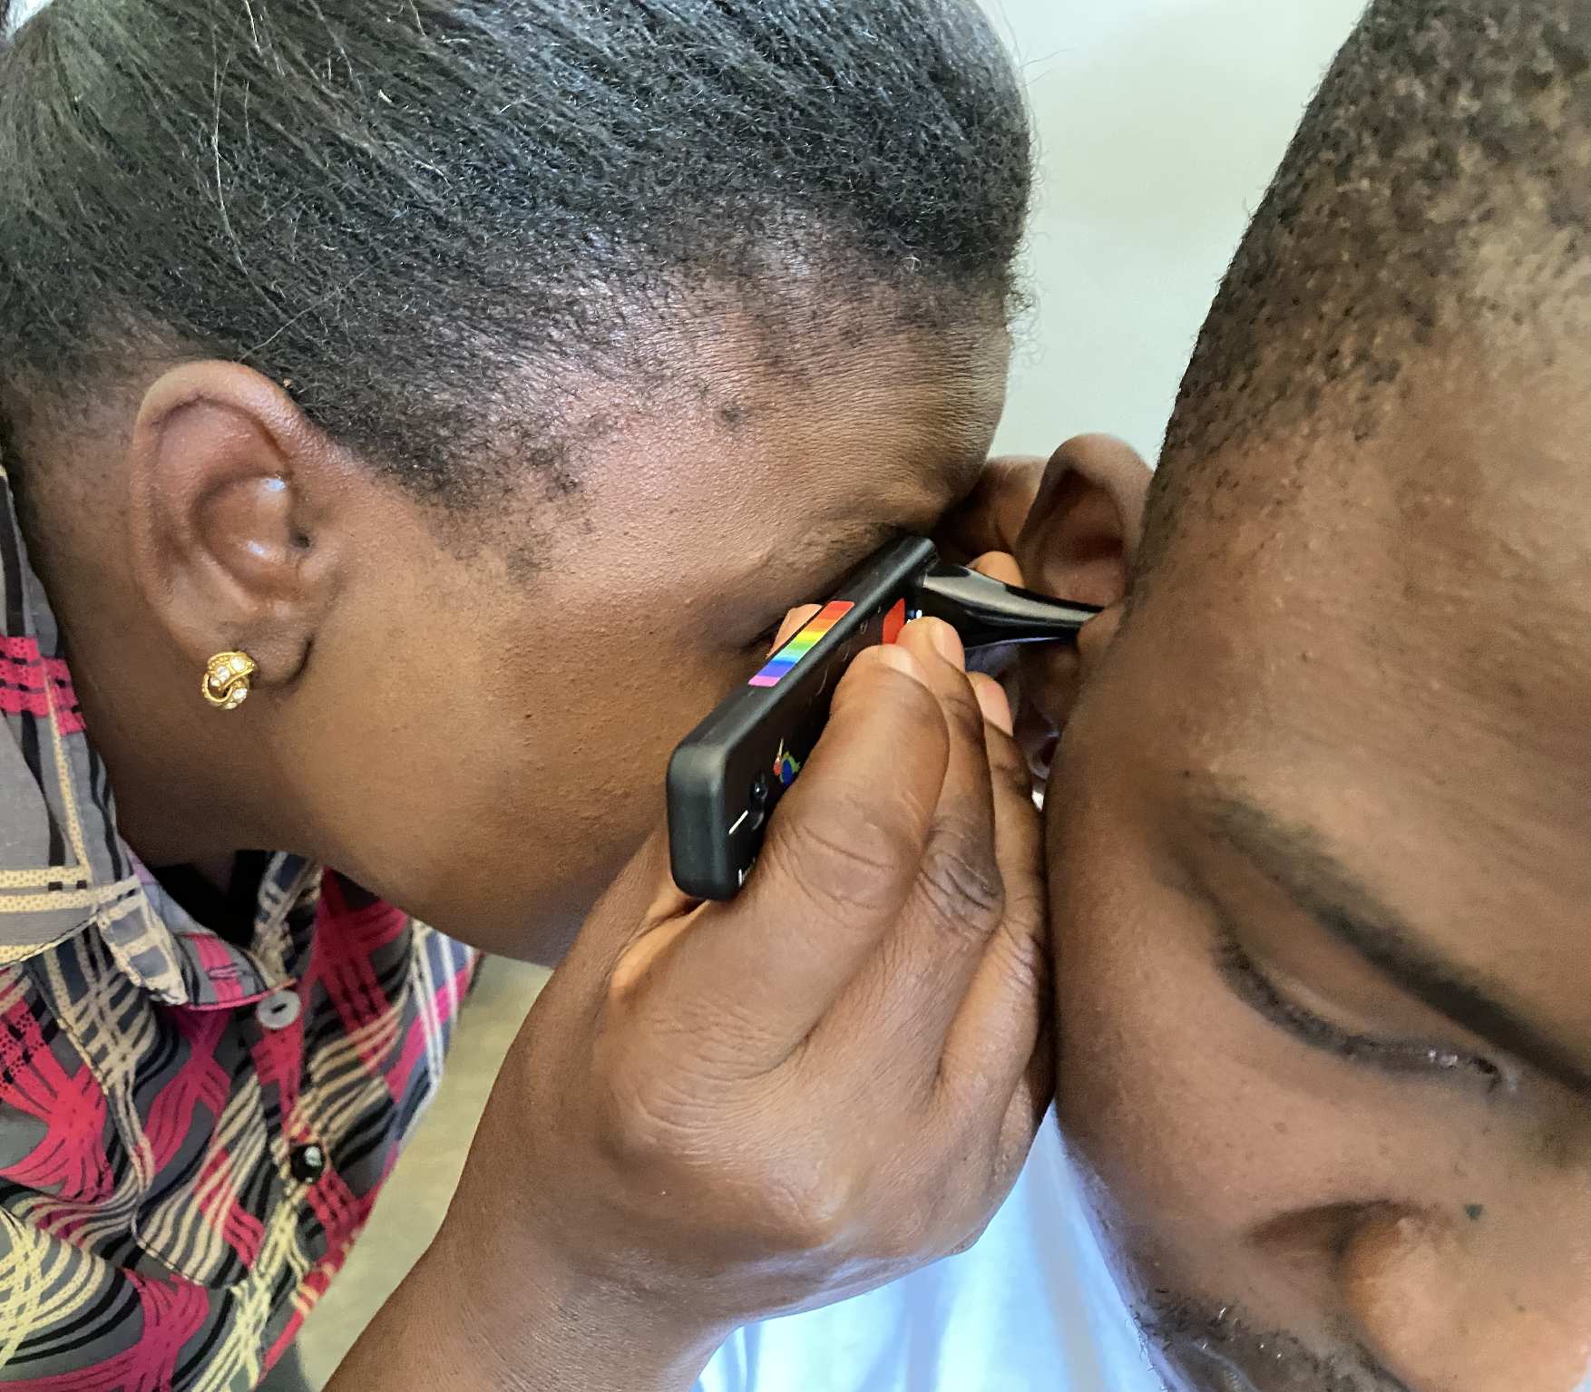
Examination – Otoscopy
Tympanic Membrane

Slide 9
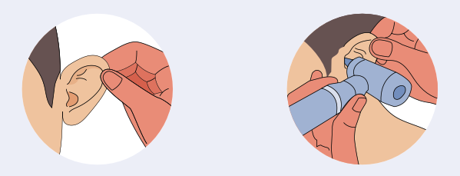
Examination
Observe: Swelling, redness, pus
Palpate: Mastoid, pinna, tragus
Otoscopy: Canal and tympanic membrane

Slide 10
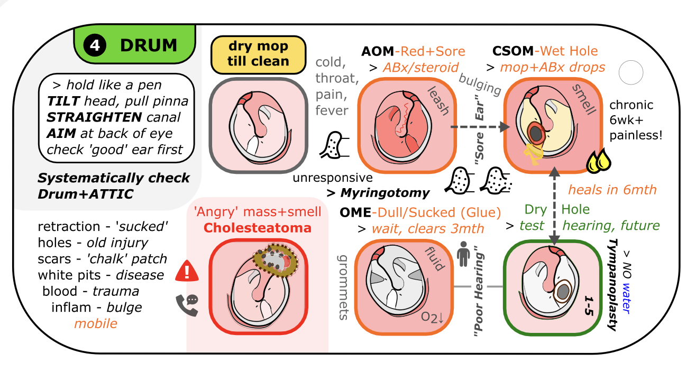

Slide 11
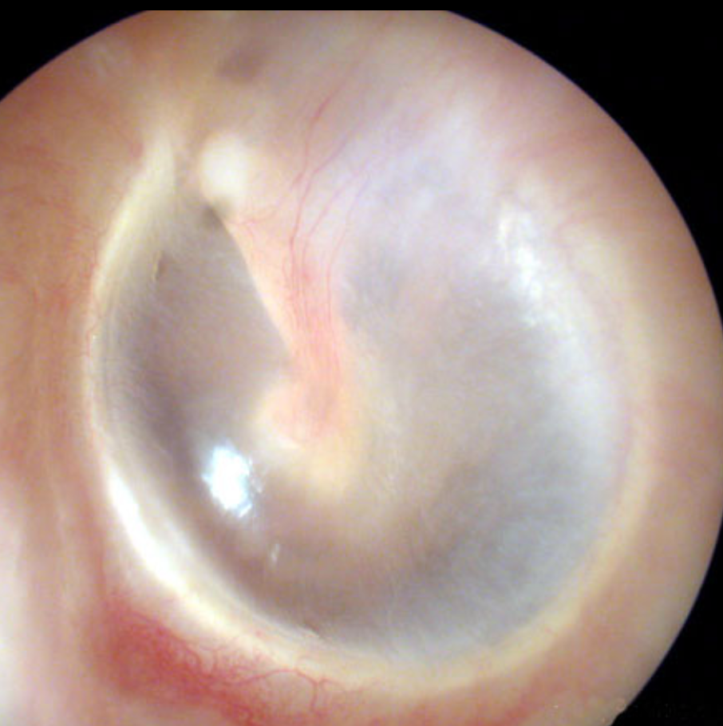
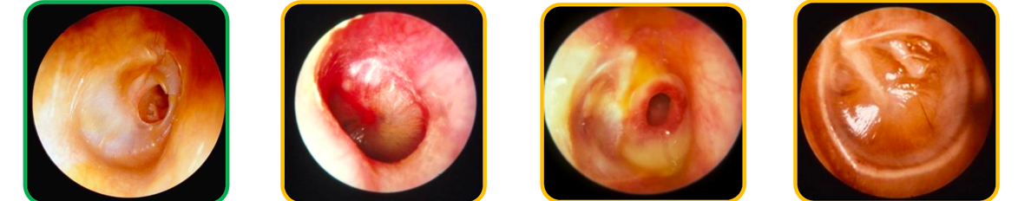
Tympanic Membranes
Normal

Slide 12
Tympanic Membranes
Normal
Hole

Slide 13
Tympanic Membranes
Chronic Suppurative Otitis Media (CSOM)
Normal
Hole

Slide 14
Tympanic Membranes
Chronic Suppurative Otitis Media (CSOM)
CSOM & Hole
Normal
Hole

Slide 15
Tympanic Membranes
Chronic Suppurative Otitis Media (CSOM)
Otitis Media with Effusion (OME)
CSOM & Hole
Normal
Hole

Slide 16
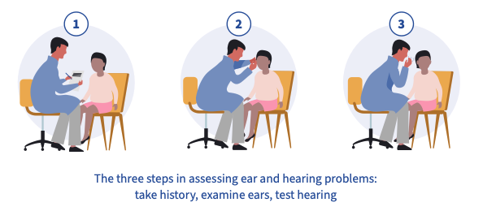
History
Examine
Hearing

Slide 17
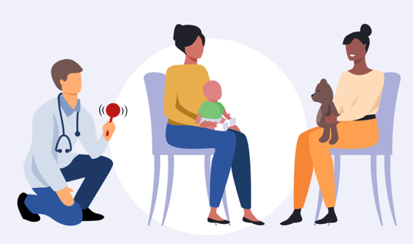

Testing Hearing in Children

Slide 18
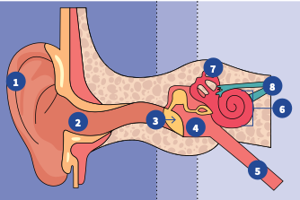

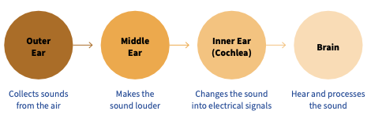

Slide 20
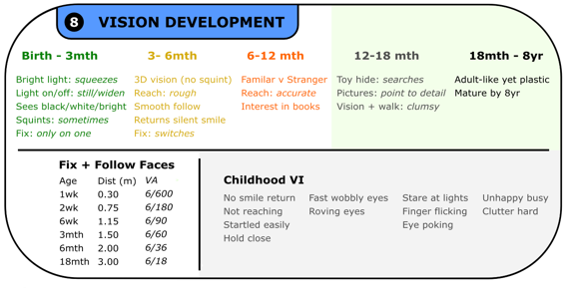
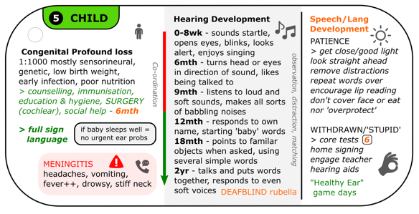

Slide 21


Slide 23
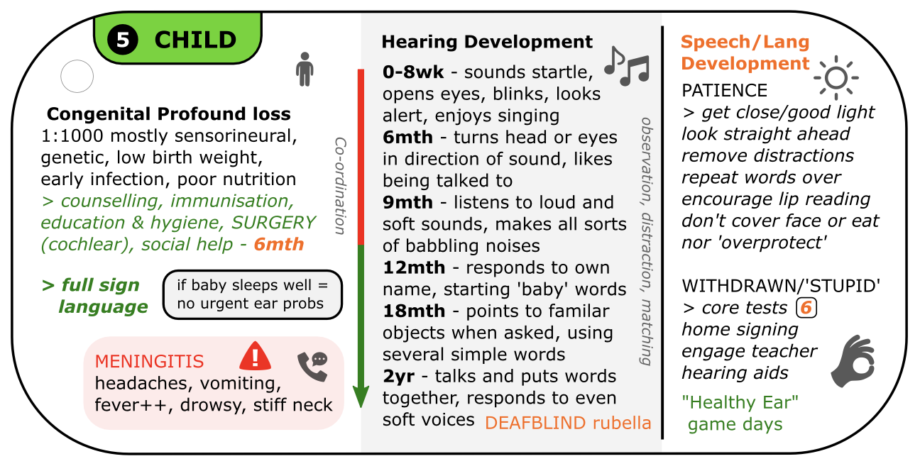

Slide 24

Objectives - Ears
Take a history
Test hearing
Examine ears
Observe
Palpate
Otoscopy

