Slide 2
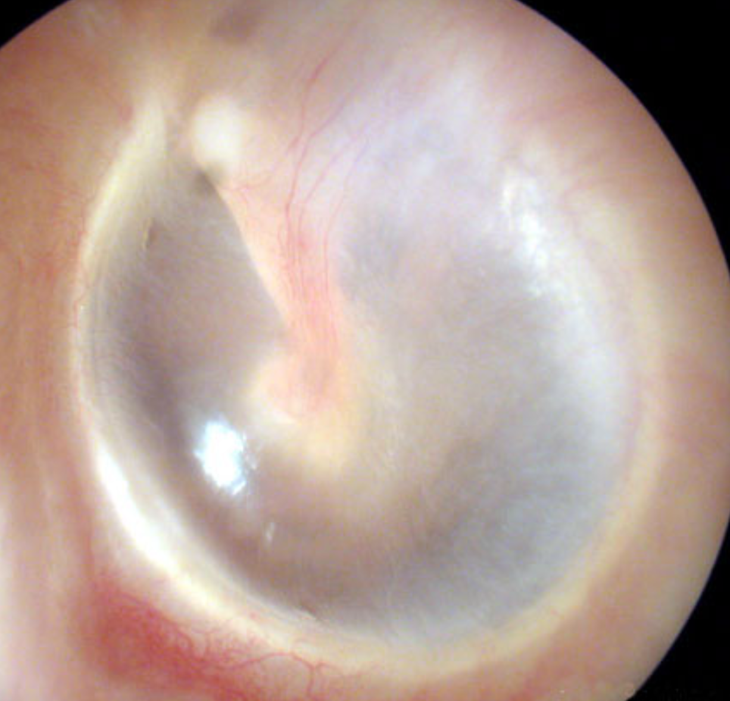

Slide 3
Umbo
Cone of Light

Slide 4
Lateral Process of Malleus
Pars
Flaccida

Slide 5
Incus
Handle of Malleus

Slide 6
Pars Tensa

Slide 8
Handle of Malleus
Pars
Flaccida
Incus
Cone of Light
Pars Tensa
Umbo

