Slide 1
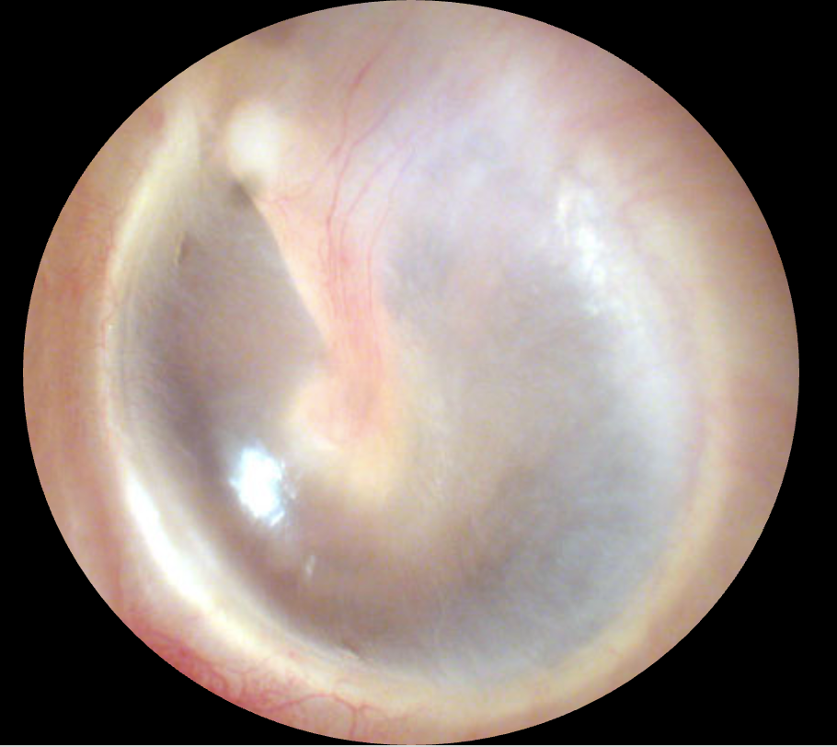
Handle of
Malleus
Tympanic Membrane
Cone of Light

Slide 2
Handle of
Malleus
Tympanic Membrane
Cone of Light

