Slide 1
Final Project
Analysis of the NBA
Timothy Murphy
Samuel Kadin

Slide 2
Introduction
The National Basketball Association or the NBA is the professional basketball league in the United States. There are 30 teams in the league and as of 2017-2018 has 491 players that bring in 63 million viewers annually.
Interests:
Salaries
3-point shots
The NBA draft

Slide 3
Questions: Part I
Which statistical categories are most correlated with the salary of a player within the NBA?
Adjusted for the team salary cap
Use Scikit-Learn to analyze with linear regression
Are we able to develop a model that can accurately predict a player’s salary based on their performance statistics?
Which players are over, fairly, and under compensated?
Once we create the best model given the available data, how does our model compare with other aggregate statistical models?
Hollinger’s Player Efficiency Rating (PER)
Value over Replacement (VORP)

Slide 4
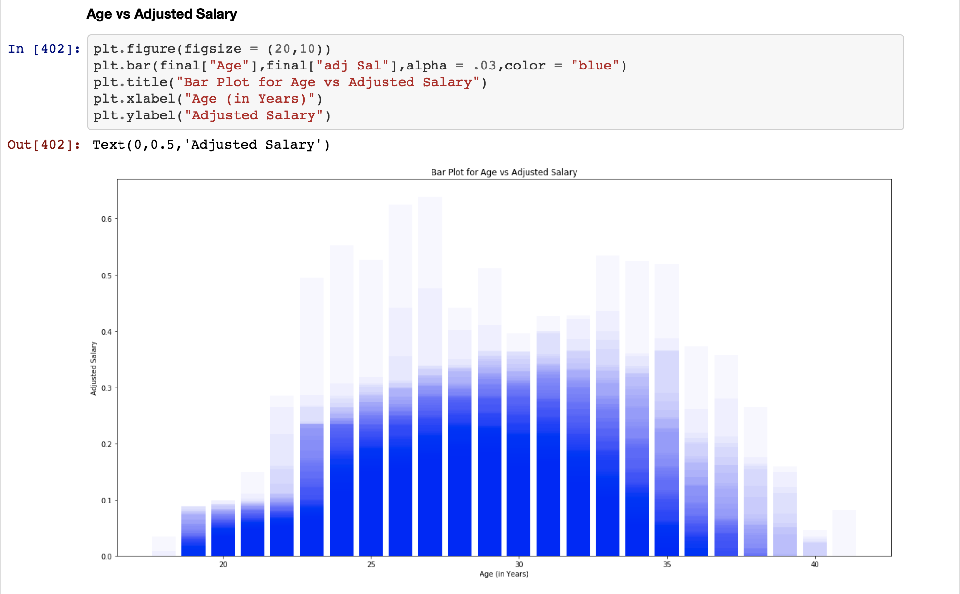
Preliminary Findings: Part I

Slide 5
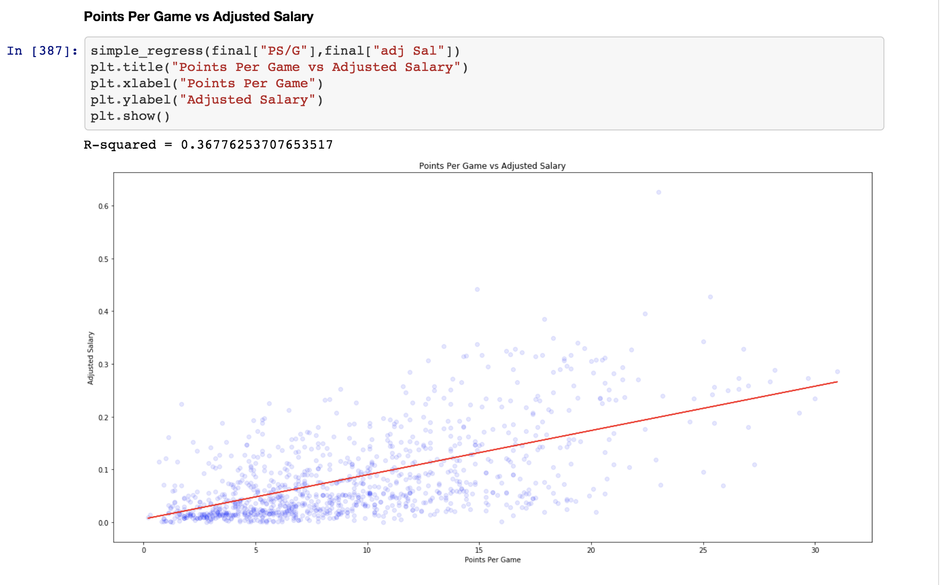
Preliminary Findings: Part II

Slide 6
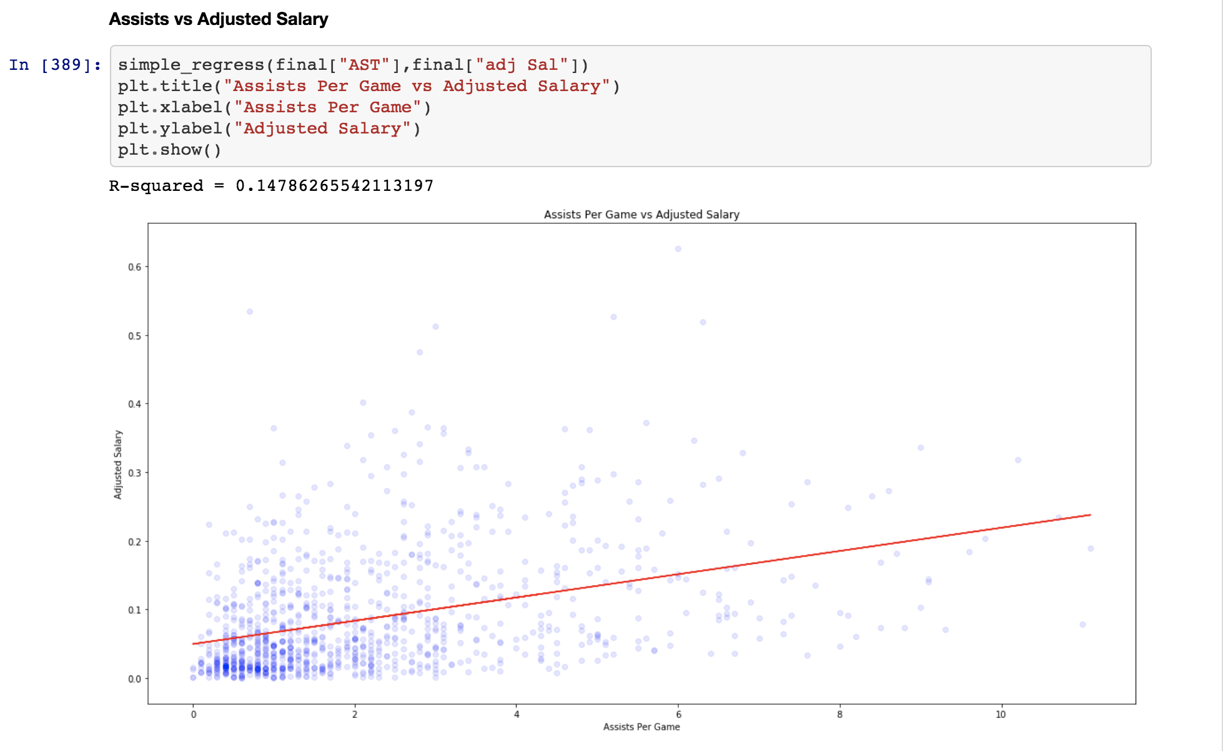
Preliminary Findings: Part III

Slide 7
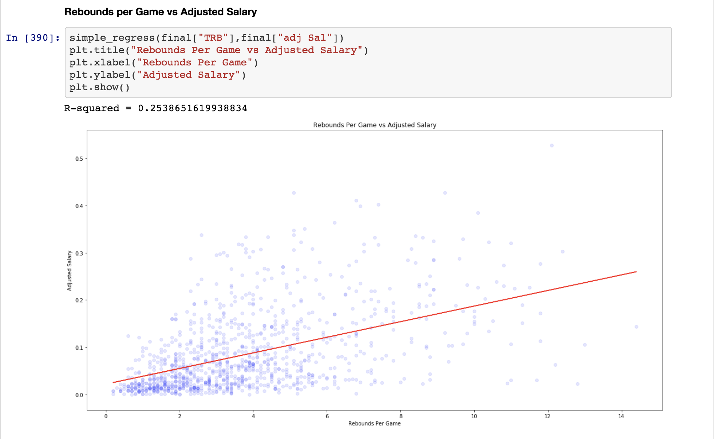
Preliminary Findings: Part IV

Slide 8
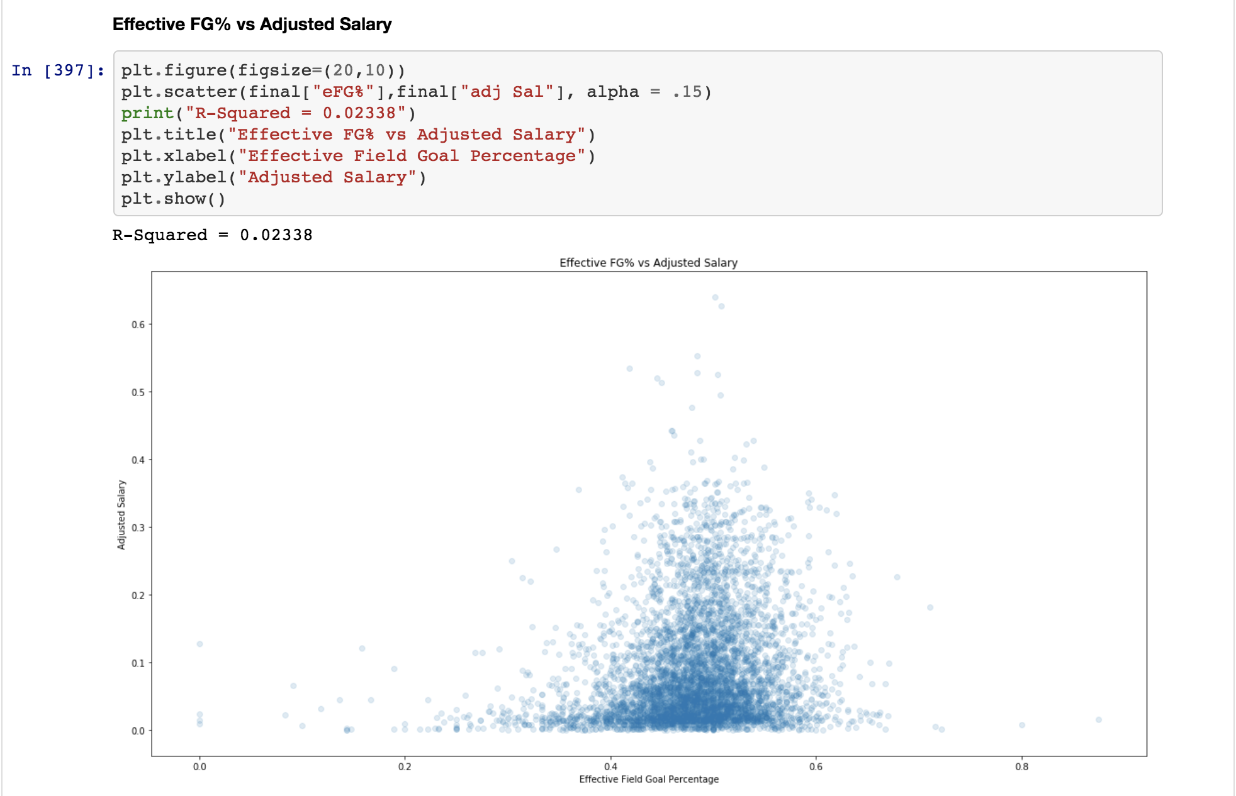
Preliminary Findings: Part V

Slide 9
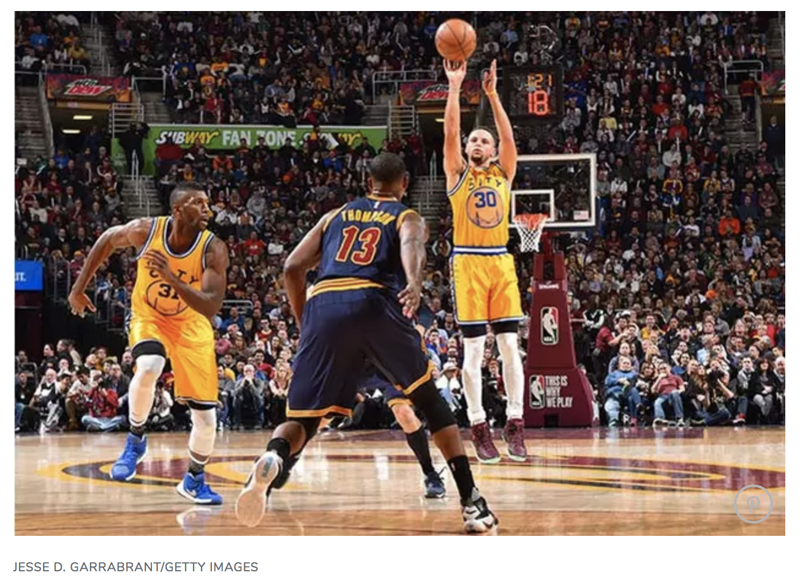
Questions: Part II
The popularity of using the 3-point shot appears to have become more popular…
Has the number of 3-point shots taken changed?
Has the efficiency of the 3-point shot changed?
If the above is true, how has the evolution of the 3-point shot impacted the NBA?
Has this led to an increase or decrease in the amount of scoring in the NBA?
Is the number 3-point shots taken associated with a team’s winning %?
How has this changed the pace of play?

Slide 10
Questions: Part III
Do the NBA draft lottery players (top 14 picks) have a greater adjusted VORP evaluation than the next 14 picks?
Value over Replacement Player (VORP) is an estimate used to evaluate a player’s quality and overall contribution to the team.
This is measured vs. what a theoretical "replacement player" would provide, where the "replacement player" is defined as a player on minimum salary or not a normal member of a team's rotation.
The conclusion was to establish -2.0 as replacement level for the NBA, measured in terms of points above or below average per 100 possessions.

Slide 11
Questions?

