Slide 1
PPP Survey PPP Execution Example
Term project #1

Slide 2
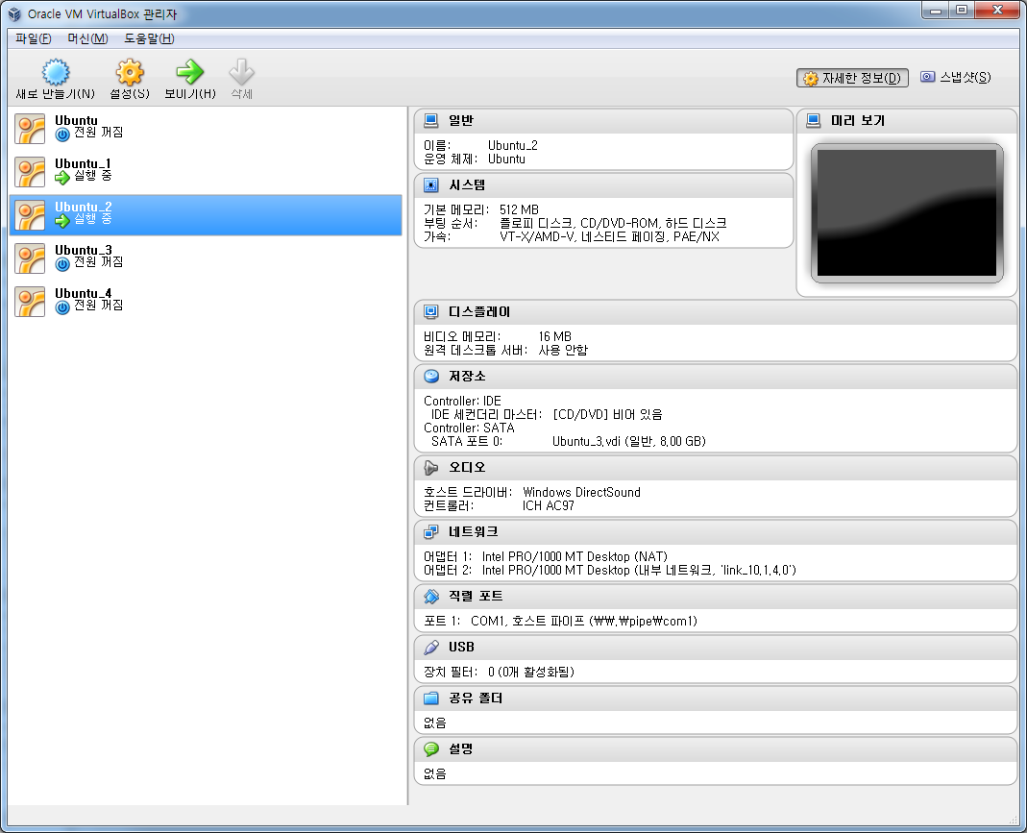
Setting Virtual Machine
Set up serial port in virtual machine
Need 2 VMs for communicate

Slide 3
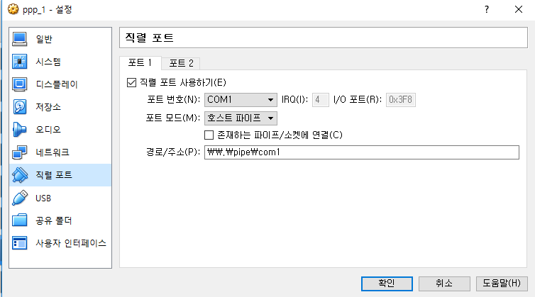
Serial Port Set Up in VM1
- 포트/파일 경로: \\.\pipe\com1으로 설정(1: 포트번호)
ex) 포트번호를 COM1로 설정, 포트/파일 경로 \\.\pipe\com1 로 설정
- vm1은 존재하는 파이프/소켓에 연결 체크 안함, vm2는 체크
- virtual machine 실행 시 존재하는 파이프/소켓에 연결을 체크하지 않은 vm부터 실행시켜야함
(즉 이 예제에선 vm1부터 실행시켜야 vm이 모두 켜짐)

Slide 4
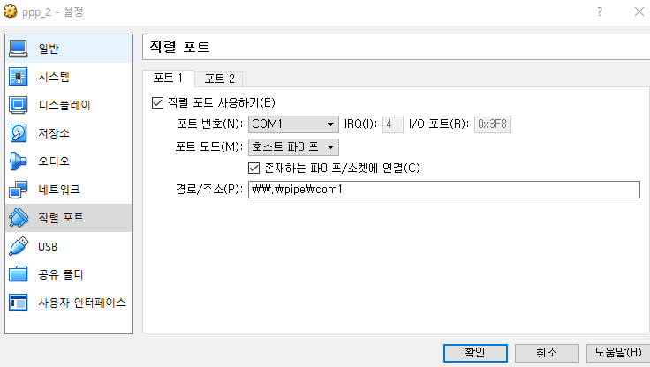
Serial Port Set Up in VM2

Slide 5
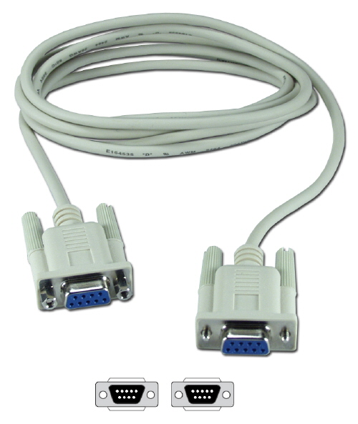
What is a Null Modem.
Null modem is a communication method to connect two DTEs
(computer, terminal, printer etc.) directly
using an RS-232 serial cable.

Slide 6
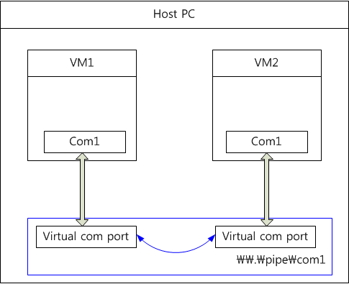
Null modem in virtual machine

Slide 7
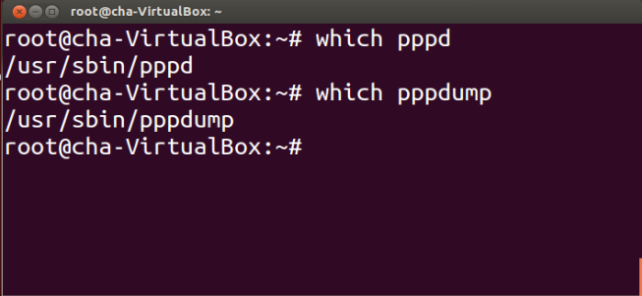
PPP Connection
Check PPP applications
$ which pppd
$ which pppdump
Install : # apt-get install ppp

Slide 8
pppd connection
Command format
Local IP : My IP address
Remote IP : Correspond IP address
ttyname : /dev/ttySx (x : port number)
record <path> : full path (ex : /root/test01)
Speed : 38400 (bps)
# pppd -detach crtscts lock debug record <path> noccp <local IP>:<remote IP> ttyname speed

Slide 9
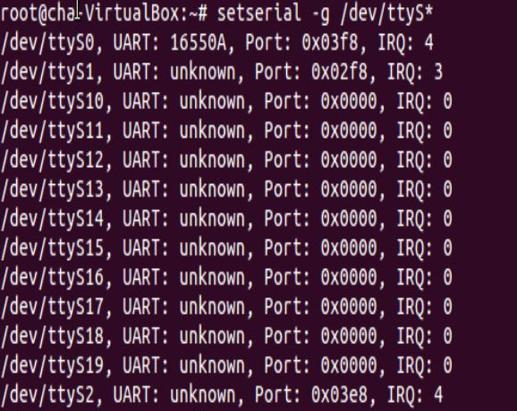
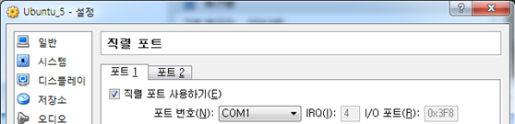
ttySx mapping
# setserial –g /dev/ttyS*

Slide 10
pppd command option
Command option
- option ($man pppd)
· crtscts: specifies that pppd should set the serial port to use h/w flow control.
· lock: specifies that pppd should create a UUCP-style lock file for the serial device
to ensure exclusive access to the device. By default, pppd will not create a lock
· debug: Enables connection debugging facilities. If this option is given, pppd will log the
contents of all control packets sent or received in a readable form.
· record <path>: Specifies that pppd should record all characters sent and received to
path
· <local IP>:<remote IP>: Set the local and/or remote interface Ip address.
· ttyname: Use the serial port called ttyname to communicate with the peer.
· speed: An option that is a decimal number is taken as the desired baud rate for the
serial device.
# pppd -detach crtscts lock debug record <path> noccp noaccomp nopcomp asyncmap 0xffffffff <local IP>:<remote IP> ttyname speed

Slide 11
pppd command option
· noccp: disable CCP(Compression Control protocol) negotiation.
· noaccomp: Disable Address/Control compression in both directions (send and receive).
· nopcomp: Disable protocol field compression negotiation in both the receive and the
transmit direction.
· asyncmap <map>: This option sets the Async-Control-Character-Map (ACCM) for this end of the link. The ACCM is a set of 32 bits, one for each of the ASCII control characters with values from 0 to 31, where a 1 bit indicates that the corresponding control character should not be used in PPP packets sent to this system. The map is encoded as a hexadecimal number (without a leading 0x) where the least significant bit (00000001) represents character 0 and the most significant bit (80000000) represents character 31. Pppd will ask the peer to send these characters as a 2-byte escape sequence. If multiple asyncmap options are given, the values are ORed together. If no asyncmap option is given, the default is zero, so pppd will ask the peer not to escape any control characters. To escape transmitted characters, use the escape option.

Slide 12
pppd connection command
pppd execution
Terminal1 (VM1)
Terminal2 (VM2)
Same as terminal1, only swap local IP for remote IP
record /root/test01 : Set the path for dump file
# pppd -detach crtscts lock debug record /root/test02 noccp 10.1.3.10:10.1.3.20 /dev/ttyS0 38400
# pppd -detach crtscts lock debug record /root/test02 noccp 10.1.3.20:10.1.3.10 /dev/ttyS0 38400

Slide 13
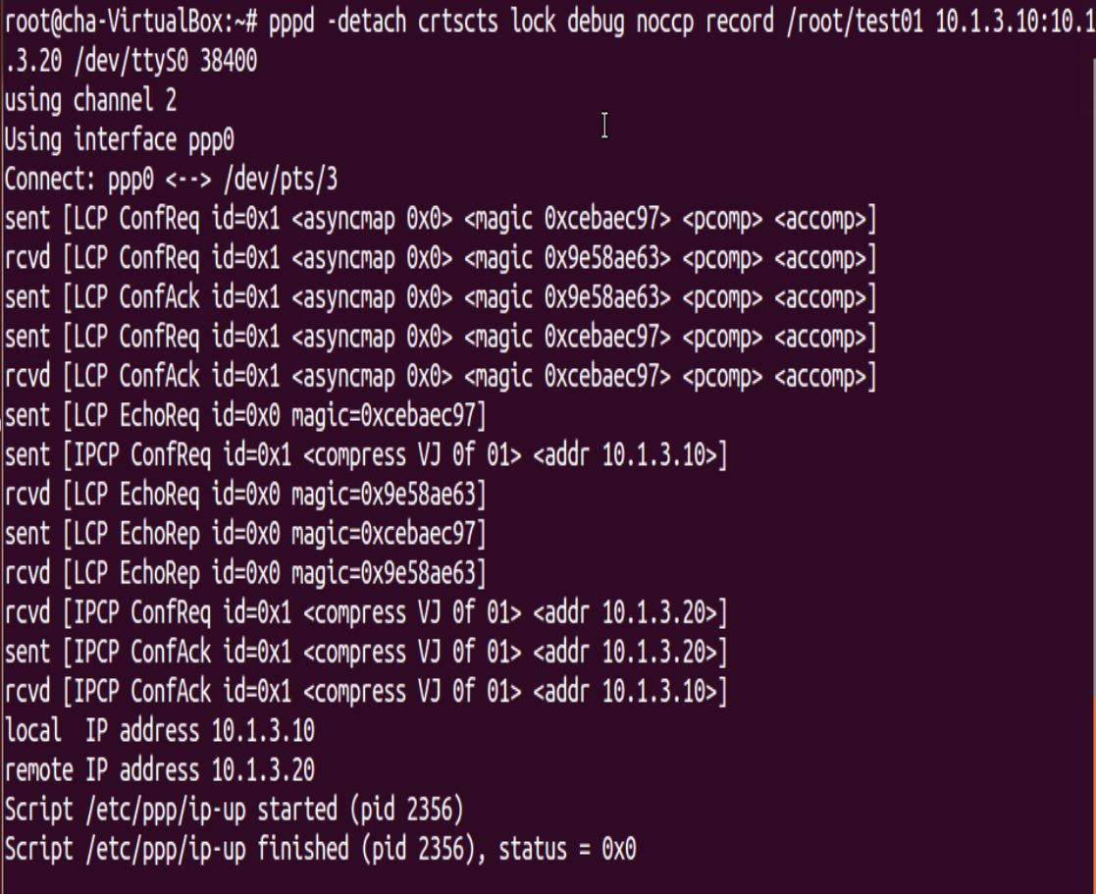
pppd connection example - debug

Slide 14
PPP frame analysis
Dump file output
#pppdump –h <path>
The pppdump utility converts the files written using the record option of pppd into a human-readable format.

Slide 15
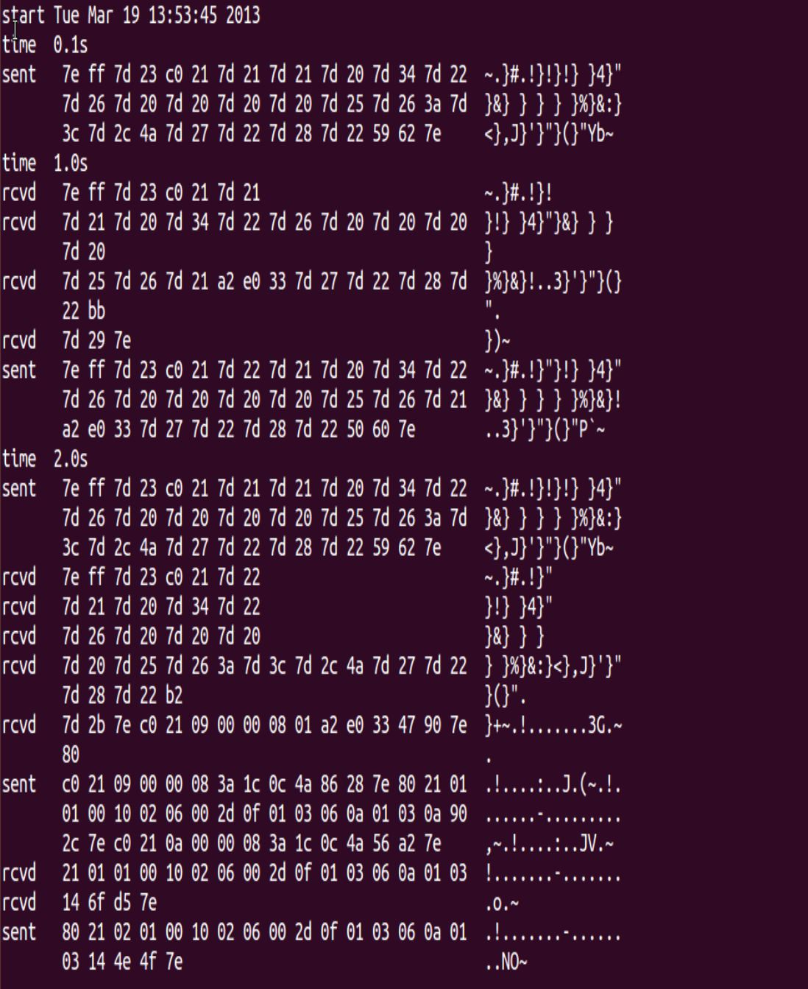
pppdump
default option

Slide 16
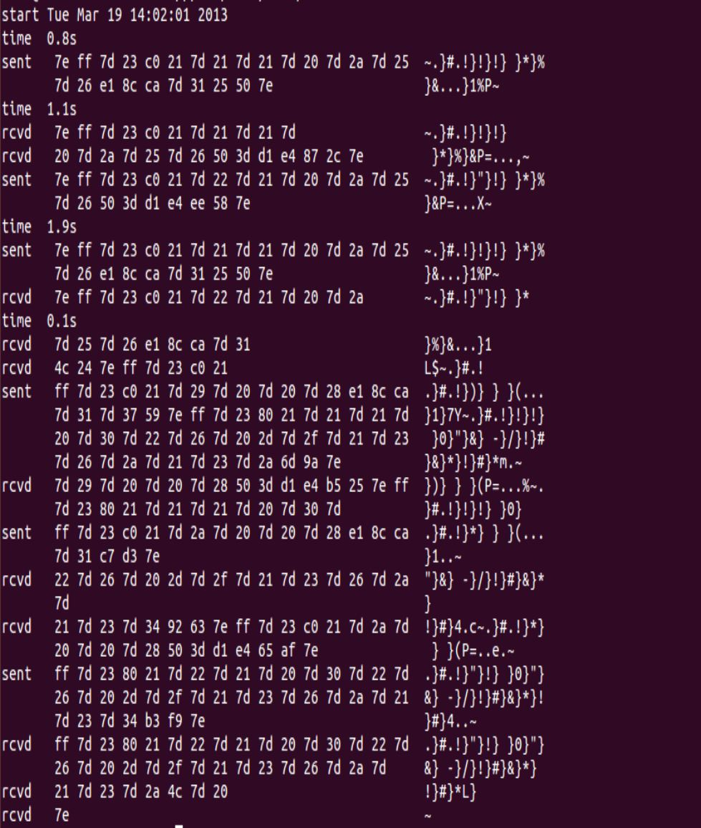
pppdump with
noaccomp,
nopcomp,
asyncmap 0xffffffff
options

Slide 17
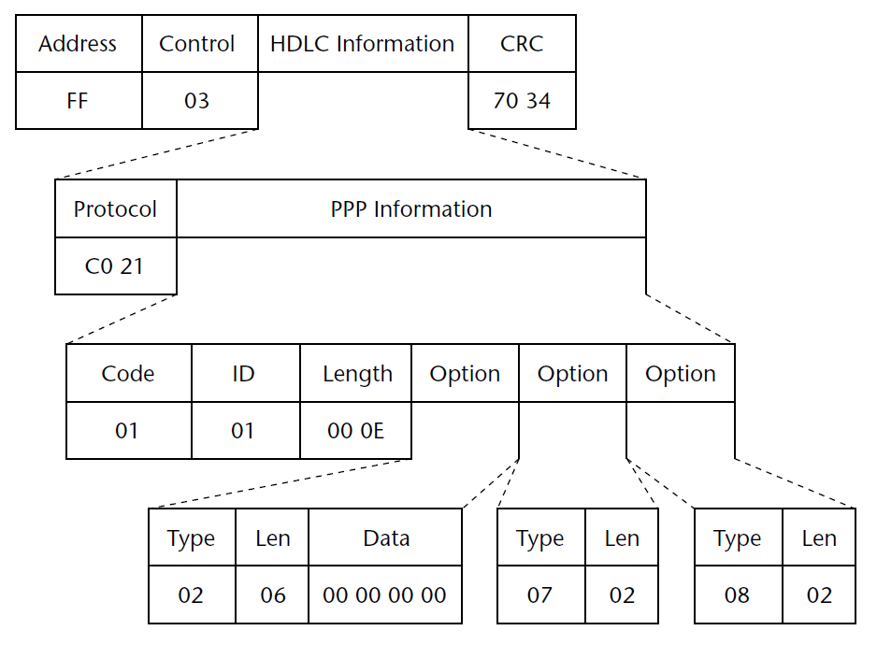
HDLC PPP LCP frame example

Slide 18
Frame Delimiter
Frame delimiter (flag)
A frame delimiter marks the end of one frame and the beginning of another. A frame delimiter at the end of a frame may also mark the start of the next frame.
The next frame is after an idle period
In case of continuous communication

Slide 19
Homework #1
PPP survey
submit a report of PPP with reference to RFC documents. (+PPP.pdf)
The report must include contents of RFC 1661 (PPP LCP), RFC 1662 (HDLC) and RFC 1332 (IPCP).

Slide 20
Homework #1
pppd execution
Execute pppd following this documents.
Execute twice: First one executes default option, and other is with noaccomp, nopcomp, asyncmap 0xffffffff option
Send a ping from terminal1 to terminal2 when the connection is established.
Ex) $ ping –c 2 10.1.3.20 (correspond IP address)
submission
Result screenshot
Execution results, debug option on, dump output
both of default option and noaccomp,… option.
Report
Explain PPP frame exchange order with reference to RFC documents. (include options)
Analyze pppdump output to fit a frame format of PPP.
LCP frames, IPCP frames and Data frame (IPv4).
Both of default option and other options.
Example
pppd -detach crtscts lock debug noaccomp nopcomp asyncmap 0xffffffff record /root/test01 10.1.3.10:10.1.3.20 /dev/ttyS0 38400

Slide 21
References
http://www.tldp.org/HOWTO/PPP-HOWTO/
http://linux.about.com/library/cmd/blcmdl8_pppdump.htm
RFC 1661, RFC 1662, RFC 1332
James Carlson, “PPP Design, Implementation, and Debugging 2nd edition,” Addison-Wesley, July 2000.

