Slide 1
OpenSCAD Workshop
Github.com/sjkelly/openscad_workshop

Slide 2
What is OpenSCAD
It is an open source 3D modeling tool first released in 2009.
It has become a dominant way to share designs on the internet (GitHub, Thingiverse).
It uses programmatic CAD style.
One of the most common tools used in RepRap design.

Slide 3
What is Programmatic CAD?
It is a design paradigm when objects are described using code.
Most CADwares can use programmatic CAD techniques through an API.
Leads to easy sharing of files and good revision control.
Software can generate objects!

Slide 4
Programmatic CAD
ImplicitCAD/extOpenSCAD – Written in Haskell. Internally represents the solid as a series of functions.
OpenJSCAD – Javascript calls to a WebGL based CSG library.
CoffeeSCAD – Improvements to OpenJSCAD using CoffeeScript.

Slide 5
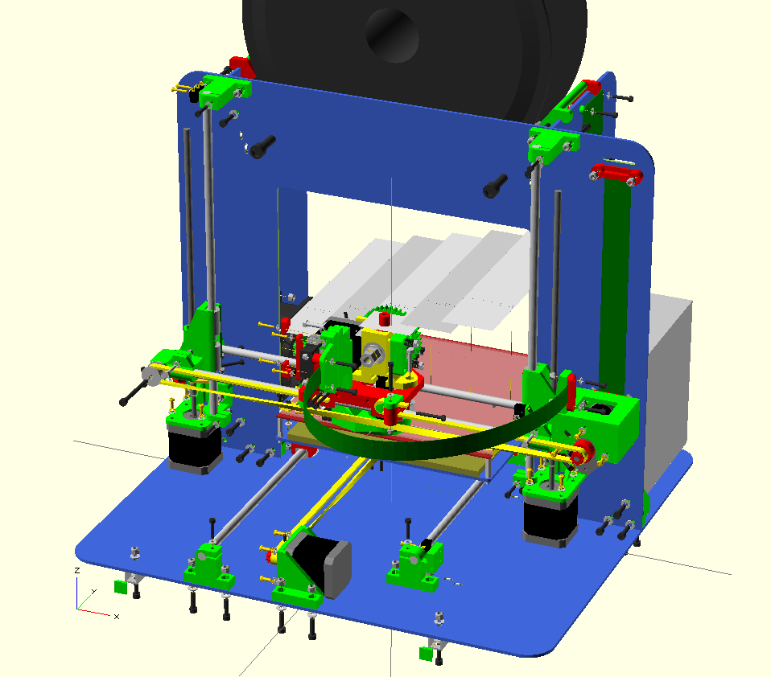

Slide 6
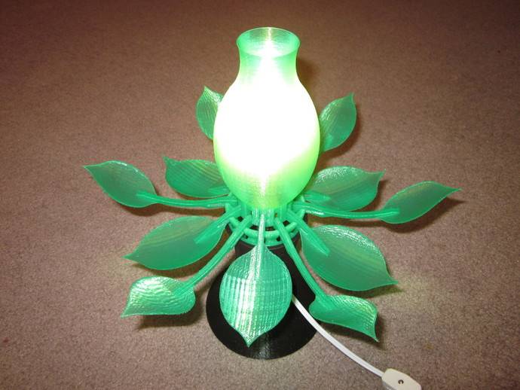
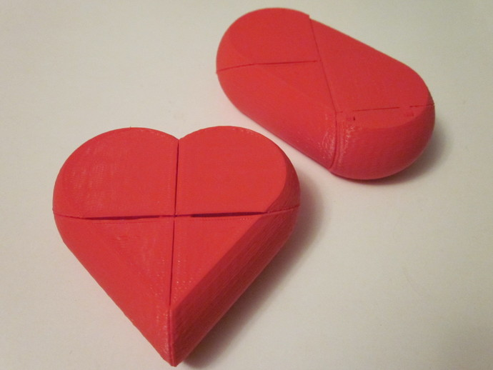
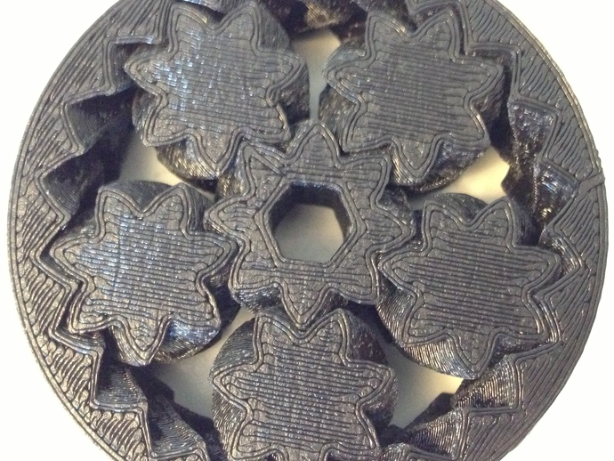
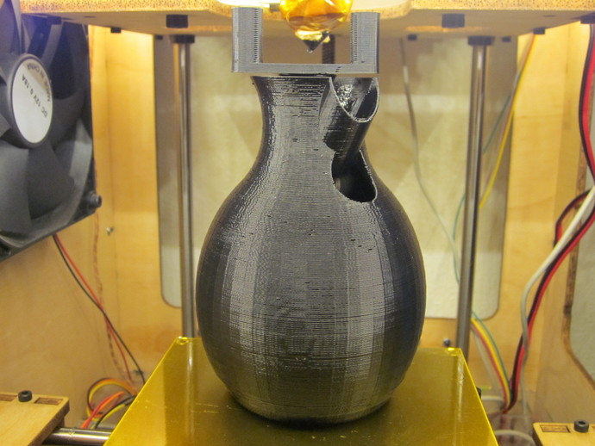

Slide 7
User Manual
In 1 hour it will be difficult to fully describe all of the functions in OpenSCAD.
The OpenSCAD user manual covers all implemented functions.
http://en.wikibooks.org/wiki/OpenSCAD_User_Manual
Openscad.org

Slide 8
Outline
Primitives
  Resolution adjustments
Transforms
Variables
Boolean Operations
For loops
Modules
2D - 3D

