Slide 1
Eating halal - nyc
IBM CAPSTONE FINAL PROJECT PRESENTATION
SHAARIQ J. KHAN

Slide 2
PROBLEM
WHAT IS THE BEST LOCATION TO ESTABLISH A NEW HALAL RESTAURANT IN NYC?

Slide 3
BACKGROUND
There are approximately 700,000 Muslims in NY City. Practicing Muslims adhere to 'halal' dietary restrictions. The word 'halal' in arabic translates casually as 'acceptable'. A more formal extension of the 'halal' definition is 'zabiha-halal' which is meat that has been hand-slaughtered with delicate precision in an ethical manner meant to minimize suffering for the animal and according to the religious teachings of Muslim beliefs. In other belief systems 'halal' is also known as 'kosher'. Since a majority of delis, restaurants, and franchises do not observe these requirements by default, this severely limits the options available for the 'halal' consumer. In this project, we'll analyze possible locations in NYC to establish a new halal restaurant catering to the 'halal' demographic based on existing demand and popularity found in our data set.

Slide 4
DATA
Our primary dataset sources used to analyze this problem include:
https://cocl.us/new_york_dataset
Used to capture and filter NYC district neighborhoods and borough information
Foursquare API
Used to query, sort, and rank relevant venue data in the area.
The two sets of data will be analyzed, integrated, overlayed, and visualized to determine potential solutions to our problem.

Slide 5
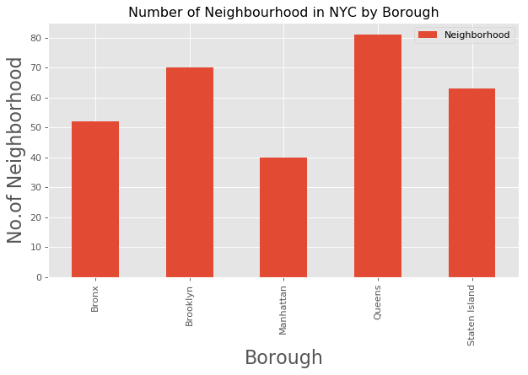
METHODOLOGY
Analyze Existing Boroughs for Potential Markets

Slide 6
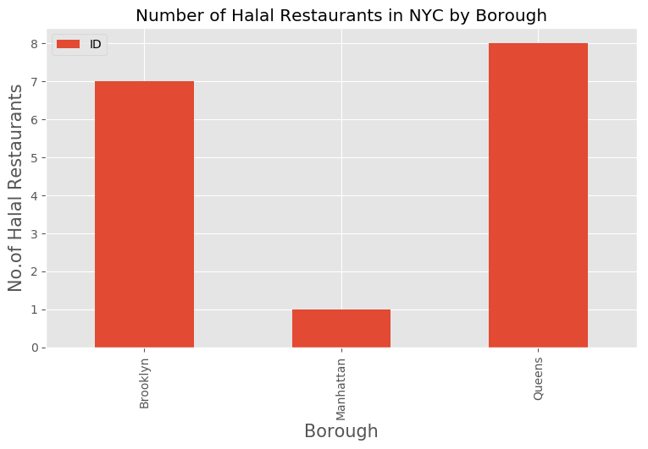
METHODOLOGY
Analyze Existing Halal Restaurants in NYC; Sorted by Borough
The borough of Queens has the most halal restaurants.

Slide 7
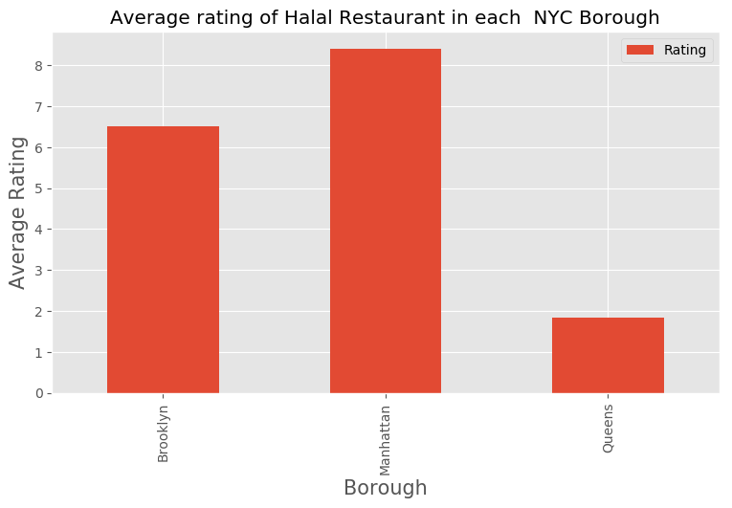
METHODOLOGY
Analyze Existing Halal Restaurants in NYC; Sorted by Popularity
While the borough of Queens has the most halal restaurants it had the poorest reviews of all boroughs.

Slide 8
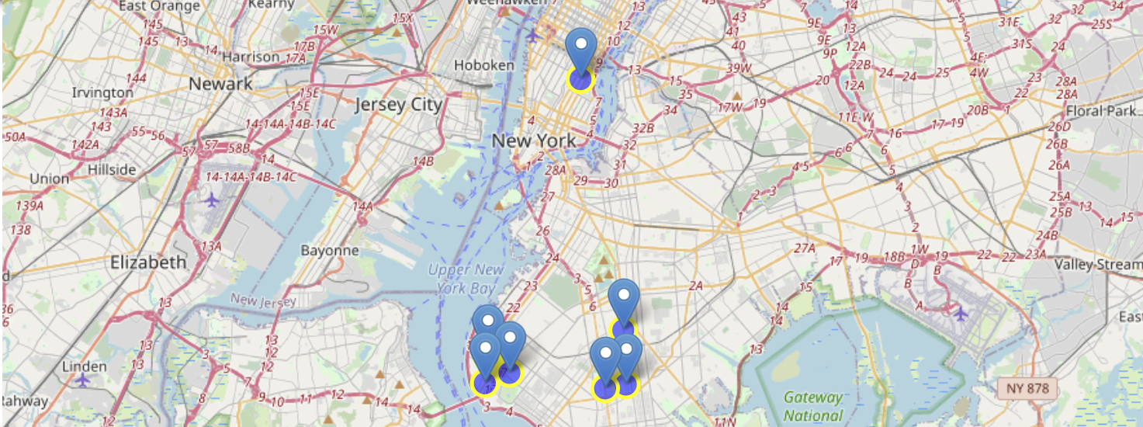
Results
Competition mapped by popularity/demand

Slide 9
Conclusion
To summarize, our analysis yielded the following results:
By volume, the market for 'halal' restaurants with the highest ratings are centered around the borough of Brooklyn.
- Advantage: Existing demand already exists.
- Disadvantage: Over-concentration. May be difficult to penetrate existing market share.
An alternate 'halal' location could be centered around the borough of Manhattan. An incumbent chain has garnered wild popularity, support, and is the highest rated model in the city by far.
- Advantage: Less competition, opportunity for growth.
- Disadvantage: Can be translated as more risk based on lack of chains.

Slide 10
recommendation
MANHATTAN MARKET
The recommended site location for the new 'halal' restaurant would be to compete in the Manhattan market alongside the incumbent. While there is existing market potential in Brooklyn, there is more opportunity to piggyback off of success of incumbent franchise in Manhattan which has made a name for itself and create more supply to meet demand for 'halal' market at this location based on exceptional reviews. It will allow new 'halal' restaurant to create some separation from the concentration in Brooklyn markets and offer consumers a contrast to existing Manhattan franchise. Also, while the borough of Queens offered potential, after further review, the reputation of halal restaurants here is much worse and would be more difficult to overcome the stigma of lower quality halal restaurants surrounding it which is why it did not rank on our final scale.

