Slide 1
Rob Ford and Municipal Populism
Presentation to the AMCTO Leaders’ Forum Simon Kiss Director, Laurier Institute for the Study of Public Opinion and Policy Wilfrid Laurier University

Slide 2
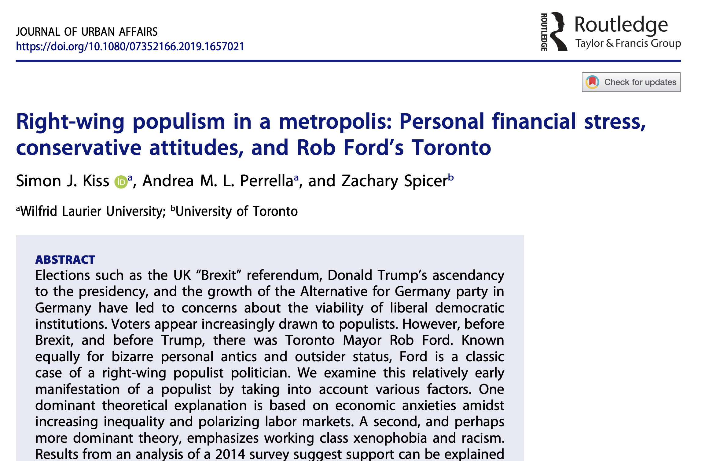
Municipal Populism
Notes:
Populism doesn’t just mean popular and it doesn’t just mean angry; tendency to use the term widely to popular politicians or moment of electoral change.

Slide 3
Municipal Populism
Populism is an anti-establishment, anti-elite ideology and political strategy. Populism as an ideology adopts a discursive approach and focuses on the tensions between the “pure people” and the “corrupt elite….Populism viewed as a political strategy focuses on its agency, or the ability of populist movements to instrumentally appeal to followers, to maintain a direct relationship between the leader and the followers, and to exploit existing institutional weaknesses (Bustikova and Guasti 2020)
Notes:
Ideology and a stratey: As an ideology it can go in a number of different ways, usually emphasizing the purity and uncorrupted nature of “the people” set against some elite ethnic or economically based
We look at Rob Ford we see a lot of this, emphasizing
Waste
Downtown elites
Paying his own office expenss
Direct cell phone line emphasizing kind of a direct relationship between him and the people.

Slide 4
Municipal Populism
Populism is an anti-establishment, anti-elite ideology and political strategy. Populism as an ideology adopts a discursive approach and focuses on the tensions between the “pure people” and the “corrupt elite….Populism viewed as a political strategy focuses on its agency, or the ability of populist movements to instrumentally appeal to followers, to maintain a direct relationship between the leader and the followers, and to exploit existing institutional weaknesses (Bustikova and Guasti 2020)
Notes:
Worldiwide movement
Debate about the merits of the populism
On the one hand, creative, manifestation of discontent way to challenge the status quo
Darker side that can upend pluralistic societies that legitimate debate and decisions by rules
Two explanations economics (people left behind)
Culture (fear of cultural loss and immigration)
Data difference. Usually aggregate measures of economic grievances show a support for populism; individual level sources of evidence, which is what we have here usually show that racism and fear of immigration are drive support for populism.
There is some evidence that right-wing populism can really have its roots in municipal politics This is the only dataset

Slide 5
Municipal Populism
Our dataset
- Ipsos-Reid’s Exit Survey of the 2014 General Election
- 8208 respondents in Ontario; 1545 in City of Toronto
- Publicly available through ODESI (Ontario Data Documentation, Extraction Service and Infrastructure)

Slide 6
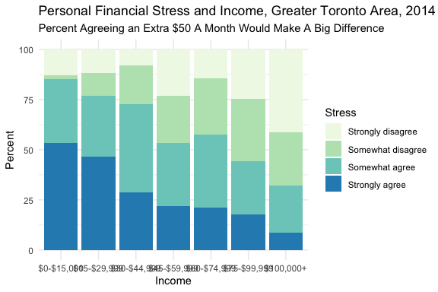
Municipal Populism
Notes:
Personal financial anxiety For all the talk about any voters, measures like this were not strongly linked to Donald Trump’s support

Slide 7
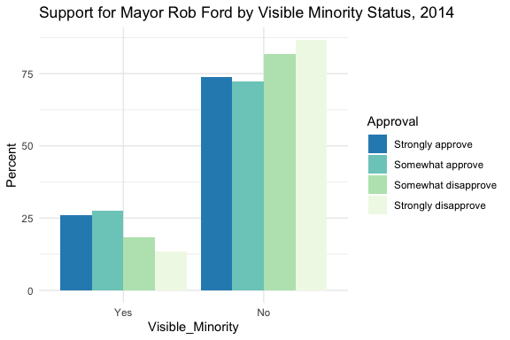
Municipal Populism
Notes:
Visible minority status remained a strong predictor of support for Rob Ford

Slide 8
Municipal Populism
Visible minority status remained a significant and important predictor of support for Rob Ford in 2014
Financial Stress was weakly related to support for Rob Ford
It made respondents more conservative
Other notable factors included;
driving a car to work
income was negatively related to support for Ford, but only through ideology

Slide 9
Municipal Populism
Lessons
Right-wing populism is a viable coalition in municipal politics in Canada.
The right-wing populist coalition was poorer, drove cars, more conservative and grumpy about their financial stress.
Unlike most other cases right wing populism is viable in Canadian municipalities, without targeting immigrants

Slide 10
References
Bustikova, L, and PEtra Guasti. 2020. “Populism.” Oxford Dictionary of Political Science. https://www.oxfordbibliographies.com/view/document/obo-9780199756223/obo-9780199756223-0300.xml.

