Slide 1
Carbon Tax At The Crossroads
Simon Kiss Director, Laurier Institute for the Study of Public Opinion and Policy
Notes:
introduction
basic overview of public opinion
core premise of scholarship is people are cognitive misers
hard to take, good evolutionary reasons
learning about science of climate change, not gone unnoticed

Slide 2
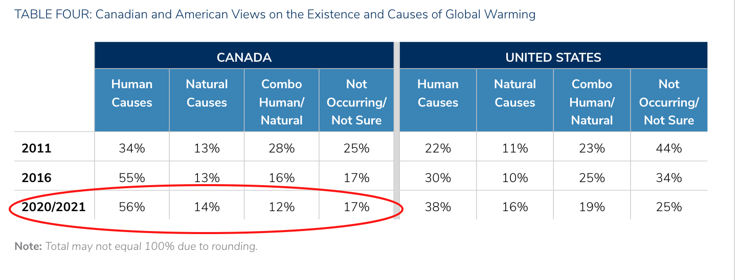
Causes of Climate Change
Source: Lachapelle, E., & Borick, C. (2022). A Decade Of Comparative Canadian and American Public Opinion on Climate Change (North American Colloquium Climate Series). https://fordschool.umich.edu/sites/default/files/2022-04/NACP_Lachapelle-Borick.pdf
Notes:
from a regular survey of voters from Erick Lachapelle at Ude M
Partisan differences in this crucial causal question

Slide 3
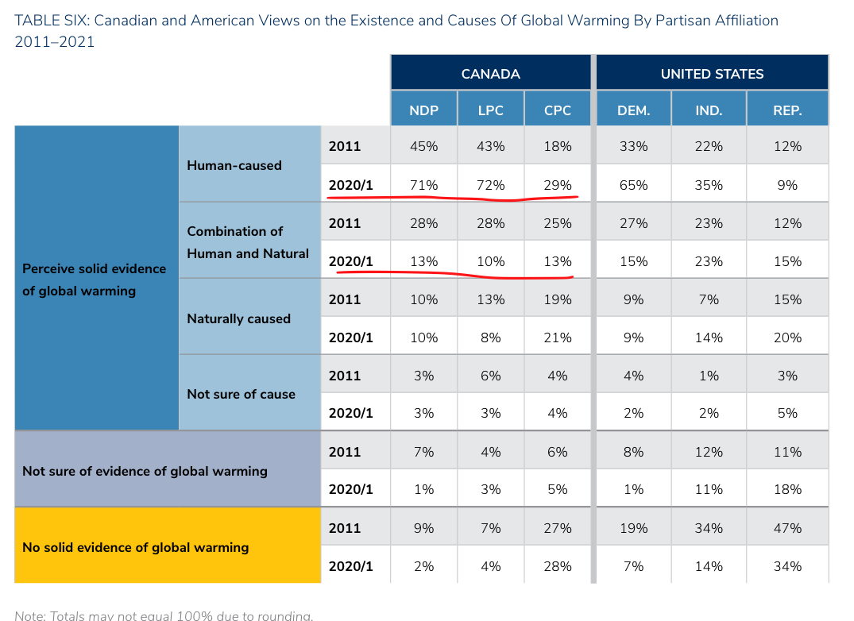
Causes of Climate Change
Source: Lachapelle, E., & Borick, C. (2022). A Decade Of Comparative Canadian and American Public Opinion on Climate Change (North American Colloquium Climate Series). https://fordschool.umich.edu/sites/default/files/2022-04/NACP_Lachapelle-Borick.pdf
Notes:
Not surpriosingly, conservative voters are much less likely to believe in human causes
Erick has them at 42% of CPC voters subscribing to some important impact of human
Rest are scattered
possible there is a misinformation problem on that side of the spectrum, but we’ll come back to this in a bit.
What to do about this is a different question
economists have been telling us for years the most efficient way to reduce greenhouse gas emissions is by putting a price on it.

Slide 4
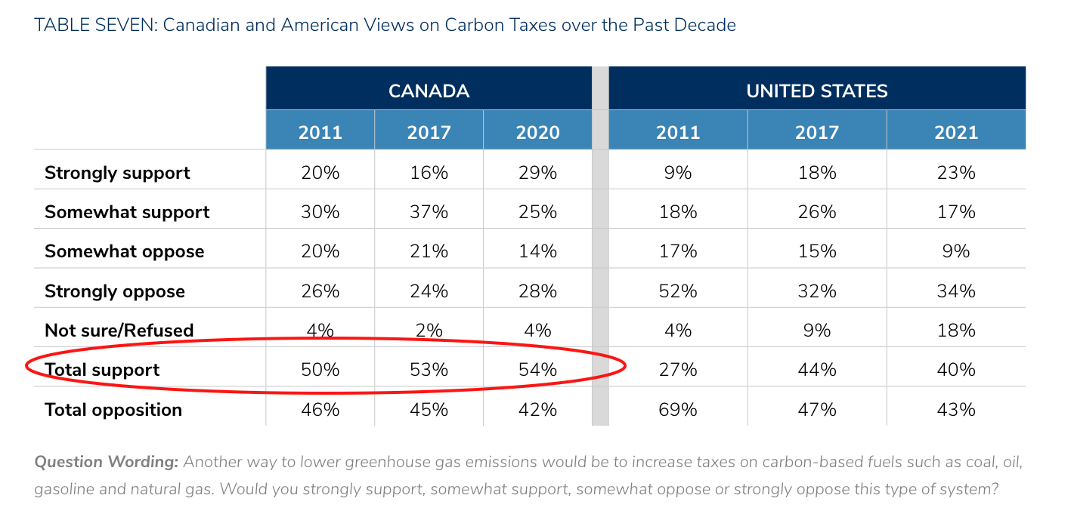
Support For Carbon Taxes
Source: Lachapelle, E., & Borick, C. (2022). A Decade Of Comparative Canadian and American Public Opinion on Climate Change (North American Colloquium Climate Series). https://fordschool.umich.edu/sites/default/files/2022-04/NACP_Lachapelle-Borick.pdf
Notes:
There is a stable national majority support for a price on carbon for two years of Erick’s survey
At least up until recently
Not surprisingly, there is also a distinct partisan difference in support or opposition to the carbon tax
One thing to be for something, it’s another thing to be for something and think that it’s important. I’m for getting some ice cream somewhere today, but on the list of things I need to get done, it’s not that important.

Slide 5
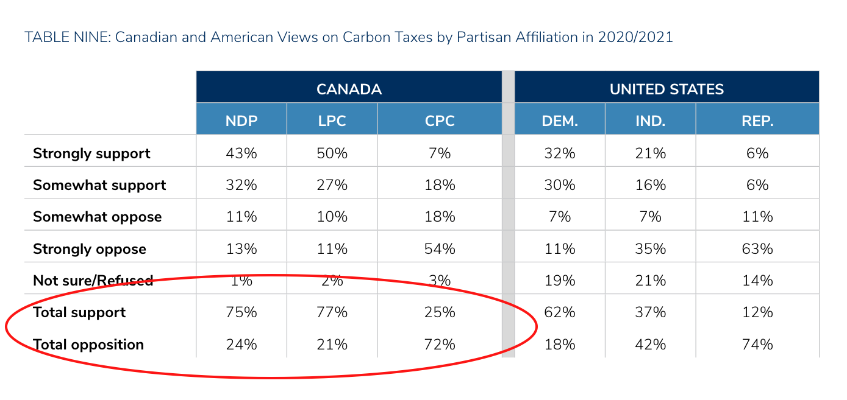
Support For Carbon Taxes
Source: Lachapelle, E., & Borick, C. (2022). A Decade Of Comparative Canadian and American Public Opinion on Climate Change (North American Colloquium Climate Series). https://fordschool.umich.edu/sites/default/files/2022-04/NACP_Lachapelle-Borick.pdf

Slide 6
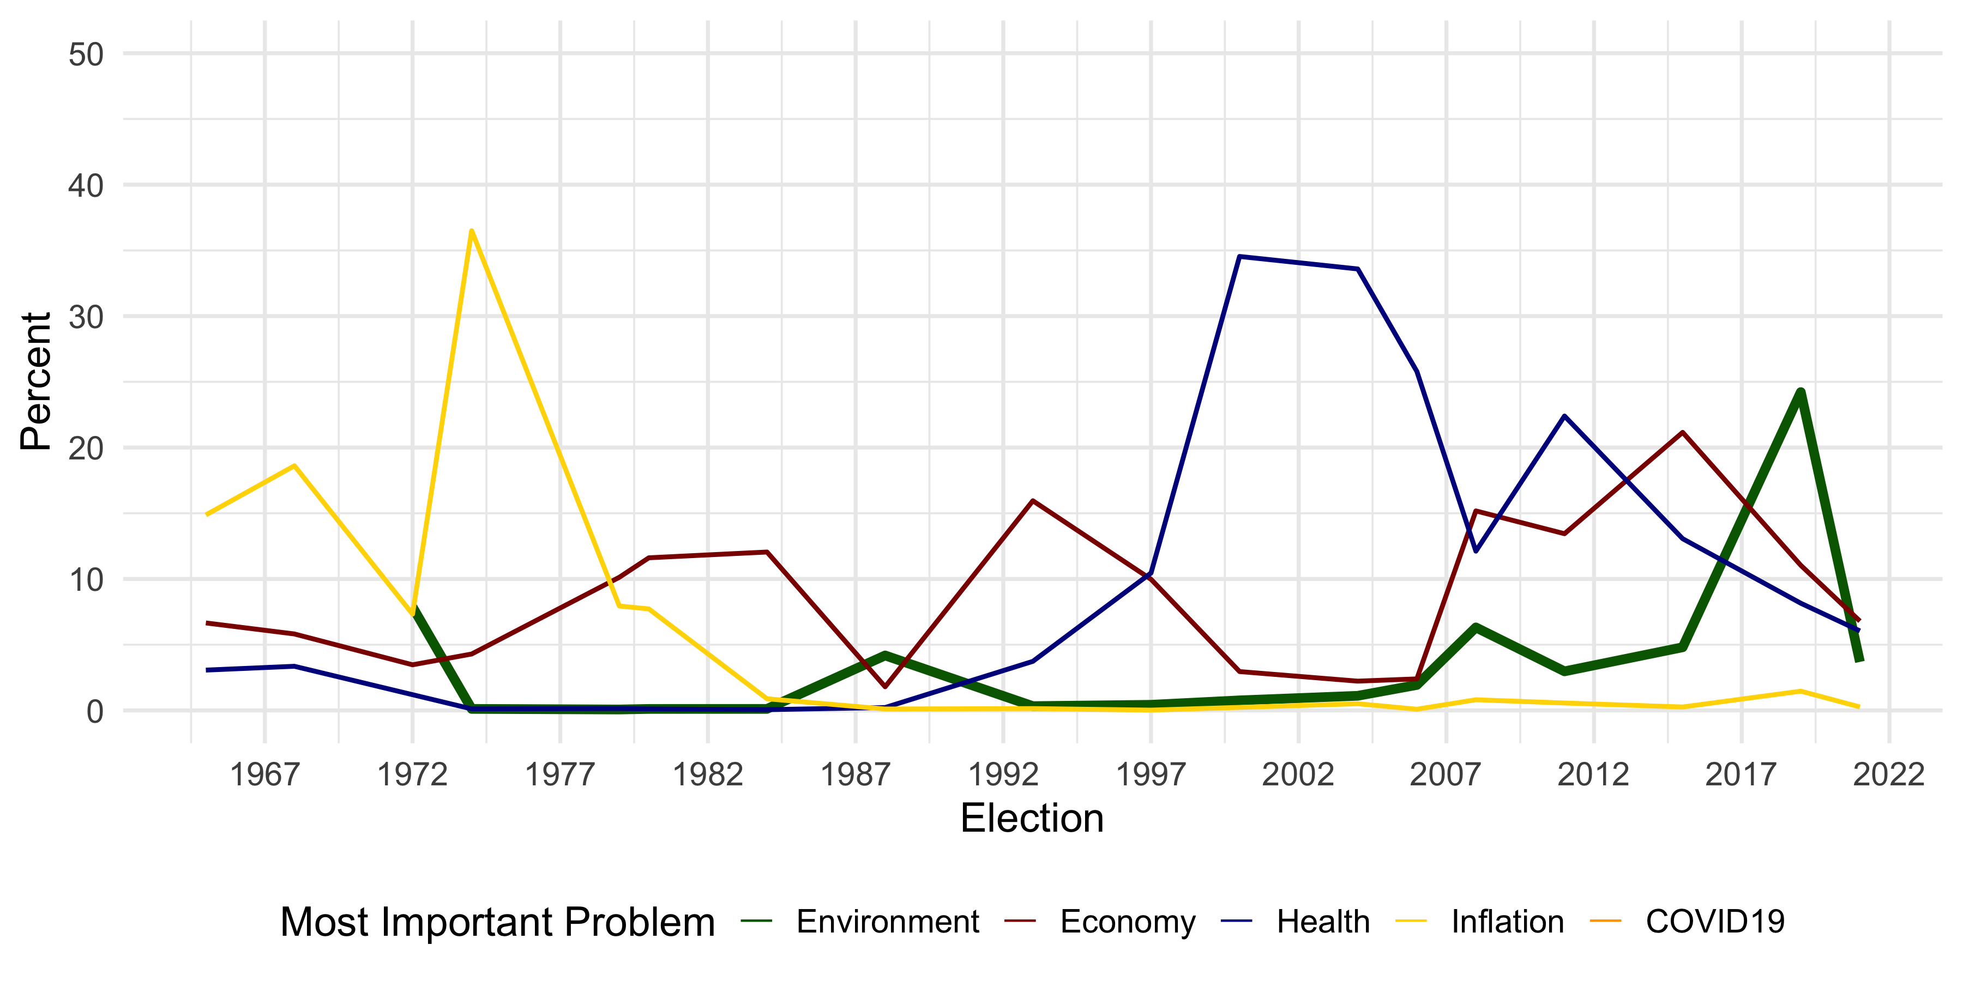
Phases of Environmentalism
Source: Canada Election Studies
Notes:
ask people about MIP, cyclical, issues rise and fall
1970s, inflation, tell students to ask grandparents, terrible time
1990s rise in concern with health care a
Interspersed, bursts of environmentalism
1974, 1988 and then the 20002s
1971 Federal Ministry of the environment
1987 Montreal Protocol, and 1988 CEPA
2019 National carbon tax.
But concern plummeted replaced by COVID19
two generations of Canadian voters have been completely socialized into politics in a low inflation environment Easy to forget how it moves voters

Slide 7
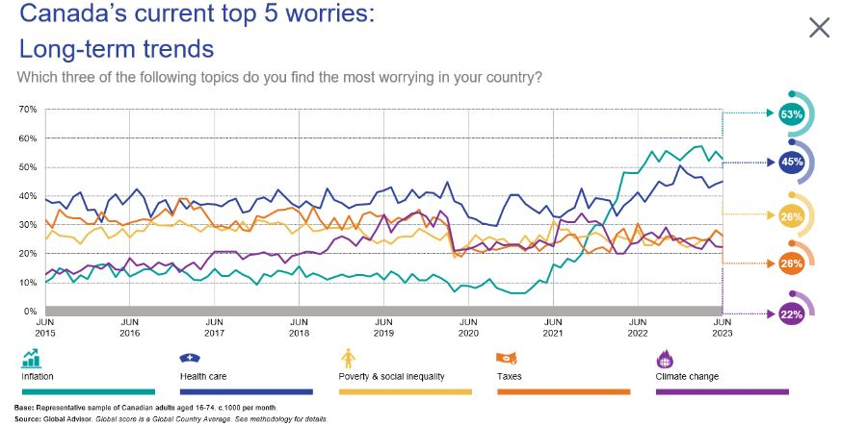
Inflation Tsunami
IPSOS. (2023, June 29). Public Opinion in Canada. Public Opinion in Canada. https://www.ipsos.com/en-ca/public-opinion-canada
Notes:
Rise in concern with inflation is clear.

Slide 8
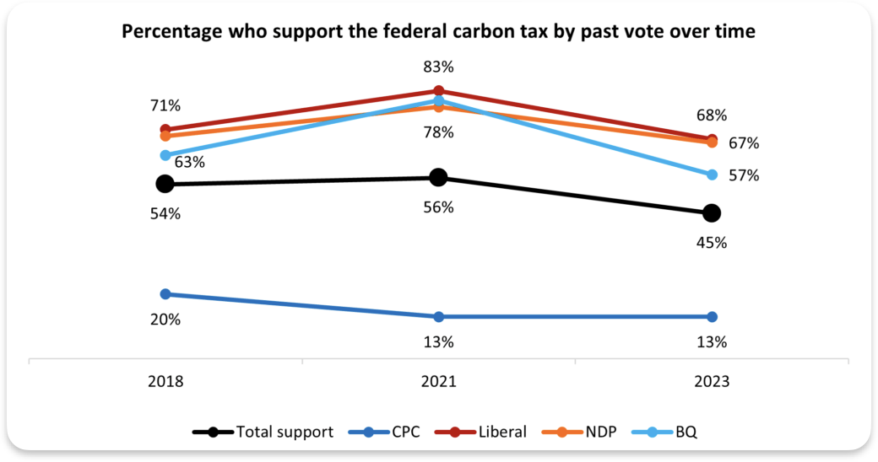
Drop In Support For Carbon Tax
Carbon Tax: Perceptions of insufficient rebates, cost of living concern & questions over efficacy send support plummeting. (2023). Angus Reid Institute. https://angusreid.org/wp-content/uploads/2023/11/2023.11.16_CarbonTax.pdf
Notes:
This has impacted support for inflation, down below 50% - note that even though the leadership of the NDP, Liberals and BQ support the carbon tax, their voters are bleeding support as much as the conservatives. So, voters themselves are receptive to opposition to the carbon tax.

Slide 9
What is to be done?
Support the Liberals or the NDP
Provide information
Focus on other policies
Notes:
If your goal is to keep the carbon tax, you have to prevent the conservatives out.
possible there is an information environment problem.
skeptical of misinformation studies because of assumptions about facts and misinformation
anecdote about waterloo fluoridation, study with Andrea

Slide 10
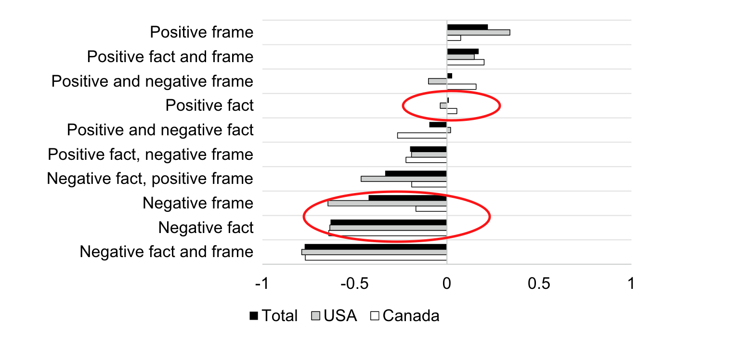
Do Facts Matter?
Source: Perrella, A. M. L., Kiss, S., & Shankardass, K. (2023). Narratives and Support for Fluoridation. In M. Gattinger (Ed.), Democratizing Risk Management. Springer.

Slide 11
What is to be done?
Support the Liberals or the NDP
Provide information
Focus on other policies

