Slide 1
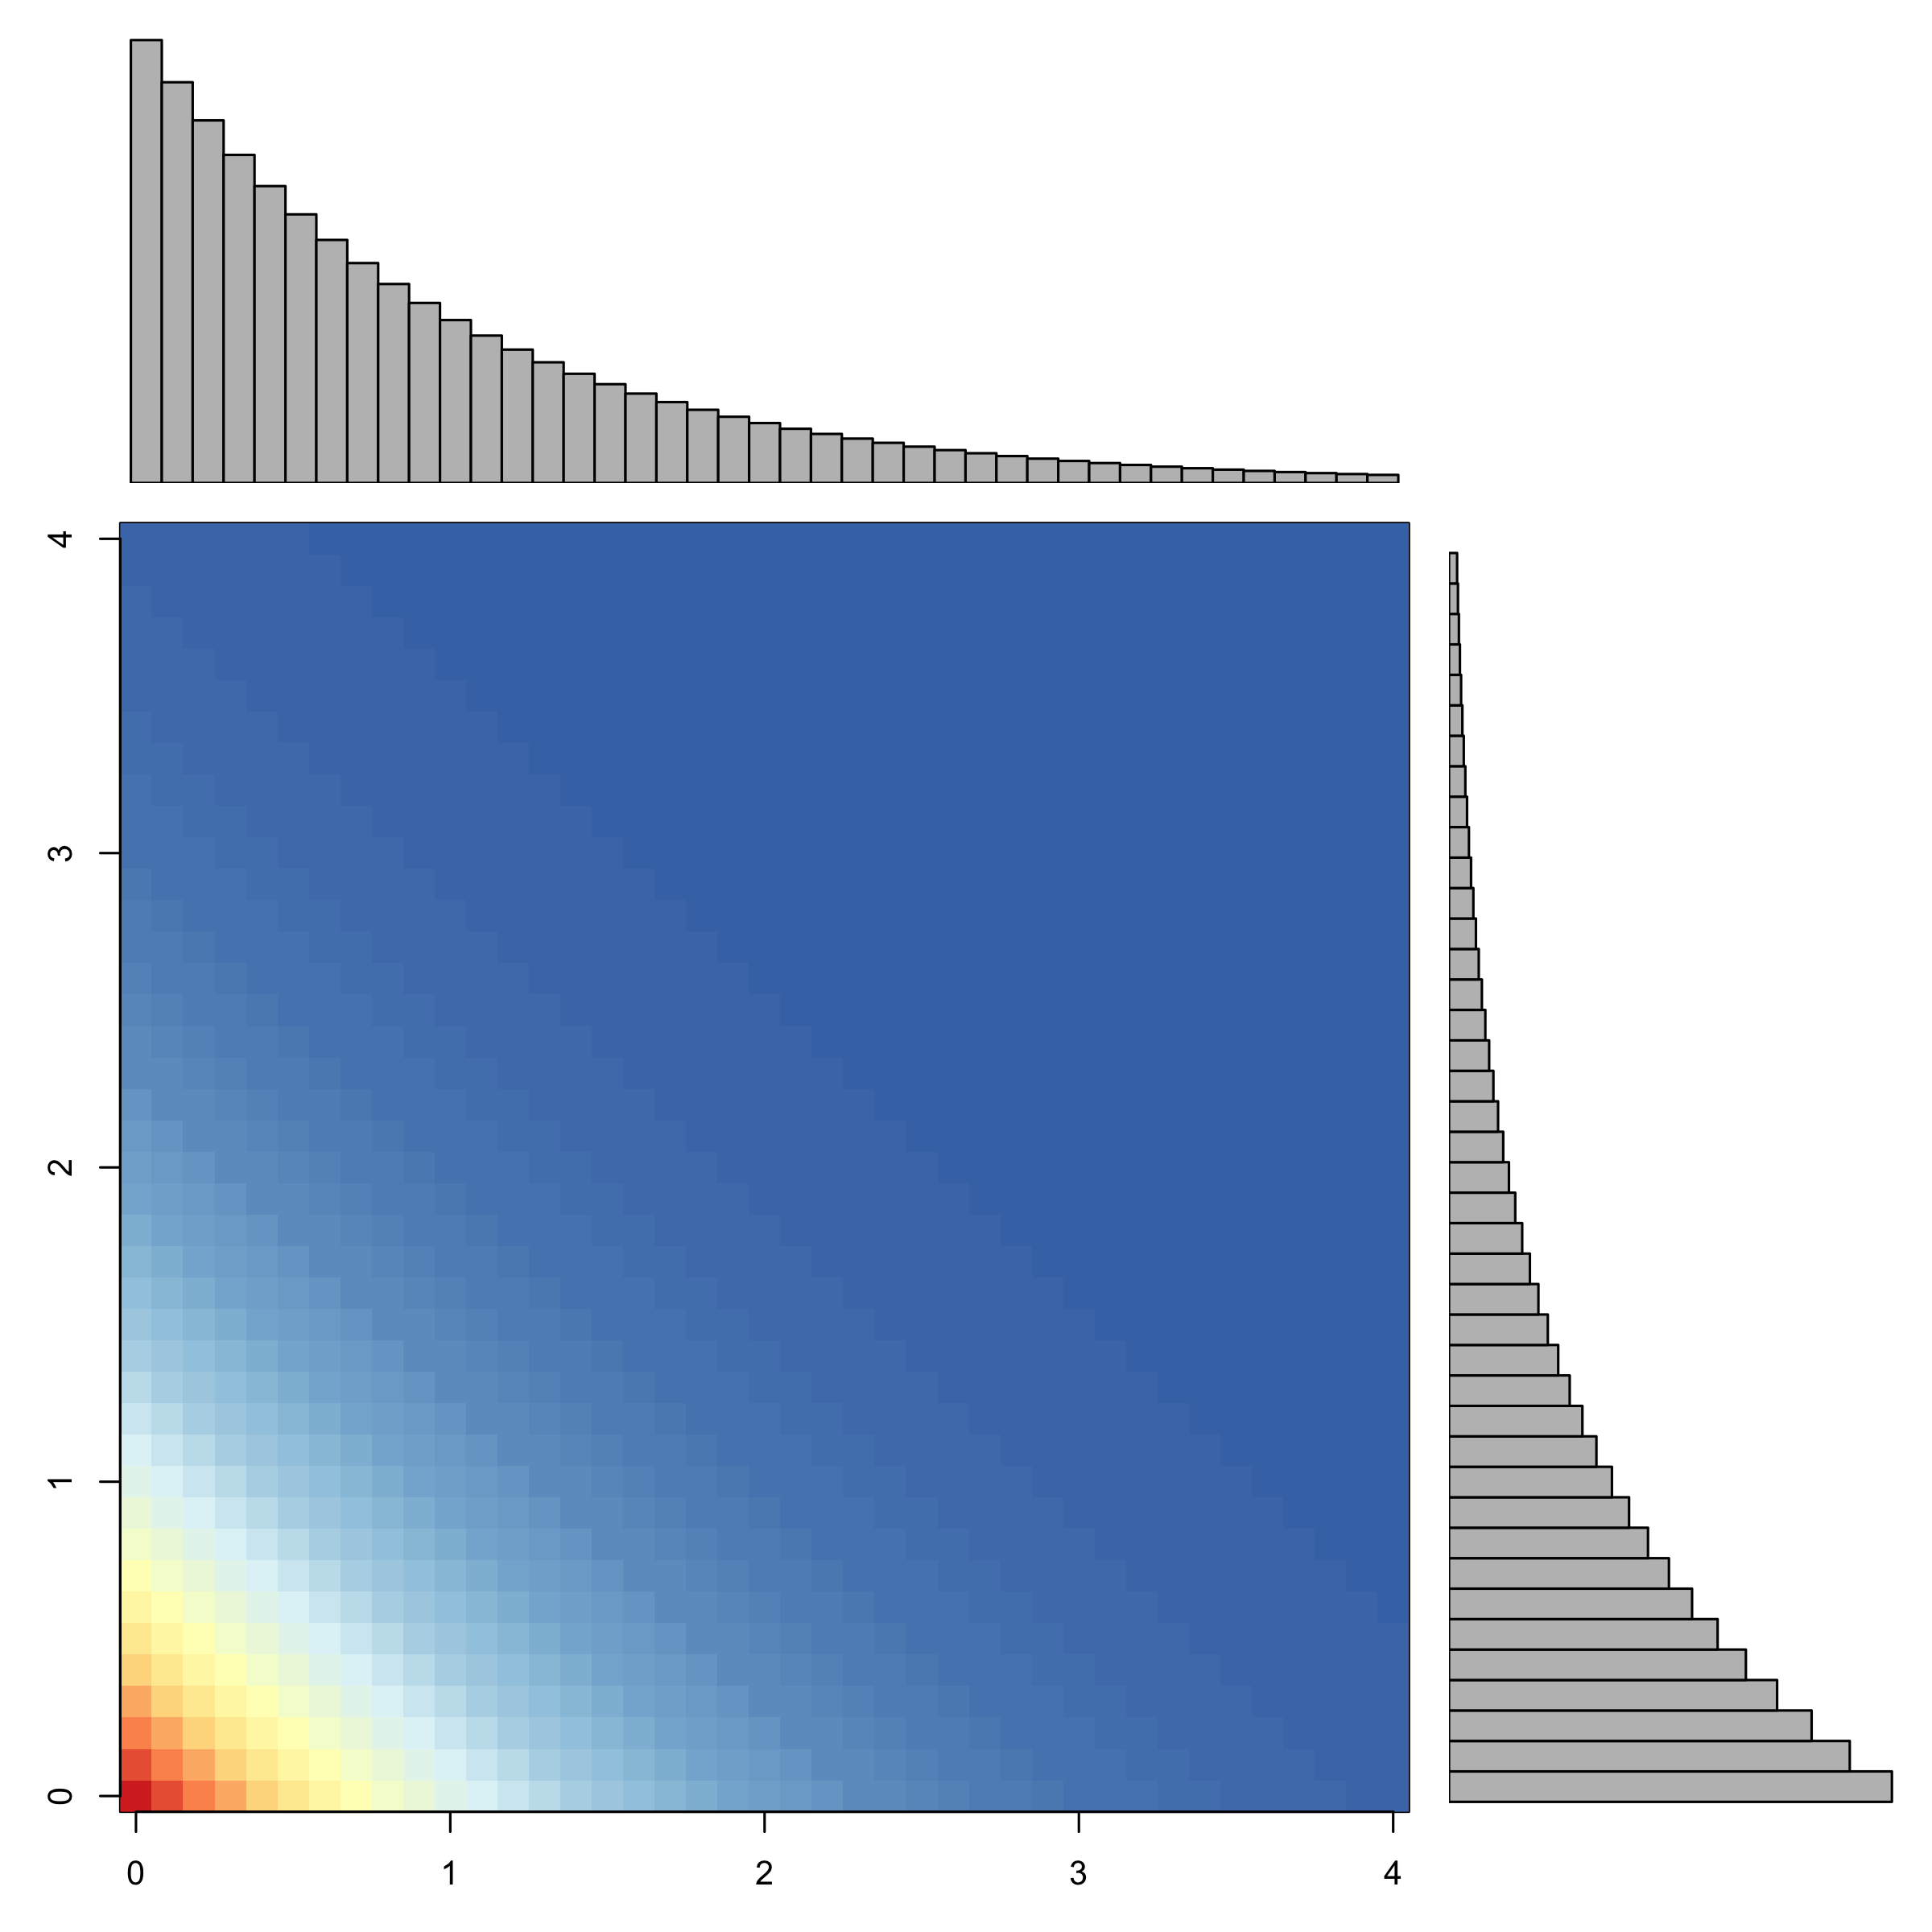
Node Conditional Distributions
Radial Conditional Distributions

