Slide 1
Classifying Defensive Coverages with Neural Networks
Spencer Kerch

Slide 2
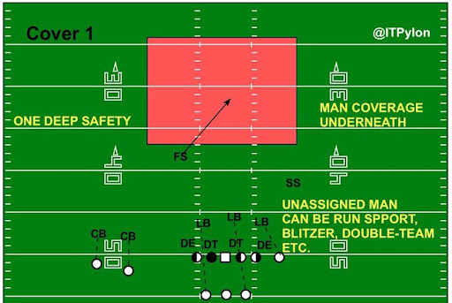
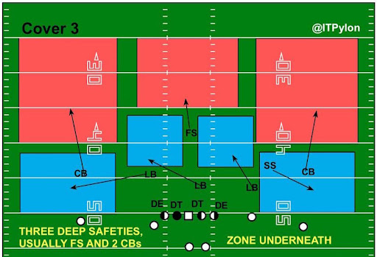
Background
There are 7 basic classifiers of defensive coverages in American football
Cover 0 Man, Cover 1 Man, Cover 2 Man, Cover 2 Zone, Cover 3 Zone, Cover 4 Zone, Cover 6 Zone and Prevent Zone
Coverages are often disguised and difficult to classify, especially pre-snap
Accurate labeling requires watching every play
Cover 1 Man vs Cover 3 Zone

Slide 3

Data
Tracking data & coverage labels of every passing play from week 1 of the 2018 NFL season
Data from the 2021 Big Data Bowl
Transformed into a tensor with size 985 x 12 x 11 x 5
Number of plays x features x possible defenders x offensive players (No QB)
Features: dist_from_los, y, s_x, s_y, a_x, a_y, diff_x, diff_y, diff_s_x, diff_s_y, diff_a_x, diff_a_y

Slide 4
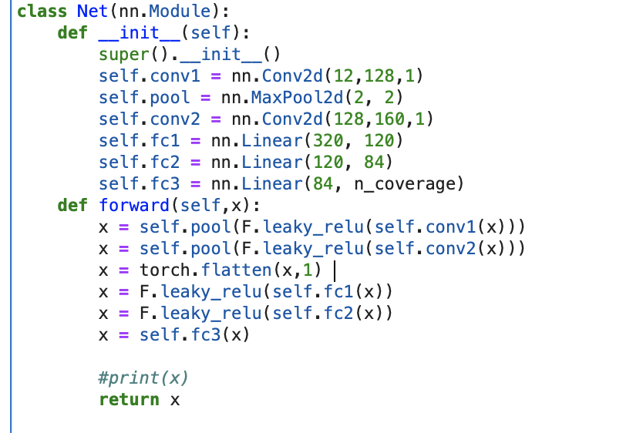
Model
Convolutional Neural Network
Leaky ReLU
Cross Entropy Loss
Uses Softmax activation function to classify the play as 1 of the 7
Training
785 plays
Trained over 400 epochs
Learning rate of .001
Test Data
200 plays

Slide 5
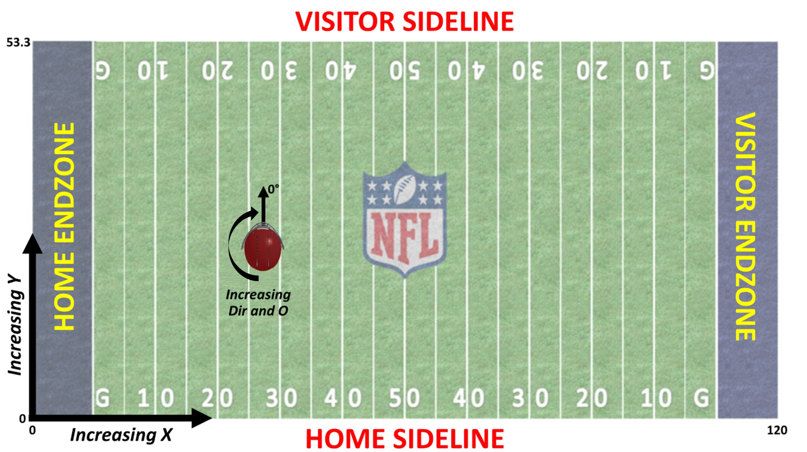
Results
53% accurate
Better than random (1/7)
Ways to improve
Include orientation to quarterback
More weeks of data
Use frames from snap to pass
Coverages can be disguised pre snap

Slide 6
ethics
Classifying coverages does not present many ethical dilemmas
However, computer vision and big data in sports does
Players don’t always have to consent to having data collected
Exceptions for certain medical data such as heart rate
Player speed and other advanced stats can be used against them in negotiations
Players don’t always have easy access to this data themselves
Problematic since it’s their data
Also, can’t use it to help themselves in negotiations

Slide 7
Thank You
Thanks to Ben Baldwin and Open Source Football

