Slide 1
Life’s too short to bet the under: Predicting Overs in the NBA
Spencer Kerch

Slide 2
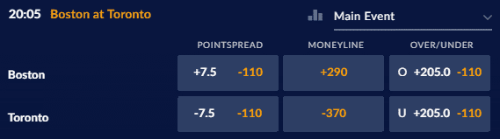
Overview
A very common bet in sports gambling is the total
If total points scored is over/under a certain threshold
Sportsbooks want to set the total as close to what will happen as possible
This is to get equal money on the over as the under
Gambling is meant to be difficult
Even being just above 50% is a success
The Process:
Data Set
Training & Testing
Linear vs Non-linear
https://news.sportsinteraction.com/wp-content/uploads/2018/04/nba-over-under-example.png

Slide 3

Data set
Data from 2012-2019
Separated by season
Odds and game data
Advantages
Can group by season
Able to get season averages
Disadvantages
Basic stats
PTS, AST, REB, TOV, 3%, FT%, FG%, Wins, Total, Spread
Multiple sportsbooks
https://pngimg.com/uploads/nba/nba_PNG20.png

Slide 4
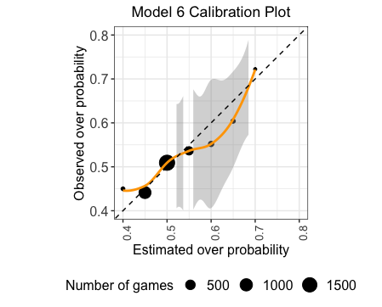
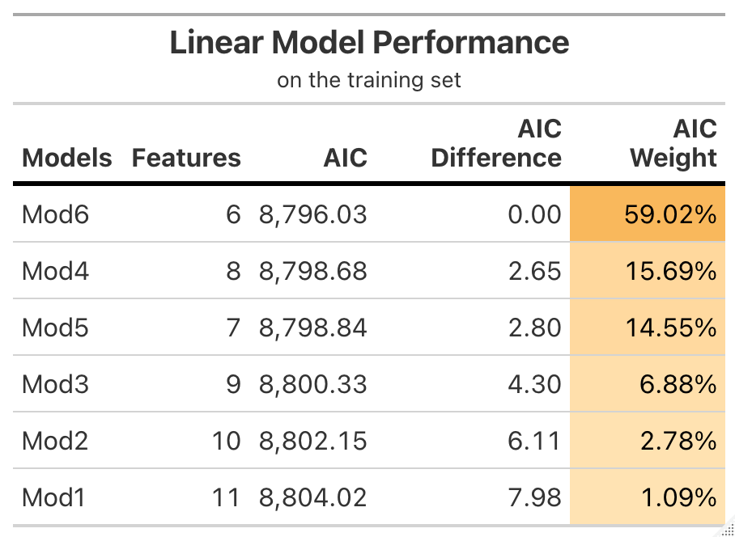
Training: Linear model
Predictors: tot_ppg, tot_wp, tot_fgpct, tot_pa, tot_rpg

Slide 5
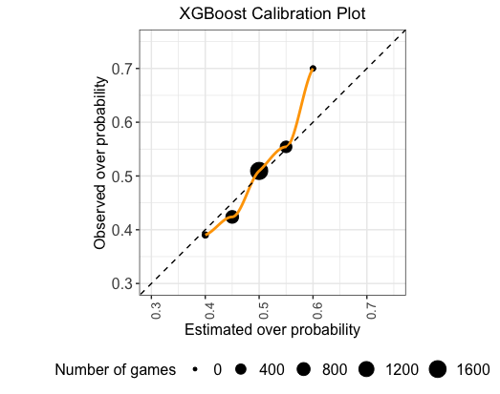
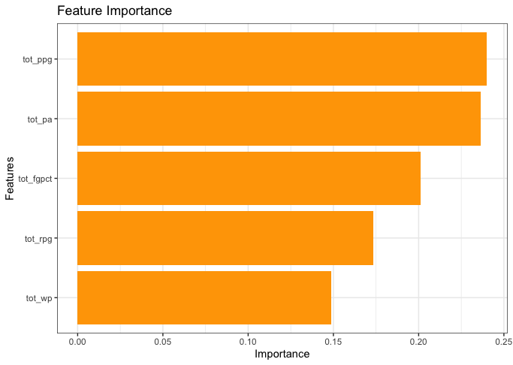
Training: Xgboost tree

Slide 6
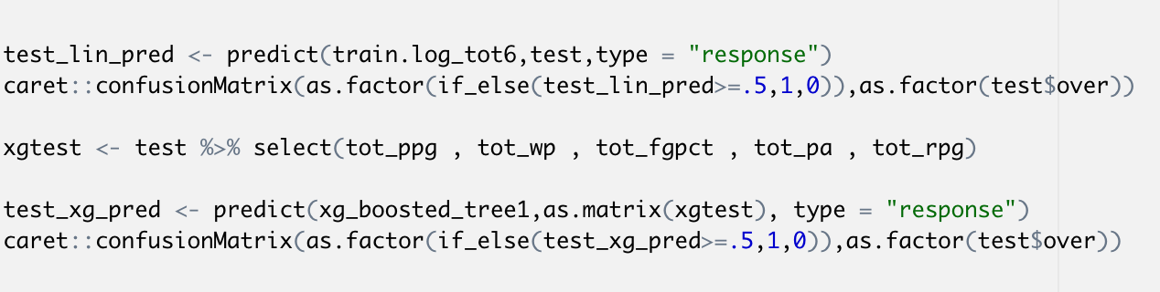
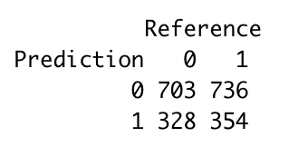
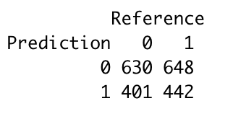
Testing R code
Linear | Xgboost
Accuracy: 49.83% | Accuracy: 50.54%
Sensitivity: 68.19% | Sensitivity: 61.11%
Specificity: 32.48% | Specificity: 40.55
Detection Prevalence: 67.85% | Detection Prevalence: 60.25%
Better on unders comparatively | Better on overs comparatively
Linear Model Results
Xgboost Results

Slide 7
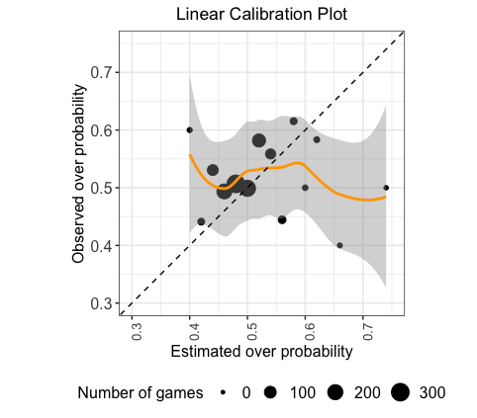
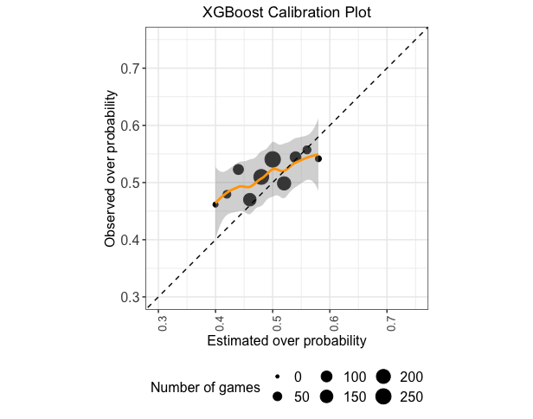
Xgboost is significantly more precise

Slide 8
Conclusions And next steps
More robust team data
FGs attempted (2 and 3 point), possessions, etc.…
Odds and implied probability*
In-season data
Injuries or trades
Moving averages
To show team improvement

Slide 9
Thank You

