Slide 1
IST 652: Scripting for Data Analysis
Paycheck Protection Program
Samantha Brennen-Lisko

Slide 2
Topics
About the Data
Exploratory Analysis
Conclusions

Slide 3
About the Data
Paycheck Protection Program
Source: Kaggle (https://www.kaggle.com/susuwatari/ppp-loan-data-paycheck-protection-program), Twitter (tweets on PPP loans)
Description: Data set listing the businesses by state for loans of $150,000 and above.
Key Fields: Loan Range, State, Business Type, Jobs Retained, Date Approved

Slide 4
Exploratory Analysis
Tweets
Retweets: 108
Tweet text: RT @SenMcSallyAZ: Over 1 million Arizona jobs were saved by the Paycheck Protection Program! Last Saturday, I visited with @PrescottBrewing owners John & Roxane who shared that they were able to pay their hourly workers using their PPP loan.
Retweets: 5381
Tweet Text: RT @TheRickyDavila: I still can’t get over the fact that Steven Mnuchin funneled $500B in PPP loan covid relief to entities of his choice including himself, Devin Nunes, Jared Kushner, Kanye West, Moscow Mitch’s wife Elaine Chao, but $600 for struggling Americans is too much. Evil is as evil does. (One of the retweets can be found here: https://twitter.com/MarshaDB54.)
Retweets: 584
Tweet text: RT @KlasfeldReports: Gas station secured small business bailout money, then paid for Trump billboards, via CNNPolitics https://t.co/y7ZqB9G… (The CNN story, which can be found here: https://www.cnn.com/2020/08/28/politics/trump-billboards-ppp-loan-invs/index.html

Slide 5
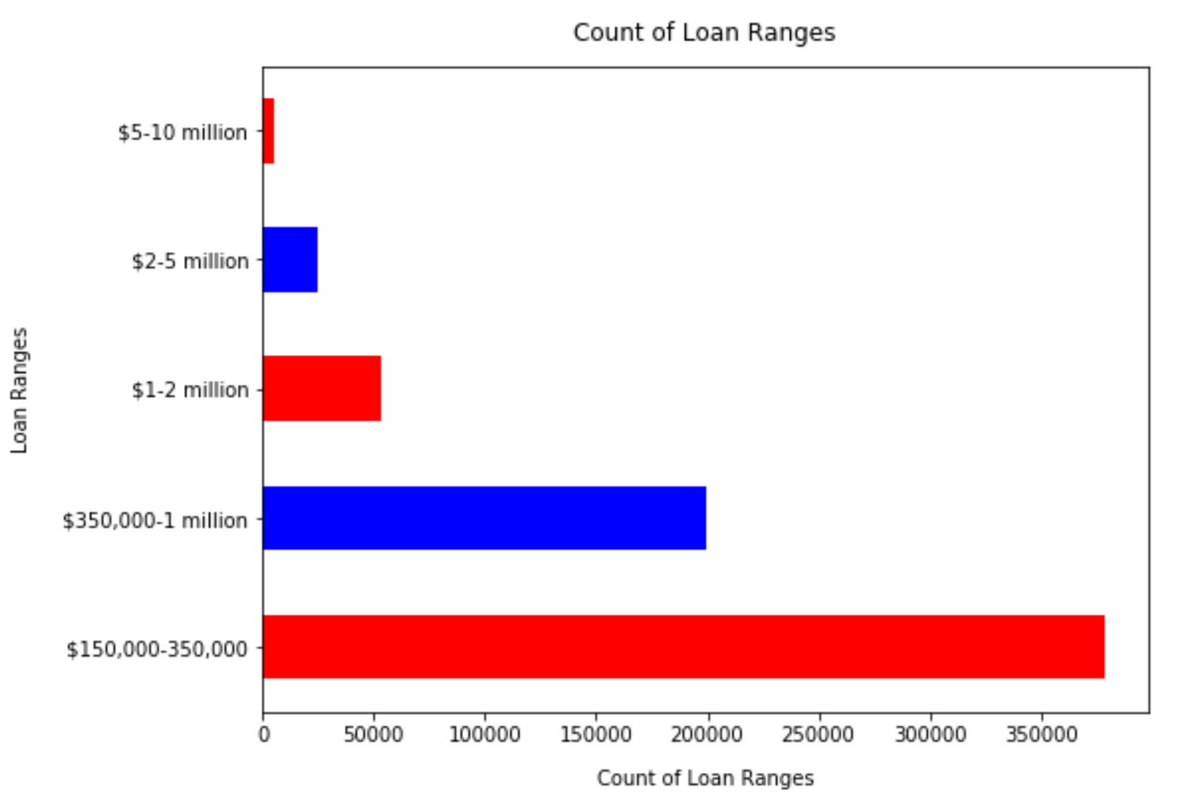
Exploratory Analysis
Understanding the Loan Ranges

Slide 6
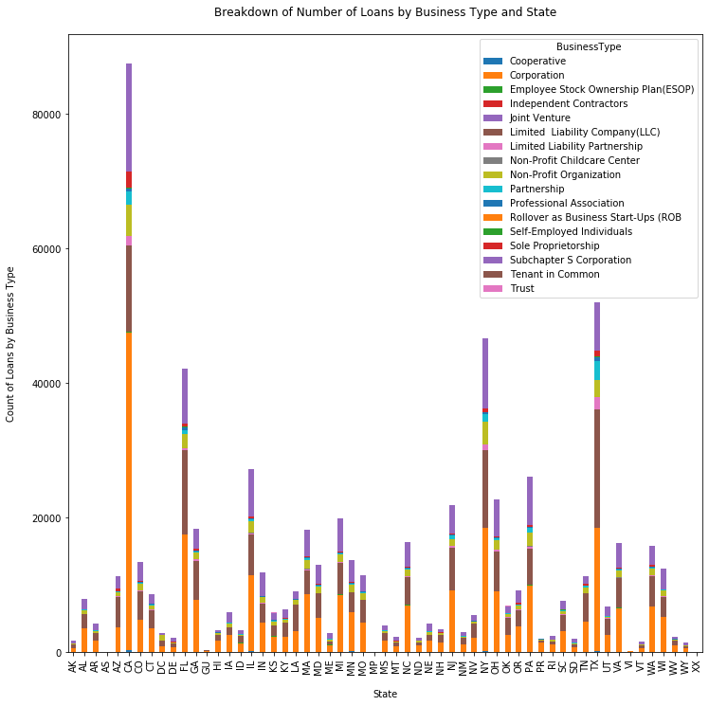
Exploratory Analysis
What state has the most loans?

Slide 7
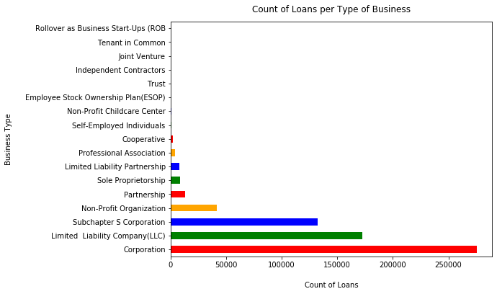
Exploratory Analysis
What business type had the most loans?
Notes:
Normal distribution of happiness scores across the countries

Slide 8
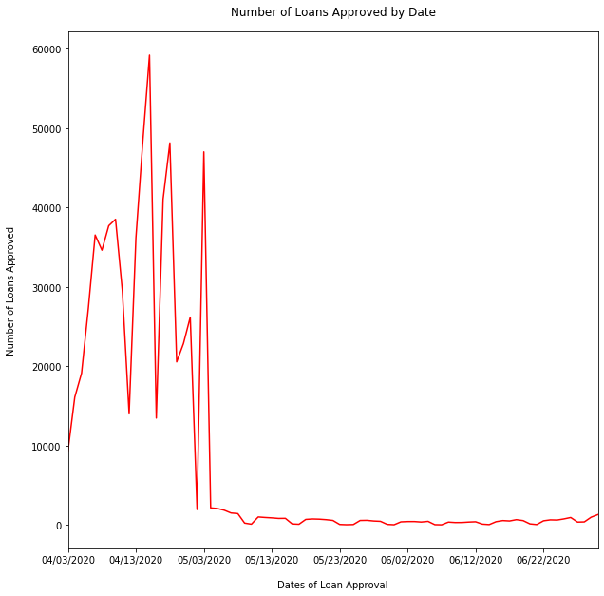
Exploratory Analysis
When were these loans approved?

Slide 9
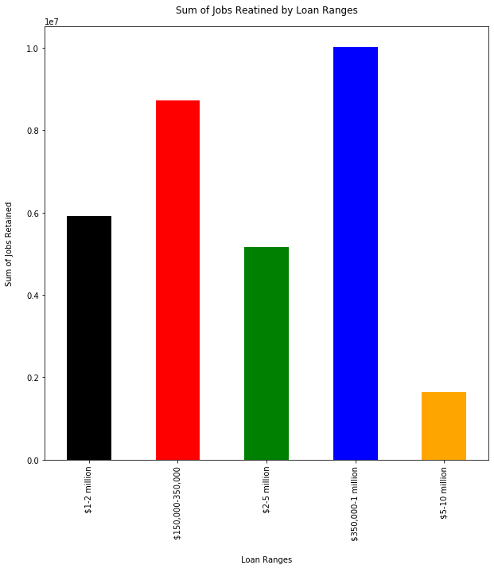
Exploratory Analysis
How many jobs were retained?

Slide 10
Conclusions
Corporations had the most loans
California, Texas, New York, and Florida had the most loans
More loans were taken out in the $150,000 to $350,000 range (almost 2 to 1) but more jobs were saved in the $350,000 to $1,000,000 range, why?

