Slide 1






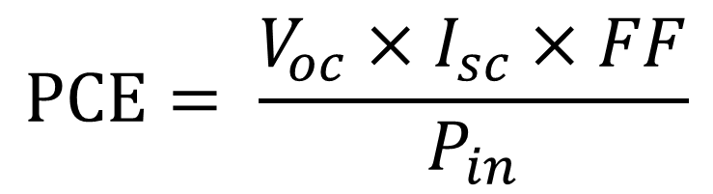





A Data Science Approach for Prediction of
Organic Photovoltaic Cell Material
Kailei Liu, Zonglun Lee, Sijin Luozhong, Chih-Wei Hsu
Department of Chemical Engineering, University of Washington, Seattle 98105, U.S.
Data Intensive Research Enabling Clean Technologies 2019
Introduction & Background Information
Dataset
Predicting Organic Photovoltaic Cell Material (OPVCM) is a python package that can predict Power Conversion Efficiency(pce) of an organic material in PV-Cell based on user's input data. The predicted model is built based on correlations between pce and molecular features (bond type, functional group, heteroatom and etc.).
All data is retrieved from The Harvard Clean Energy Project Database (HCEPDB). Three features ( C-NH-C, N-S-N, Se) are sorted to be used in this package.
Power conversion efficiency refers to the portion of energy in the form of sunlight that can be converted via photovoltaics into electricity.
Equation 1. The definition of PCE
Design
Data Cleaning
Machine Learning
Raw Data
Prediction
Artificial Neural Network
Training the ANN
Visualization
Input
Hidden
Output
Sklearn and Keras are used for training the ANN.
As this package is designed for seeking the optimized chemical structure of an organic compound which has the highest pce, we include a visualization, plot_optimized(), for users to quickly examine the optimized result.
Figure x. Graphical representation of an ANN with double hidden layers
The ANN system is a framework that several machine learning algorithms can work together and process complex data input. ANNs has been trained by adjusting the weights with every channels and nodes.
Our feature vector is built with 3 inputs:
The first feature
The second feature
The third feature
References
Acknowledgement
Steven A. Lopez, Benjamin Sanchez-Lengeling, Julio de Goes Soares and Alán Aspuru-Guzik, “Design Principles and Top Non-Fullerene Acceptor Candidates for Organic Photovoltaics”, 2017 Cell Press
Hiirotomo Moriwaki, Yu-Shi Tian, Norihito Kawashita and Tatsuya Takagi, “Mordred: a molecular descriptor calculator”, 2018 Journal of Cheminformatics
Johannes Hachmann, Roberto Olivares-Amaya, Sule Atahan-Evrenk, Carlos Amador-Bedolla, Roel S. S´anchez-Carrera, Aryeh Gold-Parker, Leslie Vogt, Anna M. Brockway and Al´an Aspuru-Guzik, “The Harvard Clean Energy Project: Large-Scale Computational Screening and Designof Organic Photovoltaics on the World Community Grid”, 2011 Harvard Library
Special thanks to Professor David Beck and the excellent teaching assistant group in DIRECT program.
We would also like to thank the Harvard Clean Energy Project for providing the dataset.

