Slide 1

Brian 2
汇报人：沈佳敏、马月洁
2016/11/22

Slide 2
Introduction
Brian is a free, open source simulator for spiking neural networks. It is written in the Python programming language
Multi-threading with OpenMP
Windows，Linux and OS X

Slide 3
Introduction
Brian is being developed by:
    Romain Brette(l’Institut de la Vision, Paris)
    Dan Goodman (Imperial College, London)
    Marcel Stimberg (l’Institut de la Vision, Paris)
Models
  Point neuron
  Multicompartment models
  IF , HH ...

Slide 4
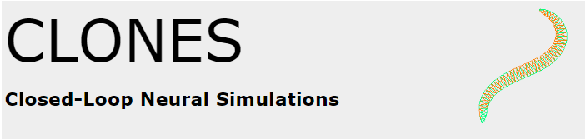



Showcase
Several projects are now using Brian
  CLONES. Closed-Loop Neural Simulations.
  DANA. Distributed, Asynchronous, Numerical and Adaptive computing framework.
  PyNN. A simulator-independent package for building neuronal network models.
  PyRhO. A Python module to fit and characterise rhodopsin photocurrents.

Slide 5
Introduction
INSTALL
  pip install brian2 ( in windows )
Other software and tools
  brian2tools: for simple plotting and analysis with Brian
  Brian Hears: for modeling the auditory system
  Model fitting toolbox: for automatically fitting models to electrophysiological data

Slide 6
Method choice
Method choice -- eight
'linear': exact integration for linear equations
'independent': exact integration for a system of independent equations, where all the equations can be analytically solved independently
'exponential_euler': exponential Euler integration for conditionally linear equations
'euler': forward Euler integration (for additive stochastic differential equations using the Euler-Maruyama method)

Slide 7
Method choice
'rk2': second order Runge-Kutta method (midpoint method)
'rk4': classical Runge-Kutta method (RK4)
'heun': stochastic Heun method for solving Stratonovich stochastic differential equations with non-diagonal multiplicative noise.
'milstein': derivative-free Milstein method for solving stochastic differential equations with diagonal multiplicative noise

Slide 8



Multicompartment models
The following table summarizes the different options to create schematic morphologies
Soma
# Soma always has a single compartment
Soma(diameter=30*um)
Cylinder
# Each compartment has fixed length and diameter
Cylinder(5, diameter=10*um, length=50*um)
Section
# Length and diameter individually defined for each compartment
Section(5, diameter=[15, 5, 10, 5, 10, 5]*um,length=[10, 20, 5, 5, 10]*um)

Slide 9
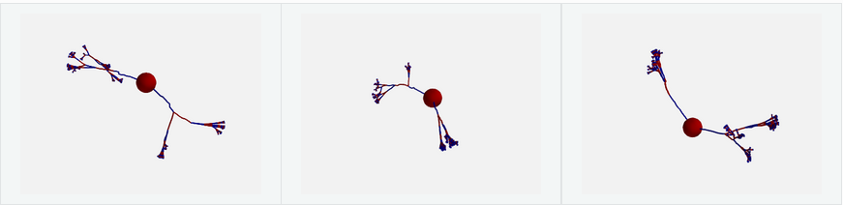
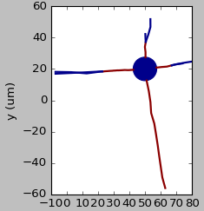
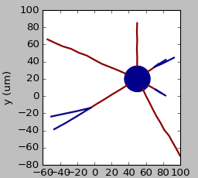
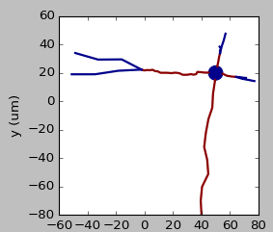
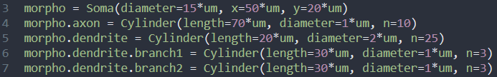
Morphologies in 2D or 3D

Slide 10
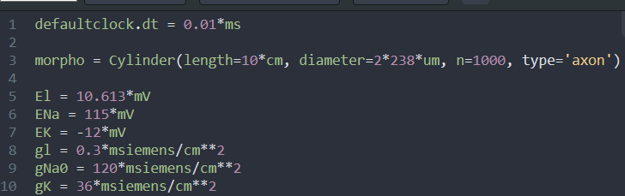
Code
Parameters of Hodgkin-Huxley equations

Slide 11
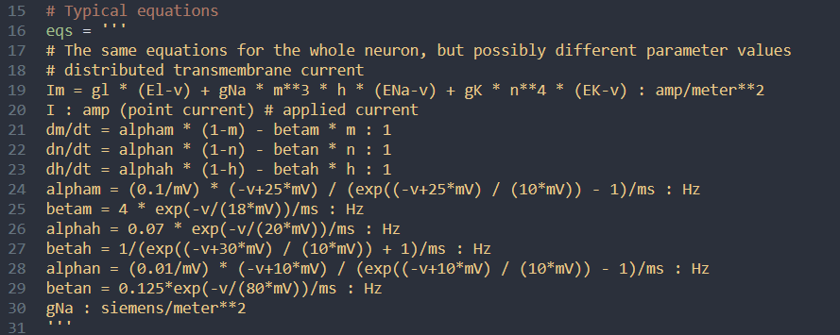
Code
Hodgkin-Huxley equations

Slide 12
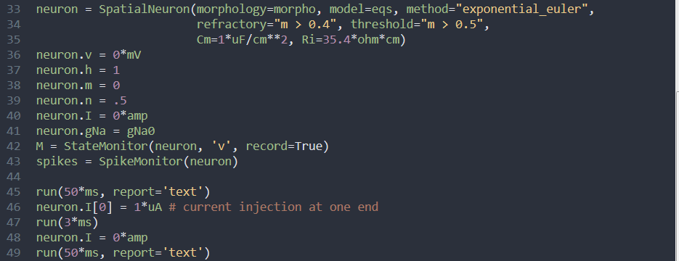
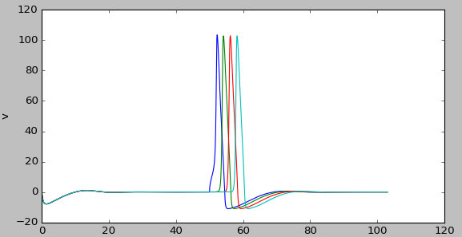
Code
run simulation

Slide 13
Point neuron models

Slide 14
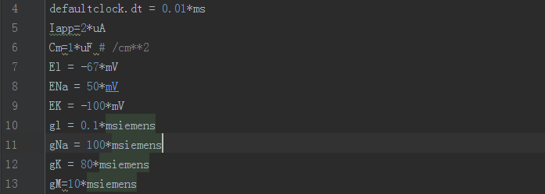
Code
point neurons

Slide 15
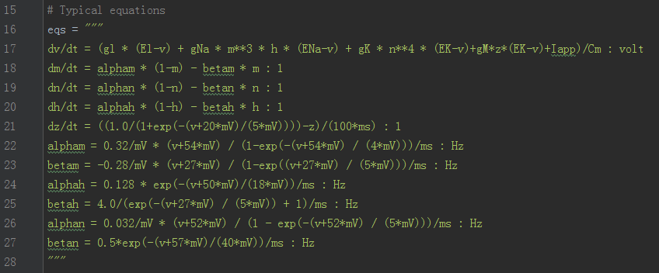
Code
point neurons

Slide 16
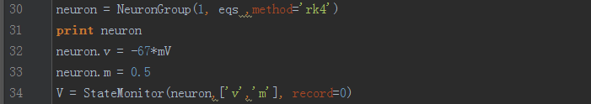
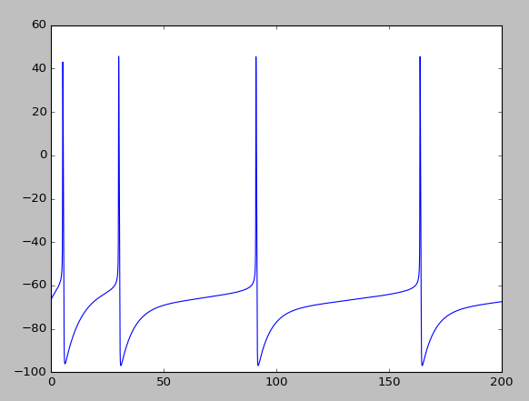
Code
point neurons

Slide 17
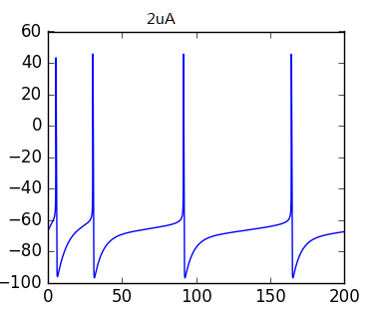
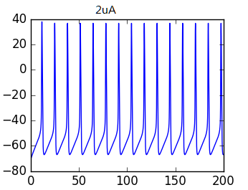
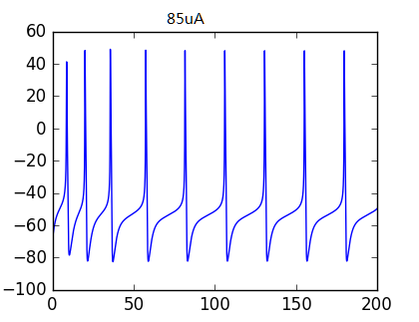
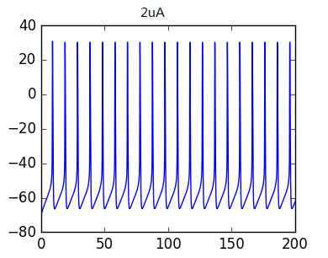
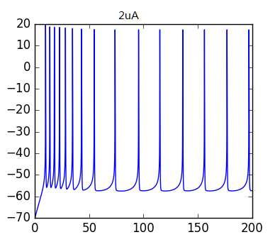
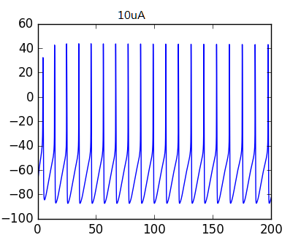
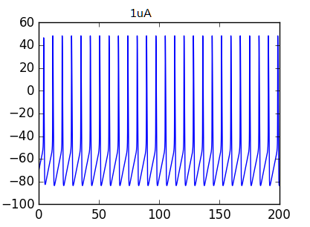
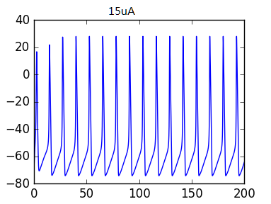
exapmle
Eight neuron models

Slide 18
Profiling
To get an idea which parts of a simulation take the most time, Brian offers a basic profiling mechanism
  run(200*ms, report='text',profile=True)
  profiling_summary(show=3)
Profiling summary
neurongroup_stateupdater | 289.00 ms | 51.98%
statemonitor | 252.00 ms | 45.32%
neurongroup | 15.00 ms | 2.70%

Slide 19
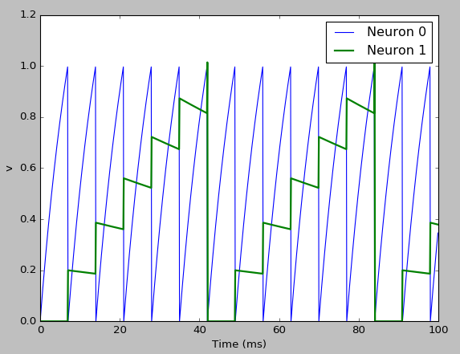


Defining synaptic models
simple synapse
transmission probability
Event-driven updates

Slide 20




Defining synaptic models
Creating synapses
Conditional
Probabilistic
Delays

Slide 21
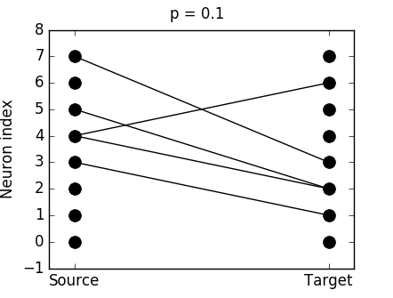
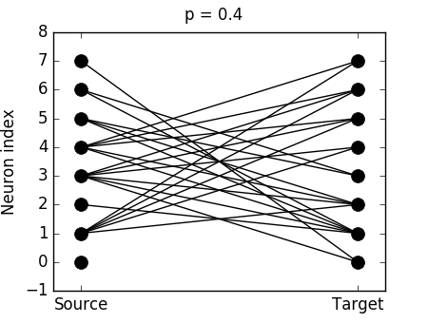
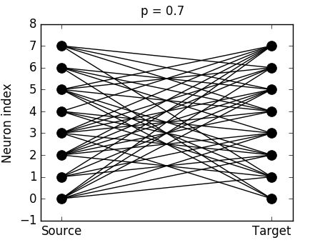
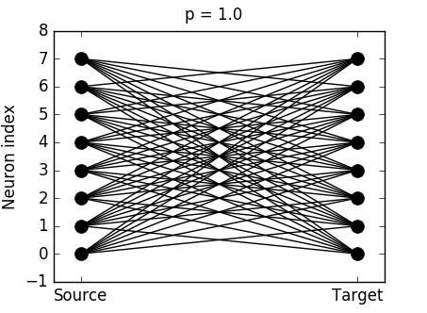
exapmle --complex connectivity

Slide 22
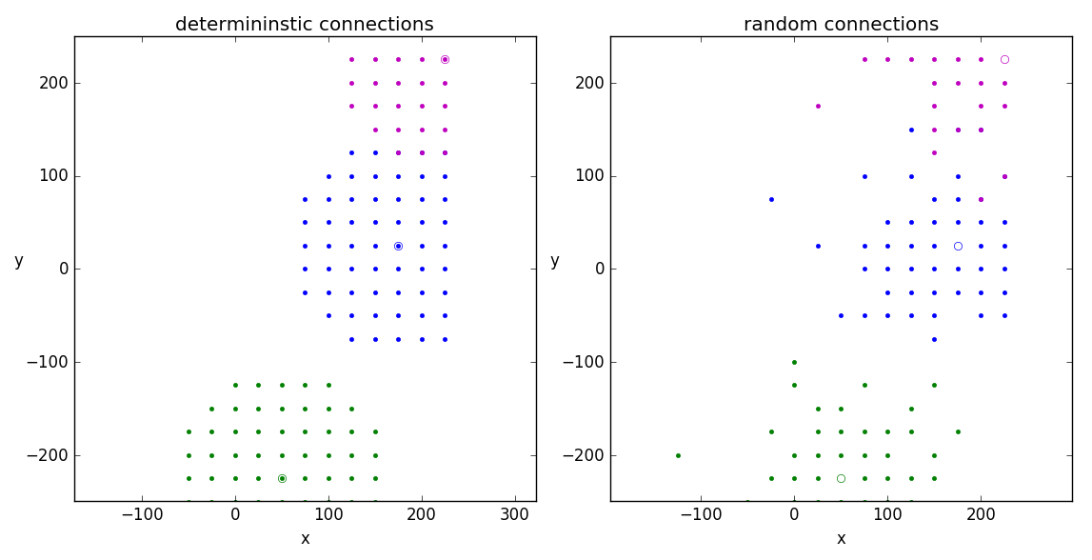
exapmle --spatial_connections
# Deterministic connections
distance = 120*umeter
S_deterministic = Synapses(G, G)
S_deterministic.connect('sqrt((x_pre - x_post)**2 + (y_pre - y_post)**2) < distance')
# Random connections (no self-connections)
S_stochastic = Synapses(G, G)
S_stochastic.connect('i != j', p='1.5 * exp(-((x_pre-x_post)**2 +
(y_pre-y_post)**2)/y_post)**2)/(2*(60*umeter)**2))')

Slide 23
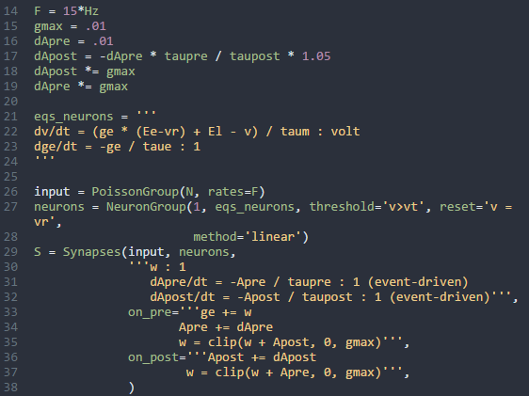
exapmle --STDP
Spike-timing dependent plasticity
Miller and Abbott (2000) and Song and Abbott (2001).

Slide 24
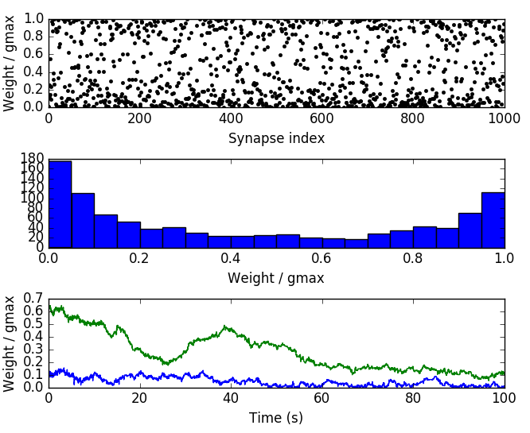
exapmle --STDP
result
1000 synaptic connections
Histogram distribution
weight change of synaptic

Slide 25
Conclusion
可以构建精细的神经元形态
构建精准的小规模神经网络
点神经元模型
多房室神经元模型
没有GPU加速

Slide 26
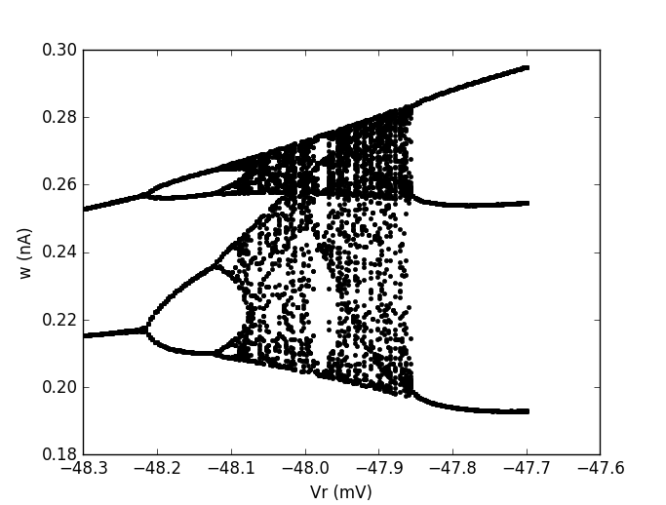
AdEx model
the bifurcation structure when the reset value is varied
Touboul, J. and Brette, R. (2008). Dynamics and bifurcations of the adaptive exponential integrate-and-fire model.

Slide 27
summary
Support point neuron and multi-compartment model
easy to learn and use, highly flexible and easily extensible
Brian can generates a complete C++ project tree that implements your model
GPU version is still in development

Slide 28
END
Thank you!

